Slide 1
Enhancing Mobile Health with RNN: Activity Recognition and Predictive Modeling Using Wearable Sensor Data
Team 3: Sashini Kosgoda, Ente Kang, Tamneet Tiwana

Slide 2
Objective
Data Processing and Exploration
How accurately can we classify different activities based on sensor data (e.g., walking, jogging, climbing stairs)?
Missing observations
Distribution of activities across each patient
Identified a class imbalance of activity distribution where majority were labelled as ‘none’ (activity = 0)
Distribution of features (e.g., accelerometer and gyroscope readings) across all activities
Train-test splitting by subjects

Slide 3
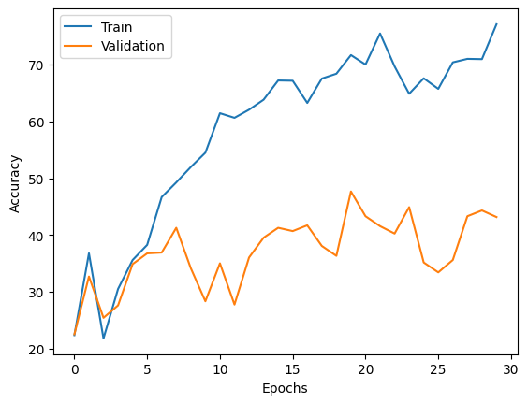

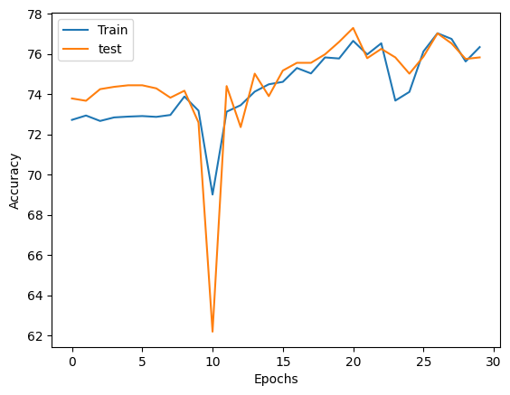
Findings
Without activity=0
Average training accuracy:
60.1%
Average test Accuracy:
41.7%
All activities
Average training accuracy:
74.3%
Average test accuracy:
74.6%
Notes:
Gap and dont converge , training higher than validation which indicates overfitting

Slide 4
Conclusion
Classes very imbalance if counting activity = 0 included
Model is not capable of classifying events
There is no promise that this model will accurately predict the type of activity based on sensor data
Models could serve as valuable tools for future research

