Slide 1
Domain Driven Design
Eugène De Villiers
Pieter Koornhof
April 2015

Slide 2
Agenda
Why DDD
Ubiquitous Language
Domain Structure
Application Structure
Practical Example
D I Y

Slide 3
Notes:
What
Proper OO, done in a clean way, with TDD in an agile manner
A Domain in the broad sense, is what an organization does and the world it does it in
DDD provides a structure of practices and terminology for making design decisions that focus and accelerate software projects dealing with complicated domains.
High level pattern

Slide 4
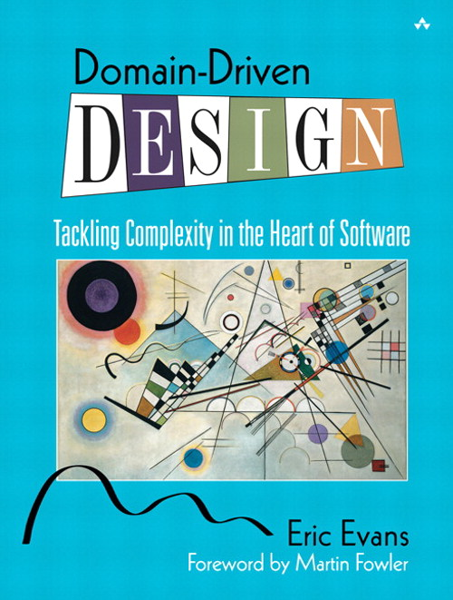
Notes:
What
Proper OO, done in a clean way, with TDD in an agile manner
A Domain in the broad sense, is what an organization does and the world it does it in
DDD provides a structure of practices and terminology for making design decisions that focus and accelerate software projects dealing with complicated domains.
High level pattern

Slide 5
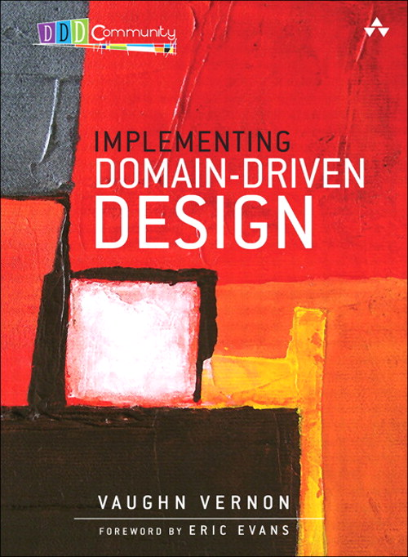
Notes:
What
Proper OO, done in a clean way, with TDD in an agile manner
A Domain in the broad sense, is what an organization does and the world it does it in
DDD provides a structure of practices and terminology for making design decisions that focus and accelerate software projects dealing with complicated domains.
High level pattern

Slide 6
Notes:
Why
Organization gains a useful model of its domain
A Refined precise definition and understanding of the business is developed. Domain Experts are forced to agree about what the domain is called and how it works
Domain experts contribute to the solution
Better user experience is gained because the domain is clearly defined
Clean boundaries, pure models (SOLID For Free)
Enterprise architecture is better organized
Agile iterative continuous modelling is used
Works well with TDD
Works well with agile
Prevents Anaemia Induced Memory Loss
Rules outlive developers
Prevents Duplication etc etc

Slide 7
Ubiquitous Language
Modelling Out Loud
One Team, One Language
Documents and Diagrams (written)
Notes:
Documents should compliment code and speech
Documents should not try to do what the code already does well
Documents Should stay current, and work for a living

Slide 8
Ubiquitous Language
Binding Model and Implementation
Cultivating a language based on the model
Developing a knowledge-rich model
Distilling the model
Brainstorming and experimenting
Notes:
“if the design or some central part of it does not map to the domain (problem domain) then it is of little value, and the correctness of the software is suspect.”
“design small portions that reflect the model in a very literal way.”
“Always demand a single model that serves all purposes well.”
“Work away from procedural and build a representative model”
Continuous learning
Extracting hidden concepts – and making them obvious
Hands-on modelers and modeling.

Slide 9
Domain Structure
Value Types
Entities
Aggregates
Bounded Context

Slide 10
Domain Structure - Entities
Known By Its Identity
Responsible for tracking it's state and the business rules
Persists beyond application lifespan
Notes:
Identity is a property that is unique across all instances of an object
Identity is not determined by object attributes
An Entity has Identity as stated above
An Entity is responsible for tracking it's state and the rules regulating it's lifecycle
Encapsulates all the data and business rules
Identity is usually an int/string/guid. It can be made by the application or in some cases the database

Slide 11
Domain Structure – Value Types
Known By Its Properties
Immutable
Describes Characteristics of something
Notes:
Multiple instances of a value object with the same properties, represent the same object in a particular context.
Primitives and struct types
Value objects are immutable.
Give Address as an example of value vs entity object
Unit Of Measure
Currency
Dimensions

Slide 12
Domain Structure - Aggregates
Boundary
Aggregate Root
Responsible for aggregates and entities encapsulated by it
Notes:
An aggregate is made up of two main parts namely a boundary and a root.

Slide 13
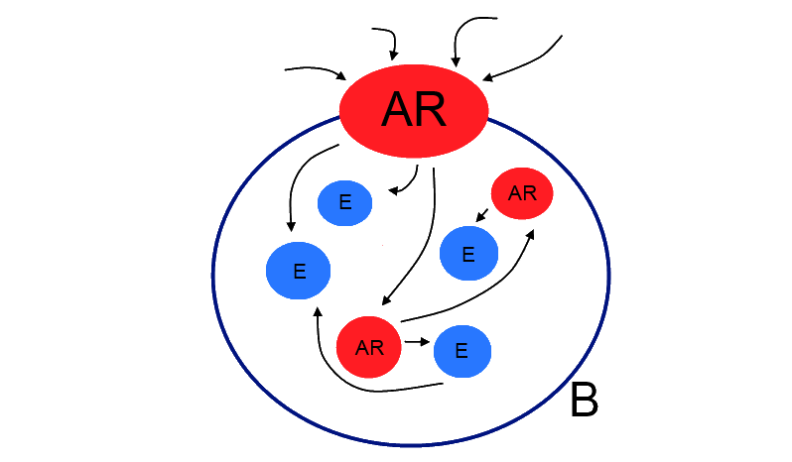
Domain Structure
Notes:
The boundary(B on the image) defines the contents of the aggregate. It is also the barrier between the aggregate contents and the rest of the application. Nothing outside the boundary can keep a reference to anything inside the boundary.
The Aggregate Root (AR on the image) provides access to the aggregate contents. We ask the aggregate to do work for us.
We either make a new aggregate, from another aggregate or a factory. Or get a valid aggregate from a Repository
Synthetic vs natural aggregate
Referencing outside of aggregate is a bad idea.

Slide 14
Bounded Context
Notes:
The bounded context is a collection of aggregate roots.
The reason for this boundary is to highlight that every use of a given domain term, phrase or sentence (The U L) inside the boundary has a specific contextual meaning.
Isolate the implementation of the problem domain from all other aspects of the application, with the domain being responsible for all decisions in the software.

Slide 15
Application Structure
Domain is at the center
It is clearly isolated
It references nothing
It is in charge of all decisions
Notes:
“A good architecture allows you to defer framework decisions. A good architecture allows frameworks to act as plugins to the application.” –Uncle Bob
Even your tests are a plugin to the application, a completely separate consumer.

Slide 16
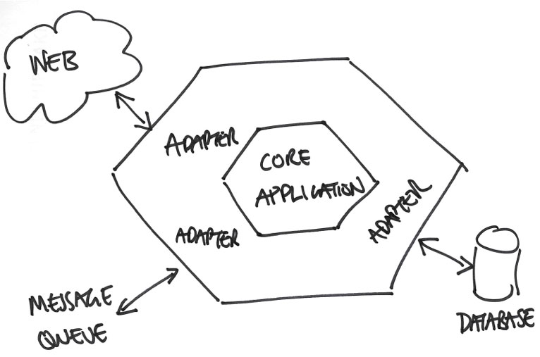

Slide 17
