Slide 1
Domain Driven Design Dojo
Eugene de Villiers Pieter Koornhof
10 April 2015

Slide 2
Agenda
Some DDD Theory
Anaemic vs. Rich Domain Example
Domain Modelling Practice

Slide 3
Why Domain Driven Design
Build software that reflects the mental model of the business experts
Delivers a model that is most useful to the business
Self Documenting Code through the ubiquitous language
Model complex domain in the simplest possible way
Prevents Anaemia Induced Memory Loss
The design is the code and the code is the design
Works well with tdd
Works well with agile
Notes:
Rules outlive developers

Slide 4
Organization gains a useful model of its domain
A Refined precise definition and understanding of the business is developed
Domain experts contribute
Better user experience is gained
Clean boundaries, pure models (SOLID)
Enterprise architecture is better organized
Agile iterative continuous modelling is used

Slide 5
Ubiquitous Language

Slide 6
Bounded Context
Notes:
The reason for this boundary is to highlight that every use of a given domain term, phrase or sentence (The U L) inside the boundary has a specific contextual meaning.

Slide 7
Domain Structure
Entities
Known By Its Identity
Notes:
Identity is a property that is unique across all instances of an object
Identity is not determined by object attributes
An Entity has Identity as stated above
An Entity is responsible for tracking it's state and the rules regulating it's lifecycle
Identity is usually an int/string/guid. It can be made by the application or in some cases the database

Slide 8
Domain Structure
Value Type
Known By Its Properties
Immutable
Notes:
Multiple instances of a value object with the same properties, represent the same object in a particular context.
Value objects are immutable.
Give Address as an example of value vs entity object

Slide 9
Domain Structure
Aggregates
Boundary
Aggregate Root
Notes:
An aggregate is made up of two main parts namely a boundary and a root.

Slide 10
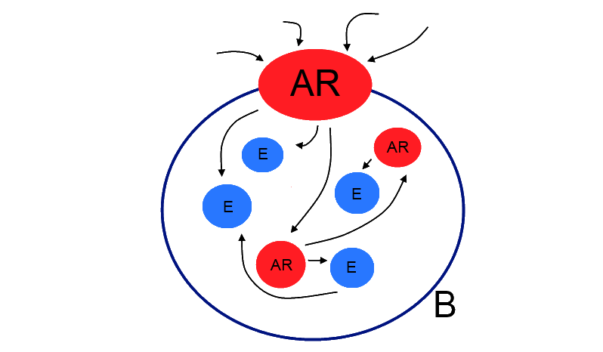
Domain Structure
Notes:
The boundary(B on the image) defines the contents of the aggregate. It is also the barrier between the aggregate contents and the rest of the application. Nothing outside the boundary can keep a reference to anything inside the boundary.
The Aggregate Root (AR on the image) provides access to the aggregate contents. We ask the aggregate to do work for us.
We either make a new aggregate, from another aggregate or a factory. Or get a valid aggregate from a Repository

Slide 11
Application Structure

Slide 12
How
Draw pictures
Develop a shared language and change it when needed

