Slide 1
Infrastructure as Code

Slide 2
Background
Infrastructure used to be managed by hand or scripts
Works when you have few machines
Infrastructure becomes a snowflake
Infrastructure fails, nobody knows how it was configured, in what order
Changes are scary to make, don’t know the impact of changes, can’t fix something if it is broken

Slide 3
Infrastructure as Code
Developers had the same problem with code
Helped fix this by introducing version control and testing
Why not do the same for Infrastructure?

Slide 4
Requirements
IaC needs to be easy to read and follow
Infrastructure needs to be idempotent
Changes should not break other components
Destructive changes need to be managed

Slide 5
Benefits
Changes can be versioned
Changes can be tested
Order of changes can be measured
Changes can be applied to multiple machines at the same time
Infrastructure can be rebuilt when needed with confidence
Infrastructure can be scaled
Environments can be kept in sync

Slide 6
Drawbacks
Need to understand how to configure applications
Need to understand the infrastructure
Tools are highly opinionated
Have to change culture or snowflakes will appear
Can be hard to update existing machines to use

Slide 7
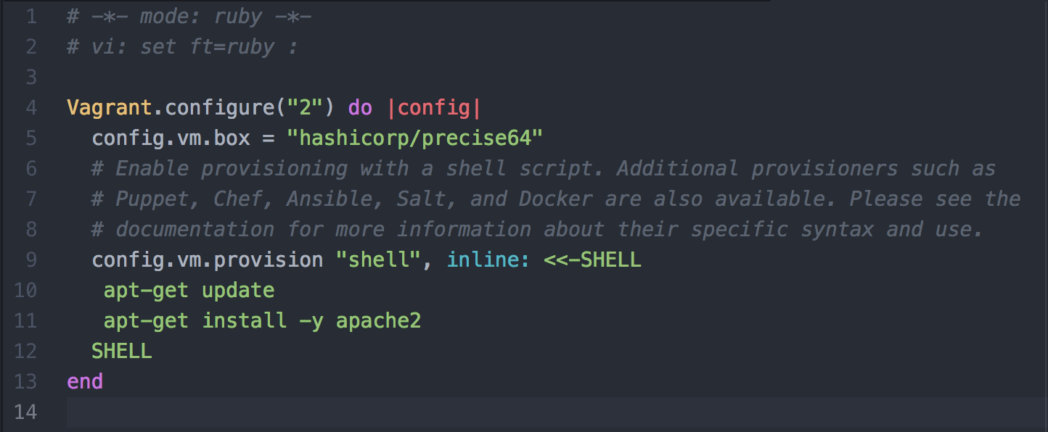
Example (Vagrant)
Vagrant uses a Ruby DSL
Used to provision Virtual Machines

Slide 8
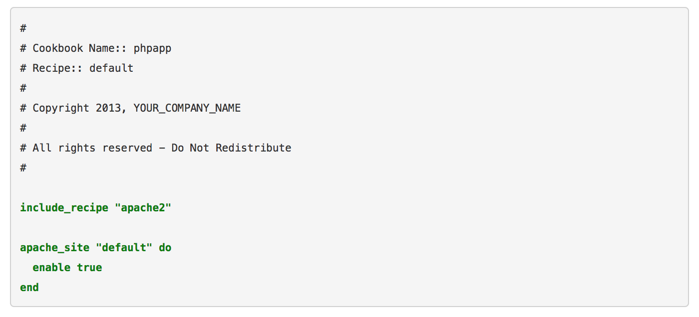
Example (Chef)
Chef uses Ruby DSL
Cookbooks provide a set of instructions to install a particular product

Slide 9
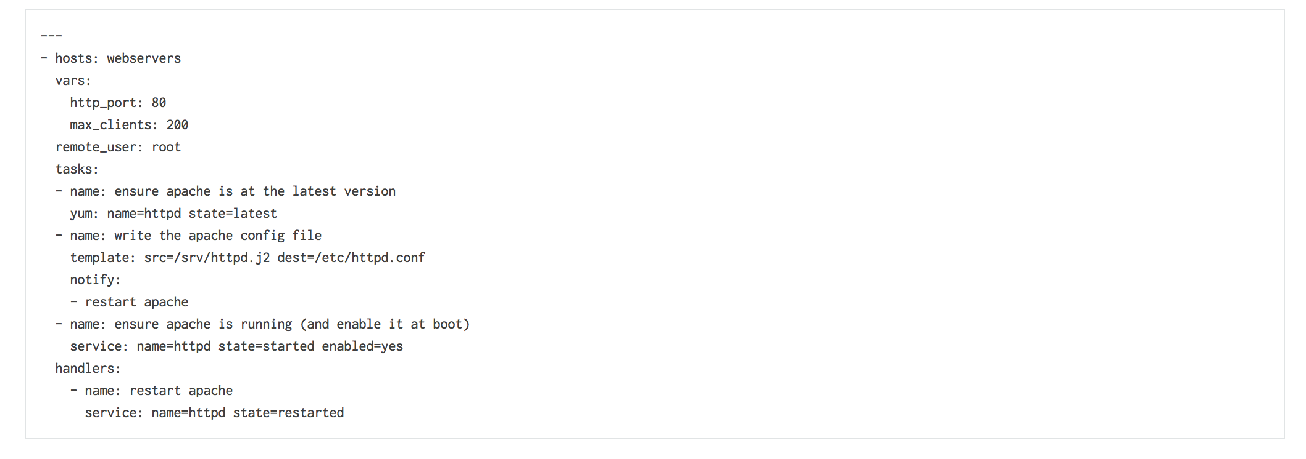
Example (Ansible)
Ansible is configuration based
Plays provide a set of instructions to install a product

Slide 10
How to test locally
Virtual Machines (VirtualBox)
Vagrant is commonly used to manage machines
Containers
Docker can provide a good alternative to Vagrant

Slide 11
How to test IaC
Various testing frameworks exist
Can test the IaC code and the final output
IaC code can be tested with the frameworks for the language (Rspec for Ruby)
Inspec can test the final machine and verify compliance

Slide 12
How to Automate
Automating depends on choice of tools
Chef uses a Pull approach (Nodes will converge)
Ansible uses a Push approach (Plays are applied)
Building environments should be the same as building the application (Build servers)

Slide 13
Practical
Need Vagrant
Need VirtualBox
Need Chef
Install Apache Web Server
Build a basic web page
Show complexity of simple example

