Slide 1
Custom Payload Encoder & Obfuscation Framework
ADITYA KUMAR
About Me
Project Summary
Internship
A Python framework to encode and obfuscate test payloads, then simulate signature-based detection to measure evasion effectiveness. Built for red team education and defensive research.
UnifiedMentor
Course
Cybersecurity Internship (6 Months)
87.5%
7 / 8
8
4
Duration
01/11/2025 – April
Bypass Rate
Bypassed
Variants
Modules
Intern ID
UMID14102561484
Run command:
Email
$ python3 payload_encoder.py
rank1aditya@gmail.com
GitHub Repo
Source / Repo:
github.com/enterlectury/payload-encoder
https://github.com/enterlectury/payload-encoder/

Slide 2
01 / Project Overview
What is this project?
This project builds a Python-based framework that takes a raw payload (like a shell command), applies multiple encoding and obfuscation techniques, then tests whether a simulated signature-based scanner can detect it. It shows how attackers hide malicious content — and how defenders can improve detection.
A. Encoding Module
B. Obfuscation Module
C. Evasion Testing
D. Reporting Engine
• Base64 encoding & decoding
• Random character insertion
• Compare against signature list
• List encoded outputs
• XOR encryption (user-defined key)
• Character splitting & concatenation
• Measure detection success/failure
• Behavior comparison
• ROT13 substitution cipher
• Escape-sequence obfuscation
• Highlight effective techniques
• Evasion insights + bypass rate

Slide 3
02 / Workflow & Architecture
Step-by-step execution flow
STEP 1
Input Payload
Raw script, shellcode, or text string loaded into the framework.
↓
STEP 2
Encoder Selection
Choose Base64, XOR (key=42), ROT13, or apply multiple layers.
↓
STEP 3
Apply String Obfuscation
Generate obfuscated versions: reversed, char-split, hex escape, junk inserted.
↓
STEP 4
Evasion Testing
Compare each variant against 17 simulated signature checks. Record detection/bypass.
↓
STEP 5
Output & Reporting
Store encoded payloads, calculate bypass rate, generate final report file.

Slide 4
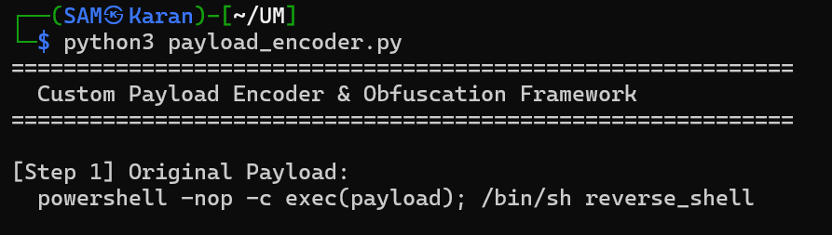
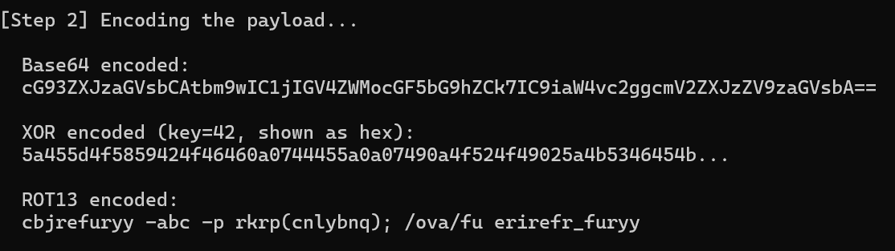
03 / Encoding Module — Base64 · XOR · ROT13
Three encoding techniques applied to the payload
Base64
Converts payload bytes to printable ASCII. Uses Python's base64 library. decode_base64() restores original.
XOR (key=42)
XORs every character's ASCII code with key 42. Returns hex string. Same key decodes it back — XOR is self-inverse.
[ Screenshot — Step 1 & Step 2 terminal output ]
ROT13
Shifts each letter 13 positions using codecs.encode(payload, 'rot_13'). Applying ROT13 twice = original string.

Slide 5
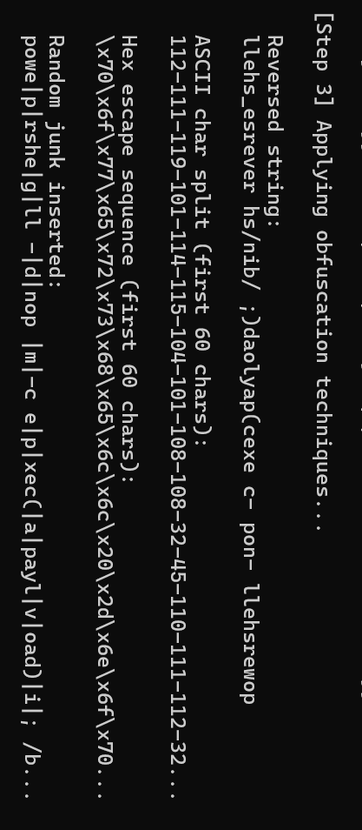
04 / Obfuscation Module — String Mutation Techniques
Four obfuscation techniques applied after encoding
Reverse String
[ Screenshot — Step 3 terminal output ]
Code: payload[::-1]
→ llehs_esrever hs/nib/ ;)daolyap(cexe...
ASCII Char Split
Code: '-'.join(str(ord(c)) for c in p)
→ 112-111-119-101-114-115-104-101...
Hex Escape Sequence
Code: '\x{:02x}'.format(ord(c))
→ \x70\x6f\x77\x65\x72\x73...
Random Junk Insertion
Code: insert |x| marker every 4 chars
→ powe|p|rshe|g|ll -|d|nop |m|...

Slide 6
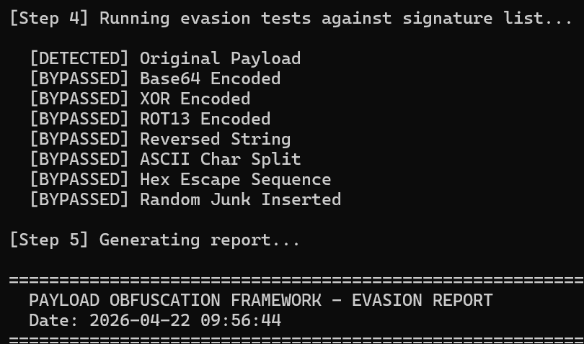
05 / Evasion Testing Results
Signature scanner vs. obfuscated variants
Method
Result
[ Screenshot — Step 4 evasion test output ]
Original Payload
DETECTED
Base64 Encoded
BYPASSED
XOR Encoded
BYPASSED
ROT13 Encoded
BYPASSED
Reversed String
BYPASSED
ASCII Char Split
BYPASSED
Hex Escape Sequence
BYPASSED
Random Junk Inserted
BYPASSED
Bypass Rate: 87.5% — 7 out of 8 variants bypassed detection

Slide 7
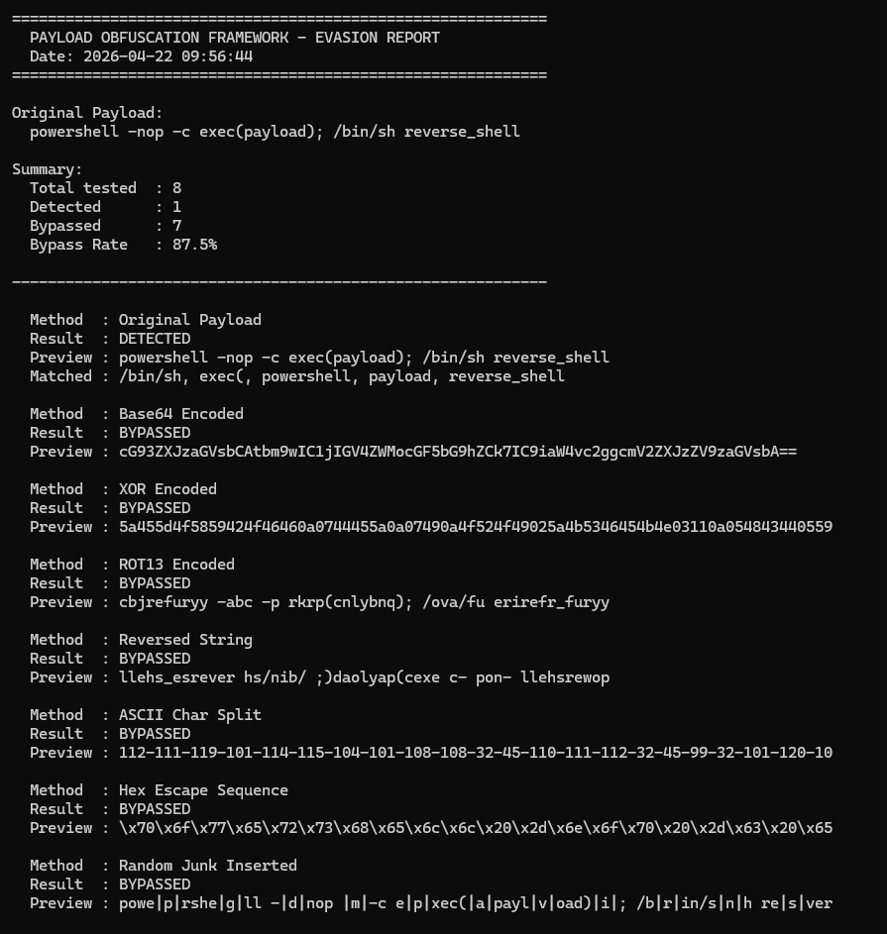
06 / Generated Report — evasion_report.txt
Auto-generated after every run
[ Screenshot — evasion_report.txt full output ]
Report contains:
Date & Time:
Timestamped on every run
Original Payload:
Stored at top of report
Total Tested:
Count of all variants run
Detected:
How many were caught
Bypassed:
How many evaded scanner
Bypass Rate:
Calculated as percentage
Per-Method:
Result + matched signatures
Saved to Disk:
Written to evasion_report.txt

Slide 8
07 / Tools Used & Learning Outcomes
Technologies used & what this project teaches
Tools & Libraries
Learning Outcomes
Python 3
Primary programming language
› How payloads are manipulated for evasion
base64
Base64 encode and decode
› How obfuscation complicates malware detection
codecs
ROT13 cipher implementation
› How red teams hide malicious content
random, string
Random junk char generation
› How blue teams strengthen detection rules
re
Regex to remove junk markers
› Practical encoding and transformation logic
datetime
Timestamp for report output
› Python scripting for security tools

Slide 9
08 / Conclusion
Summary & Key Takeaway
87.5%
8
7 / 8
1 / 8
Bypass Rate
Variants Tested
Bypassed Detection
Detected
Key Takeaway
Signature-based detection alone is not enough. All 7 obfuscated variants bypassed a scanner that instantly caught the original payload. Real security tools need to layer signatures with behavioral analysis, heuristics, and sandboxing.
Defensive Insights
› Decode Base64 and hex sequences before signature scanning
› Write YARA rules that also match encoded/obfuscated patterns
› Combine signature scanning with behavioral analysis and sandboxing
› Red team knowledge directly improves blue team detection rules

