Slide 1
GAN for music (lyrics) generation
陳冠元、 盧聖約

Slide 2
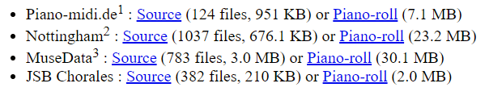
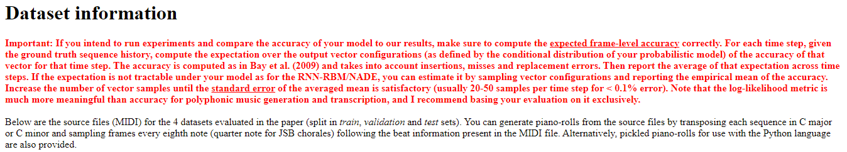

Dataset: [10]
Metric:

Slide 3
Discuss:
How to improve the performance of sequence-like work with adversarial training. [3, 4]
Analyze and compare the result with specific metrics.
The issues of hyper-parameters and concatenation method.

Slide 4
Shema 1:
Score from Critic
…
Discriminator
…
Generator

Slide 5
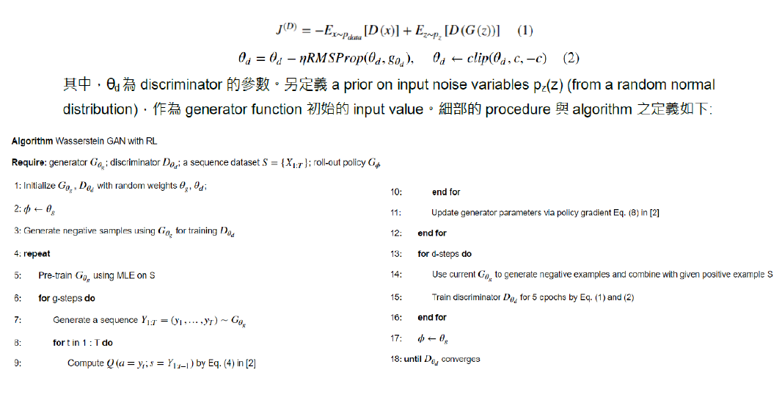

Slide 6
Shema 2 (with condition):
Result of classification (probability)
e.g. [Blues, Hip Hop, Jazz, …]
NN
…
Classifier with the input (music)

Slide 7
Shema 2 (with condition):
Score from Critic
…
Concatenate
the hidden vector
Discriminator
…
Generator

Slide 8
(Optional) Shema 3 (Automatically generate lyrics):
Score from Critic
…
encoding vector
Input: lyrics
Discriminator
…
Concatenate
the hidden vector
encoding vector
Input: melody
Encoder
Output: lyrics
…
encoding vector
Decoder (Generator)

Slide 9
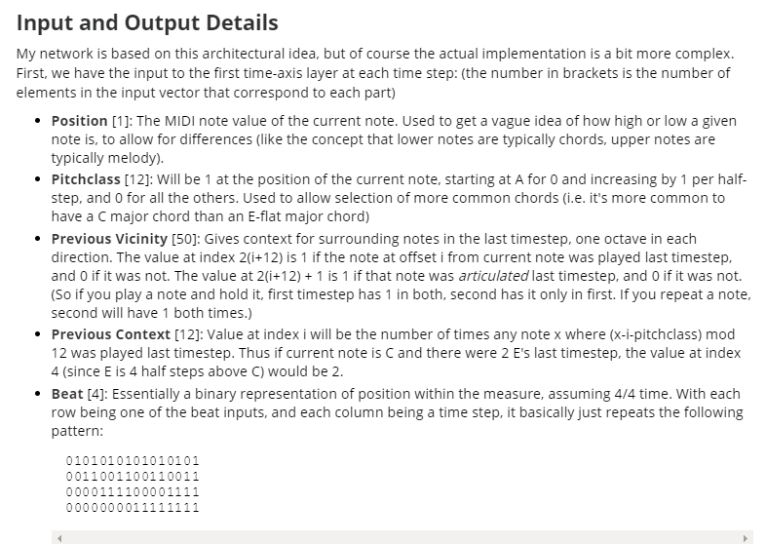
Experiments (Shema 1) (before 2017/12/12):
We referred to the [12, 13] to process the datasets [10] and used all midi files that in Piano-midi.de, Nottingham, MuseData, JSB Chorales source files, and ran the code “midi_to_statematrix.py” [13] to transform the midi files to the “statematrix”.
And then we reshaped and extracted “statematrixs” to the shape(30, 156) for keeping all training data in the same length of time steps.
In this step, we found that the generator prone to generate nonsense tones. We changed the learning phase of discriminator and generator with 5:1 then become better.

Slide 10

Demo: train from 1026 midi files. e.g.
Hyper parameters (fail):
Num of epoch == 100, Learning phase (D:G) == 1:1, Batch size: 64
Num of layer of rnn == 3, Dropout keep probability == 0.7,
hidden size of G: 200, hidden size of D: 200
Hyper parameters:
Num of epoch == 1000, Learning phase (D:G) == 5:1, , Batch size: 64
Num of layer of rnn == 3, Dropout keep probability == 0.7,
hidden size of G: 200, hidden size of D: 200
Epoch 1
Epoch 50
Epoch 99
Epoch 100
Epoch 1
Epoch 50
Epoch 99
Epoch 150
Keep training…

Slide 11
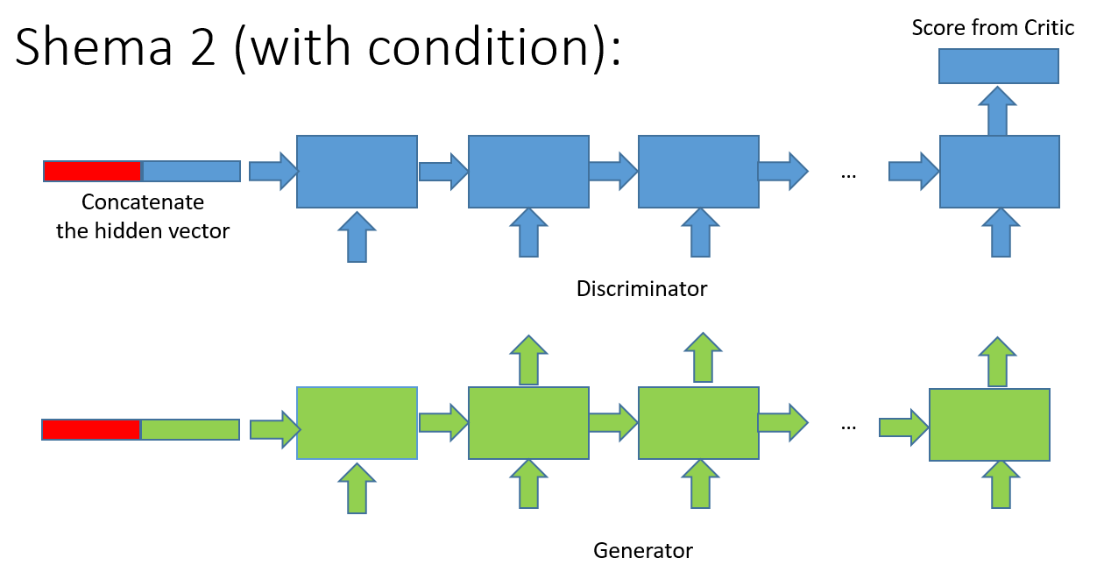
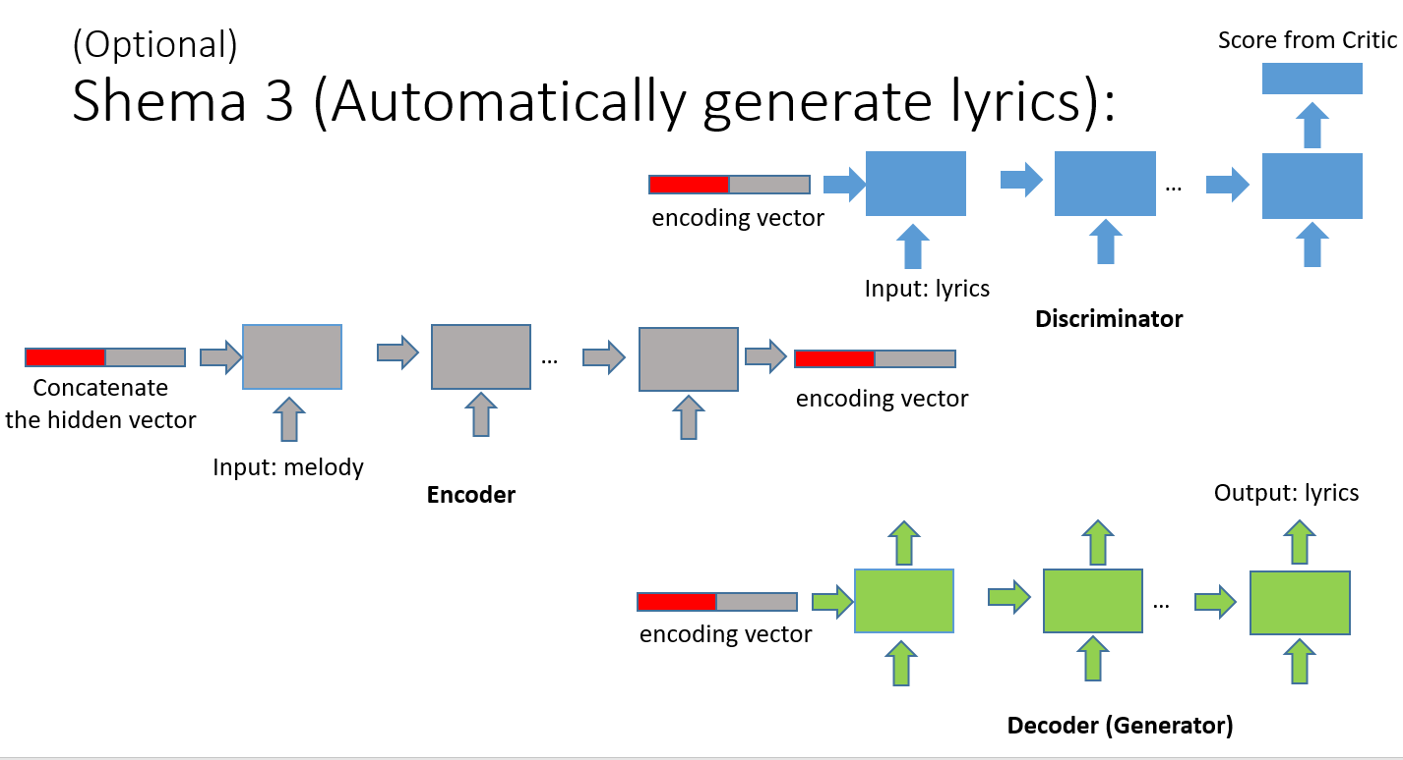
Next :

Slide 12
THX

Slide 13
References:
[1] Lantao Yu, Weinan Zhang, Jun Wang, Yong Yu. SeqGAN: Sequence Generative Adversarial Nets with Policy Gradient.
[2] Zhen Yang, Wei Chen, Feng Wang, Bo Xu. Improving Neural Machine Translation with Conditional Sequence Generative Adversarial Nets.
[3] Tong Che, Yanran Li, Ruixiang Zhang, R Devon Hjelm, Wenjie Li, Yangqiu Song, Yoshua Bengio. Maximum-Likelihood Augmented Discrete Generative Adversarial Networks.
[4] Anirudh Goyal, Nan Rosemary Ke, Alex Lamb, R Devon Hjelm, Chris Pal, Joelle Pineau, Yoshua Bengio. ACtuAL: Actor-Critic Under Adversarial Learning.
[5] Martin Arjovsky, Soumith Chintala, Léon Bottou. Wasserstein GAN.
[6] Ian J. Goodfellow, Jean Pouget-Abadie, Mehdi Mirza, Bing Xu, David Warde-Farley, Sherjil Ozair, Aaron Courville, Yoshua Bengio. Generative Adversarial Networks.
[7] https://github.com/LantaoYu/SeqGAN
[8] https://github.com/codekansas/seqgan-text-tensorflow
[9] https://github.com/ZiJianZhao/SeqGAN-PyTorch
[10] http://www-etud.iro.umontreal.ca/~boulanni/icml2012
[11] Nicolas Boulanger-Lewandowski, Yoshua Bengio and Pascal Vincent. Modeling Temporal Dependencies in High-Dimensional Sequences: Application to Polyphonic Music Generation and Transcription
[12] http://www.hexahedria.com/2015/08/03/composing-music-with-recurrent-neural-networks/
[13] https://github.com/hexahedria/biaxial-rnn-music-composition

