Slide 1



CLyther
Python OpenCL Integration
pronounced slither
+

Slide 2
Overview
Objective
Why GPU programming
Introduction to OpenCL
Python OpenCL Integration
What is CLyther
CLyther Overview
Roadmap

Slide 3
Why GPU
Cost / Performance

Slide 4
What is OpenCL
Open Compute Language
Open and royalty free API
Enables GPU, DSP, co-processors to work in tandem with CPU

Slide 5
Anatomy of OpenCL
• Language Specification
Based on ISO C99 with added extension and restrictions
• Platform API
Application routines to query system and setup OpenCL resources
•Runtime API
Manage kernels objects, memory objects, and executing kernels on OpenCLTM devices

Slide 6
OpenCL Archetecture
Kernel
Basic unit of executable code that runs on the device
Data-parallel or task-parallel
Host Program
Executes on the host system
Sends kernels to execute on OpenCL devices using command queue

Slide 7
Kernels
Define N-dimensional domain
Each element in the domain is called a work-item
^{Process 1024x1024 image:}
Global problem dimension: 1024x1024
1 kernel execution per pixel: 1,048,576 total executions

Slide 8
Kernels
Work-items are grouped into work-groups
Execute together on same compute unit
Share local memory and synchronization

Slide 9
What is CLyther
Write OpenCL code natively in Python.
Python to OpenCL translator
Take Python byte-code and translate it to OpenCL.
A set of Python Bindings to the OpenCL Runtime C library.
OpenCL already has
C++ bindings
Java bindings

Slide 10
Objective
Make OpenCL easy to use.
Make it easy for developers to take advantage of OpenCL
Python developers
OpenCL developers
Increase adoption of OpenCL
Take advantage existing Python numerical algorithms
Smooth the learning curve
Improve time to market
Accelerate my code!

Slide 11
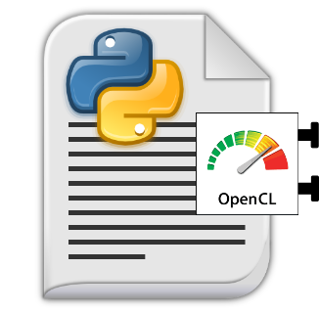
Existing Solution
import pyopencl as cl
import numpy
import numpy.linalg as la
a = numpy.arange(50000, dtype=numpy.float32)
b = numpy.arange(50000, dtype=numpy.float32)
ctx = cl.create_some_context()
queue = cl.CommandQueue(ctx)
mf = cl.mem_flags
a_buf = cl.Buffer(ctx, mf.FLAGS, hostbuf=a)
b_buf = cl.Buffer(ctx, mf.FLAGS, hostbuf=b)
dest_buf = cl.Buffer(ctx, mf.WRITE_ONLY, b.nbytes)
prg = cl.Program(ctx, """
__kernel void sum(__global const float *a,
__global const float *b, __global float *c)
{
int gid = get_global_id(0);
c[gid] = a[gid] + b[gid];
}
""").build()
prg.sum(queue, a.shape, None, a_buf, b_buf, dest_buf)
a_plus_b = numpy.empty_like(a)
cl.enqueue_copy(queue, a_plus_b, dest_buf)
Adds two arrays
Too complex
Could be written much more concisely.

Slide 12
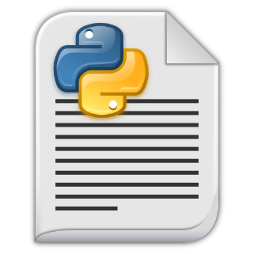
Python OpenCL Integration
import opencl as cl
np = cl.ArrayContext()
a = np.arange(50000, ctype=cl.float32)
b = np.arange(50000, ctype=cl.float32)
dest = a + b
with dest.map() as np_dest:
print np_dest
Lets start from the basics

Slide 13
Python OpenCL Integration
import opencl as cl
np = cl.ArrayContext()
a = np.arange(50000, ctype=cl.float32)
b = np.arange(50000, ctype=cl.float32)
@np.binary_ufunc
def add(a_elem, b_elem):
return a_elem + b_elem
dest = add(a, b)
I need more control
Lets define a kernel

Slide 14
Python OpenCL Integration
import opencl as cl
import clyther as cly
import clyther.runtime as clrt
np = cl.ArrayContext()
a = np.arange(50000, ctype=cl.cl_float32)
b = np.arange(50000, ctype=cl.cl_float32)
@cly.global_work_size(lambda x: x.shape)
@cly.kernel
def add(x, y, out):
gid = clrt.get_global_id(0)
out[gid] = x[gid] + y[gid]
dest = np.empty_like(a)
add(a, b, dest)
OK that’s great what about OpenCL?
Lets define a real kernel

Slide 15
CLyther
Philosophy:
Enable users to have 100% control via Python.
Access one to one mapping from Python to OpenCL.
Endorse native Python abstractions for convenience
e.g. Slice an array, pass a function as an argument.
Notes:
Longer demo of Clyther.

Slide 16
OpenCL Learning Curve
User domain (C/C++)
Learn OpenCL Optimizations
Learn OpenCL Basics
Notes:
Longer demo of Clyther.

Slide 17
Python OpenCL Learning Curve
Learn NumPy
Learn OpenCL Optimizations
Start Learning OpenCL
Notes:
Longer demo of Clyther.

Slide 18
OpenGL integration
Natively view or plot OpenCL memory objects.
Enable rapid development of lightning fast data visualization applications.
QA on data
Notes:
Plot data created in OpenCL demo.

Slide 19
What Exists Today
Minimal framework developed:
Python bindings are fully developed
Python to OpenCL converter
Supports a subset of Python
Numerical algorithms only
Supports a subset of OpenCL
OpenCL runtime types float, float2 int
OpenCL runtime functions sin(), get_**_id()
Completed a lot of the complicated work
Notes:
Give me lots of money

Slide 20
Roadmap
Phase I
100% coverage of OpenCL syntax and semantics
“80%” coverage of Python syntax and semantics
Excellent error reporting and usability.
Starting NumPy integration.*
Phase II
Comprehensive coverage of Python syntax and semantics.
NumPy integration
Focus on Accelerations and benchmarking:*
AMD specific optimizations.
Benchmark examples and applications
Notes:
Need to create timeline? budget?

Slide 21
A note on Benchmarking
Performance cost of Python C binding have been very well explored.
Very small contant time operation.
Python -> OpenCL conversion cost.
One time cost.
OpenCL binaries cached to disc.
Performace leakage due to abstraction:
Advances users can have 100% control.
Abstractions will be slower in the beginning:
Potential to be faster than all but a small fraction of the most experienced openCL developers.
Potential to be optimized on a per device basis.

Slide 22
Issues
Statically typed
Not pythonic / Where is the convenience?
Python users are typically not going to use this.
Can be summarized in 2 lines of Numpy Code

Slide 23
Python Overview: Executive Summary
Interpreted, high-level programming language
Can run interactively
Rapid Application Development
Glue language to connect existing components together
Has a growing scientific and HPC community.
Notes:
Short demo of Ipython
python syntax
numpy

Slide 24
CLyther
Spectrum of users:
End User
May not know they are using OpenCL
Biggest user group
Provides feedback
Bug reports
CLyther developer
Knowledge of OpenCL kenel concepts
Needs to get a task accomplished
Framework developer
Build for performance
Notes:
Longer demo of Clyther.

Slide 25
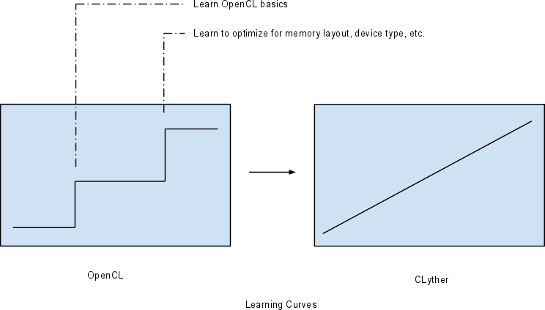
Learning Curves
Notes:
Longer demo of Clyther.

