Slide 1
PACT for Entire
Evidence-backed regression review
When the dependency graph is incomplete
Confirmed intent. Executed checks. Replayable evidence.
Shaurya / E2 - Build with Graph Intelligence
Notes:
Track E2, Bengaluru Tech Week Buildathon, 6 September2026. Source: BUILDATHON.md and verified reports in pact/docs/evidence. PACT is independent of Pact Foundation.

Slide 2
The unchanged caller still breaks
A new public-preview feature changes a shared helper.
An unchanged export entrypoint inherits the regression.
Changed-file selection misses both guest-export failures.
PACT ties approved policy to structural evidence and checks actual behavior.
Notes:
The seeded D1 changes can_access but not export_document. The feature allows guest public preview; overbroad helper also allows guest export. Source: pact-D0/D1/D2 tags and curveball impact records.

Slide 3
Measured detection, locally and on Databricks
D0 → D1 strategy | Cases executed | Failures found
Changed file | 2 | 0
Graph + fallback | 10 | 2
All registered | 10 | 2
Full matrix | 24 | 2
Corrected D2 | 10 | 0 (10 pass)
24-case synthetic fixture. Same confirmed policies. Exact assertion parity.
The benefit demonstrated is detection, not faster execution or complete coverage.
Notes:
Source: pact/docs/evidence/curveball-databricks-verification.json and curveball-local-comparison.json. Team-authored24-case fixture. All five exact local/cloud assertion signatures match. No speed or global coverage claim.

Slide 4
Curveball: qualify uncertainty, then verify
Dynamic dispatch can omit the relevant call edge.
1 Keep confirmed structural paths and label heuristic evidence.
2 Mark incomplete analysis and run all registered approved checks.
3 Preserve that context in the UI, replay and Delta receipts.
D2 can pass while analysis remains partial. No invented call path.
Notes:
Official constraint: Graph is evidence, not an oracle. Before-fix real-Graph test missed2failures. Implemented source precautions, resolution qualification, Git reconciliation, fallback to confirmed policies, context preservation. Source CURVEBALL.md and tests/test_curveball.py.

Slide 5
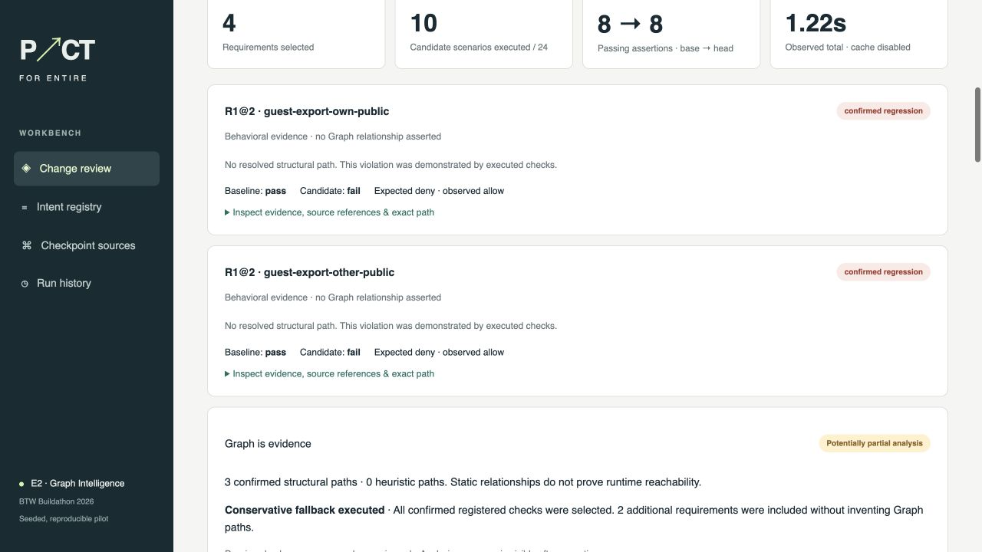
A working review and correction flow
Inspect intent
Run D1
Explain failures
Review D2
Replay evidence
Actual local workbench capture; no generated UI.
Notes:
Actual screenshot: pact/docs/evidence/d1-fallback-ui.png, captured from the real local product. Real44-frame walkthrough is linked in BUILDATHON.md. D2 correction has10passes,0failures; screenshot not a mockup.

Slide 6
Verified implementation, inspectable evidence
22 passing tests · 5 successful cloud jobs
Clean installed replay; receipt integrity; idempotence; Delta recovery.
Authentic final-review Checkpoint: 90d4a736f01e
Scope: registered-policy synthetic fixture. Historical policy/pre-noon capture gaps remain disclosed. Workspace jobs require permission; public reports and offline replay are available.
github.com/Shaurya002800/entire-graph/tree/pact/implementation
Notes:
22tests passed in13.08s; five post-Curveball Databricks jobs SUCCESS; independent final CP90d4a736f01e reviewed e3b512e. Original policy/pre-noon capture gaps remain. Public manifest and reports at github.com/Shaurya002800/entire-graph/tree/pact/implementation. Future expansion not implemented.

