Slide 1
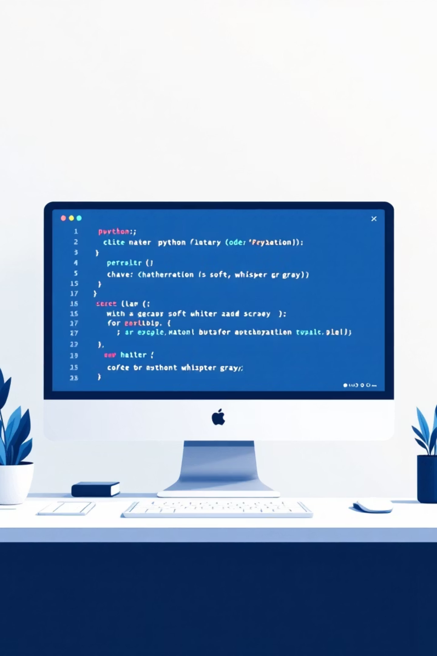
Word Guess Game Course
Micro Project (Experiment 12): PCITL307 Programming in Python Lab
Submitted To: Miss Divya
Submitted By - Group Number 9:
Abhiraj Krishna - 3
Leon P Pauly - 33
Muhammad Nasih N - 37
Pritam Krishna - 48

Slide 2
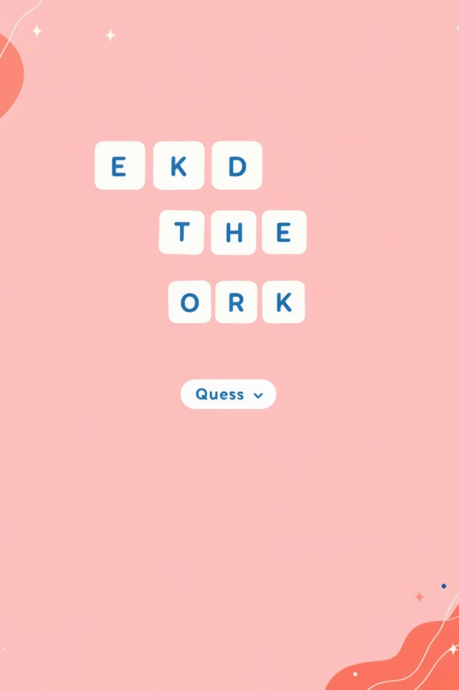
Project Objective
Our primary goal was to satisfy the requirements of Experiment 12 by building a micro-project that integrates concepts from Experiments 1-11 of the Python Lab syllabus. We developed a command-line word-guessing game that combines features from "Hangman" and "Wordle" to create an engaging, interactive experience.
Key Purpose: To apply and demonstrate our understanding of core Python principles—including data structures, functions, exception handling, file operations, and JSON parsing—in a single, functional application that showcases practical programming skills.
Integrated Concepts
Practical Application
Combines Hangman and Wordle mechanics
Demonstrates real-world Python skills
Syllabus Coverage
Experiments 1-11 integrated into one project

Slide 3
Game Features & Mechanics
Our word-guessing game offers multiple customizable features that enhance player engagement and provide varied difficulty levels. Players can tailor their experience by selecting difficulty and determining the number of guesses available for each round.
1
2
Difficulty Levels
Custom Guesses
Easy: 4-letter words | Normal: 5-letter words | Hard: 6-letter words. Players choose their preferred challenge level at the start of each game.
Users decide how many guesses they want for the round, allowing complete control over game difficulty and personal preference.
3
4
Wordle-Style Feedback
Win/Loss Conditions
Green: Correct letter in correct position | Yellow: Correct letter, wrong position | Gray/Red: Letter not in word
The game clearly displays victory when the word is guessed or defeat when guesses are exhausted, providing immediate feedback on game outcome.

Slide 4

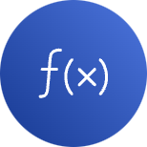




Python Concepts Implemented
This project integrates numerous concepts from our lab syllabus, demonstrating comprehensive understanding of Python fundamentals and practical programming techniques. Each experiment's concepts are strategically applied throughout the codebase.
Exp 1: Lists & Dictionaries
Exp 3: Functions
Exp 4: Exception Handling
Words stored in dictionary structure; individual words organized in lists; guess results maintained in list format (total_results)
Highly modular code using dedicated functions: game(), get_difficulty_level(), get_guess(), evaluate_guess(), display_layout() for logical separation
Try-except blocks validate user input and prevent crashes in get_difficulty_level() and get_guess() functions
Exp 5 & 7: File & JSON
Built-in Modules
Uses with open("words.json", "r") for file handling; json.load(f) deserializes JSON data into Python dictionary structure
Random module's choice() function selects random words from the loaded dictionary

Slide 5
Code Highlight: File Handling & JSON
This code snippet demonstrates how we load and parse the game data, integrating file handling and JSON deserialization concepts. The implementation shows proper resource management using context managers and clean data structure initialization.
import jsonfrom random import choiceif __name__ == "__main__": # Exp 5: File Handling with open("words.json", "r") as f: # Exp 7: Deserializing JSON # Exp 1: Data stored in Dictionary total_words = json.load(f) # Exp 3: Calling the main game function game(total_words)
Key Implementation Details: The open() function reads the file with automatic resource cleanup via context manager. The json.load() function converts JSON text into a Python dictionary. This approach ensures efficient memory usage and proper exception handling if the file is missing or malformed.

Slide 6
Code Highlight: Error Handling
This function demonstrates robust input validation using exception handling, ensuring the user provides valid difficulty level selection. The try-except structure prevents crashes from invalid input and provides clear user feedback for correction.
def get_difficulty_level(): while True: try: # Exp 4: Start try block difficulty_level = int(input( "Choose difficulty (1=Easy, 2=Normal, 3=Hard): ")) if difficulty_level not in (1, 2, 3): raise ValueError("Choose 1, 2 or 3") return difficulty_level except ValueError: # Exp 4: Catch the error print("Enter either 1, 2 or 3")
Error Handling Strategy: The function catches both non-integer input (ValueError from int()) and invalid number ranges. The while loop ensures repeated prompting until valid input is received, creating a user-friendly experience that prevents program crashes.

Slide 7
Code Highlight: Core Game Logic
The evaluate_guess() function represents the heart of our game, providing Wordle-style color-coded feedback for each guess. This function demonstrates string manipulation, conditional logic, and ANSI color code implementation for terminal-based visual feedback.
def evaluate_guess(random_word, guess, continue_game): GREEN = "\033[42m" # ANSI codes for terminal color YELLOW = "\033[43m" RED = "\033[100m" RESET = "\033[0m" result = "" if random_word == guess: result += GREEN + guess + RESET continue_game = False # Ends game on win else: for i, letter in enumerate(guess): if letter == random_word[i]: result += GREEN + letter + RESET elif letter in random_word: result += YELLOW + letter + RESET else: result += RED + letter + RESET return (result, continue_game)
Logic Explanation: The function checks for complete word match first (instant win). For partial matches, it iterates through each letter position, comparing against the target word. ANSI color codes provide visual feedback: green for correct position, yellow for correct letter wrong position, red for letters not in word. The function returns both the formatted result and game state.

Slide 8
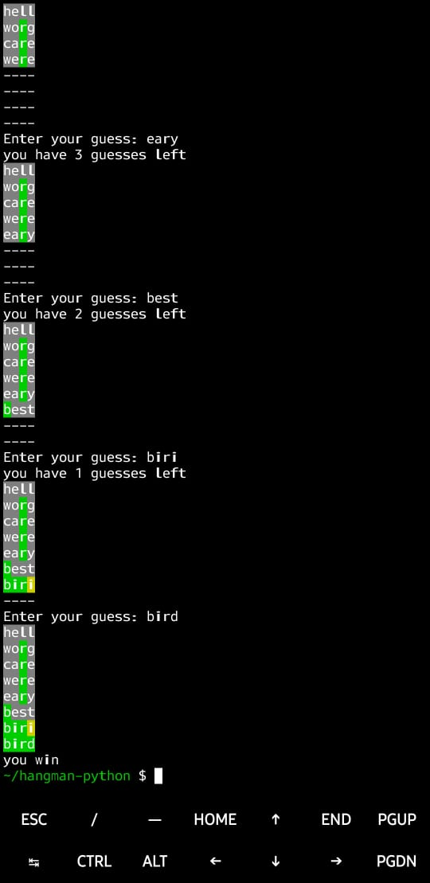
Demonstration: Winning the Game
This screenshot captures a successful game session where the player selected easy difficulty with a 4-letter word and allocated 8 guesses. Through strategic letter guessing and logical deduction, the player successfully identified the target word "bird" before exhausting their available guesses, demonstrating effective game strategy and the Wordle-style feedback system in action.
Difficulty Selected
Easy mode with 4-letter word
Guesses Allocated
8 total guesses available
Outcome
Successfully guessed "bird" - Victory!
Feedback System
Color-coded letters showed correct positions and letter presence

Slide 9
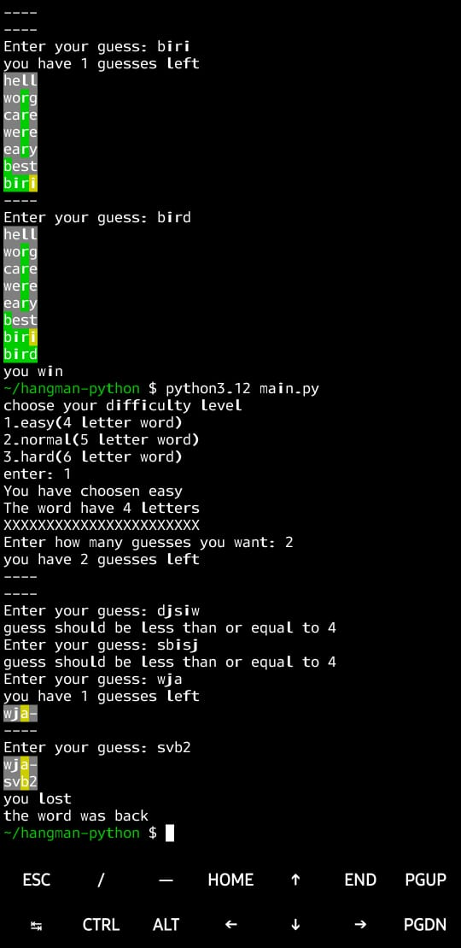
Demonstration: Losing the Game
This screenshot illustrates a challenging game scenario where the player selected only 2 guesses for their attempt. Despite the limited guess allocation, the player made strategic attempts but ultimately exhausted their guesses before identifying the target word. The game correctly revealed the answer "back" upon defeat, demonstrating the loss condition and providing learning feedback for the player's next attempt.
Difficulty Challenge
Game Outcome
Limited to only 2 guesses
Guesses exhausted - Defeat
Revealed Answer
Learning Opportunity
Correct word was "back"
Demonstrates importance of guess allocation strategy

Slide 10
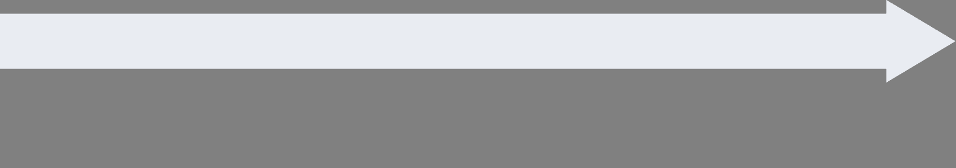
Conclusion & Future Scope
We successfully created a complete, interactive Python game that applies file handling, JSON parsing, exception handling, functional programming, and data structures—all requirements of the lab syllabus. The project demonstrates practical integration of Experiments 1-11 concepts into a cohesive, working application that provides engaging user experience with robust error handling and clear game mechanics.
GUI Enhancement
Current Achievement
Develop graphical user interface using Tkinter or Pygame for improved user experience and visual appeal
Fully functional command-line word-guessing game with Wordle-style feedback and customizable difficulty levels
Advanced Features
Expanded Content
Implement scoring system based on guesses remaining, leaderboards, multiplayer modes, and difficulty progression
Increase words.json to include thousands of words across multiple categories and languages
Thank You | Questions?

