Slide 1
Project Management:
A Functional Perspective
Presented to the Southwest Ohio Chapter of DAMA
November 9, 2000
Presented by:
Steve Seeskin – seeskins@dncx.com
Data Networks Corporation – http://www.dncx.com
Notes:
Abstract: Project management is the critical business function of providing a product or service deliverable on a nonrecurring basis. This is in contrast to operations management, which is also a critical business function, but is focused on ongoing and recurring business activity. The project manager must ensure schedule compliance, cost control, and quality performance of the deliverable.
This presentation uses the IDEF0 (FIPS 183) technique to define and explore the project management function. The advantage of the IDEF0 technique is that interrelationships between sub functions and information flows are clearly identified. Moreover, the IDEF0 technique identifies the interfaces between the project management function and the business functions external to the project management purview. The presentation assumes no prior knowledge of the IDEF0 technique – a short IDEF0 tutorial precedes the project management discussion.
The main subject of the presentation is an adaptation of the Project Management Institute (PMI) Project Management Body of Knowledge (PMBOK). As such, an IDEF0 Functional Decomposition Model is used to addresses the project management sub functions of: integration, scope, time, cost, quality, human resources, communications, risk, and procurement management.
Speaker: The presenter will be Mr. Steven J. Seeskin. He is a senior engineer at Data Networks Corporation, http://www.dncx.com. For the past 16 years he has applied IDEF0 (functional decomposition modeling) and IDEF1X (information modeling) in a variety of U.S. Department of Defense logistics assignments, which included aspects of business process improvement, information requirements determination, data standardization, data mapping, database and metadata repository design, and information system modernization/data migration. Prior to this, Steve developed, implemented, and managed commercial Manufacturing Resource Planning (MRP II) systems. Steve has extensive project management experience in these professional involvements.
In addition to being a member of DAMA, The Data Management Association International (Southwest Ohio Chapter, where he serves on the board of directors), Steve belongs to the International Society of Logistics (SOLE), Education Society for Resource Management (APICS), World Future Society (WFS), and participates in the Armed Forces Electronics and Communications Association (AFCEA) under Data Networks Corporation’s corporate membership.
Steve has a BS, Summa Cum Laude, in Information Processing Systems from the University of Cincinnati. He has considerable course work completed for an MBA in Technology Management. He is a Certified Fellow in Production and Inventory Management (CFPIM), Certified in Integrated Resource Management (CIRM) and Certified Computing Professional (CCP). The CCP is for proficiencies in Business Information Systems, Data Resource Management, Management, Software Engineering, and Systems Development.
Steve can be reached at seeskins@dncx.com.

Slide 2
Purpose
To inform the member attendees of the many complex and integrated sub-functions of the project management discipline.
Note: The presenter acknowledges that much of the presentation is an adaptation of the following document:
A Guide to the Project Management Body of Knowledge, 1996 Ed.
Project Management Institute Standards Committee
William R. Duncan, Director of Standards
Project Management Institute, Newtown Square, PA
http://www.pmi.org

Slide 3
TOPICS
Introduction to Project Management
Brief Tutorial – IDEF0 Functional Decomposition Modeling
Project Management Body of Knowledge IDEF0 Model
Concluding Materials

Slide 4
Introduction to Project Management

Slide 5
Project Characteristics
A project
  Work done one time
  Has a beginning and an end
  Produces a unique product (service)
    Examples: designing a new jet engine, developing a software program, construction of an office building
Versus ongoing operations
  Repetitive work processes
  No defined end
  Produce similar products (services)
    Examples: manufacturing ball point pens, sending out invoices, refining crude oil

Slide 6
Management Functions
Management involves:
  Planning
  Organizing
  Directing
  Controlling
        an organization’s resources to achieve goals

Slide 7
The Project Manager
Project Responsibilities
  Meet or exceed customer’s quality expectation
  Meet or beat schedule constraints
  Meet or beat budgetary constraints
Dilemma - simultaneously satisfy:
  The customer’s needs: budget, quality, time (cheaper, better, faster paradigm)
  The corporation’s goals: customer satisfaction, profit (or cost avoidance), high employee morale, high productivity
  The human resources’s needs: job satisfaction, learning new skills and knowledge

Slide 8
Project Management - Summary
Complex
Multi-disciplined
Integrated

Slide 9
Brief Tutorial – IDEF0 Functional Decomposition Modeling

Slide 10
IDEF0 History
Integration Definition for Function Modeling – FIPS 183
Formerly, ICAM Definition for Function Modeling
  USAF Integrated-Computer Aided Manufacturing Program
Softech Corporation’s Structured Analysis and Design Technique (SADT)

Slide 11
Function vs. Process Modeling
Function models have no implied sequence, steps, procedures, or if-then logic); process models do
Function models use decomposition to expose greater detail; process models do not
Function models are based on the plan, control, execute paradigm

Slide 12
Functional Decomposition Example
Plan a Meeting
  Make Location Arrangements
    Reserve Room
    Negotiate Caterer Contract
    Rent Audio Visual Equipment
  Make Speaker Arrangements
    Acquire Speaker Commitment
    Make Speaker Travel Reservations
  Ensure Meeting Participation by Members & Guests
    Promote Meeting, Speaker, and Topic
    Take Meeting Reservations

Slide 13
IDEF0 Basic Syntax
The function, constrained by the
controls, transforms the inputs into
outputs, by using the mechanisms.
Control
Input
Output
Function
Mechanism

Slide 14
Project Management Body of Knowledge IDEF0 Model

Slide 15
Modeler’s Prerogatives
Third level arrow attribution only; no arrow bundling; no rollup
Selected control arrows from among inputs and mechanisms (PMI refers to mechanisms as tools & techniques)
Some output arrows were terminated at another function box in the same node; not extended to boundary

Slide 16
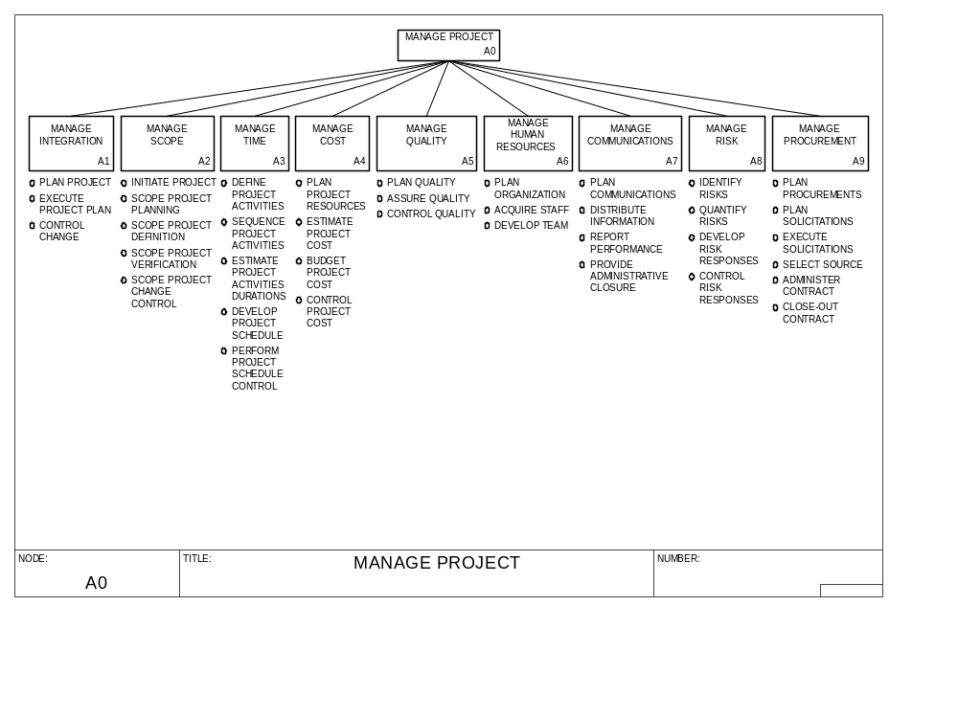

Slide 17
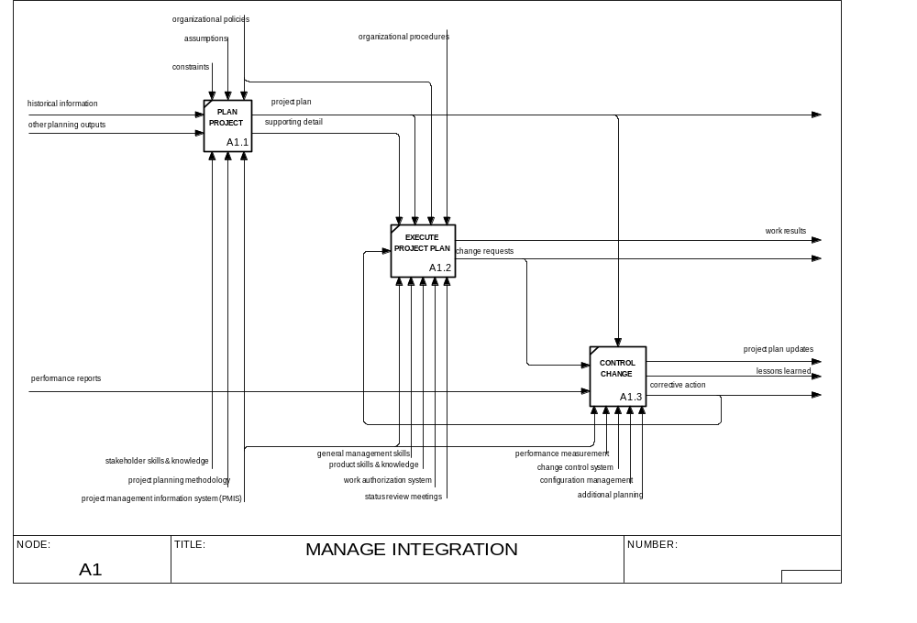

Slide 18
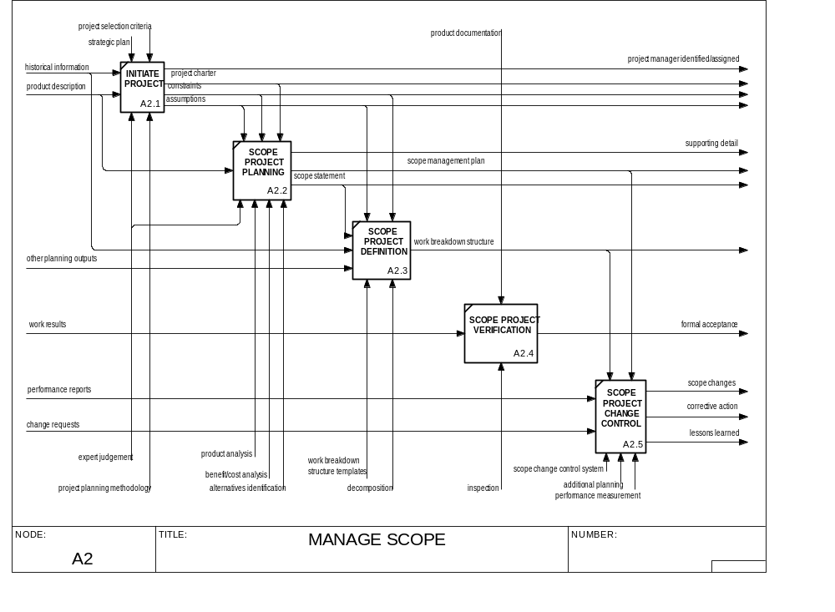

Slide 19
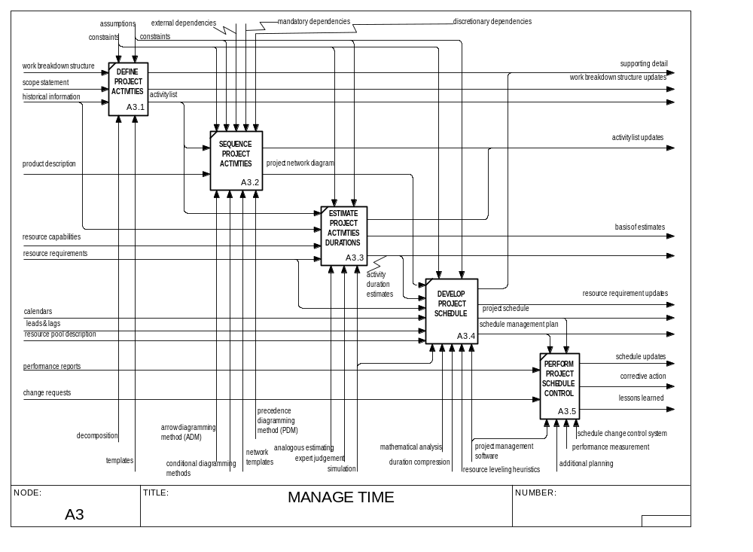

Slide 20
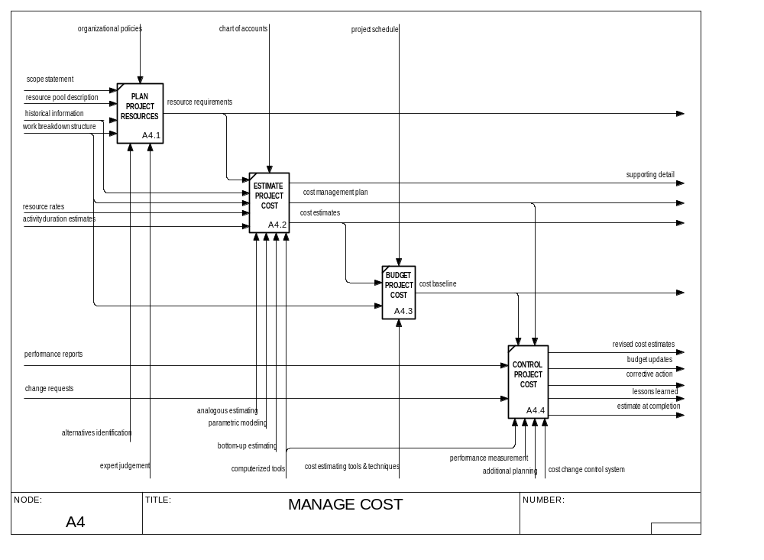

Slide 21
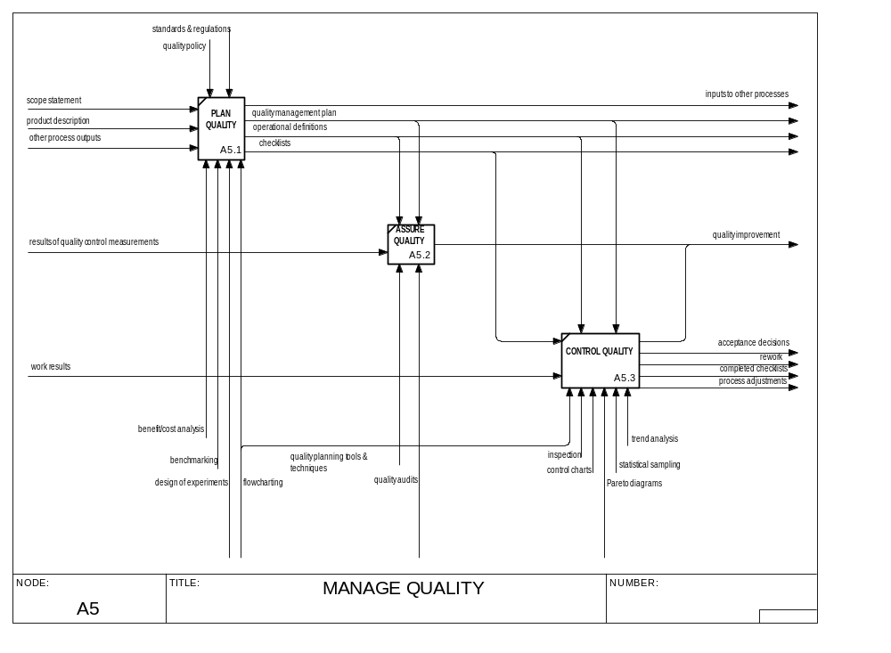

Slide 22
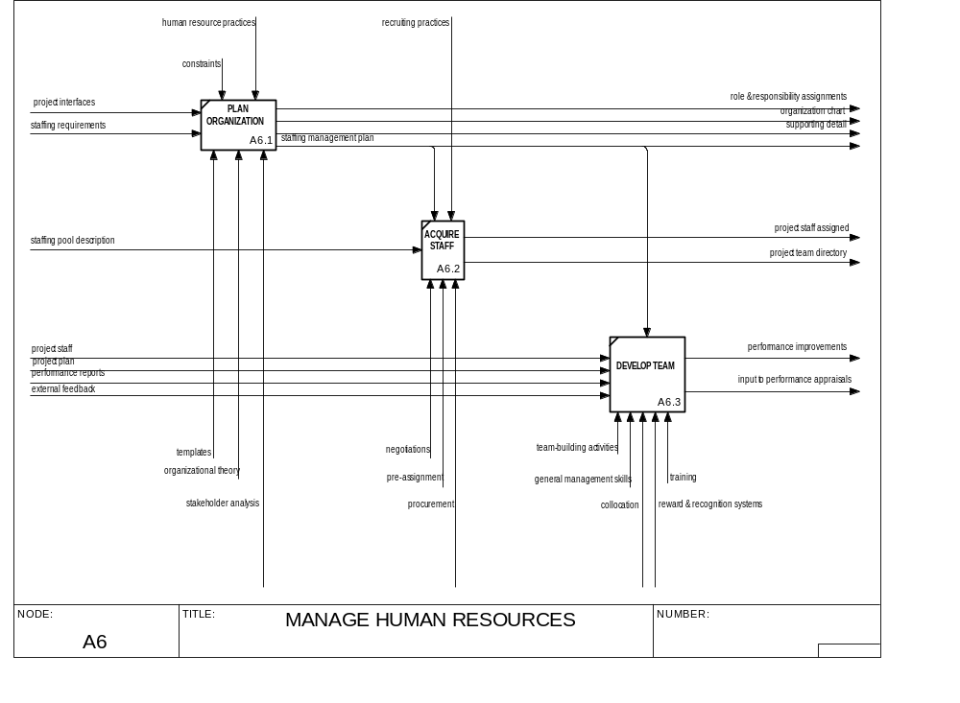

Slide 23
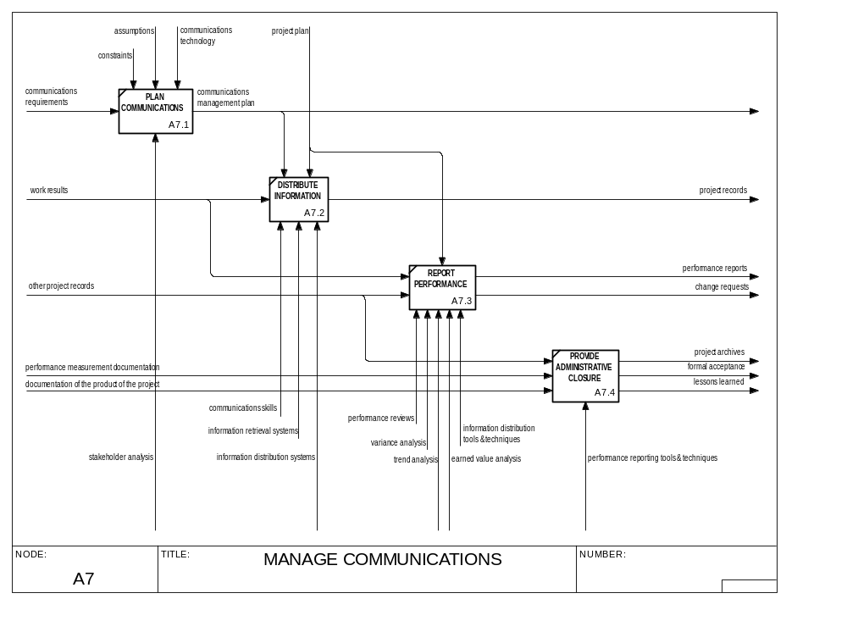

Slide 24
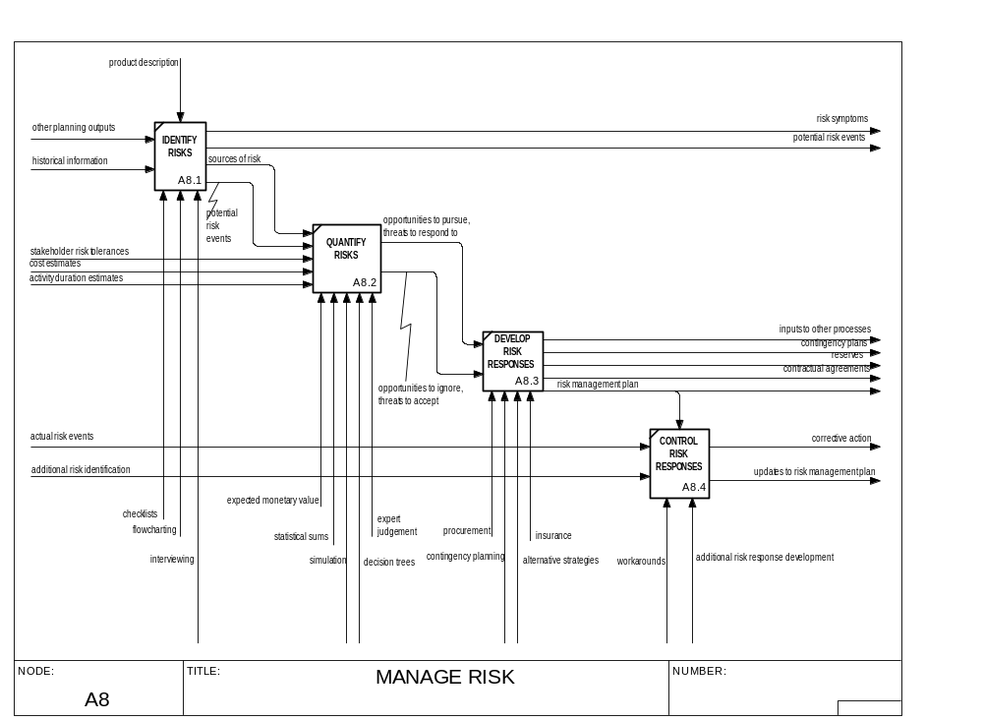

Slide 25
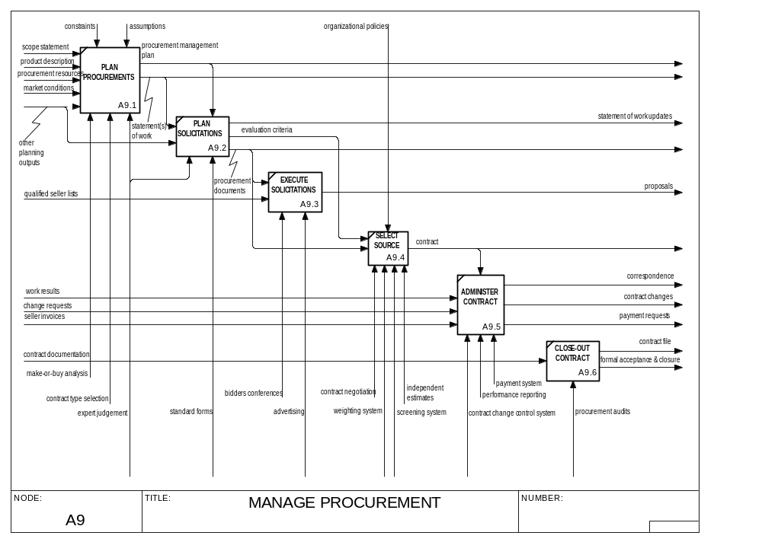

Slide 26
Concluding Materials

Slide 27
References
Project Management
  A Guide to the Project Management Body of Knowledge, 1996 Ed., Project Management Standards Committee, William R. Duncan, Director of Standards, Project Management Institute, Newton Square, PA.
    Download free at http://www.pmi.org/publictn/pmboktoc.htm
    2000 Ed. due for release in Dec. 2000.
IDEF0 Modeling
  Integration Definition for Functional Modeling (IDEF0), FIPS PUB 183, U.S. Dept. of Commerce, National Institute of Standards and Technology, Gaithersburg, MD, Dec. 21, 1993.
    Download free at http://www.itl.nist.gov/fipspubs/by-num.htm

Slide 28
The Final Word on Project Management

Slide 29
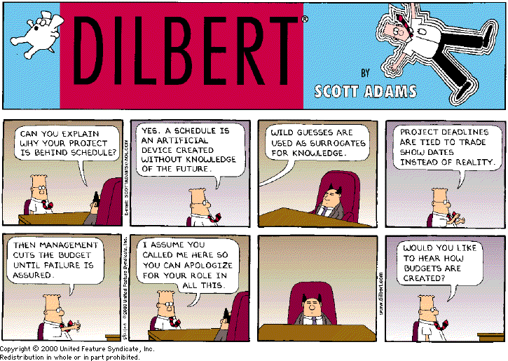
Dilbert on Project Management

