Slide 1
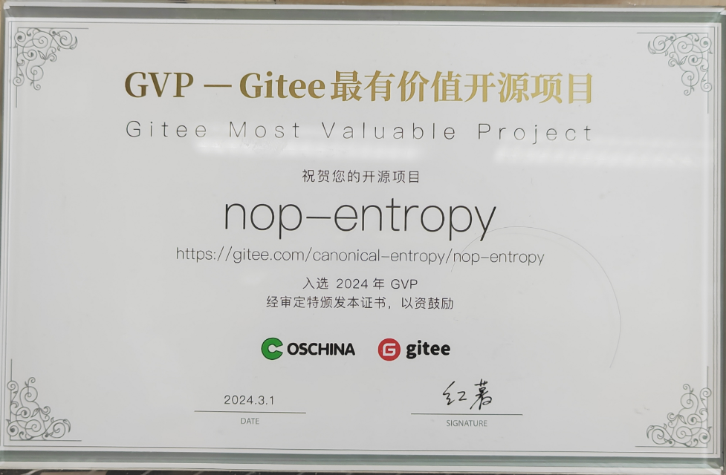
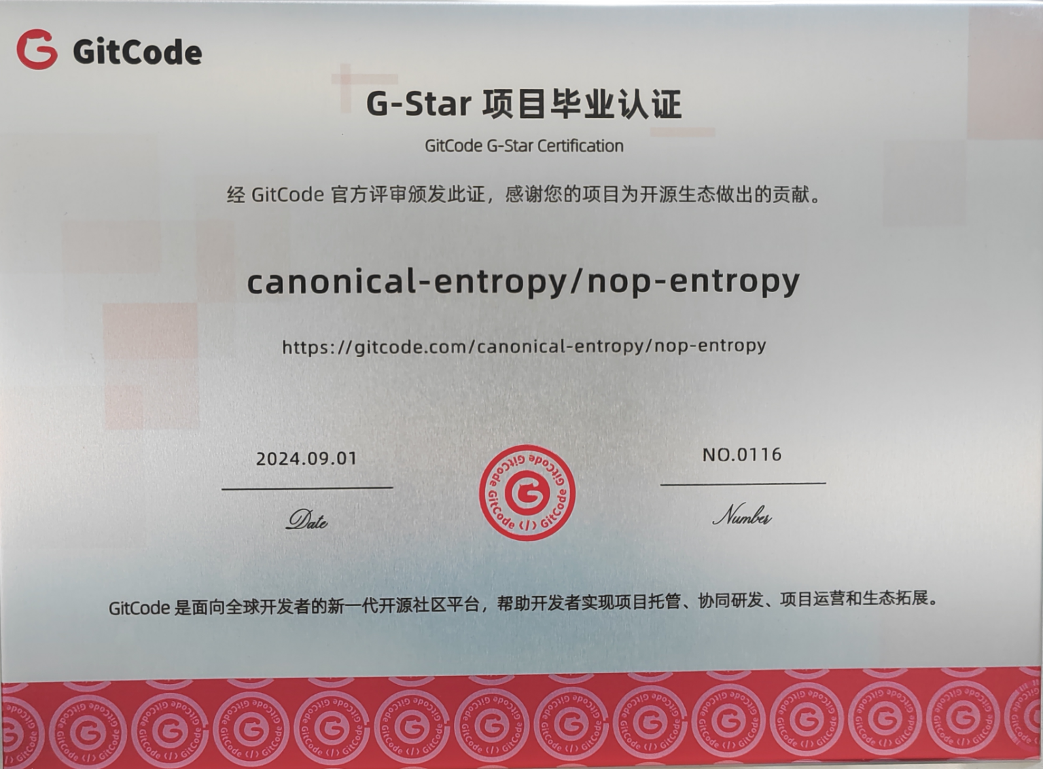


Slide 2


https://gitee.com/canonical-entropy/nop-entropy
https://gitcode.com/canonical-entropy/nop-entropy
https://github.com/entropy-cloud/nop-entropy
微信群
公众号

