Slide 1
RESEARCH BRIEFING · TSLA CASE STUDY
Deep Stock Research with
Claude Code/SDK + a Local LLM
A TSLA case study for developers
2026-05-03
Audience: developers building research workflows · run-20260503-210828-f48e

Slide 2
Executive Summary
■ Claude Code is a research-grade CLI: subagents, skills, hooks, MCP, plan mode, 1M-token context.
■ The Agent SDK exposes the same loop programmatically (Python + TS); custom @tool MCP servers ship in-process.
■ TSLA workflow has four stages: SEC EDGAR ingest, market data, news/sentiment, then frameworks and a bull/base/bear memo.
■ Local LLMs (Ollama, LM Studio, llama.cpp) speak OpenAI- and Anthropic-compatible APIs — a 70B model fits in ~46 GB VRAM.
■ Hybrid pattern: Claude Opus plans/critics, local 8B-22B does bulk work; MCP is the spine, files are the state.
■ Anti-hallucination is non-negotiable in finance: tool-grounded RAG cuts the 41% ungrounded error rate by 60-80%.
run-20260503-210828-f48e
2

Slide 3
Audience & Scope
WHO THIS IS FOR
WHAT WE COVER
■ Developers who already use Claude Code daily
■ Quant-curious engineers exploring agentic research
■ Builders running on-device LLMs alongside cloud APIs
■ Teams cost-optimizing premium reasoning vs bulk work
■ Claude Code CLI surfaces: subagents, skills, hooks, MCP
■ Claude Agent SDK: query(), ClaudeSDKClient, custom tools
■ End-to-end TSLA research pipeline (sources -> memo)
■ Pairing with Ollama / LM Studio / llama.cpp
■ Hybrid topology, pitfalls, and concrete next steps
run-20260503-210828-f48e
3

Slide 4
Hybrid Architecture at a Glance
PLANNER / CRITIC
Claude Opus 4.7 (1M ctx)
Decomposes the topic, writes plans, reviews drafts, makes the final call.
BULK WORKER
Local LLM (8B-22B, Ollama)
Summarizes filings, drafts sections, runs overnight iterations cheaply.
INTEGRATION SPINE
Model Context Protocol
MCP servers expose tools (SEC, prices, browser, local LLM) to both tiers.
STATE STORE
File artifacts + SQLite
JSON drilldowns, xlsx workbooks, charts — durable handoffs between runs.
DATA FLOW
■ Prompt -> Claude planner decomposes into subtopics; writes drilldown specs.
■ Subagents fan out: each calls MCP tools (WebFetch, SEC, Polygon, local-LLM).
■ Local LLM does the bulk read-and-summarize; returns JSON to planner.
■ Planner critiques, runs outlier detection, then assembles xlsx + pptx artifacts.
■ Hooks (PreToolUse/PostToolUse) gate tool calls; /loop schedules recurring runs.
run-20260503-210828-f48e
4

Slide 5
Claude Code: research-grade CLI primitives
■ Subagents isolate context: own tools, prompt, summary-only return.
■ Built-ins: Explore, Plan, general-purpose. Custom in .claude/agents/.
■ Skills at .claude/skills/<name>/SKILL.md with YAML frontmatter.
■ Hooks fire on lifecycle events from settings.json (PreToolUse, etc.).
■ MCP via 'claude mcp add' over HTTP / stdio / SSE — three scopes.
■ Plan mode = read-only tools + reviewable plan before any side effect.
MCP wiring (claude mcp add)
# wire an MCP server into the project scope
claude mcp add --scope project sec-edgar \
--transport stdio \
-- python servers/sec_edgar.py
# verify it landed and is reachable
claude mcp list
# inside a session, scope a one-off
/permissions allow Bash:claude mcp call sec-edgar:get_filing
run-20260503-210828-f48e

Slide 6
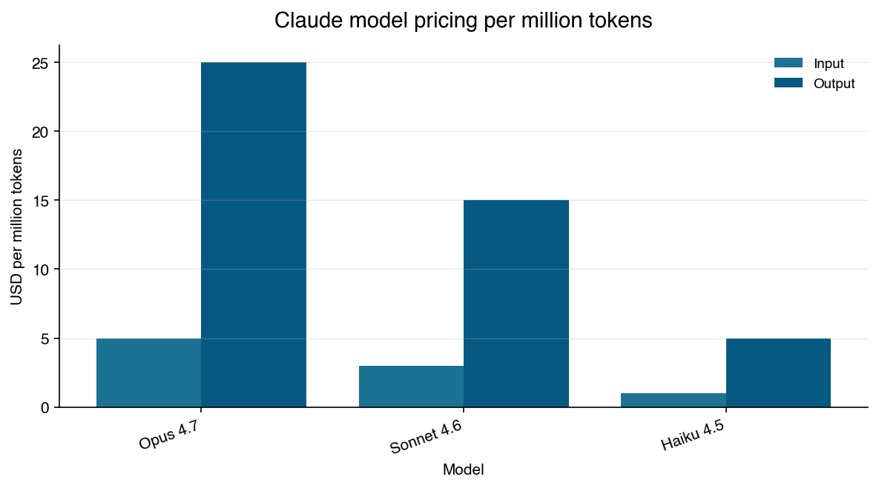
Claude Code: model pricing per 1M tokens
1M
0.1x
$10
context window @ standard pricing
cache-read multiplier
per 1,000 web searches
Source: platform.claude.com/docs/en/about-claude/pricing
run-20260503-210828-f48e

Slide 7
Claude Agent SDK: programmatic research loop
■ Official Python (claude-agent-sdk) and TS (@anthropic-ai/claude-agent-sdk).
■ query() = single-shot async iterator; ClaudeSDKClient = bidirectional.
■ Custom tools via @tool + create_sdk_mcp_server (in-process MCP).
■ Streaming opt-in with include_partial_messages -> StreamEvent stream.
■ Sub-agents via AgentDefinition delegate focused work with own toolsets.
■ Headless mode + Bedrock/Vertex/Foundry providers ready for CI/CD.
query() with custom tools (Python)
import anyio
from claude_agent_sdk import query, ClaudeAgentOptions
async def main():
opts = ClaudeAgentOptions(
model='claude-opus-4-7',
system_prompt='You are a TSLA research analyst.',
allowed_tools=['WebFetch', 'mcp__sec__get_filing'],
)
async for msg in query(prompt='Brief TSLA Q1 2026', options=opts):
print(msg)
anyio.run(main)
run-20260503-210828-f48e

Slide 8
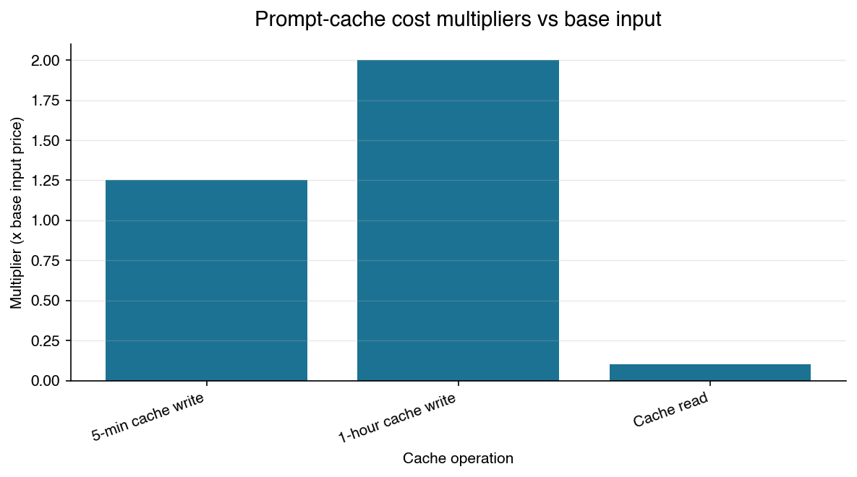
Agent SDK: prompt-cache cost multipliers
0.1.72
0.2.111+
50%
Python SDK current
min for Opus 4.7
Batch API discount
Reads cost 0.1x base input; long-TTL writes cost 2x. Source: prompt-caching docs.
run-20260503-210828-f48e

Slide 9
TSLA workflow: from EDGAR to memo
■ Stage 1 - Primary disclosures: SEC EDGAR (10-K/10-Q/8-K) + Tesla IR.
■ Stage 2 - Market data: Polygon (prod), Tiingo (EOD), yfinance (proto).
■ Stage 3 - News & sentiment: Finnhub, NewsAPI, social-media scrapers.
■ Stage 4 - Frameworks: fundamentals, technicals, macro, narrative.
■ Outputs: exec summary, price-vs-catalyst chart, fundamentals table, bull/base/bear memo.
■ Event-trigger re-runs on new 8-K filings (e.g., Q1 2026 4/22, deliveries 4/2).
run-20260503-210828-f48e

Slide 10
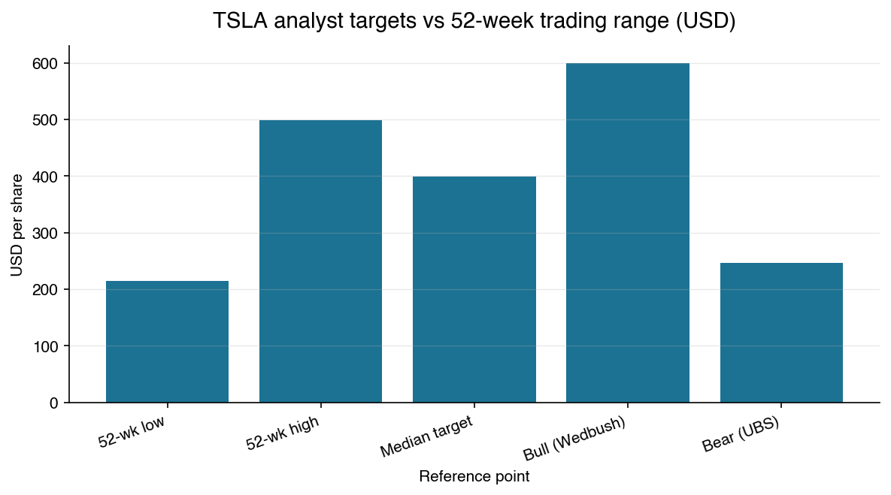
TSLA: analyst-target spread and trading range
$22.38B
21.1%
357
Q1 2026 revenue (+16% YoY)
Q1 2026 gross margin
P/E ratio (May 1 2026)
Bull/bear spread spans roughly +/-50% around the $398 median target.
run-20260503-210828-f48e

Slide 11
Local LLMs: Ollama, LM Studio, llama.cpp
■ Ollama @ :11434, LM Studio @ :1234, llama-server @ :8080.
■ All speak OpenAI-compat; llama.cpp also speaks Anthropic /v1/messages.
■ Point Claude Code at Ollama: ANTHROPIC_BASE_URL=http://localhost:11434.
■ OllamaClaude MCP cuts Anthropic tokens up to ~98.75% on file work.
■ Routing: ~70% bulk to local/open, ~10% premium reasoning to Claude.
■ Q4_K_M sizing: 8B ~6 GB, 14B ~11 GB, 70B ~46 GB, 72B ~50 GB.
Wire Claude Code to Ollama
# pull a fast worker model
ollama pull llama3.1:8b
# enable Anthropic-compatible mode
export ANTHROPIC_BASE_URL=http://localhost:11434
export ANTHROPIC_AUTH_TOKEN=ollama
export ANTHROPIC_API_KEY=''
# Claude Code now uses Ollama as the backend
claude --model llama3.1:8b
run-20260503-210828-f48e

Slide 12
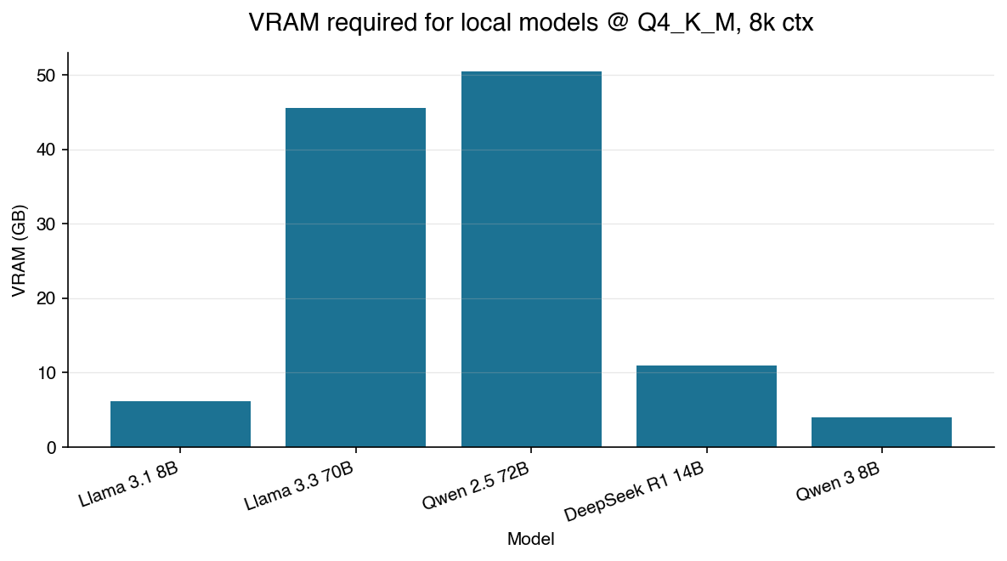
Local LLM VRAM footprint (Q4_K_M, 8k ctx)
~6 GB
~46 GB
98.75%
Llama 3.1 8B VRAM
Llama 3.3 70B VRAM
tokens saved (file ops)
12.6x spread between 8B and 72B class — flagged as outlier.
run-20260503-210828-f48e

Slide 13
Hybrid topology: planner, worker, spine, state
■ MCP spec 2025-11-25: async Tasks, server-side loops, parallel calls.
■ LiteLLM: one OpenAI-compatible gateway in front of 100+ providers.
■ Opus 4.7 (1M ctx) plans/critiques; Llama 3.1 8B (128k) does bulk work.
■ Watch out: Ollama default ctx is 2048 - silent truncation in pipelines.
■ Hooks gate tool calls; headless 'claude -p' fits GitHub Actions / cron.
■ Anti-hallucination: never read finance facts from parametric memory.
Hooks + headless run
# .claude/settings.json (excerpt)
{
"hooks": {
"PostToolUse": [{
"matcher": {"tool": "Bash"},
"command": "scripts/audit_tool_call.py"
}]
}
}
# headless run, exits on completion
claude -p 'Run TSLA daily brief; write to artifacts/'
run-20260503-210828-f48e

Slide 14
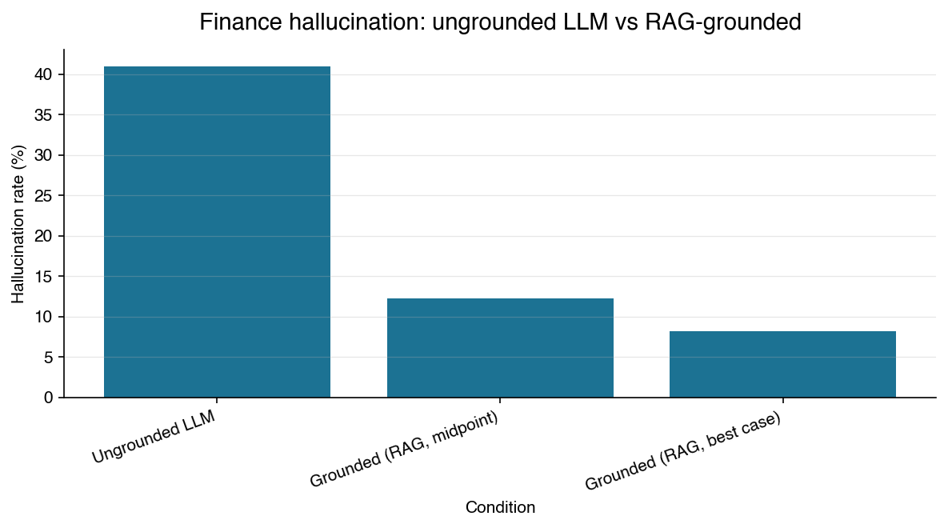
Why grounding matters: finance hallucination rate
41%
60-80%
64.4%
ungrounded finance error rate
reduction with RAG/tools
Opus 4.7 Finance Agent v1.1
60-80% reduction with RAG/tool grounding (QuantMCP pattern).
run-20260503-210828-f48e

Slide 15
Outliers, contradictions & risks
MEDIUM
local-llm-collaboration · claude-code-capabilities
The local-llm-collaboration drilldown (medium confidence) cites Claude Sonnet 4.5 at $3 input / $15 output per 1M tokens as the current Claude reference for cost arbitrage, while the claude-code-capabilities drilldown (high confidence) states that the current model line is Sonnet 4.6 at those same $3/$15 prices and explicitly notes Sonnet 4.5 belonged to...
low confidence conflict
LOW
claude-code-capabilities · claude-agent-sdk
claude-code-capabilities data point 0 and claude-agent-sdk data point 11 both report Claude Opus 4.7 input at $5 per MTok and output at $25 per MTok, while every other Anthropic price reference in the corpus pegs Opus-tier models at materially higher figures historically; both subtopics cite the same canonical pricing page so they agree with each other, b...
contradiction
LOW
local-llm-collaboration
Across the local-LLM VRAM data points in local-llm-collaboration (4 GB, 6.2 GB, 11 GB, 45.6 GB, 50.5 GB at Q4_K_M, 8k context), the max-to-min ratio is 12.6x, exceeding the 10x heuristic for stat outliers. The 70B/72B-class models (Llama 3.3 70B at 45.6 GB and Qwen 2.5 72B at 50.5 GB) sit far above the 8B/14B cluster. The spread is decision-relevant: it d...
stat outlier
MEDIUM
tsla-research-workflow
tsla-research-workflow asserts (medium confidence) that TSLA's median 12-month analyst target is $398 with bull cases at $600 and bear cases at $247, implying a roughly +/-50% disagreement around the median. The same drilldown also reports (medium confidence) a P/E of ~357 vs a 12-month average of ~280, signaling extreme valuation. No high-confidence clai...
low confidence conflict
run-20260503-210828-f48e
15

Slide 16
How to start (concrete next steps)
FIRST 30 MINUTES
COMMANDS
■ Install Claude Code; verify with 'claude --version'.
■ Pull a local worker model with Ollama.
■ Wire SEC EDGAR + a market-data MCP server.
■ Add a logging hook in settings.json.
■ Run a TSLA brief in headless mode and inspect artifacts.
■ Schedule a /loop or cron run for daily refresh.
# 1. Install the SDK
pip install claude-agent-sdk
# 2. Pull a worker model
ollama pull llama3.1:8b
# 3. Wire an MCP server
claude mcp add --scope project sec-edgar \
--transport stdio -- python sec.py
# 4. Headless brief
claude -p 'Brief TSLA Q1 2026; bull/base/bear' \
--output-format json > brief.json
# 5. Recurring run
claude /loop 24h /tsla-brief
run-20260503-210828-f48e
16

Slide 17
Sources & references
claude-code-capabilities
https://code.claude.com/docs/en/sub-agents
https://code.claude.com/docs/en/skills
https://code.claude.com/docs/en/mcp
https://code.claude.com/docs/en/hooks
https://platform.claude.com/docs/en/about-claude/pricing
https://mikhail.io/2025/10/claude-code-web-tools/
https://claudelog.com/mechanics/plan-mode/
tsla-research-workflow
https://electrek.co/2026/04/22/tesla-tsla-q1-2026-financial-results/
https://carboncredits.com/tesla-reports-first-ever-annual-revenue-drop-in-2025-carbon-credit-sales-also-dip-28/
https://www.tesery.com/blogs/news/tesla-reports-q4-and-full-year-2025-financial-results-energy-storage-deploys-record-growth-while-automotive-figures-reflect-market-stabilization
https://www.tesery.com/blogs/news/tesla-confirms-aggressive-robotaxi-expansion-to-seven-major-us-cities-in-first-half-of-2026
https://247wallst.com/investing/2026/04/07/wall-street-sees-22-upside-for-tesla-tsla-this-year/
https://www.sec.gov/search-filings/edgar-application-programming-interfaces
https://www.nb-data.com/p/best-financial-data-apis-in-2026
https://github.com/quant-sentiment-ai/claude-equity-research
https://www.stocktitan.net/sec-filings/TSLA/
https://www.macrotrends.net/stocks/charts/TSLA/tesla/pe-ratio
https://www.tipranks.com/news/tesla-stock-tsla-battles-500-as-bulls-and-bears-clash
https://eletric-vehicles.com/tesla/tesla-ramps-unsupervised-robotaxi-fleet-to-25-vehicles/
https://www.heygotrade.com/en/blog/tesla-q1-2026-earnings-recap/
claude-agent-sdk
https://pypi.org/project/claude-agent-sdk/
https://github.com/anthropics/claude-agent-sdk-python
https://github.com/anthropics/claude-agent-sdk-typescript
https://code.claude.com/docs/en/agent-sdk/overview
https://code.claude.com/docs/en/agent-sdk/streaming-output
https://platform.claude.com/docs/en/agent-sdk/custom-tools
https://platform.claude.com/docs/en/agent-sdk/mcp
https://platform.claude.com/docs/en/build-with-claude/prompt-caching
local-llm-collaboration
https://docs.ollama.com/api/openai-compatibility
https://docs.ollama.com/integrations/claude-code
https://lmstudio.ai/docs/developer/openai-compat
https://github.com/ggml-org/llama.cpp/blob/master/tools/server/README.md
https://github.com/Jadael/OllamaClaude
https://localllm.in/blog/ollama-vram-requirements-for-local-llms
https://github.com/vllm-project/vllm/blob/main/docs/serving/openai_compatible_server.md
https://costgoat.com/compare/llm-api
hybrid-architecture
https://modelcontextprotocol.io/specification/2025-11-25
https://github.com/BerriAI/litellm
https://platform.claude.com/docs/en/about-claude/models/whats-new-claude-4-7
https://code.claude.com/docs/en/hooks-guide
https://lobehub.com/mcp/aplaceforallmystuff-mcp-local-llm
https://localaimaster.com/models/llama-3-1-8b
https://www.promptquorum.com/local-llms/long-context-local-llms
https://www.codewithseb.com/blog/claude-code-headless-mode-cicd-automation-playbook
https://www.packtpub.com/en-us/newsletters/how-to-tutorials/detecting-addressing-llm-hallucinations-in-finance
https://masterofcode.com/blog/hallucinations-in-llms-what-you-need-to-know-before-integration
https://arxiv.org/html/2506.06622v1
https://www.kunalganglani.com/blog/local-llm-vs-claude-coding-benchmark
https://llm-stats.com/blog/research/claude-opus-4-7-launch
Full machine-readable corpus: drilldown/*.json, outliers.json, report.xlsx in run-20260503-210828-f48e
run-20260503-210828-f48e
17

