Slide 1
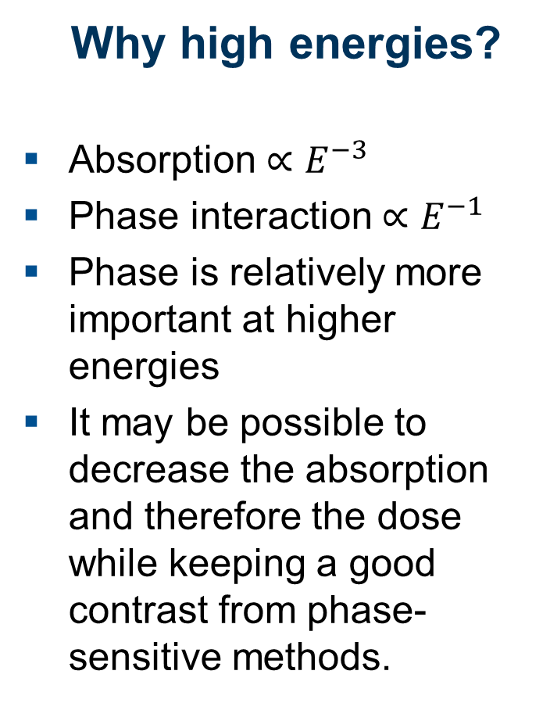
High-energy phase contrast
Why high energies?
Absorption ${∝E}^{−3}$
Phase interaction ${∝E}^{−1}$
Phase is relatively more important at higher energies
It may be possible to decrease the absorption and therefore the dose while keeping a good contrast from phase-sensitive methods.
60-160 keV

Slide 2
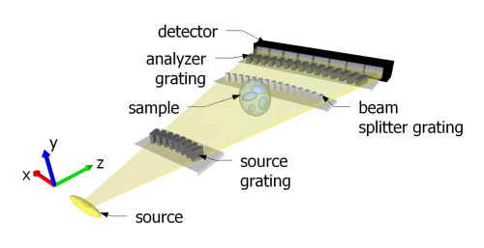
High-energy phase contrast
The technical challenge
Large thickness (> 500 μm of gold) needed to block X-rays above 100 keV
Small period needed for higher sensitivity
Conventional gratings cannot be fabricated with such thickness and a small period (2.8 μm)
Edge-on illumination
Illumination from the side (edge-on) is a solution

Slide 3
High-energy phase contrast
Two edge-on systems built at PSI
High-voltage X-ray tube: 160 kVp
Gold gratings, 2.8 μm pitch
Symmetric setup
1st Lohmann distance
Nominal energies 100 and 120 keV

Slide 4
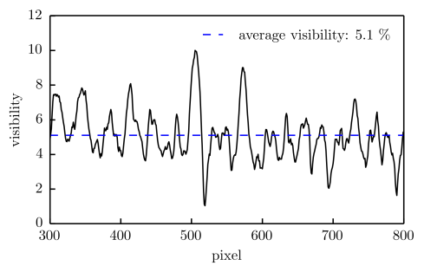
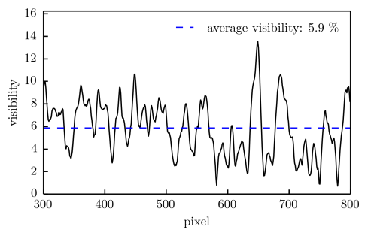
High-energy phase contrast Performance
100 keV
120 keV

Slide 5
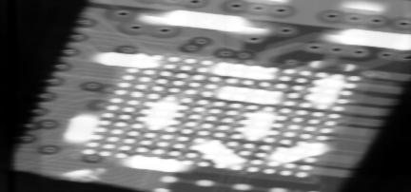
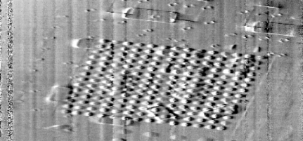
High-energy phase contrast The first images: an electronic chip at 100 keV
Complementarity of absorption and differential phase
All soldering points visible in the phase image, even under the strongly absorbing resistors

Slide 6
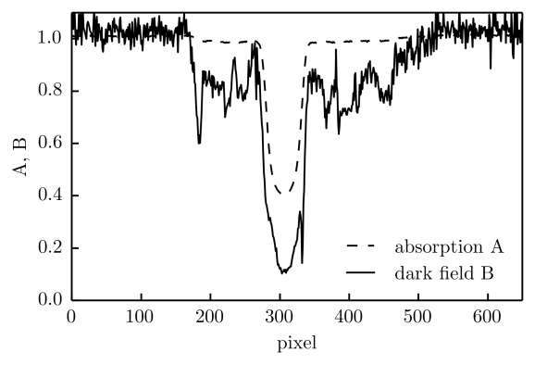
High-energy phase contrast The first images: soft materials at 120 keV
air
foam
steel
Complementarity of absorption and dark field
Contrast from soft polystyrene foam increased from 2 to 20%

Slide 7
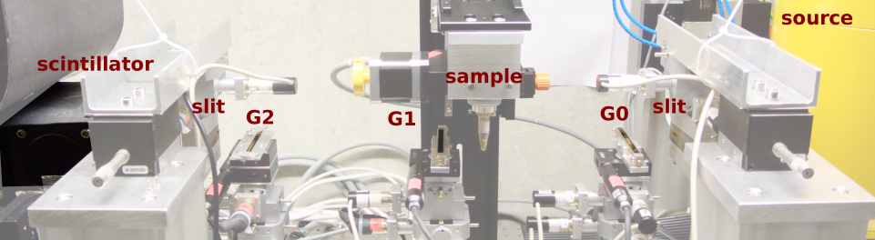
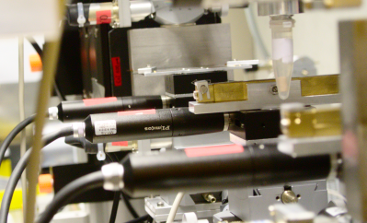
High-energy phase contrast
The edge-on setup

