Slide 1

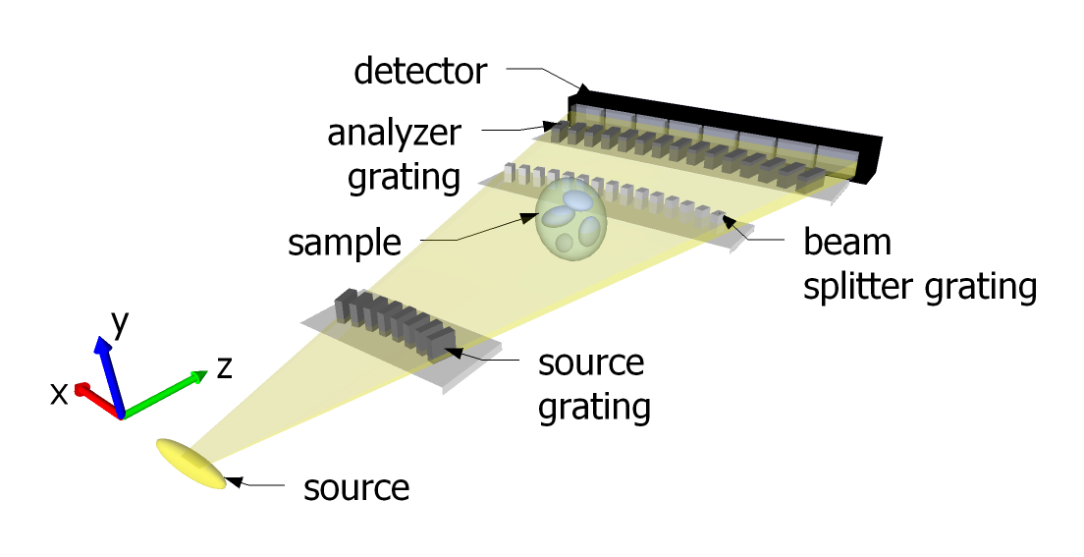
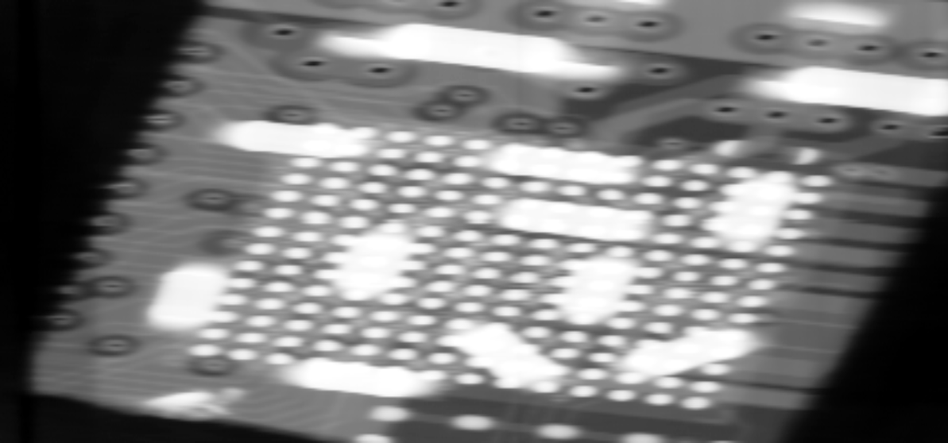
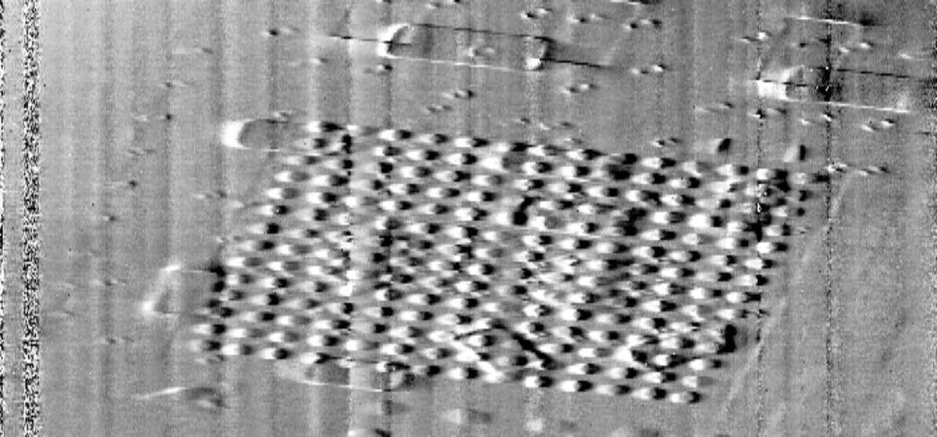
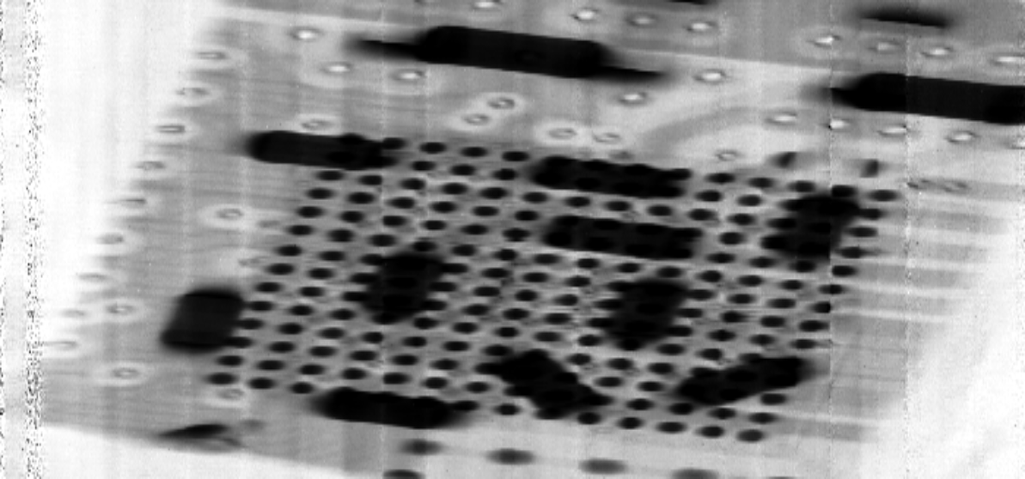





Grating interferometry at 100 keV and 120 keV
on lab sources
M. Abis[1, 2], T. Thüring[1, 2], Z. Wang[2], C. David[2], M. Stampanoni[1, 2]
[1] Institut für Biomedizinische Technik, ETH Zürich
[2] Paul Scherrer Institut
CCMX
Objectives
Conclusions
Bringing grating interferometry in the energy range of medical and security systems.
Overcome the limitations in the fabrication of the gratings.
Explore the complementarity of the signals provided by the grating interferometer.
The feasibility of high-energy grating interferometry is shown for the first time
The three complementary signals can be retrieved, although the preliminary results show a different behaviour of the scattering image compared to lower energy systems
Our Mission
The edge-on illumination
First images
The large thickness and small period needed by high-energy systems can be achieved only with an edge-on illumination.
Scan of an electronic chip
2cm x 2cm field of view
Average visibility between 5% and 6%
Absorption, differential phase and visibility signals
Long exposure (several hours)
Results 2
The gratings were manufactured by Microworks GmbH. The absorption gratings have a thickness of 800 µm, all the gratings have a pitch of 2.8 µm.
Outlook
Medical and security applications need a high penetration power through large thicknesses and heavy materials.
Improvements in the fabrication of the gratings will substantially decrease the exposure times.
Design energy | 100 keV | 120 keV
Intergrating distance | 15.8 cm | 18.9 cm
Total length | 54 cm | 61 cm
Beam splitter | gold | nickel
Publications
C. David, B. Nöhammer, H. Solak, and E. Ziegler, “Differential x-ray phase contrast imaging using a shearing interferometer,” Applied Physics Letters, vol. 81, no. 17, pp. 3287–3289, 2002.
M. Abis, T. Thüring, Z. Wang, C. David, M. Stampanoni “X-ray phase-contrast imaging at 100 keV on a conventional source”, submitted to Scientific Reports, 2014.
C. David and M. Stampanoni, "A method for x-ray phase contrast and dark-field imaging using an arrangement of gratings in planar geometry", EP10167569.

