Slide 1
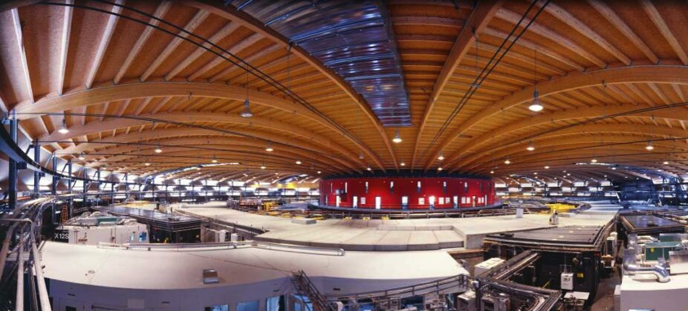
Dark field and transmission in the Compton regime
Matteo Abis, Pablo Villanueva Perez, Zhentian Wang, Marco Stampanoni
Institute for Biomedical Engineering, University and ETH Zürich, Zürich, Switzerland
Swiss Light Source, Paul Scherrer Institut, Villigen, Switzerland

Slide 2
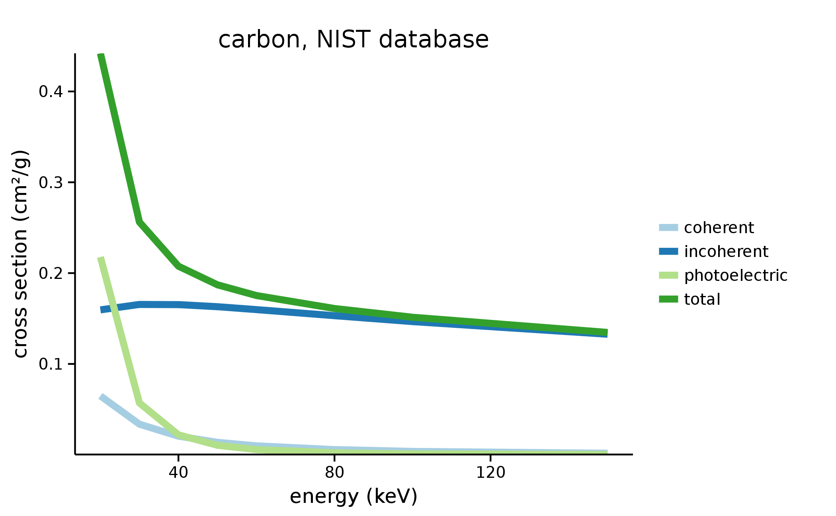
What is the Compton regime?
Energy > 40-50 keV for biomedical applications
Matteo Abis – XNPIG2015
2

Slide 3
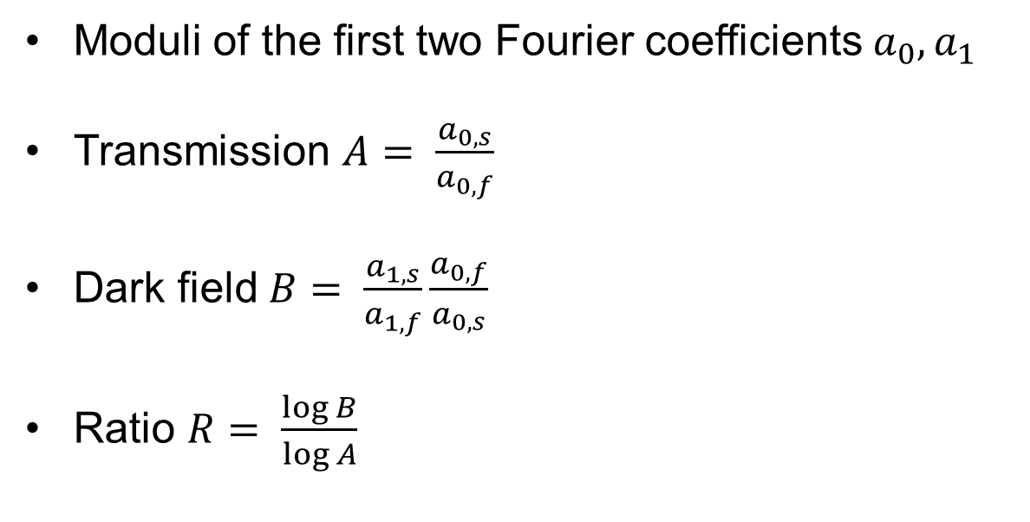
Signals from phase stepping curves
Moduli of the first two Fourier coefficients $a_{0},a_{1}$
Transmission $A= \frac{a_{0,s}}{a_{0,f}}$
Dark field $B= \frac{a_{1,s}}{a_{1,f}}\frac{a_{0,f}}{a_{0,s}}$
Ratio $R= \frac{\log{B}}{\log{A}}$
Matteo Abis – XNPIG2015
3

Slide 4
The ratio $R$in literature below 40 kVp
Independent of thickness
Depends on atomic number
Depends on microstructure size
Wang and Stampanoni, Quantitative x-ray radiography using grating interferometry: a feasibility study, Phys. Med. Biol., 2013
Scherer et al., Non-invasive Differentiation of Kidney Stone Types using X-ray Dark-Field Radiography, Sci. Rep., 2015
Matteo Abis – XNPIG2015
4

Slide 5
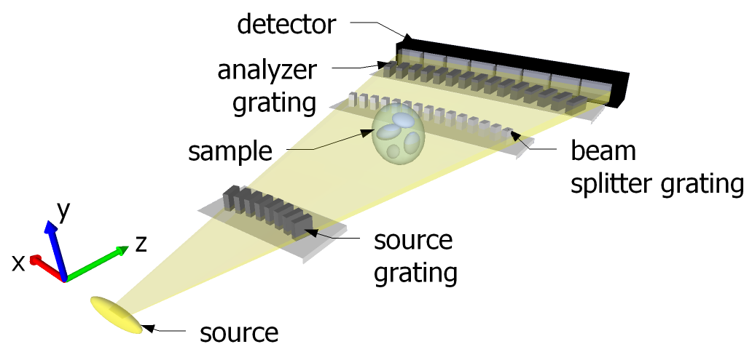
Edge-on illumination for experiments at 160 kVp
Matteo Abis – XNPIG2015
5

Slide 6
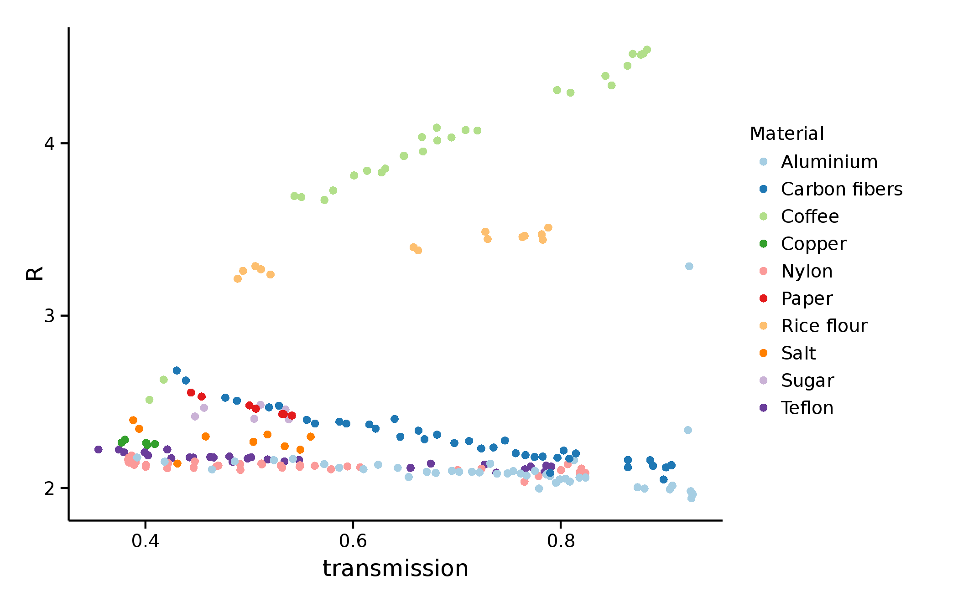
Experiment at 160 kVp
Matteo Abis – XNPIG2015
6

Slide 7
Experiment at 160 kVp
R independent of thickness
R depends on atomic number
R depends on microstructures
Matteo Abis – XNPIG2015
7

Slide 8
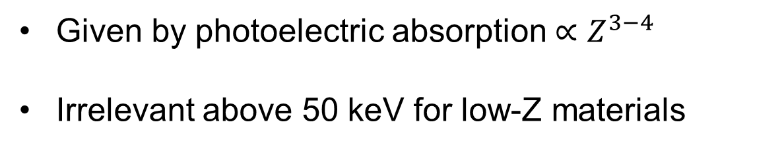
No Z information
Given by photoelectric absorption ${∝Z}^{3−4}$
Irrelevant above 50 keV for low-Z materials
Matteo Abis – XNPIG2015
8

Slide 9
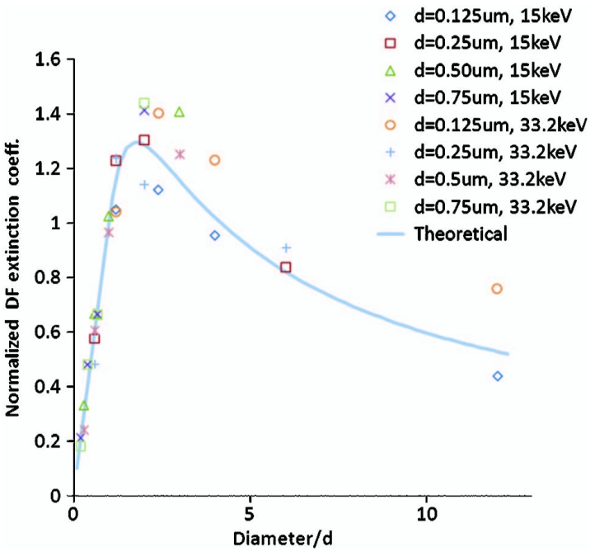
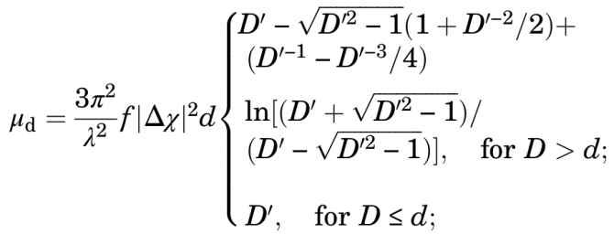
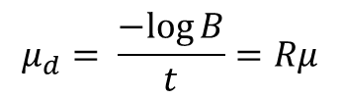
Microstructures
Lynch et al. 2011, synchrotron experiment and analytical description
$$μ_{d}= \frac{−log{B}}{t}=Rμ$$
Matteo Abis – XNPIG2015
9

Slide 10
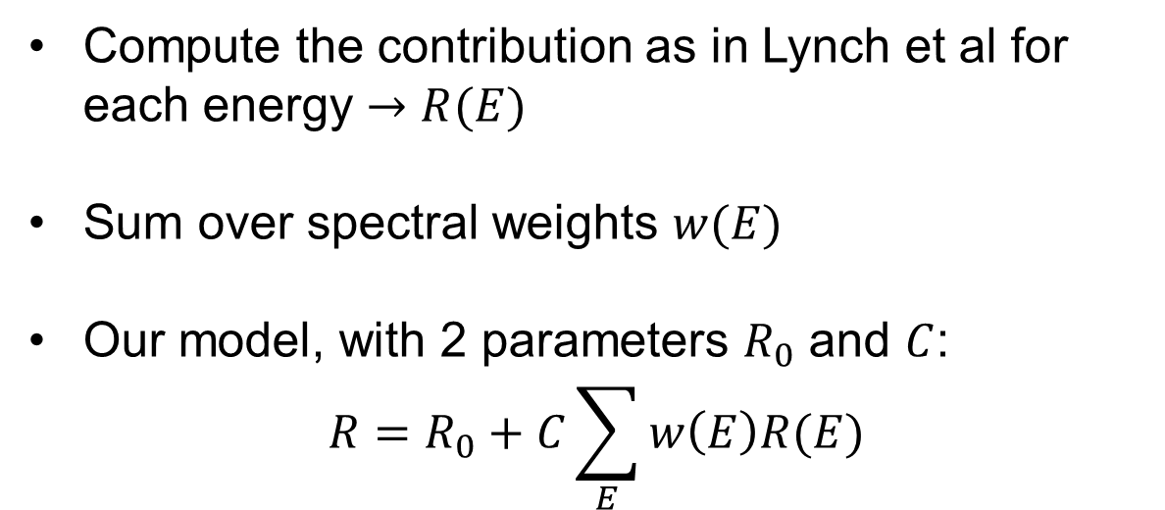
Microstructures on polychromatic sources
Compute the contribution as in Lynch et al for each energy $→R(E)$
Sum over spectral weights $w(E)$
Our model, with 2 parameters $R_{0}$ and $C$:
$$R=R_{0}+C\sum_{E}{w\left(E\right)R(E)}$$
Matteo Abis – XNPIG2015
10

Slide 11
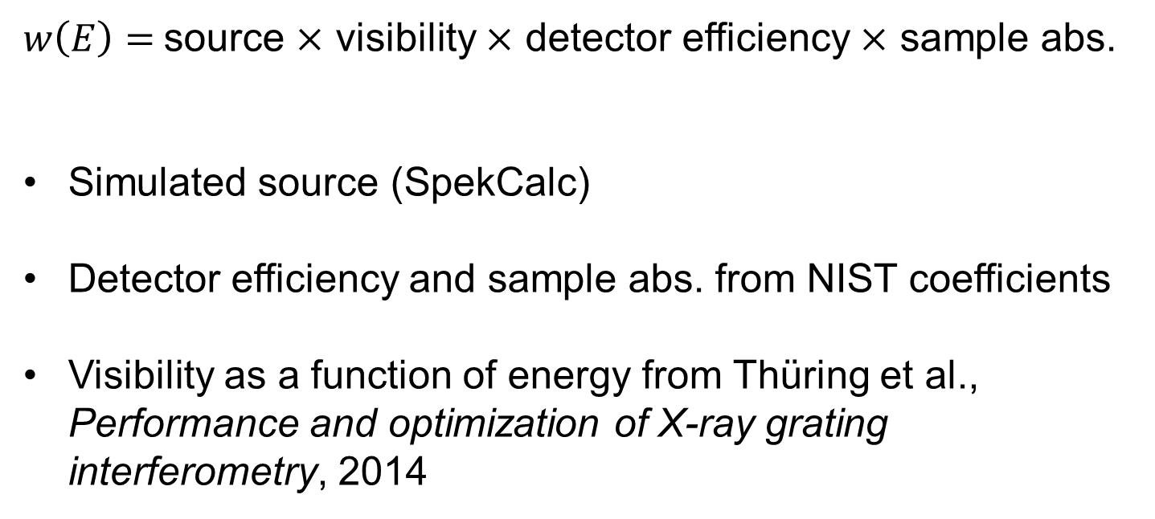
Spectral weights
$w\left(E\right)=$source $×$ visibility $×$ detector efficiency $×$ sample abs.
Simulated source (SpekCalc)
Detector efficiency and sample abs. from NIST coefficients
Visibility as a function of energy from Thüring et al., Performance and optimization of X-ray grating interferometry, 2014
Matteo Abis – XNPIG2015
11

Slide 12
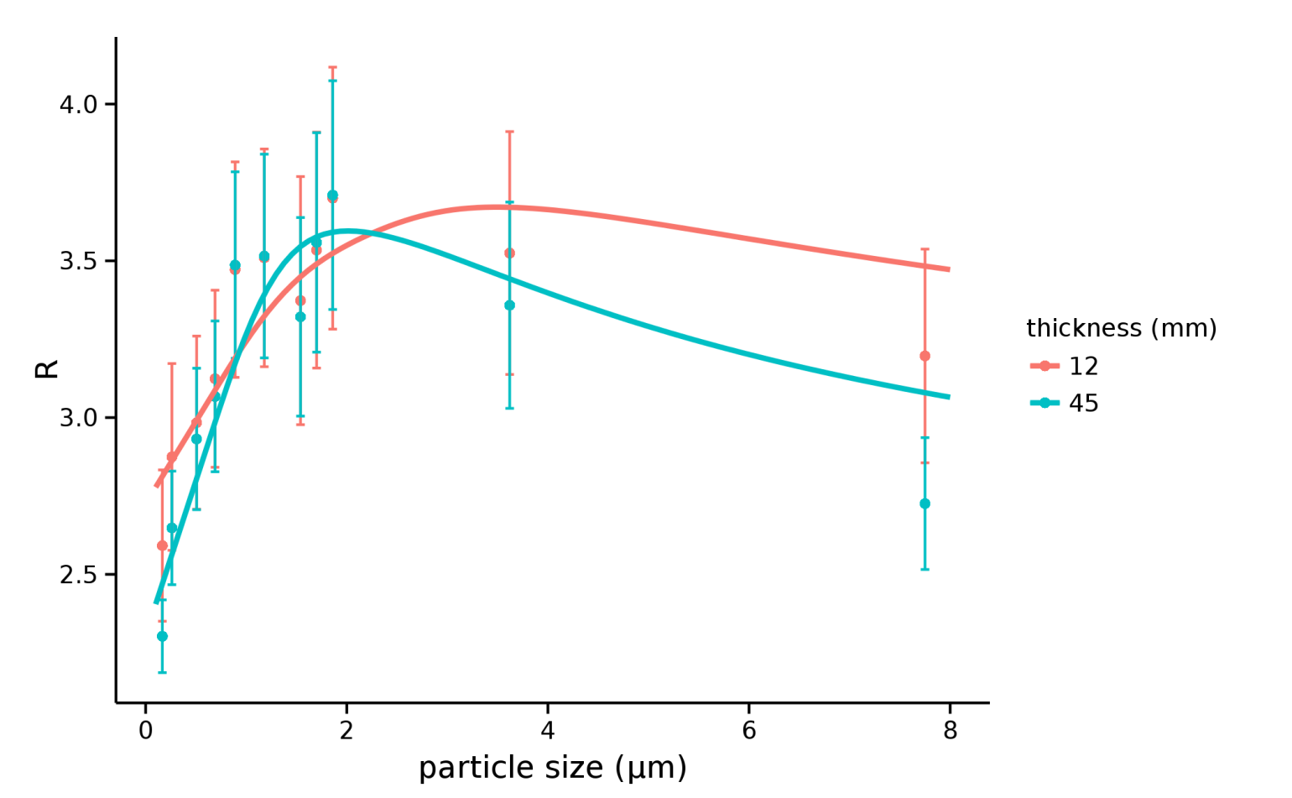
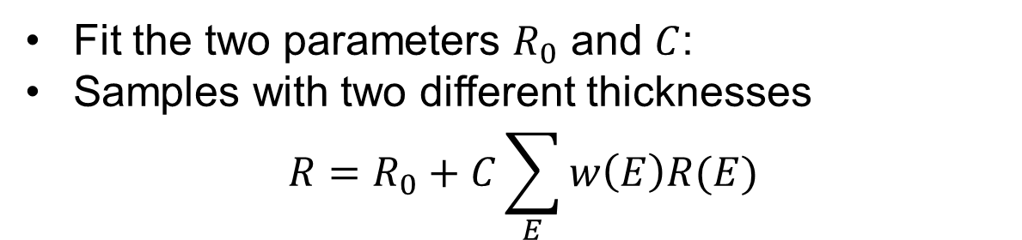
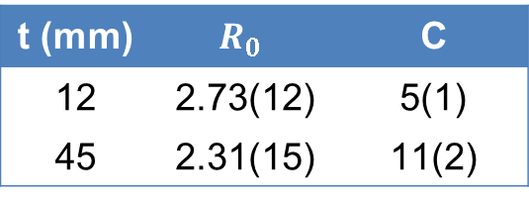
Silica microspheres 0.16 to 7.75 μm
Fit the two parameters $R_{0}$ and $C$:
Samples with two different thicknesses
$$R=R_{0}+C\sum_{E}{w\left(E\right)R(E)}$$
t (mm) | $$R_{0}$$ | C
12 | 2.73(12) | 5(1)
45 | 2.31(15) | 11(2)
Matteo Abis – XNPIG2015
12

Slide 13
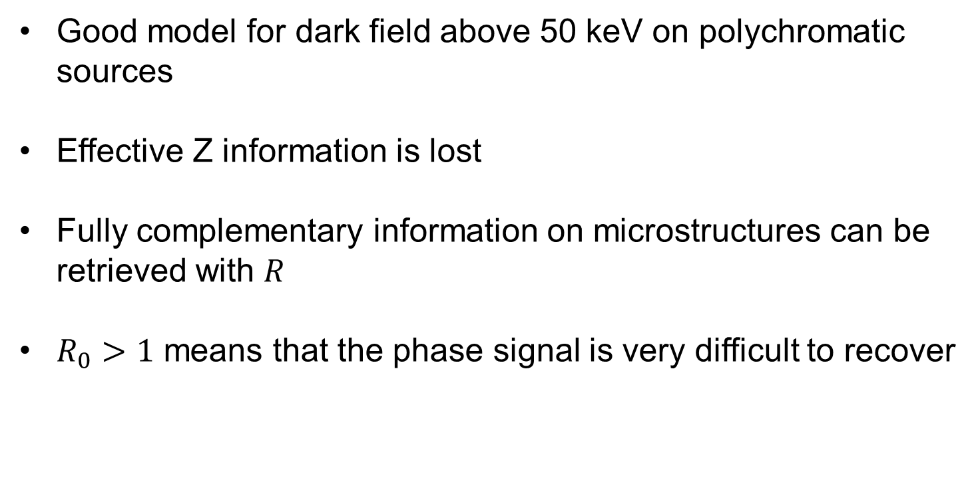
Conclusions
Good model for dark field above 50 keV on polychromatic sources
Effective Z information is lost
Fully complementary information on microstructures can be retrieved with $R$
$R_{0}>1$ means that the phase signal is very difficult to recover
Matteo Abis – XNPIG2015
13

Slide 14
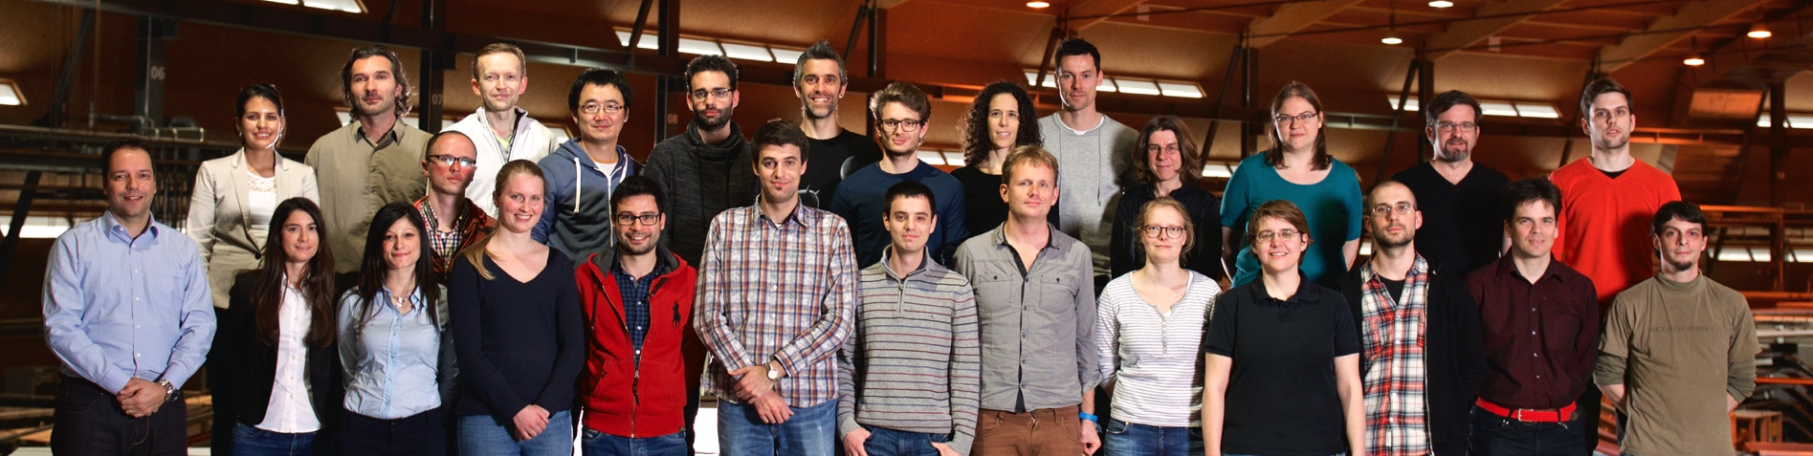


Acknowledgements
TOMCAT Team
14

Slide 15
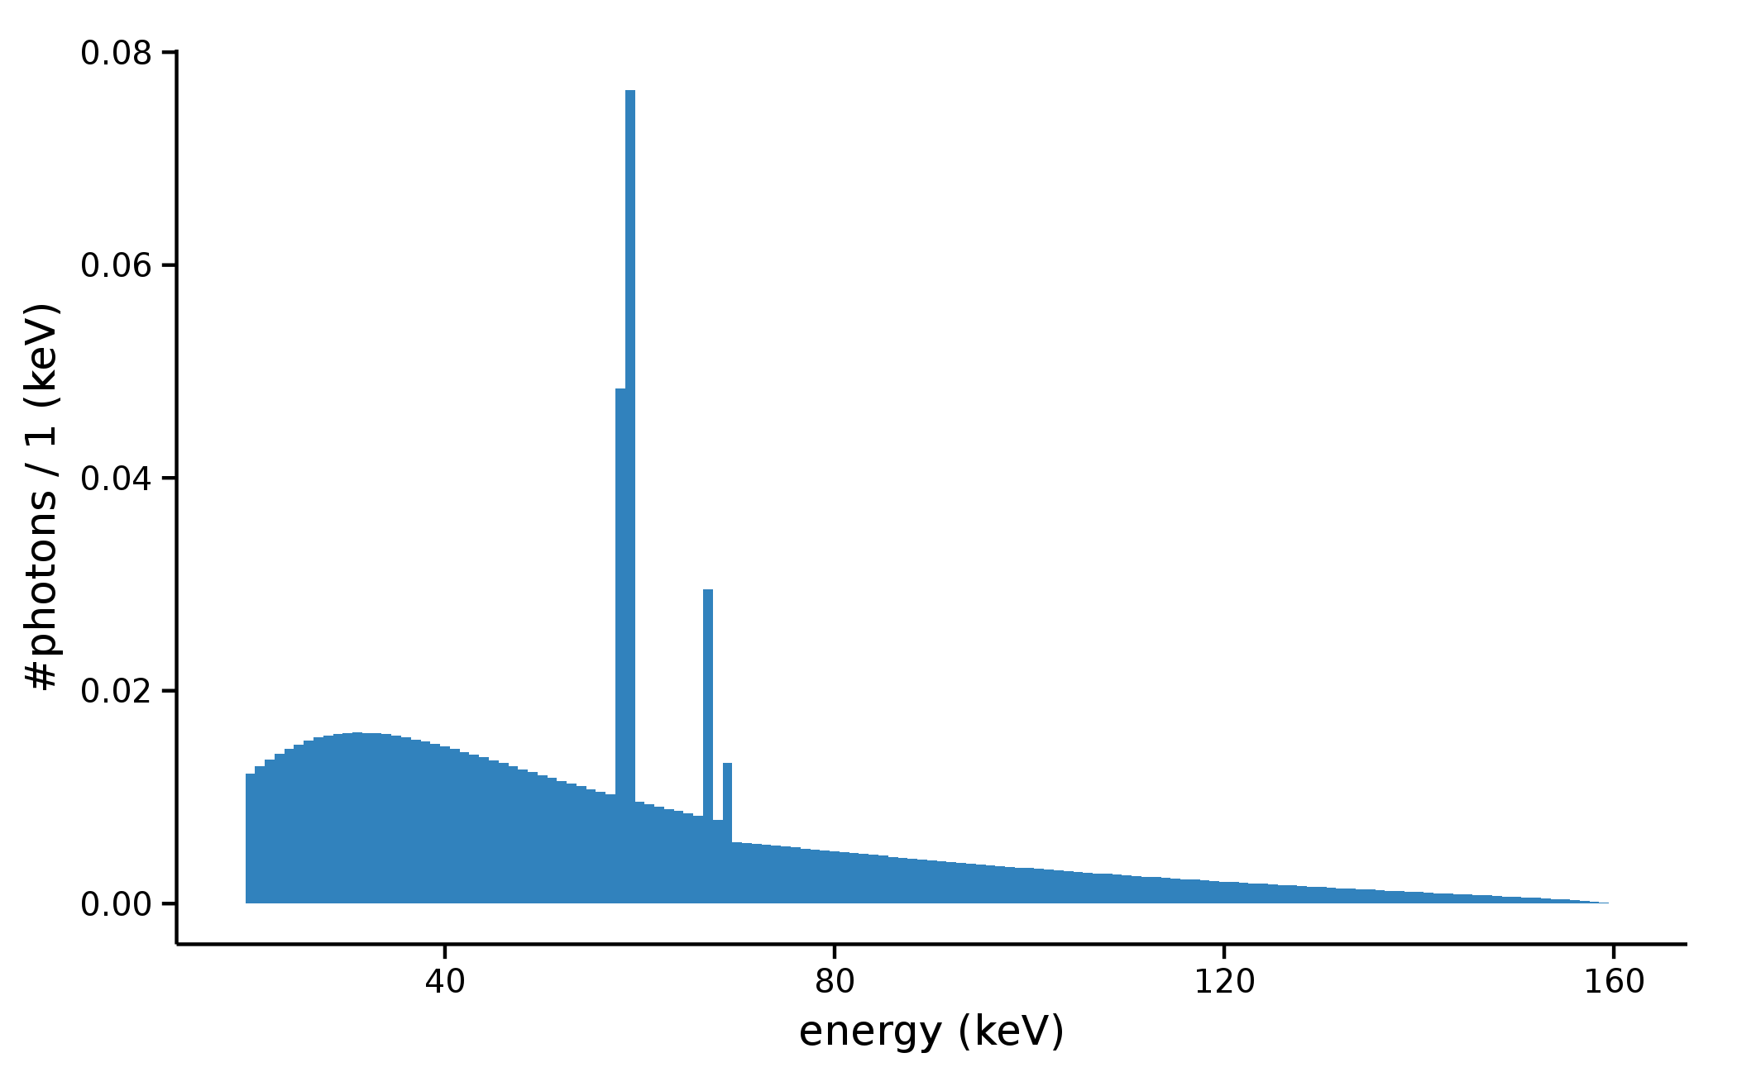
15

Slide 16
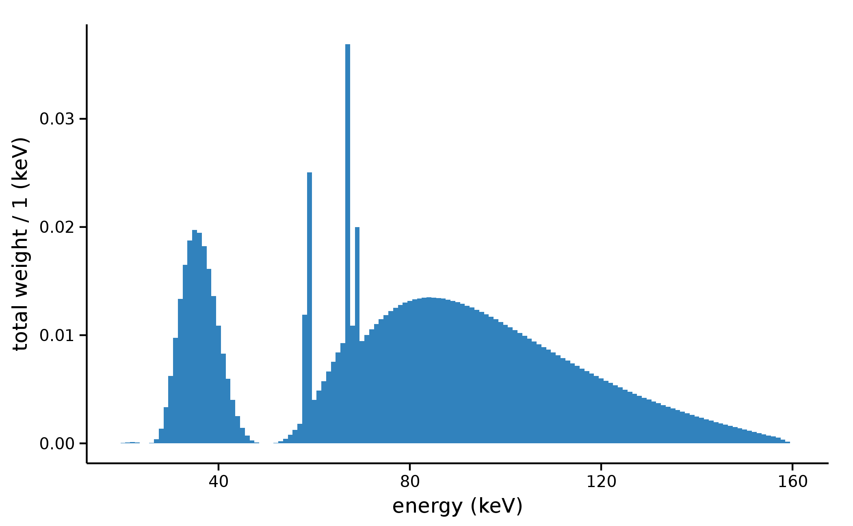
16

Slide 17
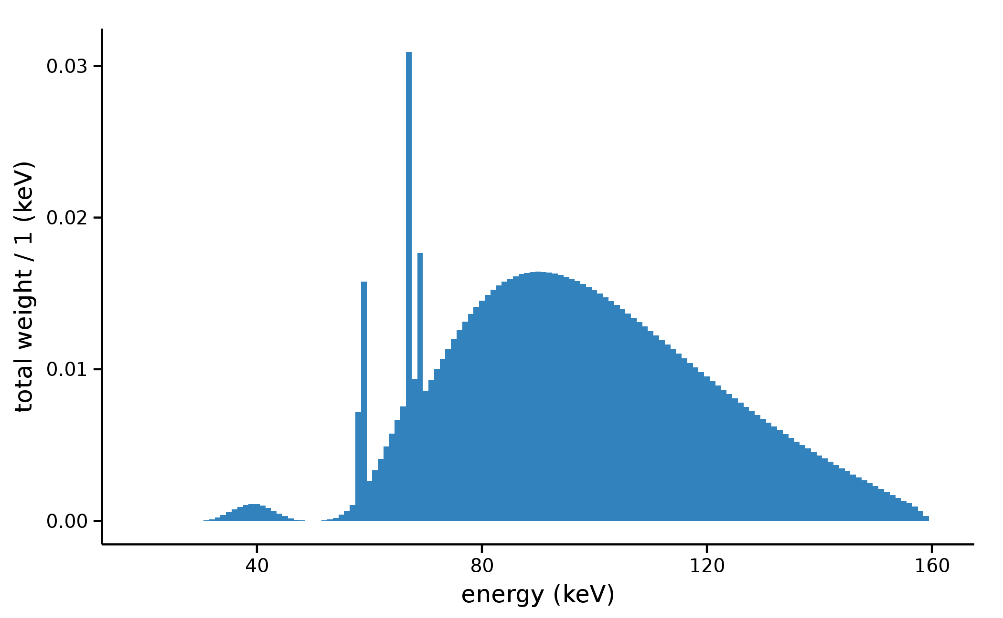
17

Slide 18
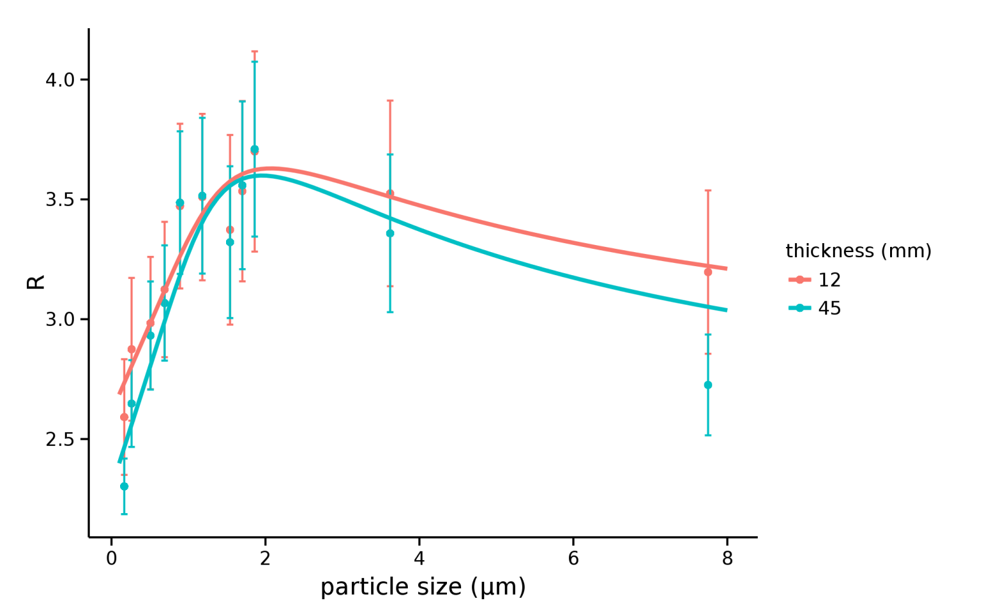
18

