Slide 1
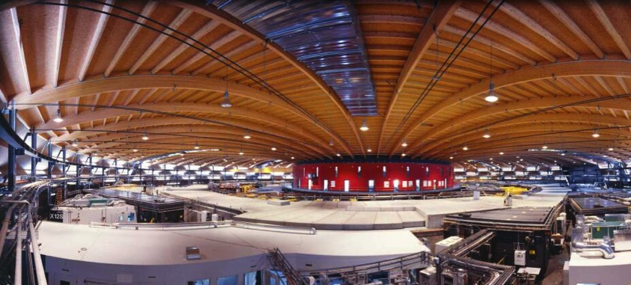
Dark field and transmission in the Compton regime
Matteo Abis, Pablo Villanueva Perez, Zhentian Wang, Marco Stampanoni
Institute for Biomedical Engineering, University and ETH Zürich, Zürich, Switzerland
Swiss Light Source, Paul Scherrer Institut, Villigen, Switzerland

Slide 2
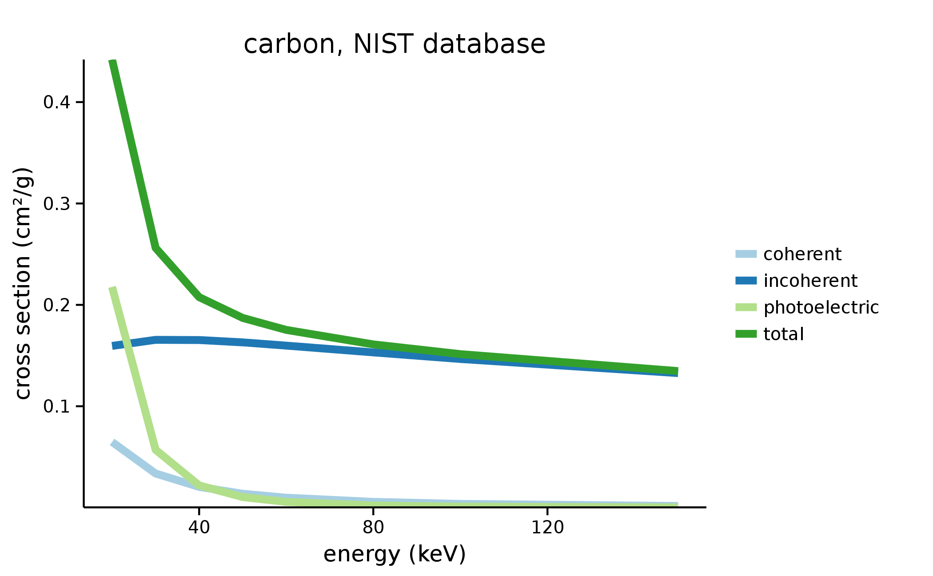
What is the Compton regime?
Energy > 40-50 keV for biomedical applications
Matteo Abis – XNPIG2015
<numero>

Slide 3
Signals from phase stepping curves
Moduli of the Fourier transform:
Matteo Abis – XNPIG2015
<numero>

Slide 4
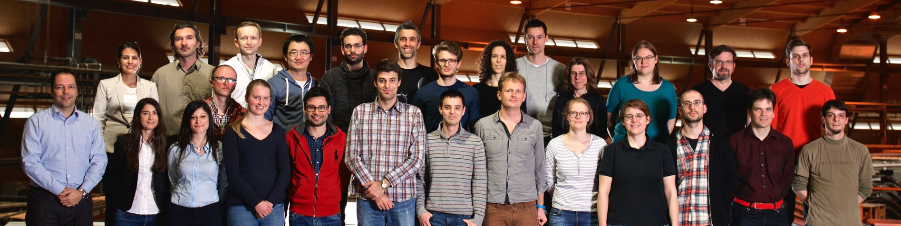


Acknowledgements
TOMCAT Team
<numero>

