Slide 1
E-Pay I am using
Takashi Niimura
Mar 13rd, 2019

Slide 2




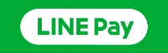


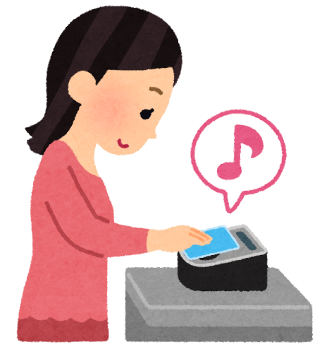
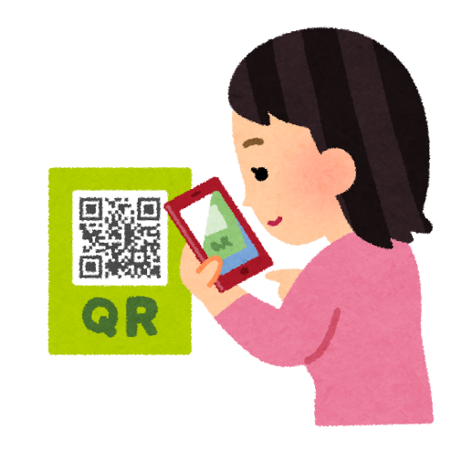
Type of E-pay
E-Money
QR Code
Easy to use
No need to run app
Good reduction rate
Good Coupon

Slide 3


E-Money payment services
iPhone | ✓ | ✗ | ✓
Train/Bus | ✗ | ✗ | ✓
Stores | 440,000 | 350,000 | 200,000
For daily use iD seems good
Suica is needed for transportation

Slide 4
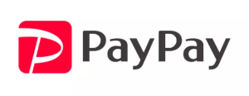
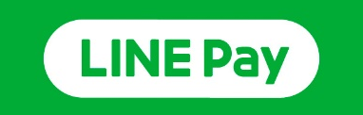
QR Code payment services
Reduction | 0.5% | 0.5%-2%
Campaign Reduction | 20% till end of May | 20% till end of Mar
PayPay seems Currently best
considering campaign

Slide 5
Conclusion
Daily use
iD
Transportation
Suica
Other case
PayPay

