Slide 1
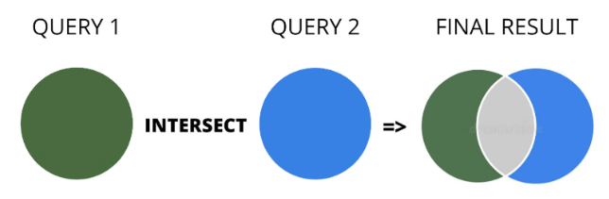
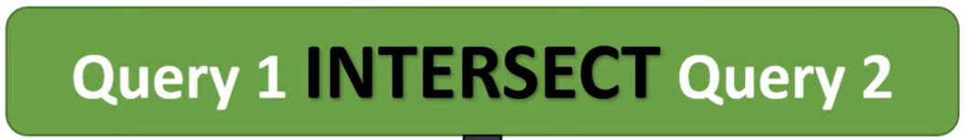

Slide 2
Ex 01: Basic INTERSECT usage

Slide 3
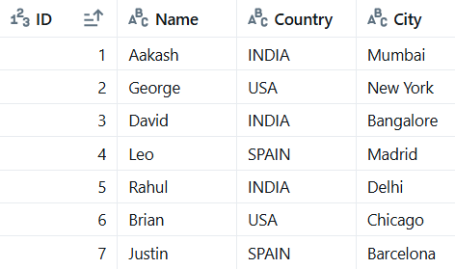
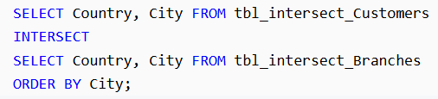
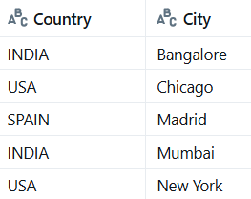
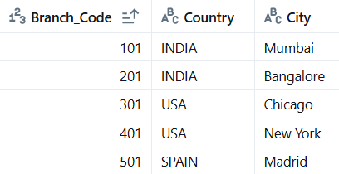
tbl_intersect_Customers
tbl_intersect_Branches

Slide 4
Ex 02: Common Customers in Two Tables

Slide 5
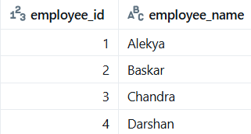
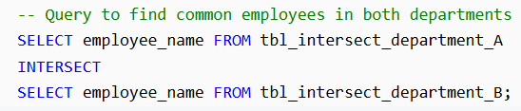
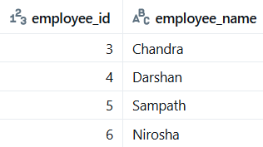
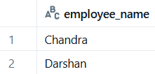
tbl_intersect_department_A
tbl_intersect_department_B

Slide 6
Ex 03: Different column orders, still works if data types and count match

Slide 7
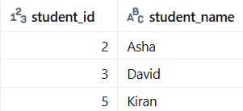

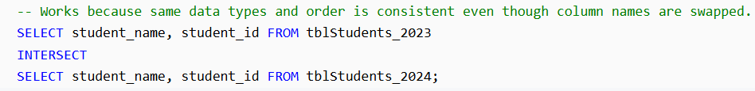
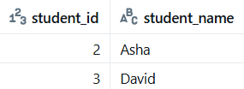
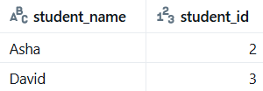
tblStudents_2023
tblStudents_2024
student_id | student_name
1 | John
2 | Asha
3 | David
4 | Priya

Slide 8
Ex 04: Case-sensitive match

Slide 9
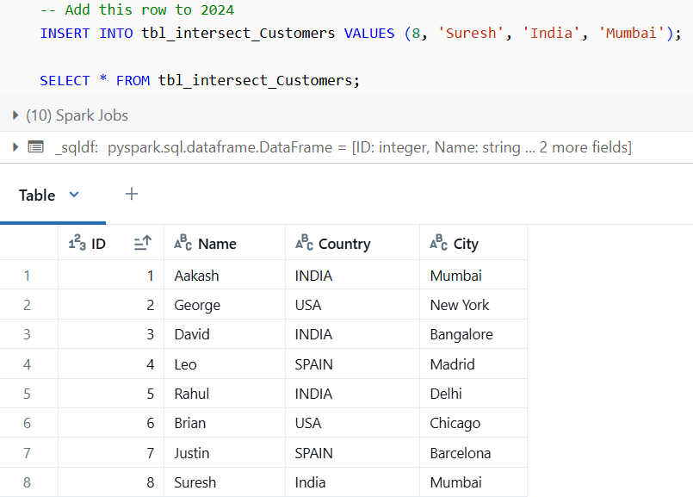

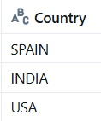
tbl_intersect_Customers
tbl_intersect_Branches
INTERSECT returns only distinct rows that appear in both result sets.

Slide 10
Ex 05: INTERSECT with Multiple Columns

Slide 11
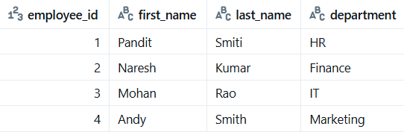
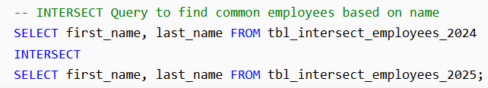
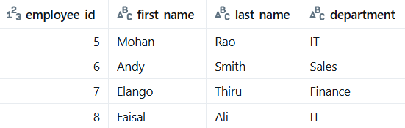
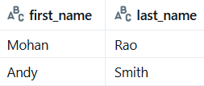
tbl_intersect_employees_2024
tbl_intersect_employees_2025

Slide 12
Ex 06: Common IDs with Conditions (Using INTERSECT with WHERE Clause)

Slide 13
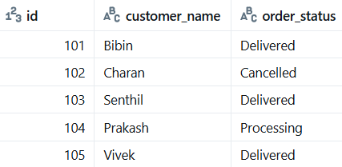
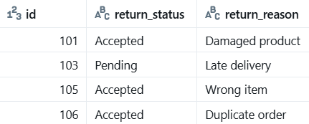


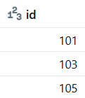
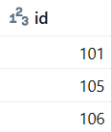
tbl_intersect_orders
tbl_intersect_returns

Slide 14
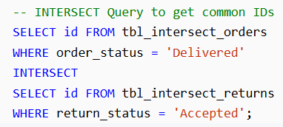
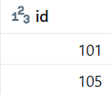

Slide 15
Ex 07: INTERSECT with BETWEEN Operator

Slide 16
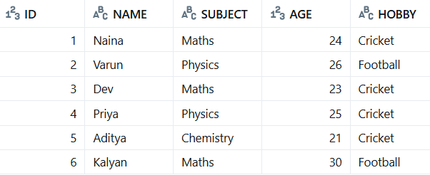
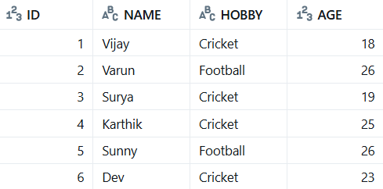

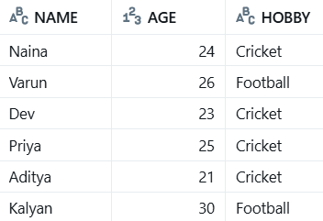
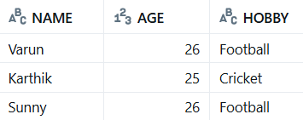
tbl_intersect_students
tbl_intersect_students_hobby

Slide 17
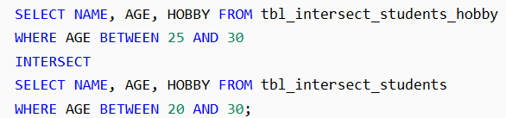


Slide 18
Ex 08: INTERSECT with IN Operator

Slide 19

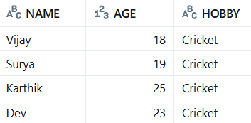
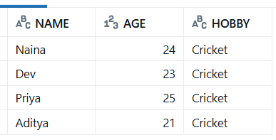
tbl_intersect_students_hobby
tbl_intersect_students
OUTER QUERY
OUTER QUERY
INNER QUERY
INNER QUERY

Slide 20
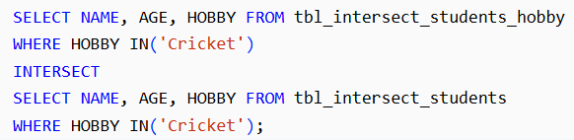

OUTER QUERY
OUTER QUERY
INNER QUERY
INNER QUERY

Slide 21
Ex 09: INTERSECT with LIKE Operator

Slide 22

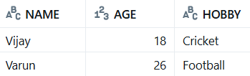

tbl_intersect_students_hobby
tbl_intersect_students

Slide 23
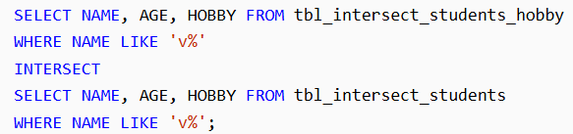


Slide 24
Ex 10: INTERSECT Inside a View or Subquery

Slide 25
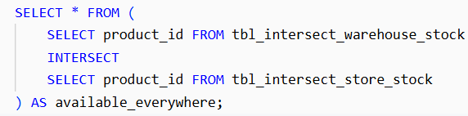
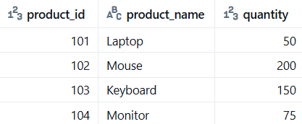
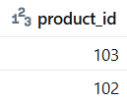
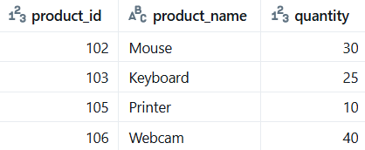
tbl_intersect_warehouse_stock
tbl_intersect_store_stock

