Slide 1
Time Series Analysis
Contributed by National Academy of Statistical Administration

Slide 2
Module objectives
Introduce time series
Components of time series
Deseasonalising a time series
Contributed by National Academy of Statistical Administration

Slide 3
What is a time series?
Essentially, Time Series is a sequence of numerical data obtained at regular time intervals.
Occurs in many areas: economics, finance, environment, medicine
The aims of time series analysis are
  to describe and summarize time series data,
  fit models, and make forecasts
Contributed by National Academy of Statistical Administration

Slide 4
Why are time series data different from other data?
Data are not independent
  Much of the statistical theory relies on the data being independent and identically distributed
Large samples sizes are good, but long time series are not always the best
  Series often change with time, so bigger isn’t always better
Contributed by National Academy of Statistical Administration

Slide 5
What Are Users Looking for in an Economic Time Series?
Important features of economic indicator series include
  Direction
  Turning points
  In addition, we want to see if the series is increasing/decreasing more slowly/faster than it was before
Contributed by National Academy of Statistical Administration
Notes:
Econometric models require seasonally adjusted data.

Slide 6
When should time series analysis best be used?
We do not assume the existence of deterministic model governing the behaviour of the system considered.
Instances where deterministic factors are not readily available and the accuracy of the estimate can be compromised on the need..(be careful!)
We will only consider univariate time series
Contributed by National Academy of Statistical Administration

Slide 7
Forecasting Horizons
Long Term
  5+ years into the future
  R&D, plant location, product planning
  Principally judgement-based
Medium Term
  1 season to 2 years
  Aggregate planning, capacity planning, sales forecasts
  Mixture of quantitative methods and judgement
Short Term
  1 day to 1 year, less than 1 season
  Demand forecasting, staffing levels, purchasing, inventory levels
  Quantitative methods
Contributed by National Academy of Statistical Administration

Slide 8
Examples of Time series data
Number of babies born in each hour
Daily closing price of a stock.
The monthly trade balance of Japan for each year.
GDP of the country, measured each year.
Contributed by National Academy of Statistical Administration

Slide 9
Time Series example
How the data (x) and time (t) is recorded and presented
Exports, 1989-1998
t
Year
x=Value
1
1989
44,320
2
1990
52,865
3
1991
53,092
4
1992
39,424
5
1993
34,444
6
1994
47,870
7
1995
49,805
8
1996
59,404
9
1997
70,214
10
1998
74,626
Contributed by National Academy of Statistical Administration

Slide 10
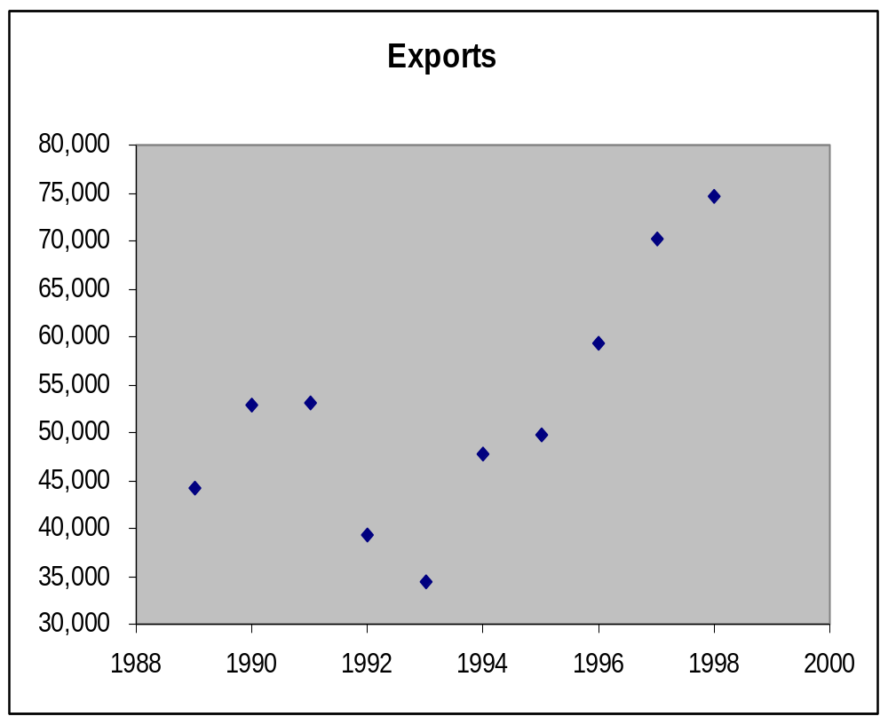
Time Series
Coordinates (t,x) is established in the 2 axis
(1, 44,320)
(2, 52,865)
(3, 53,092)
etc..
Contributed by National Academy of Statistical Administration

Slide 11
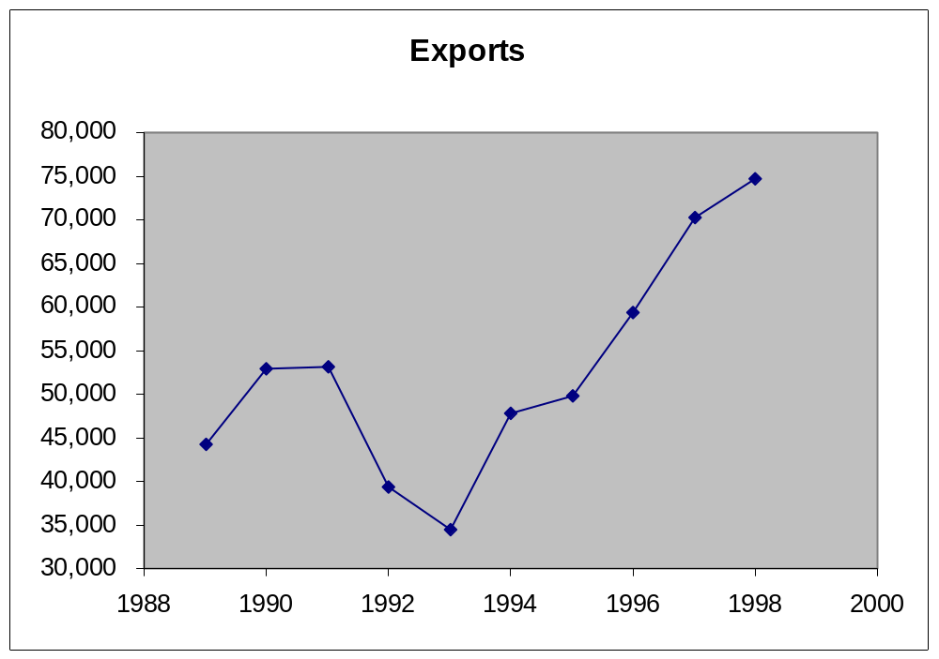
Time Series
A graphical representation of time series.
We use x as a function of t: x= f(t)
Data points connected by a curve
Contributed by National Academy of Statistical Administration

Slide 12

Importance of time series analysis
  Understand the past.
  What happened over the last years, months?
  Forecast the future.
  Government wants to know future of unemployment rate, percentage increase in cost of living etc.
  For companies to predict the demand for their product etc.
Contributed by National Academy of Statistical Administration

Slide 13




Time-Series Components
Trend
Cyclical
Time-Series
Seasonal
Random
Contributed by National Academy of Statistical Administration

Slide 14
Components of Time Series
Trend (Tt )
Seasonal variation (St )
Cyclical variation ( Ct )
Random variation (Rt ) or irregular
Contributed by National Academy of Statistical Administration

Slide 15
Components of Time Series
Trend (Tt )
Trend: the long-term patterns or movements in the data.
Overall or persistent, long-term upward or downward pattern of movement.
The trend of a time series is not always linear.
Contributed by National Academy of Statistical Administration

Slide 16
Seasonal variation (St )
Components of Time Series
Regular periodic fluctuations that occur within year.
Examples:
Consumption of heating oil, which is high in winter, and low in other seasons of year.
Gasoline consumption, which is high in summer when most people go on vacation.
Contributed by National Academy of Statistical Administration

Slide 17
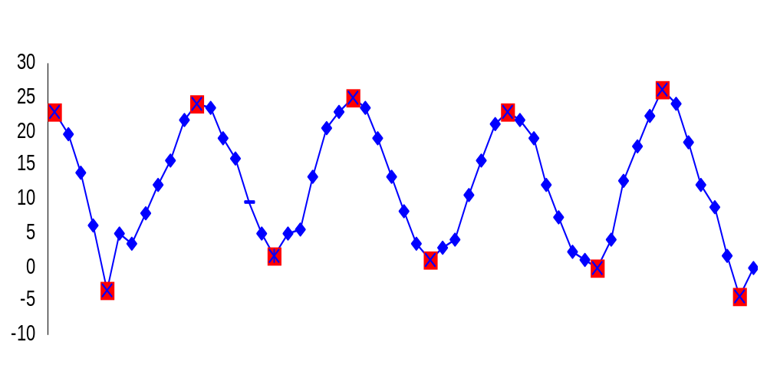
Components of Time Series
Seasonal variation (St )
Summer
Summer
Winter
Winter
Contributed by National Academy of Statistical Administration

Slide 18
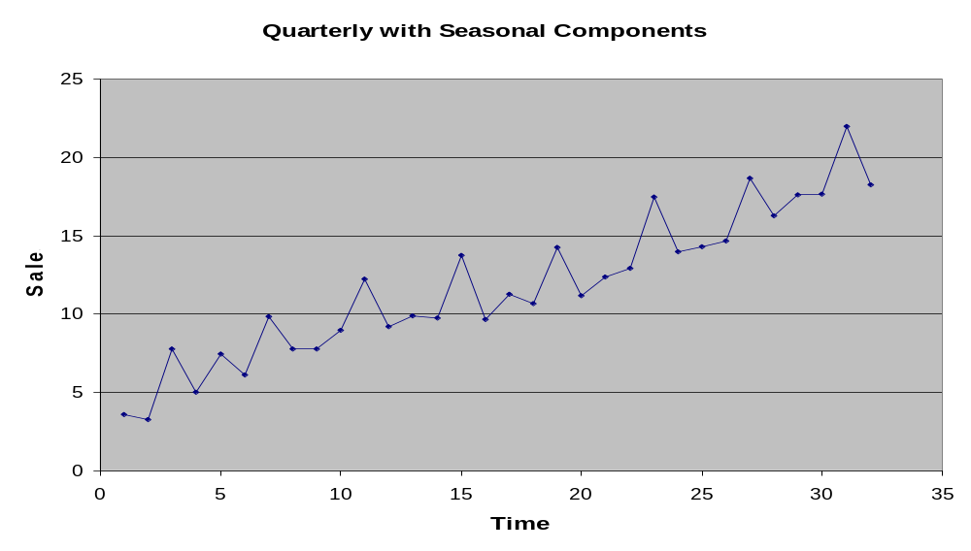
Example
Contributed by National Academy of Statistical Administration

Slide 19
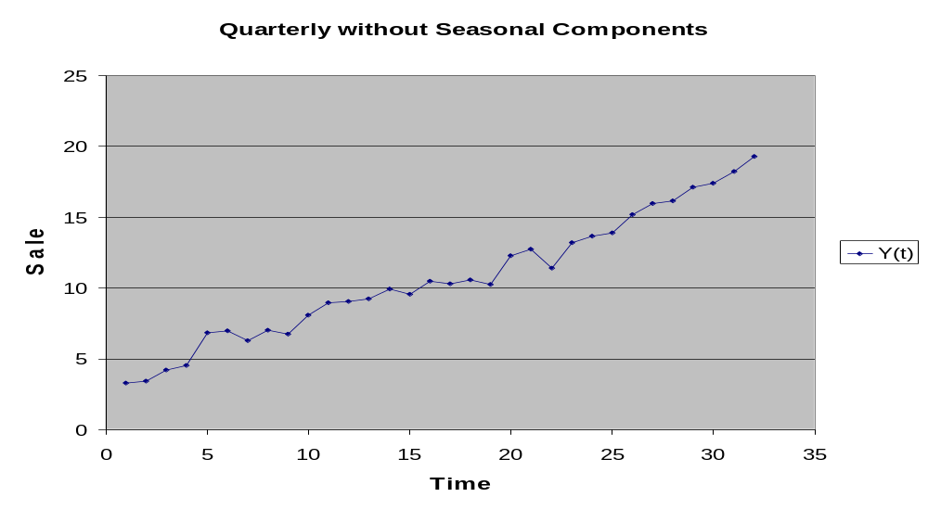
Seasonal Components Removed
Contributed by National Academy of Statistical Administration

Slide 20
Why Do Users Want Seasonally Adjusted Data?
Seasonal movements can make features difficult or impossible to see
Contributed by National Academy of Statistical Administration
Notes:
Econometric models require seasonally adjusted data.

Slide 21
Causes of Seasonal Effects
Possible causes are
  Natural factors
  Administrative or legal measures
  Social/cultural/religious traditions (e.g., fixed holidays, timing of vacations)
Contributed by National Academy of Statistical Administration

Slide 22
Components of Time Series
Cyclical variation ( Ct )
Cyclical variations are similar to seasonal variations. Cycles are often irregular both in height of peak and duration.
Examples:
Long-term product demand cycles.
Cycles in the monetary and financial sectors. (Important for economists!)
Contributed by National Academy of Statistical Administration

Slide 23
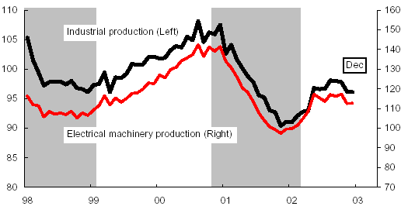
Cyclical Component
Long-term wave-like patterns
Regularly occur but may vary in length
Often measured peak to peak or trough to trough
1 Cycle
Sales
Year
Contributed by National Academy of Statistical Administration

Slide 24

Irregular Component
Unpredictable, random, “residual” fluctuations
Due to random variations of
  Nature
  Accidents or unusual events
“Noise” in the time series
Contributed by National Academy of Statistical Administration

Slide 25
Causes of Irregular Effects
Possible causes
  Unseasonable weather/natural disasters
  Strikes
  Sampling error
  Nonsampling error
Contributed by National Academy of Statistical Administration

Slide 26
Classical Decomposition
One method of describing a time series
Decompose the series into various components
  Trend – long term movements in the level of the series
  Seasonal effects – cyclical fluctuations reasonably stable in terms of annual timing (including moving holidays and working day effects)
  Cycles – cyclical fluctuations longer than a year
  Irregular – other random or short-term unpredictable fluctuations
Contributed by National Academy of Statistical Administration

Slide 27
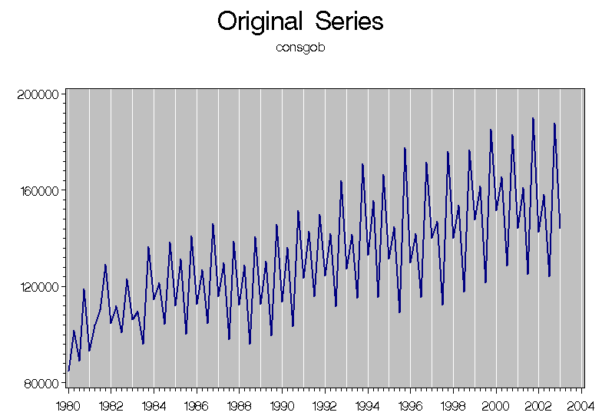
Not easy to understand the pattern!
Contributed by National Academy of Statistical Administration

Slide 28
Our aim
is to understand and identify different variations so that we can easily predict the future variations separately and combine together
Look how the above complicated series could be understood as follows separately
Contributed by National Academy of Statistical Administration

Slide 29
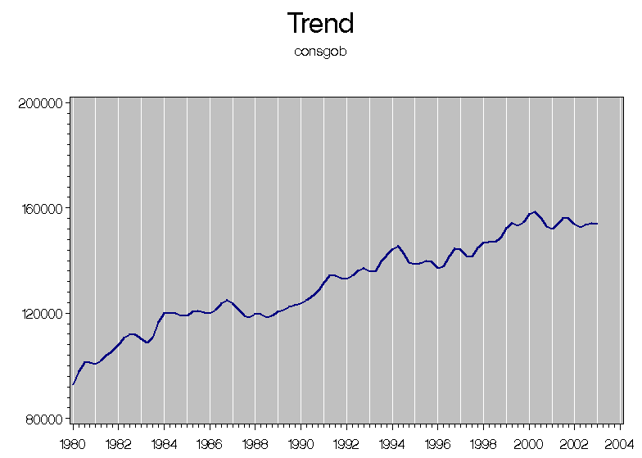
Contributed by National Academy of Statistical Administration

Slide 30
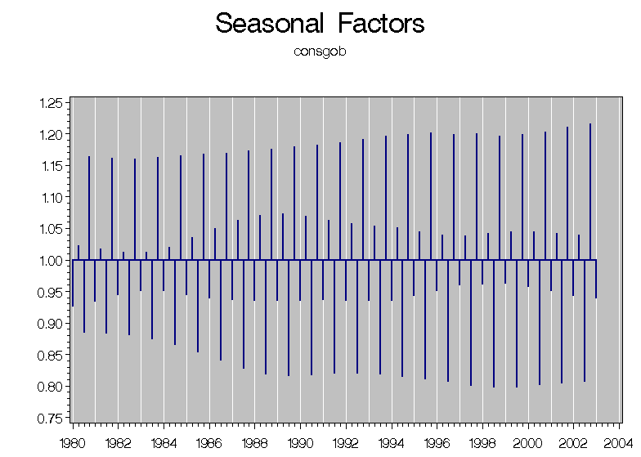
Contributed by National Academy of Statistical Administration

Slide 31
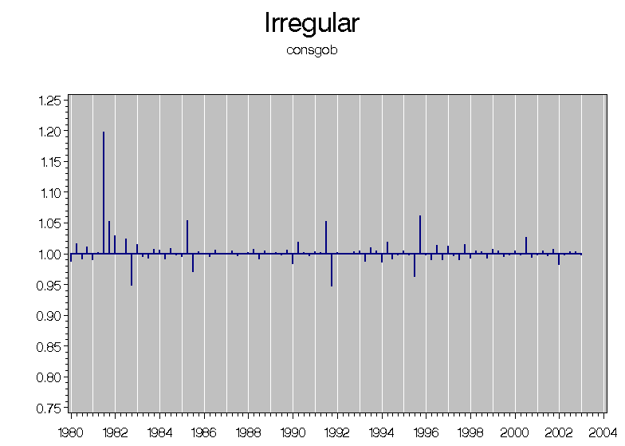
Contributed by National Academy of Statistical Administration

Slide 32
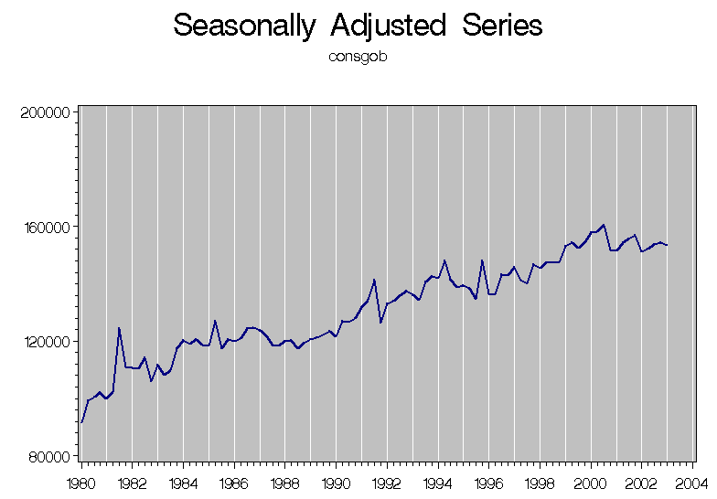
Contributed by National Academy of Statistical Administration

Slide 33
Few variations separately
Contributed by National Academy of Statistical Administration

Slide 34
Can you imagine how all components aggregate together to form this?
Contributed by National Academy of Statistical Administration

Slide 35
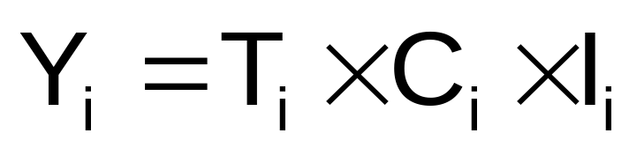
Multiplicative Time-Series Model for Annual Data
Used primarily for forecasting
Observed value in time series is the product of components
where T_{i} = Trend value at year i
C_{i} = Cyclical value at year i
I_{i} = Irregular (random) value at year i
Contributed by National Academy of Statistical Administration

Slide 36
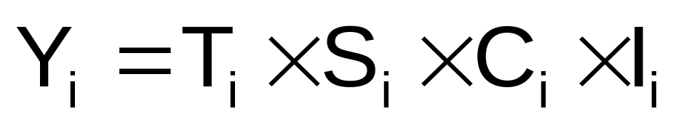
Multiplicative Time-Series Model with a Seasonal Component
Used primarily for forecasting
Allows consideration of seasonal variation
where T_{i} = Trend value at time i
S_{i} = Seasonal value at time i
C_{i} = Cyclical value at time i
I_{i} = Irregular (random) value at time i
Contributed by National Academy of Statistical Administration

Slide 37
Smoothing techniques
Smoothing helps to see overall patterns in time series data.
Smoothing techniques smooth or “iron” out variation to get the overall picture.
There are several smoothing techniques of time series.
Contributed by National Academy of Statistical Administration

Slide 38
Smoothing techniques
We will study :
Moving average.
Exponential smoothing
Contributed by National Academy of Statistical Administration

Slide 39
Smoothing the
Annual Time Series
Calculate moving averages to get an overall impression of the pattern of movement over time
Moving Average: averages of consecutive
time series values for a
chosen period of length L
Contributed by National Academy of Statistical Administration

Slide 40
Moving Averages
Used for smoothing
A series of arithmetic means over time
Result dependent upon choice of L (length of period for computing means)
Examples:
  For a 3 year moving average, L = 3
  For a 5 year moving average, L = 5
  Etc.
Contributed by National Academy of Statistical Administration

Slide 41
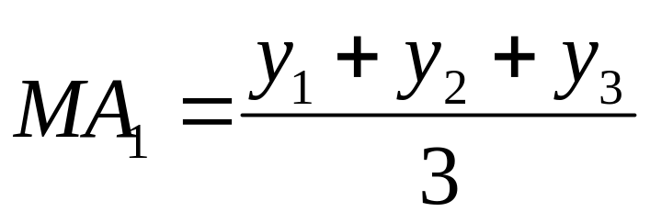
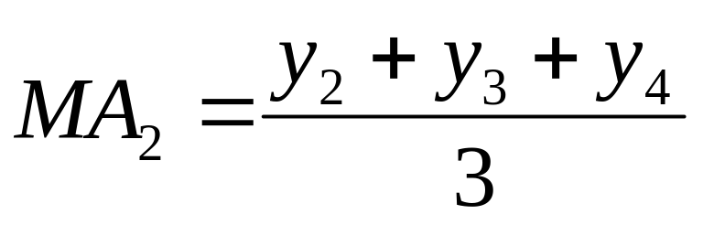
Smoothing techniques:
Moving Average (MA)
  Odd number of points. Points (k) – length for computing MA
  k=3
  and so on.
Contributed by National Academy of Statistical Administration

Slide 42
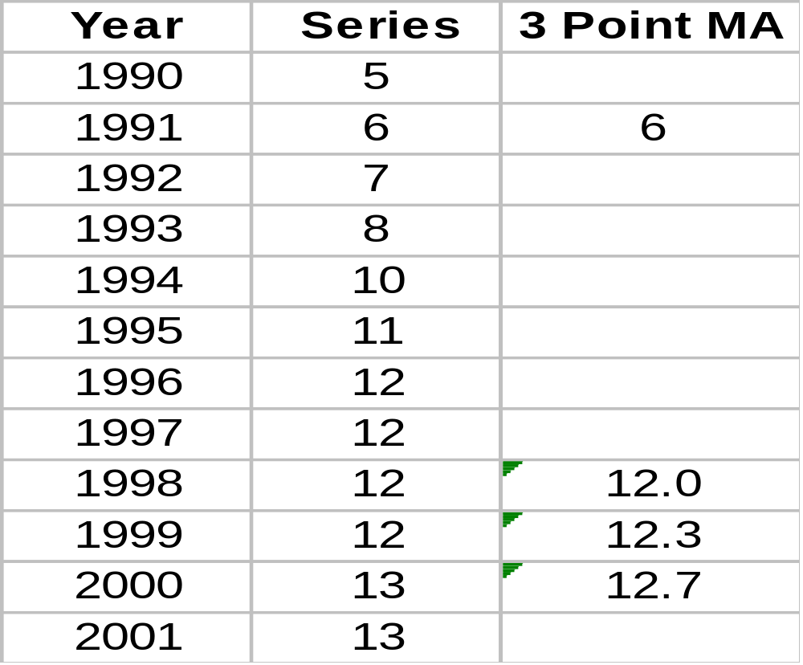


Smoothing techniques:
Moving Average (MA) k=3
Contributed by National Academy of Statistical Administration

Slide 43
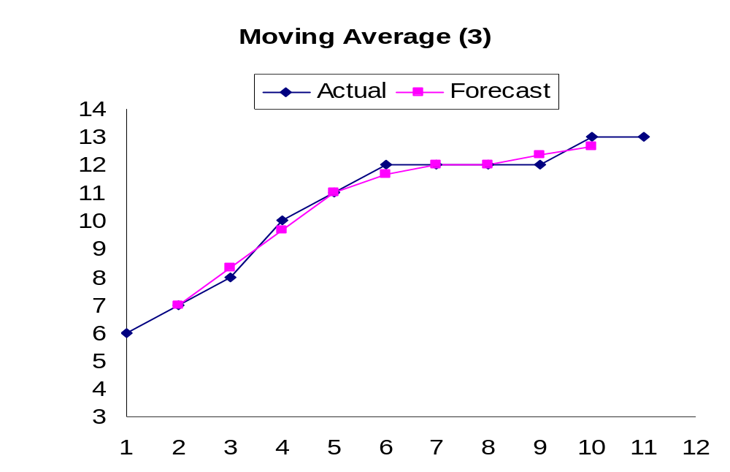
Smoothing techniques:
Moving Average (MA)
Contributed by National Academy of Statistical Administration

Slide 44
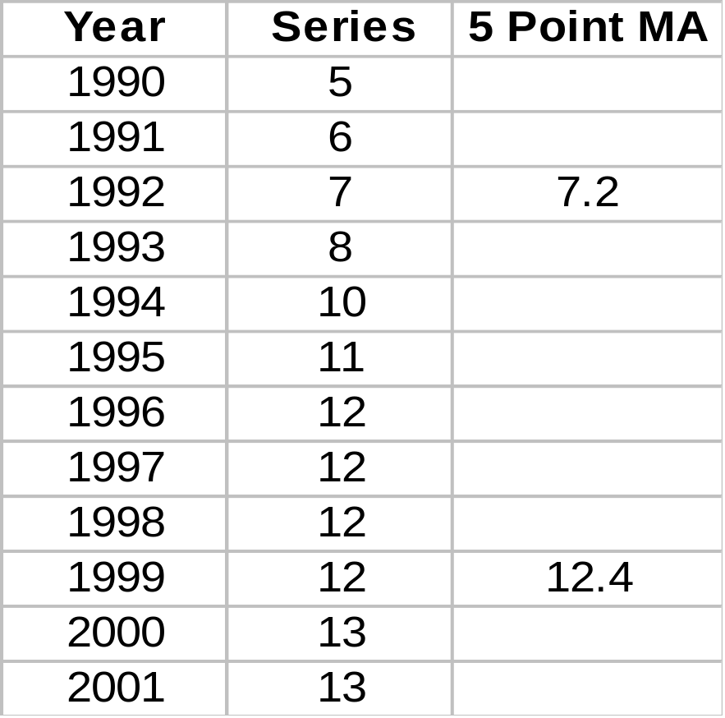
Smoothing techniques:
Moving Average (MA) k=5
Contributed by National Academy of Statistical Administration

Slide 45
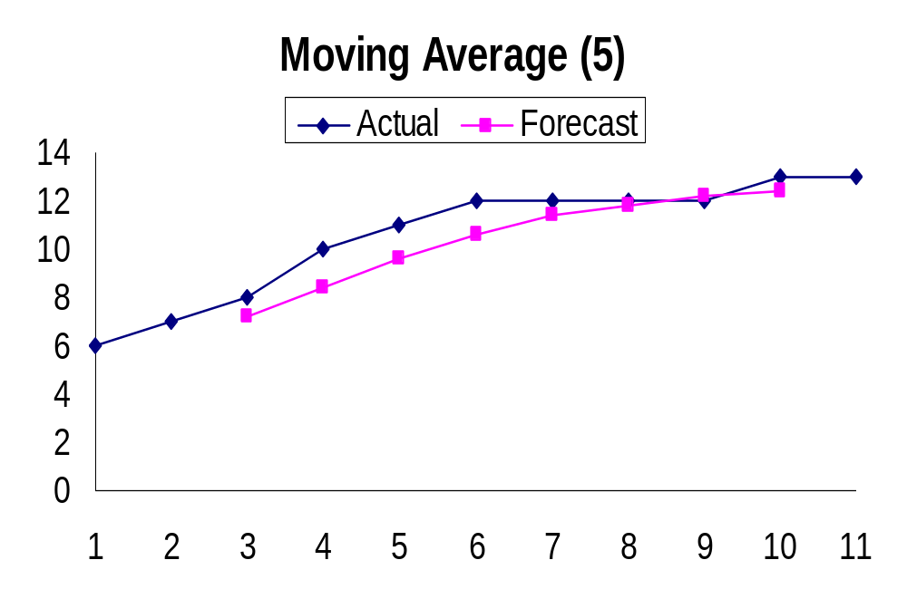
Smoothing techniques:
Moving Average (MA)
Contributed by National Academy of Statistical Administration

Slide 46
Smoothing techniques:
Moving Average (MA)
We need even numbered MA s for seasonal adjustments
  eg: 4 – quarterly data
  12 – monthly data
Contributed by National Academy of Statistical Administration

Slide 47
Smoothing techniques:
Moving Average (MA)
Even number of points.
Two stages:
1. Obtain MA, centered halfway between t and t-1.
2. To get a trend take the average of two successive estimates. Estimate centered halfway between t and t-1.
Contributed by National Academy of Statistical Administration

Slide 48
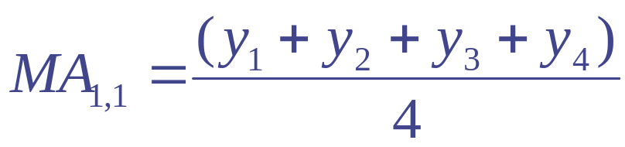
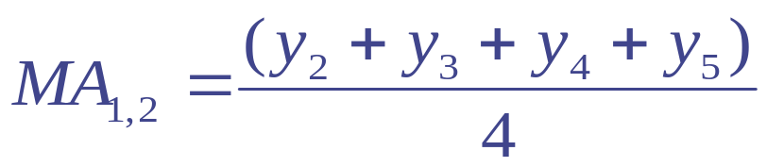
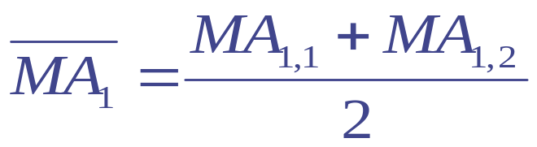
Smoothing techniques:
Moving Average (MA)
for k=4.
Stage 1.
Stage 2.
and so on.
Contributed by National Academy of Statistical Administration

Slide 49
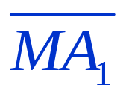
Smoothing techniques:
Moving Average (MA)
Series
MA stage 1
MA stage 2:
MA Centered
Observation
1
5
MA1,1
#NA
MA1,2
2
6
#NA
6.5
3
7
7.1
4
8
9.0
5
10
10.3
6
11
#NA
7
12
#NA
Contributed by National Academy of Statistical Administration

Slide 50
Measuring the seasonal effect
To measure seasonal effect construct seasonal indices.
Seasonal indices is a degree to which the seasons differ from one another.
Requirement: time series should be sufficiently long to allow to observe seasonal fluctuations.
Contributed by National Academy of Statistical Administration

Slide 51
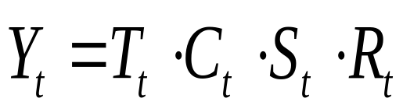
Measuring the seasonal effect
Computation:
  Calculating MA.
  Set the number of periods equal to the number of types of season.
  Use multiplicative model:
  MA remove St and Rt
Contributed by National Academy of Statistical Administration

Slide 52

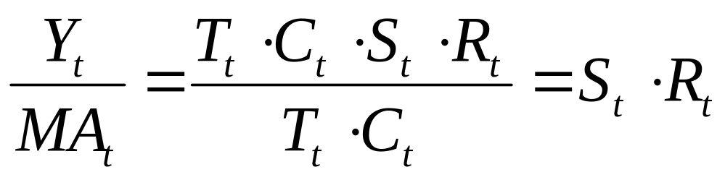
Measuring the seasonal effect
Calculate (step 1)
Compute the ratio (step 2):
For each type of season calculate the average of the ratios (step 3).
The seasonal indices are the average ratios from ratios step 3 adjusted.
Contributed by National Academy of Statistical Administration

Slide 53
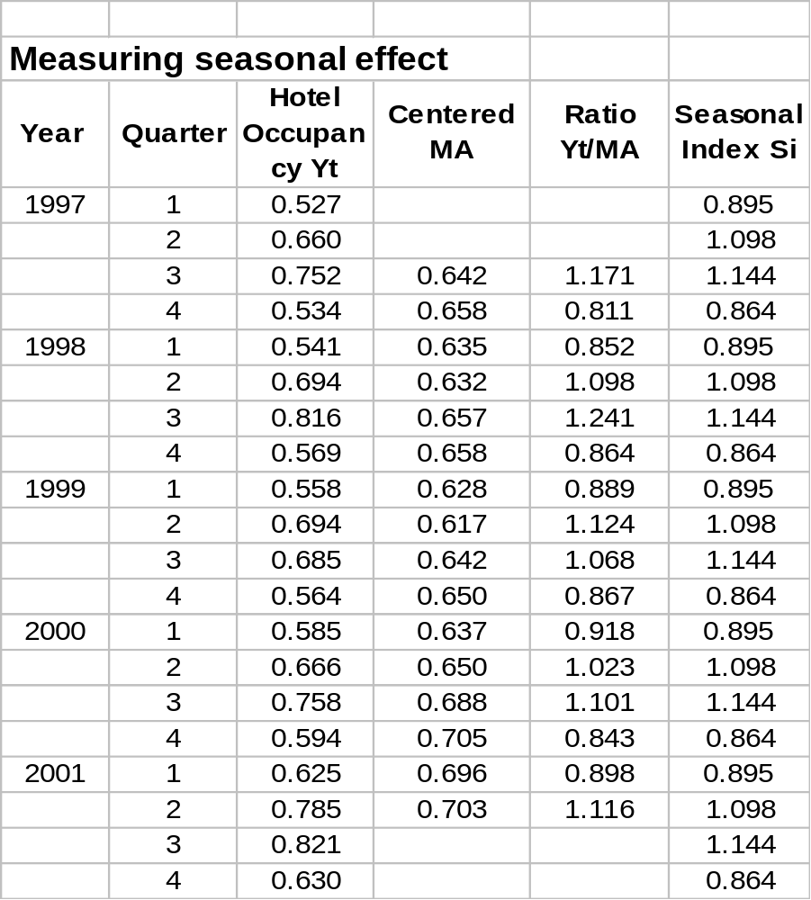
Step 1
Step 2
Step 3
(calculation see next slide)
Contributed by National Academy of Statistical Administration

Slide 54
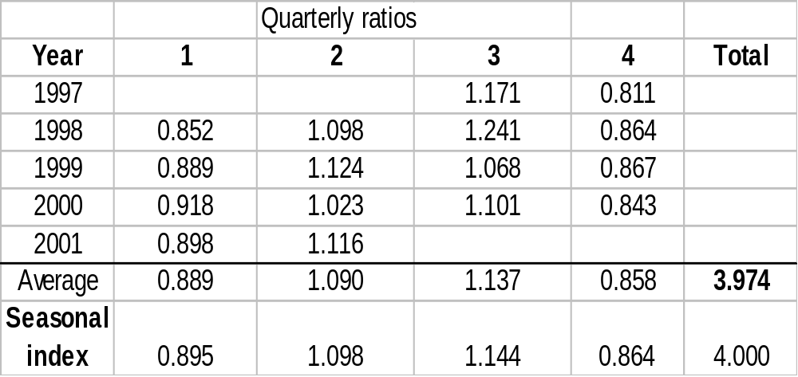
Calculating seasonal index
Example:
Seasonal index for Quarter 1 = 0.889/3.974*4.000=0.895
Contributed by National Academy of Statistical Administration

Slide 55
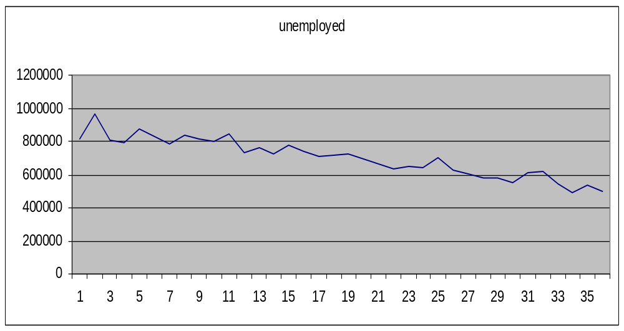
Negative trend is also a trend..
Contributed by National Academy of Statistical Administration

Slide 56
Exercise
Plot the time series in unemployment.xls
Compute quarterly (seasonal) indices. .
Plot components separately and show them in one graph
Contributed by National Academy of Statistical Administration

