Slide 1
Measuring Inequality
An examination of the purpose and techniques of inequality measurement

Slide 2
What is inequality?
From Merriam-Webster:
in·equal·i·ty
Function: noun
1 : the quality of being unequal or uneven: as a : lack of evenness b : social disparity c : disparity of distribution or opportunity d : the condition of being variable : changeableness
2 : an instance of being unequal

Slide 3
Our primary interest is in economic inequality.
In this context, inequality measures the disparity between a percentage of population and the percentage of resources (such as income) received by that population.
Inequality increases as the disparity increases.

Slide 4
If a single person holds all of a given resource, inequality is at a maximum. If all persons hold the same percentage of a resource, inequality is at a minimum.
Inequality studies explore the levels of resource disparity and their practical and political implications.

Slide 5
Economic Inequalities can occur for several reasons:
Physical attributes – distribution of natural ability is not equal
Personal Preferences – Relative valuation of leisure and work effort differs
Social Process – Pressure to work or not to work varies across particular fields or disciplines
Public Policy – tax, labor, education, and other policies affect the distribution of resources

Slide 6
Why measure Inequality?
Measuring changes in inequality helps determine the effectiveness of policies aimed at affecting inequality and generates the data necessary to use inequality as an explanatory variable in policy analysis.

Slide 7
How do we measure Inequality?
Before choosing an inequality measure, the researcher must ask two additional questions:
Does the research question require the inequality metric to have particular properties (inflation resistance, comparability across groups, etc)?
What metric best leverages the available data?

Slide 8
Choosing the best metric
Some popular measures include:
Range
Range Ratio
The McLoone Index
The Coefficient of Variation
The Gini Coefficient
Theil’s T Statistic

Slide 9

Range
The range is simply the difference between the highest and lowest observations.
Number of employees
Salary
2
$1,000,000
4
$200,000
6
$100,000
6
$60,000
8
$45,000
12
$24,000
In this example, the Range = $1,000,000-$24,000
= 976,000

Slide 10
Range
The range is simply the difference between the highest and lowest observations.
Pros
Easy to Understand
Easy to Compute
Cons
Ignores all but two of the observations
Does not weight observations
Affected by inflation
Skewed by outliers

Slide 11
Range Ratio
The Range Ratio is computed by dividing a value at one predetermined percentile by the value at a lower predetermined percentile.
Number of employees
Salary
95 percentile
Approx. equals
36th person
2
$1,000,000
4
$200,000
5 percentile
Approx. equals
2nd person
6
$100,000
6
$60,000
8
$45,000
12
$24,000
In this example, the Range Ratio=200,000/24,000 =8.33
Note: Any two percentiles can be used in producing a Range Ratio. In some contexts, this 95/5 ratio is referred to as the Federal Range Ratio.

Slide 12
Range Ratio
The Range Ratio is computed by dividing a value at one predetermined percentile by the value at a lower predetermined percentile.
Pros
Easy to understand
Easy to calculate
Not skewed by severe outliers
Not affected by inflation
Cons
Ignores all but two of the observations
Does not weight observations

Slide 13
The McLoone Index
The McLoone Index divides the summation of all observations below the median, by the median multiplied by the number of observations below median.
Number of employees
Salary
2
1,000,000.00
4
200,000.00
6
100,000.00
Observations
below
median
6
60,000.00
8
45,000.00
12
24,000.00
In this example, the summation of observations below the
median = 603,000, and the median = 45,000
Thus, the McLoone Index = 603,000/(45,000(19)) = .7053

Slide 14
The McLoone Index
The McLoone Index divides the summation of all observations below the median, by the median multiplied by the number of observations below median.
Pros
Easy to understand
Conveys comprehensive information about the bottom half
Cons
Ignores values above the median
Relevance depends on the meaning of the median value

Slide 15
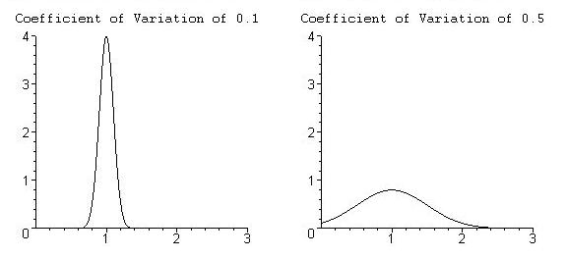
The Coefficient of Variation
The Coefficient of Variation is a distribution’s standard deviation divided by its mean.
Both distributions above have the same mean, 1, but the standard deviation is much smaller in the distribution on the left, resulting in a lower coefficient of variation.

Slide 16
The Coefficient of Variation
The Coefficient of Variation is a distribution’s standard deviation divided by its mean.
Pros
Fairly easy to understand
If data is weighted, it is immune to outliers
Incorporates all data
Not skewed by inflation
Cons
Requires comprehensive individual level data
No standard for an acceptable level of inequality

Slide 17
The Gini Coefficient
The Gini Coefficient has an intuitive, but possibly unfamiliar construction.
To understand the Gini Coefficient, one must first understand the Lorenz Curve, which orders all observations and then plots the cumulative percentage of the population against the cumulative percentage of the resource.

Slide 18
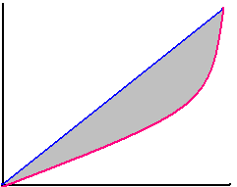
The Gini Coefficient
An equality diagonal represents perfect equality: at every point, cumulative population equals cumulative income.
The Lorenz curve measures the actual distribution of income.
Cumulative Income
A – Equality Diagonal Population = Income
B – Lorenz Curve
C – Difference Between Equality and Reality
A
C
B
Cumulative Population

Slide 19
The Gini Coefficient
Mathematically, the Gini Coefficient is equal to twice the area enclosed between the Lorenz curve and the equality diagonal.
When there is perfect equality, the Lorenz curve is the equality diagonal, and the value of the Gini Coefficient is zero.
When one member of the population holds all of the resource, the value of the Gini Coefficient is one.

Slide 20
The Gini Coefficient
Twice the area between the Lorenz curve and the equality diagonal.
Pros
Generally regarded as gold standard in economic work
Incorporates all data
Allows direct comparison between units with different size populations
Attractive intuitive interpretation
Cons
Requires comprehensive individual level data
Requires more sophisticated computations

Slide 21
Theil’s T Statistic
Theil’s T Statistic lacks an intuitive picture and involves more than a simple difference or ratio.
Nonetheless, it has several properties that make it a superior inequality measure.
Theil’s T Statistic can incorporate group-level data and is particularly effective at parsing effects in hierarchical data sets.

Slide 22
Theil’s T Statistic
Theil’s T Statistic generates an element, or a contribution, for each individual or group in the analysis which weights the data point’s size (in terms of population share) and weirdness (in terms of proportional distance from the mean).
When individual data is available, each individual has an identical population share (1/N), so each individual’s Theil element is determined by his or her proportional distance from the mean.

Slide 23
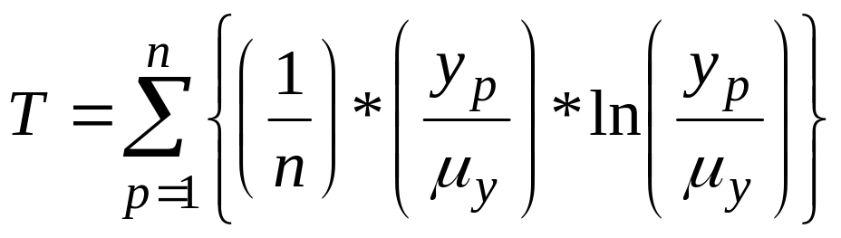
Theil’s T Statistic
Mathematically, with individual level data Theil’s T statistic of income inequality is given by:
where n is the number of individuals in the population, y_{p} is the income of the person indexed by p, and µ_{y} is the population’s average income.

Slide 24
Theil’s T Statistic
The formula on the previous slide emphasizes several points:
The summation sign reinforces the idea that each person will contribute a Theil element.
y_{p}/µ_{y} is the proportion of the individual’s income to average income.
The natural logarithm of y_{p} /µ_{y} determines whether the element will be positive (y_{p} /µ_{y} > 1); negative (y_{p} /µ_{y} < 1); or zero (y_{p} /µ_{y} = 0).

Slide 25
Theil’s T Statistic – Example 1
The following example assumes that exact salary information is known for each individual.
Number of employees
Exact Salary
2
$100,000
4
$80,000
6
$60,000
4
$40,000
2
$20,000
For this data, Theil’s T Statistic = 0.079078221
Individuals in the top salary group contribute large positive elements. Individuals in the middle salary group contribute nothing to Theil’s T Statistic because their salaries are equal to the population average. Individuals in the bottom salary group contribute large negative elements.

Slide 26
Theil’s T Statistic
Often, individual data is not available. Theil’s T Statistic has a flexible way to deal with such instances.
If members of a population can be classified into mutually exclusive and completely exhaustive groups, then Theil’s T Statistic for the population (T ) is made up of two components, the between group component (T’g) and the within group component (T^{w}g).

Slide 27
Theil’s T Statistic
Algebraically, we have:
T = T’_{g} + T^{w}_{g}
When aggregated data is available instead of individual data, T’_{g} can be used as a lower bound for Theil’s T Statistic in the population.

Slide 28
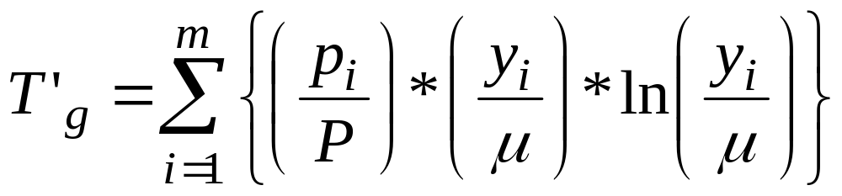
Theil’s T Statistic
The between group element of the Theil index has a familiar form:
where i indexes the groups, p_{i} is the population of group i, P is the total population, y_{i} is the average income in group i, and µ is the average income across the entire population.

Slide 29
Theil’s T Statistic – Example 2
Now assume the more realistic scenario where a researcher has average salary information across groups.
Number of employees in group
Group Average Salary
2
$95,000
4
$75,000
6
$60,000
4
$45,000
2
$25,000
For this data, T’_{g} = 0.054349998
The top salary two salary groups contribute positive elements. The middle salary group contributes nothing to the between group Theil’s T Statistic because the group average salary is equal to the population average. The bottom two salary groups contribute negative elements.

Slide 30
Group analysis with Theil’s T Statistic:
As Example 2 hints, Theil’s T Statistic is a powerful tool for analyzing inequality within and between various groupings, because:
The between group elements capture each group’s contribution to overall inequality
The sum of the between group elements is a reasonable lower bound for Theil’s T statistic in the population
Sub-groups can be broken down within the context of larger groups

Slide 31
Theil’s T Statistic
Pros
Can effectively use group data
Allows the researcher to parse inequality into within group and between group components
Cons
No intuitive motivating picture
Cannot directly compare populations with different sizes or group structures
Comparatively mathematically complex

Slide 32
Next Steps
Those interested in a more rigorous examination of inequality metrics with several numerical examples should proceed to The Theoretical Basics of Popular Inequality Measures.
Otherwise, proceed to A Nearly Painless Guide to Computing Theil’s T Statistic which emphasizes constructing research questions and using a spreadsheet to conduct analysis.

