Slide 1
Practical solutions for dealing with missing data
Rob Woods
Senior Consultant
Copyright 2003-4, SPSS Inc.

Slide 2

Common issues
Issues
Consequences of missing data
Is my data really missing?
How techniques deal with missing data
Solutions
Different approaches for dealing with missing data
Copyright 2003-4, SPSS Inc.

Slide 3
Issues
Copyright 2003-4, SPSS Inc.

Slide 4

Consequences of missing data
Descriptive statistics
  Missing data can distort descriptive statistics
  For example, if workers are surveyed
  about hours of work
    Shift workers are underrepresented in survey
    If shift workers work more hours but hours are more variable
    Overall worker mean and standard deviation of hours would be underestimated
Predictive modelling
  Most modelling techniques require complete set of independent variables in order to make a prediction
  Missing data can result in no prediction for a case
  Procedure may not run if data set contains high percentage of missing data
Copyright 2003-4, SPSS Inc.

Slide 5
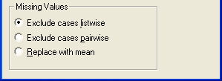
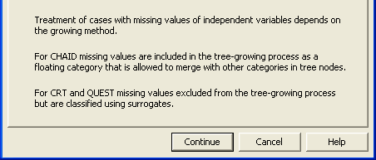
Model estimation: Missing values
Linear regression
Decision trees
Binary logistic regression
Multinomial logistic regression
Discriminant analysis
  Also listwise exclusion of missing values
  In order for a case to be scored a complete set of information on independent variables is required
Copyright 2003-4, SPSS Inc.

Slide 6
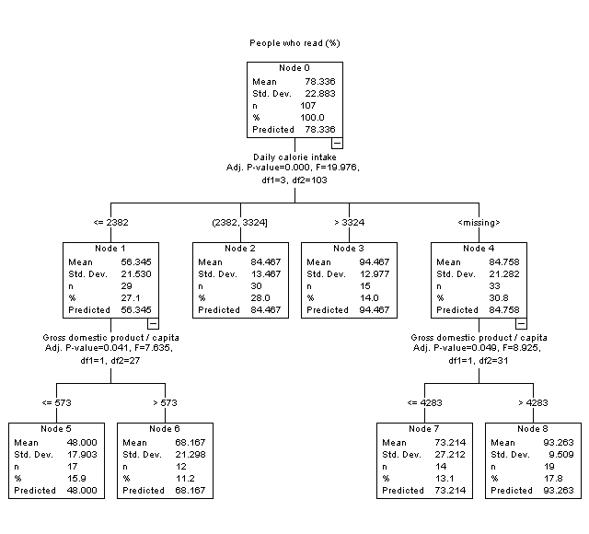
Example of decision tree
Copyright 2003-4, SPSS Inc.

Slide 7
Possible imputation modelling techniques
Missing value continuous
  Linear Regression
  Decision Trees
    C&RT
  Neural networks
    MLP
Missing value categorical
  Binary logistic regression
  Multinomial logistic regression
  Discriminant analysis
  Ordinal regression
  Decision Trees
    CHAID
    C5.0
    C&RT
  Neural Networks
    MLP
Copyright 2003-4, SPSS Inc.

Slide 8

Is my data really missing?
Always understand your data
  A field may appear to be missing
  but further investigations reveals it is…
  a ‘not applicable’ survey response
  In the commercial world data often not collected with analysis in mind
Is it a calculation you have made?
  Derived fields can create missing data
    eg. Log10(x) when x is 0 equals …
      Undefined
    Consider using Log10(1+x) instead
  In SPSS two ways to calculate a mean (x2 is missing)
    x1+x2+x3/3 will return a missing value
    Consider using MEAN function MEAN(x1,x2,x3)
Copyright 2003-4, SPSS Inc.

Slide 9
Is my data really missing?
Check original data source
  Has the data feed failed?
Check your merge
  Have you accidentally dropped a field
Have you appended two files together when only one file has the field you are interested in?
Copyright 2003-4, SPSS Inc.

Slide 10
Solutions
Copyright 2003-4, SPSS Inc.

Slide 11


Different approaches for dealing with missing data
Look for fields with very high percentage of missing fields
  It may be necessary to exclude field and use an alternative
Look for records with a high percentage of missing fields
  Consider excluding the case
  For example, someone who has started inputting a survey and given up after two questions!
Copyright 2003-4, SPSS Inc.

Slide 12

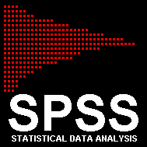

Different approaches for dealing with missing data
SPSS Missing Value module
  Missing value statistics
  Shows common patterns in missing data
  Performs statistical tests to see if the variables are affected by missing data
  Imputes missing data
    Regression
    EM (Expectation Maximisation)
  Easy to impute missing values for several fields in one step
Use traditional modelling techniques to impute missing data
  Classification and Regression Tree (CRT)
  Chi-Square Automatic Interaction Detector (CHAID)
Would impute one variable at a time
Copyright 2003-4, SPSS Inc.

Slide 13

Demonstration
Data collected on 109 countries (five regions)
    Europe
    East Europe
    Pacific/Asia
    Africa
    Middle East
    Latn America
  Data collected on key national indicators such as
    Religion
    Life expectancy
    Male and female literacy
    Daily calorie intake
Copyright 2003-4, SPSS Inc.

Slide 14
Summary
Show how Missing Values module is a powerful tool for
  Describing and imputing missing values
  Evaluate possible consequences of ignoring missing data
Showed different methods for imputing missing data
  EM (Expectation Maximisation)
  Regression
  Decision Trees
Copyright 2003-4, SPSS Inc.

Slide 15
Any
questions..
Copyright 2003-4, SPSS Inc.
Notes:
SPSS Inc.
Copyright 2003-4, SPSS Inc.

