Slide 1
Regression
Linear Regression

Slide 2
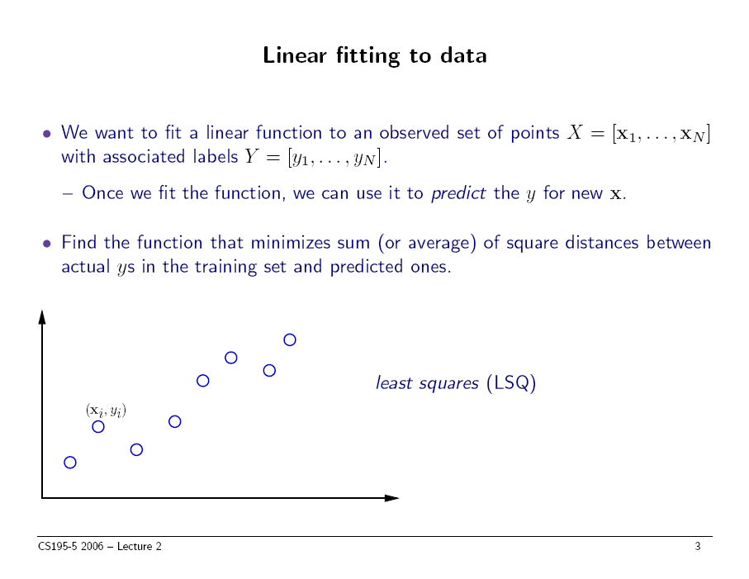

slide thanks to Greg Shakhnarovich (CS195-5, Brown Univ., 2006)

Slide 3
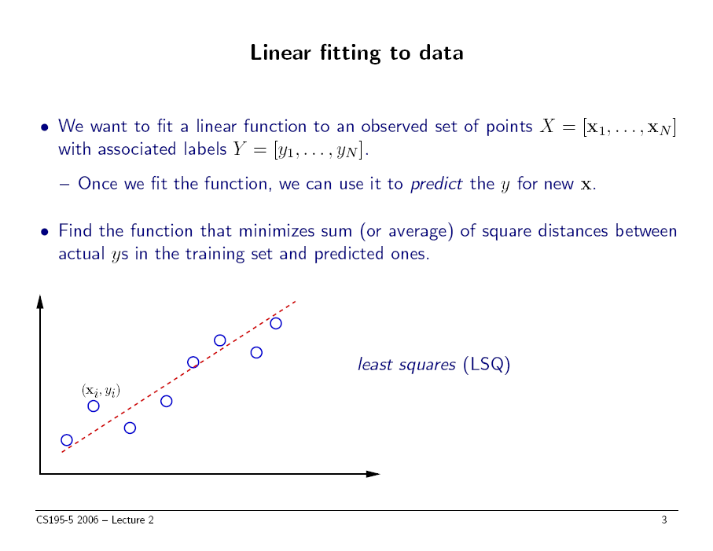
slide thanks to Greg Shakhnarovich (CS195-5, Brown Univ., 2006)

Slide 4
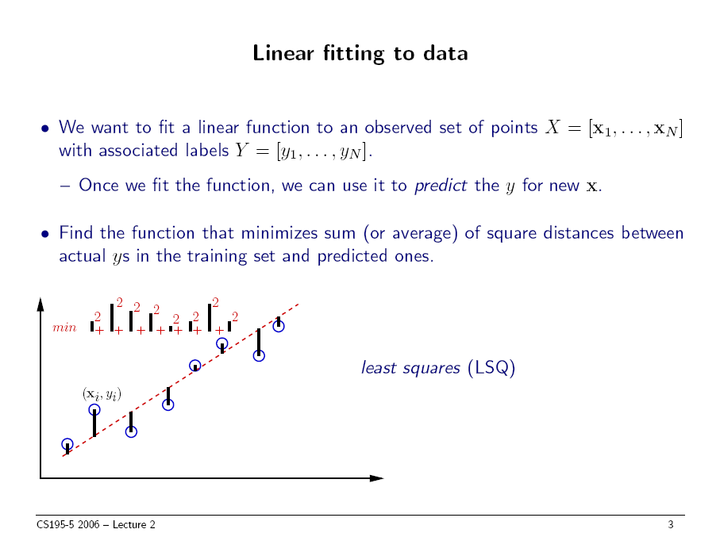
slide thanks to Greg Shakhnarovich (CS195-5, Brown Univ., 2006)

Slide 5
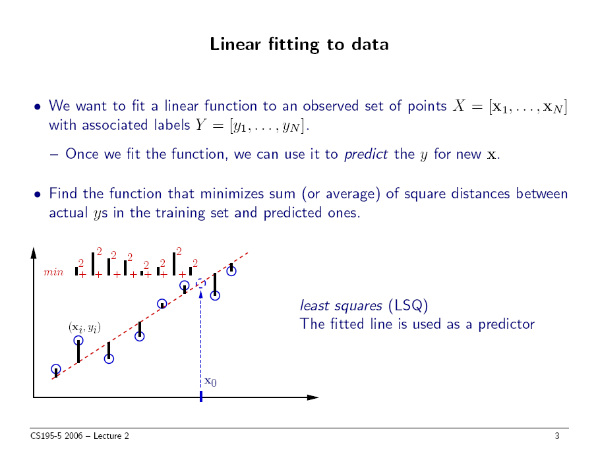
slide thanks to Greg Shakhnarovich (CS195-5, Brown Univ., 2006)

Slide 6
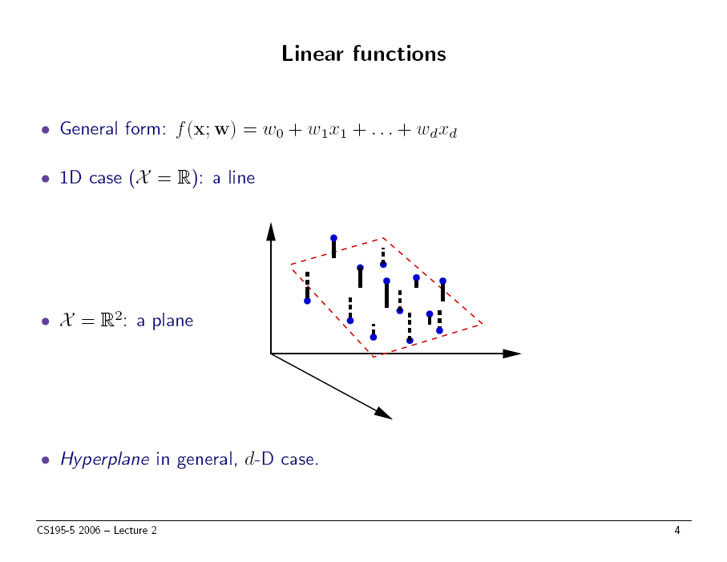
slide thanks to Greg Shakhnarovich (CS195-5, Brown Univ., 2006)

Slide 7



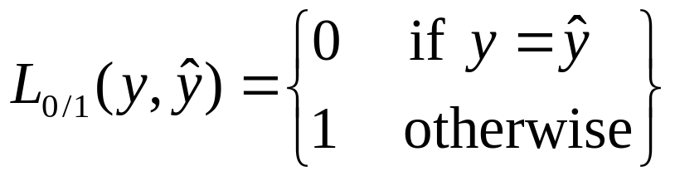
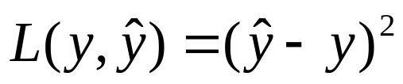
Loss function
Suppose target labels come from set Y
  Binary classification: Y = { 0, 1 }
  Regression: Y = ℜ (real numbers)
A loss function maps decisions to costs:
  defines the penalty for predicting when the true value is .
Standard choice for classification:
0/1 loss (same as
misclassification error)
Standard choice for regression:
squared loss

Slide 8
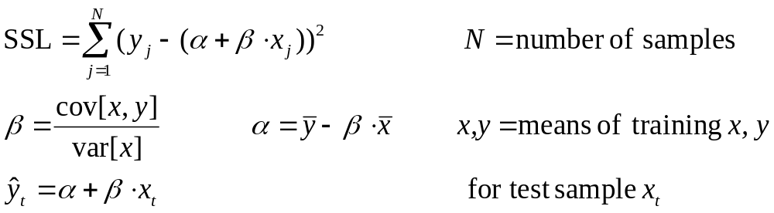
Least squares linear fit to data
Most popular estimation method is least squares:
  Determine linear coefficients α, β that minimize sum of squared loss (SSL).
  Use standard (multivariate) differential calculus:
    differentiate SSL with respect to α, β
    find zeros of each partial differential equation
    solve for α, β
One dimension:

Slide 9
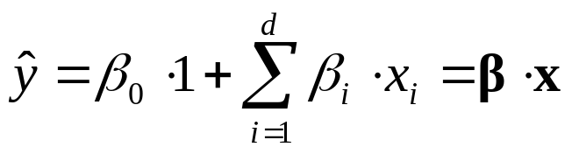
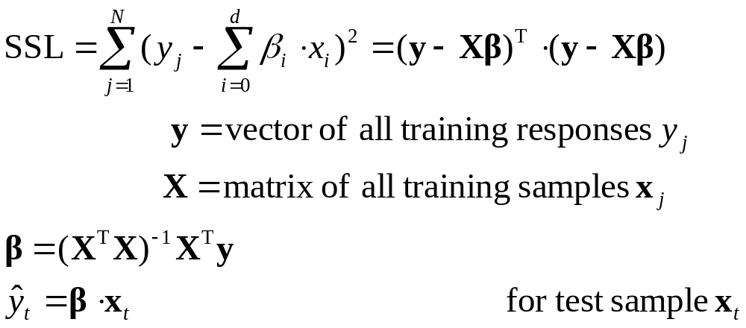
Least squares linear fit to data
Multiple dimensions
  To simplify notation and derivation, change α to β₀, and add a new feature x₀ = 1 to feature vector x:
  Calculate SSL and determine β:

Slide 10
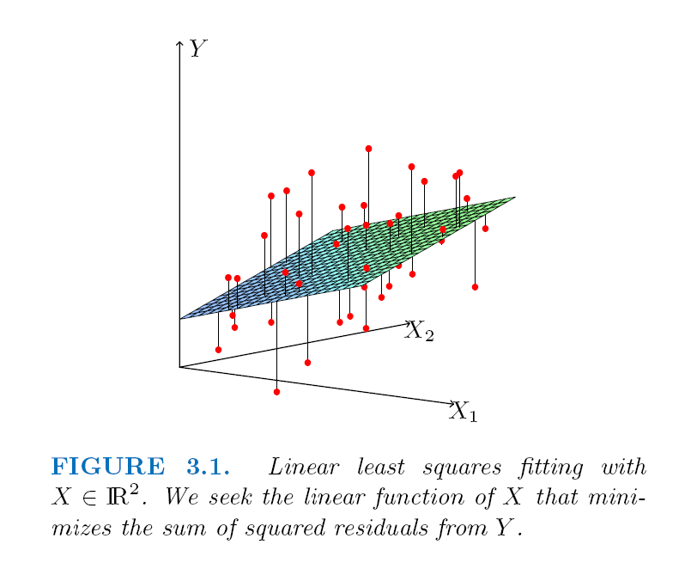
Least squares linear fit to data

Slide 11
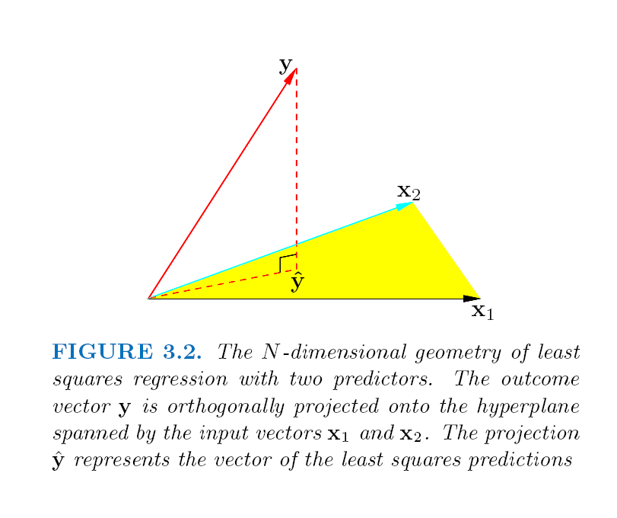
Least squares linear fit to data

Slide 12
Extending application of linear regression
The inputs X for linear regression can be:
  Original quantitative inputs
  Transformation of quantitative inputs, e.g. log, exp, square root, square, etc.
  Polynomial transformation
    example: y = β₀ + β₁⋅x + β₂⋅x² + β₃⋅x³
  Basis expansions
  Dummy coding of categorical inputs
  Interactions between variables
    example: x₃ = x₁ ⋅ x₂
This allows use of linear regression techniques to fit much more complicated non-linear datasets.

Slide 13
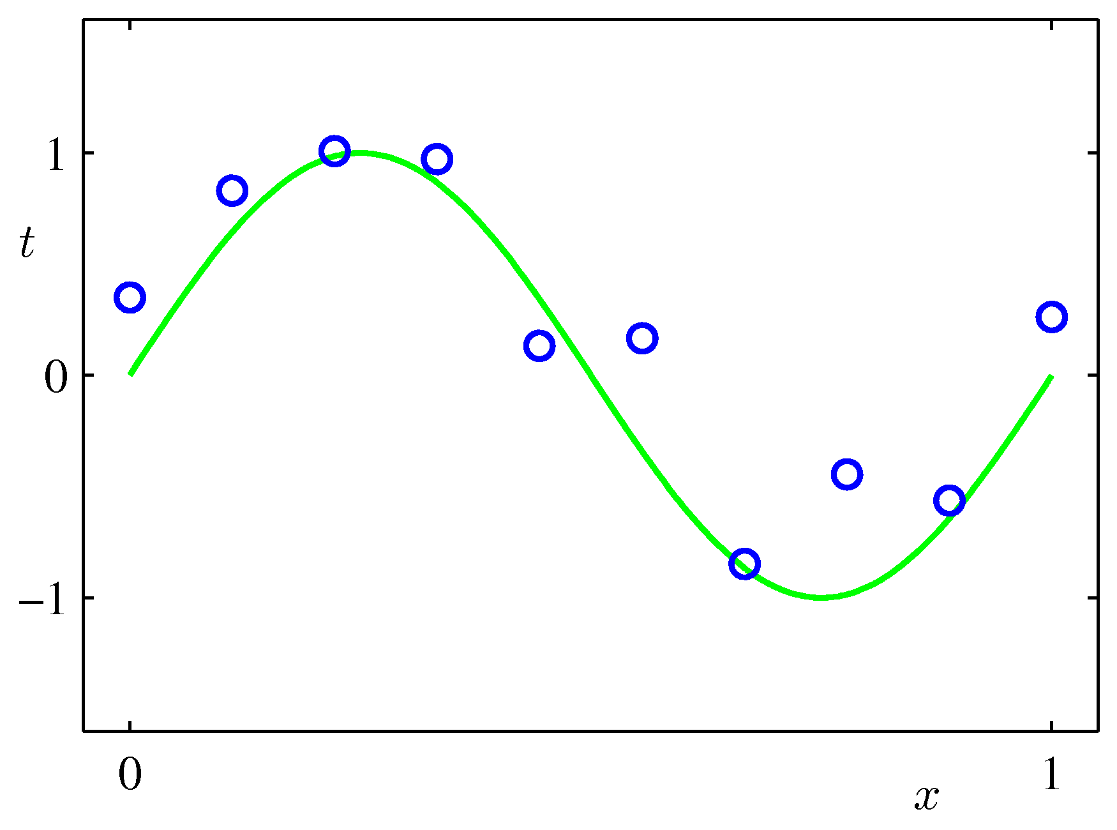
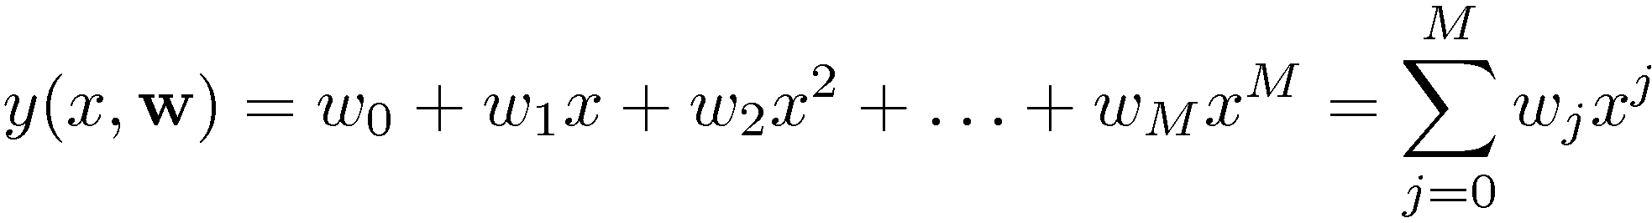
Example of fitting polynomial curve with linear model

Slide 14
Prostate cancer dataset
97 samples, partitioned into:
  67 training samples
  30 test samples
Eight predictors (features):
  6 continuous (4 log transforms)
  1 binary
  1 ordinal
Continuous outcome variable:
  lpsa: log( prostate specific antigen level )

Slide 15
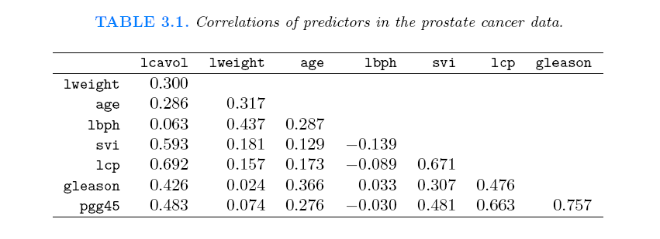
Correlations of predictors in prostate cancer dataset

Slide 16
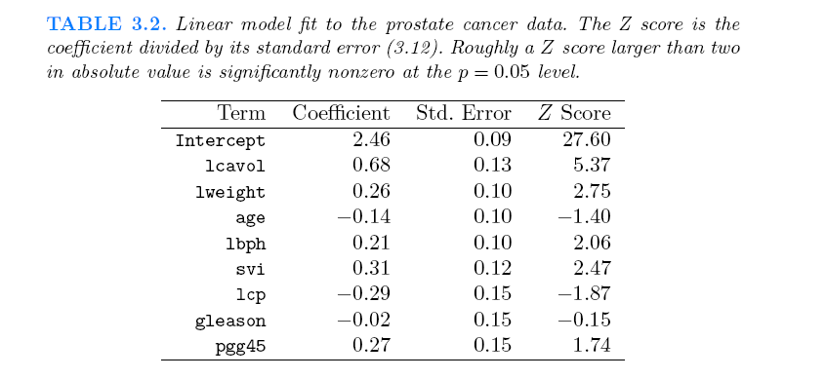
Fit of linear model to prostate cancer dataset

Slide 17
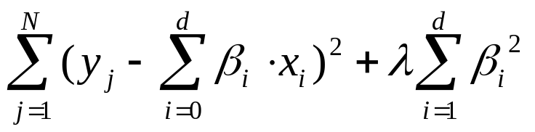
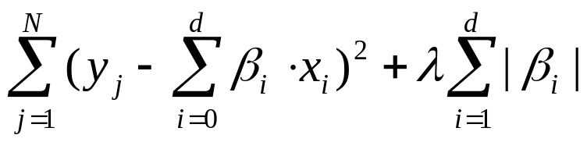
Regularization
Complex models (lots of parameters) often prone to overfitting.
Overfitting can be reduced by imposing a constraint on the overall magnitude of the parameters.
Two common types of regularization in linear regression:
  L₂ regularization (a.k.a. ridge regression). Find β which minimizes:
    λ is the regularization parameter: bigger λ imposes more constraint
  L₁ regularization (a.k.a. lasso). Find β which minimizes:

Slide 18
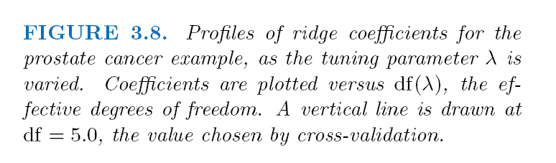
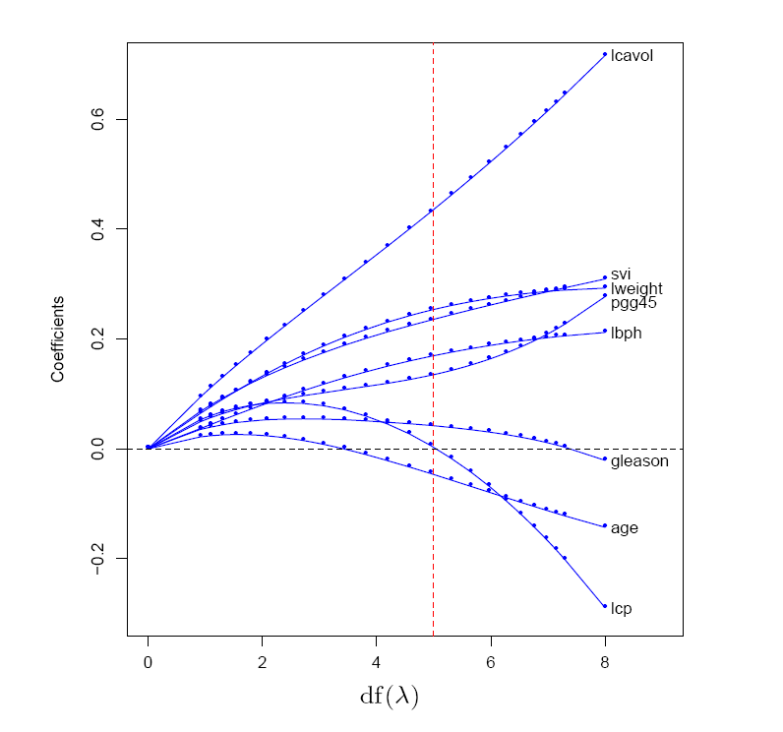
Example of L₂ regularization
L2 regularization shrinks coefficients towards (but not to) zero, and towards each other.

Slide 19
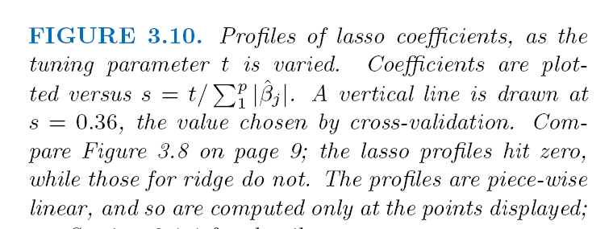
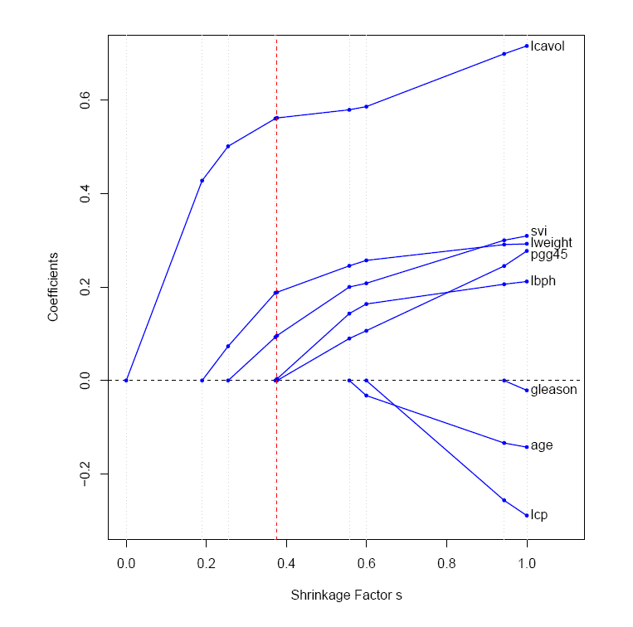
Example of L₁ regularization
L1 regularization shrinks coefficients to zero at different rates; different values of λ give models with different subsets of features.

Slide 20
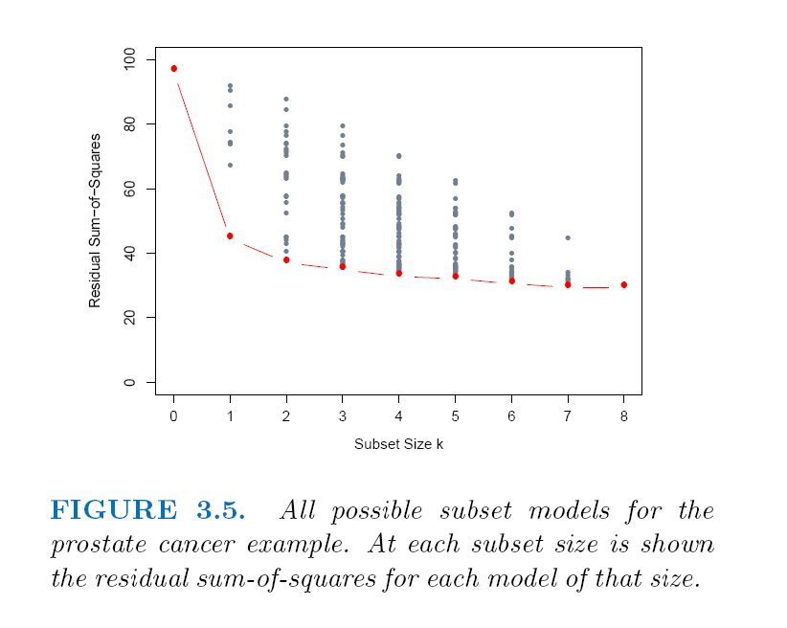
Example of subset selection

Slide 21
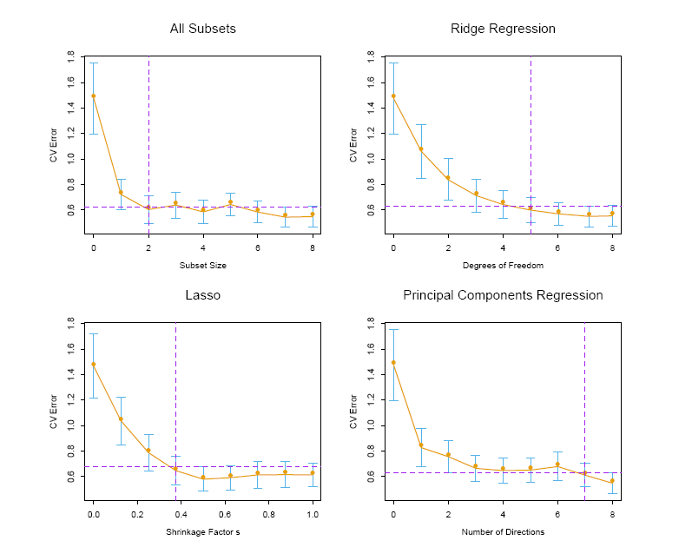
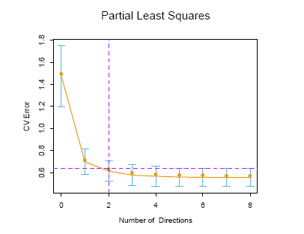
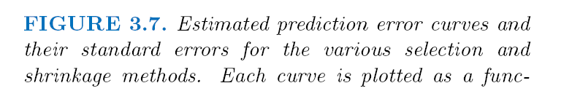
Comparison of various selection and shrinkage methods

Slide 22
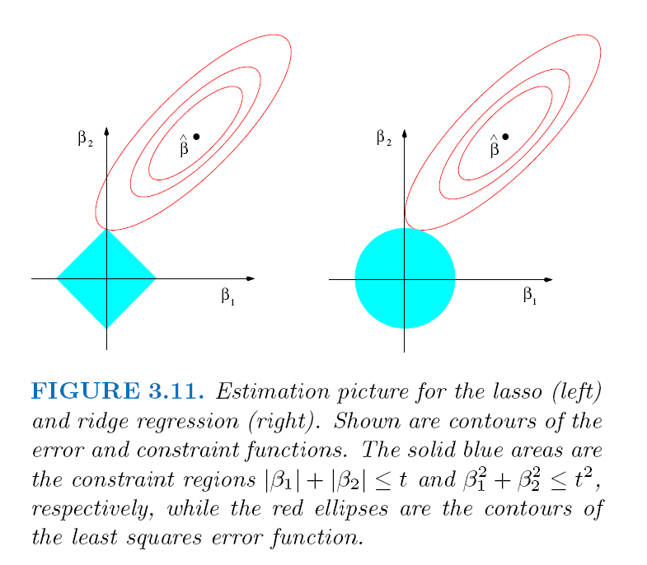
L₁ regularization gives sparse models, L₂ does not

Slide 23
Other types of regression
In addition to linear regression, there are:
  many types of non-linear regression
    decision trees
    nearest neighbor
    neural networks
    support vector machines
  locally linear regression
  etc.

Slide 24
MATLAB interlude
matlab_demo_07.m
Part B

