Slide 1
Hadoop Details
Gururajan Narasimhan

Slide 2


Slide 3
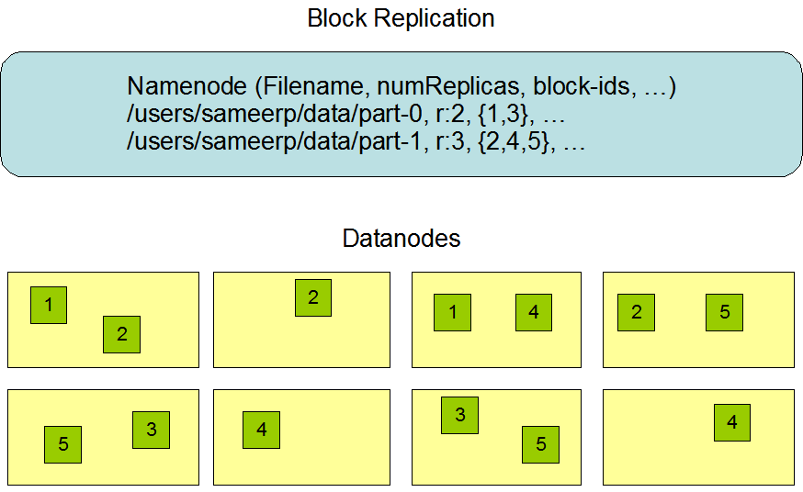

Slide 4
Name node
Name Node is the centerpiece of HDFS.
Name Node is also known as the Master
Name Node only stores the metadata of HDFS – the directory tree of all files in the file system, and tracks the files across the cluster.
Name Node does not store the actual data or the dataset. The data itself is actually stored in the Data Nodes.
Name Node knows the list of the blocks and its location for any given file in HDFS. With this information Name Node knows how to construct the file from blocks.
Name Node is so critical to HDFS and when the Name Node is down, HDFS/Hadoop cluster is inaccessible and considered down.
Name Node is a single point of failure in Hadoop cluster.
Name Node is usually configured with a lot of memory (RAM). Because the block locations are help in main memory.

Slide 5
Data node
DataNode is responsible for storing the actual data in HDFS.
DataNode is also known as the Slave
NameNode and DataNode are in constant communication.
When a DataNode starts up it announce itself to the NameNode along with the list of blocks it is responsible for.
When a DataNode is down, it does not affect the availability of data or the cluster. NameNode will arrange for replication for the blocks managed by the DataNode that is not available.
DataNode is usually configured with a lot of hard disk space. Because the actual data is stored in the DataNode.

Slide 6
Hadoop Use Cases

Slide 7
Interactive SQL
By dispensing with MapReduce and using a distributed query engine that uses dedicated “always on” daemons (like Impala) or container reuse (like Hive on Tez), it’s possible to achieve low-latency responses for SQL queries on Hadoop while still scaling up to large dataset sizes.

Slide 8
Iterative processing
Many algorithms—such as those in machine learning—are iterative in nature, so it’s much more efficient to hold each intermediate working set in memory, compared to loading from disk on each iteration.
The architecture of MapReduce does not allow this, but it’s straightforward with Spark, for example, and it enables ahighly exploratory style of working with datasets.

Slide 9
Stream processing
Streaming systems like Storm, Spark Streaming, or Samza make it possible to run real-time, distributed computations on unbounded streams of data and emit results to Hadoop storage or external systems.

Slide 10
Search
The Solr search platform can run on a Hadoop cluster, indexing documents as they are added to HDFS, and serving search queries from indexes stored in HDFS.

Slide 11
What is Hadoop
Hadoop offers a reliable, scalable platform for storage and analysis of huge data
For storage you use HDFS
For analysis you use MapReduce

Slide 12
What is Mapreduce
MapReduce is a programming model for data processing.

Slide 13
What is Mapreduce - detail
MapReduce is a programming model for data processing.
The model is simple, yet not too simple to express useful programs in.
Hadoop can run MapReduce programs written in various languages such as python, java, ruby and C++
The important fact is MapReduce programs are inherently parallel
This pus very large-scale data analysis into the hands of anyone with enough machines at their disposal.
MapReduce comes into its own for large datasets, map reduce begins shine around 100 Giga byes

Slide 14
Data node
DataNode is responsible for storing the actual data in HDFS.
DataNode is also known as the Slave
NameNode and DataNode are in constant communication.
When a DataNode starts up it announce itself to the NameNode along with the list of blocks it is responsible for.
When a DataNode is down, it does not affect the availability of data or the cluster. NameNode will arrange for replication for the blocks managed by the DataNode that is not available.
DataNode is usually configured with a lot of hard disk space. Because the actual data is stored in the DataNode.

Slide 15
Resource Manager
The Resource Manager (RM) is responsible for tracking the resources in a cluster, and scheduling applications (e.g., MapReduce jobs)
Prior to Hadoop 2.4, the ResourceManager is the single point of failure in a YARN cluster.

Slide 16
Node Manager
Node Manager: It takes care of individual node on Hadoop cluster and manages application and workflow and that particular node. Its primary job is to keep-up with the Node Manager.
It monitors resource usage, performs log management and also kills a container based on directions from the resource manager. It is also responsible for creating the container process and start it on the request of Application master.

Slide 17
YARN
YARN stands for “Yet Another Resource Negotiator“. It was introduced in Hadoop 2.0 to remove the bottleneck on Job Tracker which was present in Hadoop 1.0.
YARN was described as a “Redesigned Resource Manager” at the time of its launching, but it has now evolved to be known as large-scale distributed operating system used for Big Data processing.

Slide 18
Client submits an application
The Resource Manager allocates a container to start the Application Manager
The Application Manager registers itself with the Resource Manager
The Application Manager negotiates containers from the Resource Manager
The Application Manager notifies the Node Manager to launch containers
Application code is executed in the container
Client contacts Resource Manager/Application Manager to monitor application’s status
Once the processing is complete, the Application Manager un-registers with the Resource Manager

Slide 19
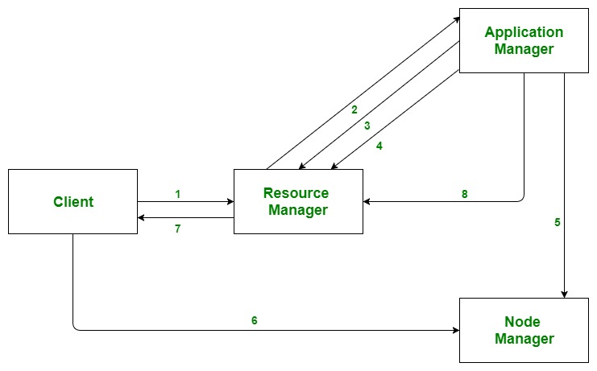

Slide 20
Standalone Mode
1. Standalone Mode – It is the default mode of configuration of Hadoop. It doesn’t use hdfs instead, it uses a local file system for both input and output. It is useful for debugging and testing.

Slide 21
Pseudo-Distributed Mode
It is also called a single node cluster where both NameNode and DataNode resides in the same machine. All the daemons run on the same machine in this mode. It produces a fully functioning cluster on a single machine.

Slide 22
Fully Distributed Mode
Fully Distributed Mode – Hadoop runs on multiple nodes wherein there are separate nodes for master and slave daemons
The data is distributed and stored in a cluster of machines which provides a production environment
Here we configure multiple machines with different IP addresses
You can configure multiple machines on Amazon cloud or google cloud and run Hadoop on them

