Slide 1
Types of inheritance

Slide 2
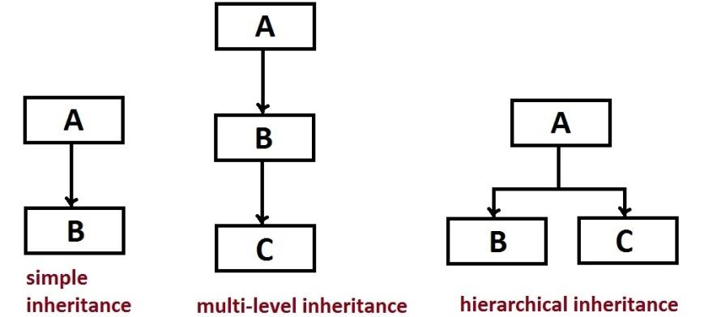

Slide 3
