Slide 1
Skewness and Kurtosis

Slide 2
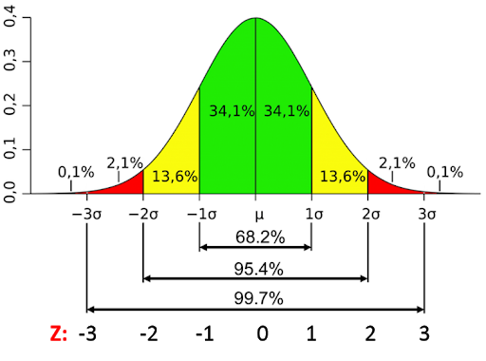

Slide 3
Standard normal distribution
The left and right side of the distribution are mirror images of each other
It is uni-modal
Here, mean = median = mode
68.27 % of data are 1 std away, 95.5 % data are 2 std away and 99.73 % of data are 3 std away

Slide 4
What is skewness
Skewness is a measure of asymmetry of a distribution. Another measure that describes the shape of a distribution is kurtosis
In a normal distribution, the mean divides the curve symmetrically into two equal parts at the median and the value of skewness is zero.

Slide 5
What is skewness
When a distribution is asymmetrical the tail of the distribution is skewed to one side-to the right or to the left.
When the value of the skewness is negative, the tail of the distribution is longer towards the left hand side of the curve.
When the value of the skewness is positive, the tail of the distribution is longer towards the right hand side of the curve.

Slide 6
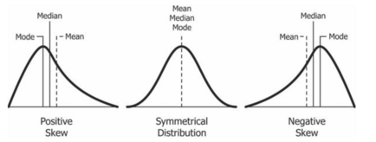

Slide 7
Kurtosis
Kurtosis is one of the two measures that quantify shape of of a distribution. The another measure is skewness.
Kurtosis describes the peakedness of the distribution.
If the distribution is tall and thin it is called a leptokurtic distribution. Values in a leptokurtic distribution are near the mean or at the extremes.

Slide 8
A flat distribution where the values are moderately spread out (i.e., unlike leptokurtic) is called platykurtic distribution.
A distribution whose shape is in between a leptokurtic distribution and a platykurtic distribution is called a mesokurtic distribution. A mesokurtic distribution looks more close to a normal distribution.

Slide 9
How to calculate
The pandas DataFrame has a computing method kurtosis() which computes the kurtosis for a set of values across a specific axis (i.e., a row or a column).
The pandas library function kurtosis() computes the Fisher's Kurtosis which is obtained by subtracting the Pearson's Kurtosis by three.
With Fisher's Kurtosis, definition a normal distribution has a kurtosis of 0.

Slide 10
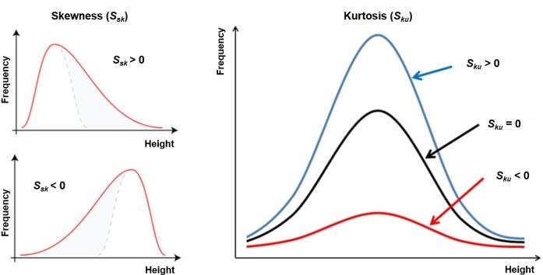

Slide 11
