Slide 1
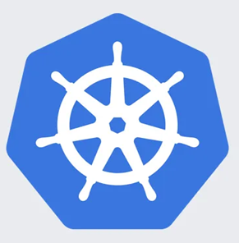
Software Productution Engineering
Kubernetes Lab Exercises
Learn Kubernetes by Doing: Lab Workbook
<number>

Slide 2
Agenda
1. Installing Minikube on Ubuntu VM
2. Namespace Management
3. Practicing Basic Kubernetes Commands
4. Persistent Storage with PV and PVC
5. Pod-to-Pod Communication
6. Deploying ClusterIP Service
7. Deploying NodePort Service
8. Implementing Ingress Controller
9. ConfigMaps in Kubernetes
10. Managing Secrets in Kubernetes
11. Demonstrating Live Updates
12. Resource Quotas in Kubernetes
13. Defining Resource Limits
14. Horizontal Pod Autoscaler (HPA) Demonstration
<number>

Slide 3
Q1. Installing Minikube in Ubuntu VM
1. Install Virtualization Hypervisor: Since you are using a virtual machine, you'll need a virtualization hypervisor inside that VM. You can use Docker as the hypervisor for Minikube within the Ubuntu virtual machine.
sudo apt update
sudo apt install docker.io
2. Install kubectl: kubectl is the command-line tool for interacting with Kubernetes clusters.
sudo snap install kubectl --classic
3. Install Minikube: You can download the Minikube binary and move it to your `/usr/local/bin` directory.
curl -Lo minikube https://storage.googleapis.com/minikube/releases/latest/minikube-linux-amd64
chmod +x minikube
sudo mv minikube /usr/local/bin/
4. Start Minikube: You can start Minikube using the following command. This will start a Minikube cluster inside your Ubuntu virtual machine using Docker as the hypervisor.
minikube start --driver=dockersudo mv minikube /usr/local/bin/
<number>

Slide 4
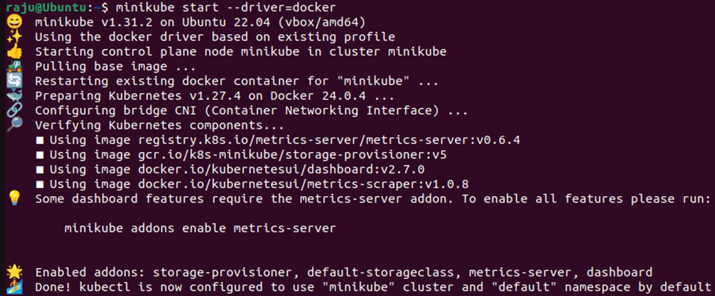
Q1. Installing Minikube in Ubuntu VM
<number>

Slide 5
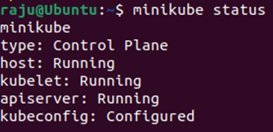
Q1. Installing Minikube in Ubuntu VM
To enable all dashboard features run the following command:
Check Minikube Status: You can check the status of your Minikube cluster using:
minikube status
<number>

Slide 6
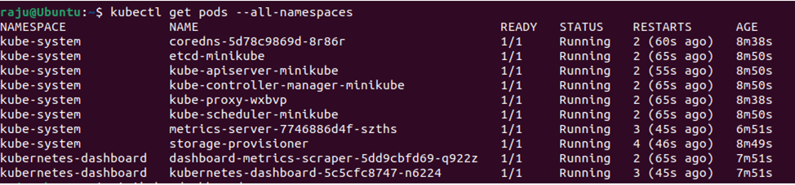
Q1. Installing Minikube in Ubuntu VM
Interact with Minikube: You can now use `kubectl` commands to interact with your Minikube cluster from within the Ubuntu virtual machine. For example, you can run:
kubectl get pods --all-namespaces
Access Kubernetes Dashboard: To access the Kubernetes dashboard, you can use the following command:
minikube dashboard
<number>

Slide 7
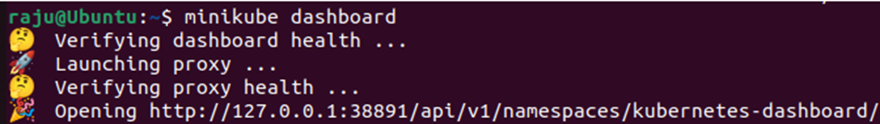
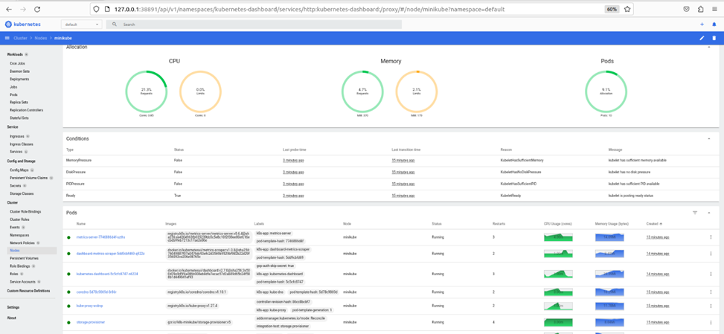
Q1. Installing Minikube in Ubuntu VM
It will open your default browser automatically and display the dashboard:
<number>

Slide 8
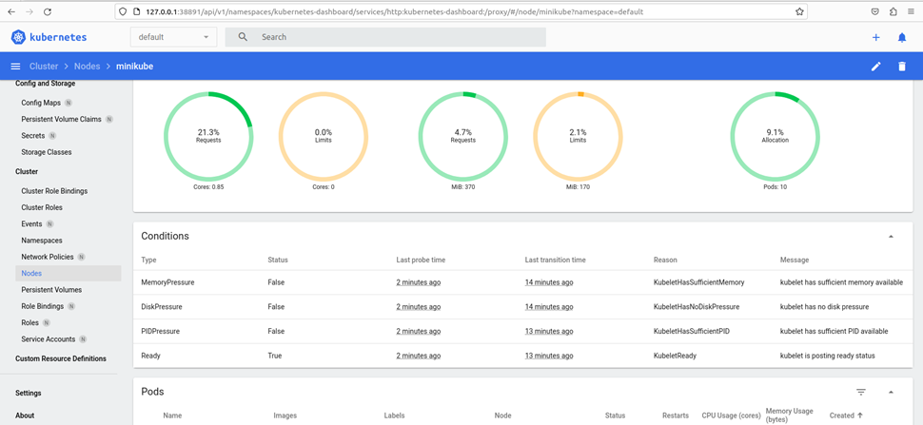
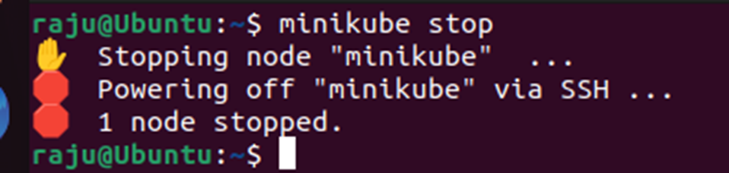
Q1. Installing Minikube in Ubuntu VM
Stop Minikube: When you're done working with Minikube, you can stop the cluster:
minikube stop
<number>

Slide 9
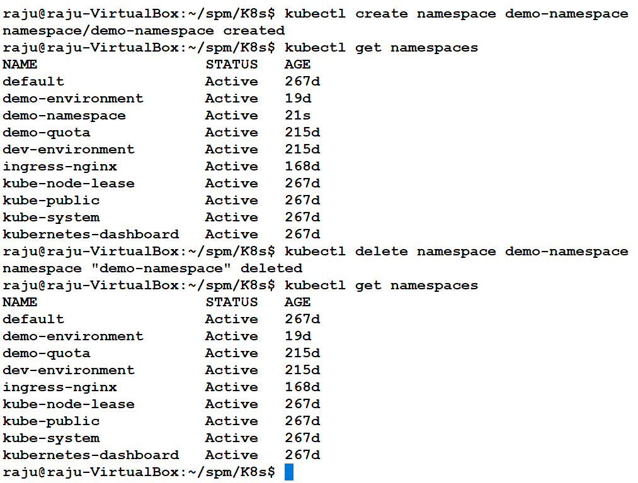
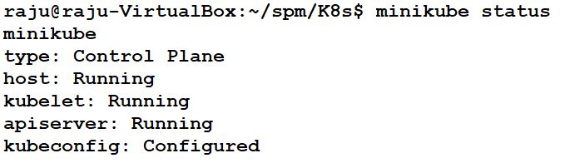
Q2. Namespace Management
2
3
1
4

Slide 10
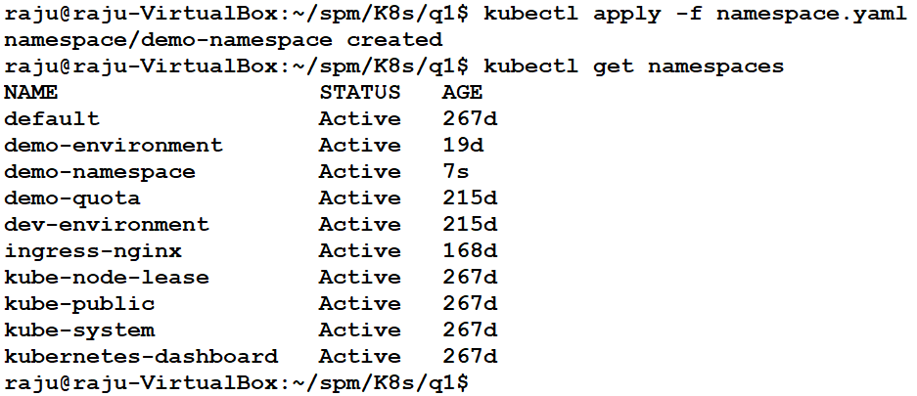
Q2. Namespace Management
apiVersion: v1
kind: Namespace
metadata:
name: demo-namespace
namespace.yaml
kubectl apply -f namespace.yaml

Slide 11
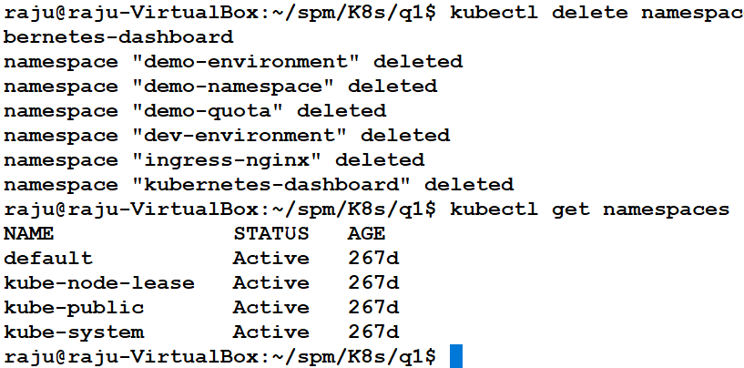
Q2. Namespace Management
To remove all namespaces except for system and essential namespaces (default, kube-system, kube-public, kube-node-lease, etc.):
kubectl delete namespace demo-environment demo-namespace demo-quota dev-environment ingress-nginx kubernetes-dashboard

Slide 12
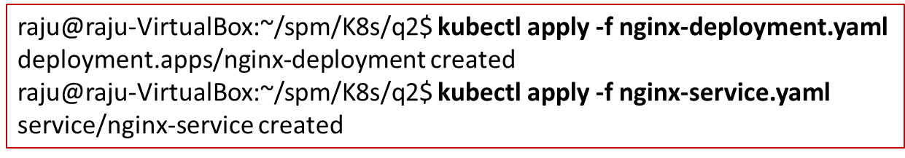
Q3. Basic Commands Demo
apiVersion: apps/v1
kind: Deployment
metadata:
name: nginx-deployment
spec:
replicas: 2
selector:
matchLabels:
app: nginx
template:
metadata:
labels:
app: nginx
spec:
containers:
- name: nginx
image: nginx:latest
ports:
- containerPort: 80
---
apiVersion: v1
kind: Service
metadata:
name: nginx-service
spec:
selector:
app: nginx
ports:
- protocol: TCP
port: 80
targetPort: 80
type: ClusterIP
nginx-service.yaml
$ kubectl create namespace demo-basic-commands
namespace/demo-basic-commands created
$ kubectl config set-context --current --namespace=demo-basic-commands
Context "minikube" modified.
1
2
3
4
nginx-deployment.yaml

Slide 13
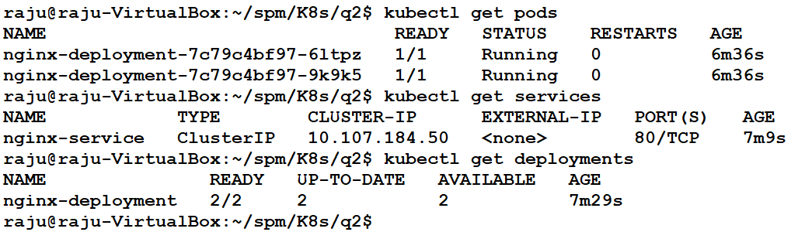
Q3. Basic Commands Demo
Get a List of All Pods: kubectl get pods
Get a List of All Services: kubectl get services
Get a List of All Deployments: kubectl get deployments

Slide 14
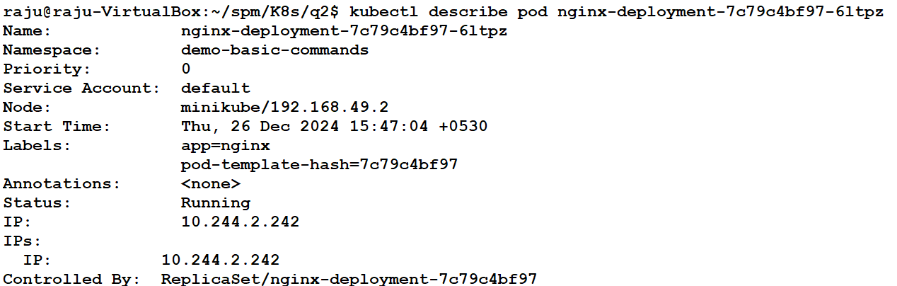
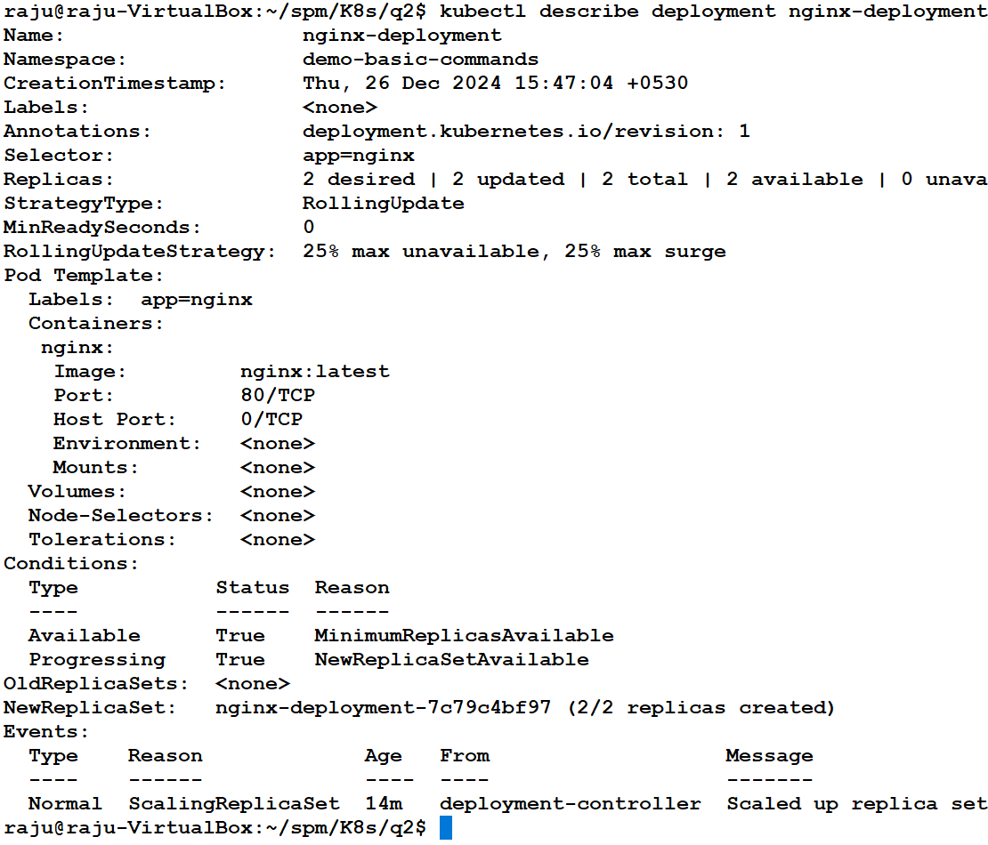
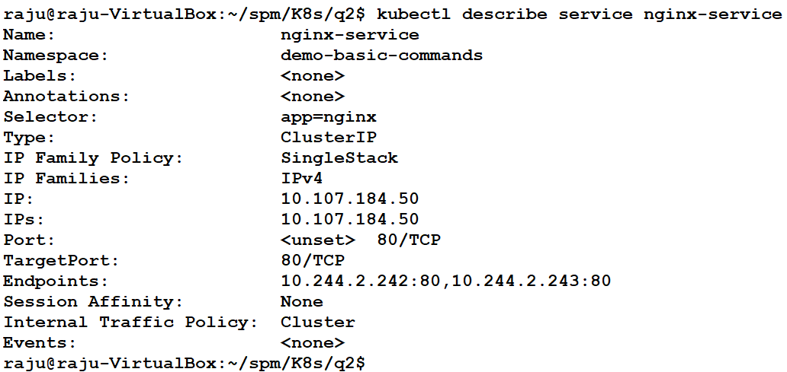
Q3. Basic Commands Demo
4. Describe a Pod: kubectl describe pod nginx-deployment-7c79c4bf97-6ltpz
5. Describe a Service: kubectl describe service nginx-service
6. Describe a Deployment: kubectl describe deployment nginx-deployment
6. kubectl delete namespace demo-basic-commands

Slide 15
Q4. Persistent Storage with PV and PVC
Step 1: Create PersistentVolume (PV)
Step 2: Create PersistentVolumeClaim (PVC)
apiVersion: v1
kind: PersistentVolume
metadata:
name: my-pv
spec:
capacity:
storage: 1Gi
accessModes:
- ReadWriteOnce
persistentVolumeReclaimPolicy: Retain
storageClassName: manual
hostPath:
path: /mnt/data
apiVersion: v1
kind: PersistentVolumeClaim
metadata:
name: my-pvc
spec:
accessModes:
- ReadWriteOnce
resources:
requests:
storage: 1Gi
storageClassName: manual
Requests 1GiB of storage from an available PV.
Matches storageClassName: manual to bind to my-pv.
storage: 1Gi - Specifies 1GiB of storage.
accessModes: ReadWriteOnce - Allows read-write by a single node.
persistentVolumeReclaimPolicy: Retain - Keeps data even after PVC is deleted.
hostPath: /mnt/data - Mounts the volume to Minikube's file system.
1. Delete all the existing pv and pvc: kubectl delete pv --all

Slide 16
Q4. Persistent Storage with PV and PVC
Step 3: Create a Pod Using PVC
apiVersion: v1
kind: Pod
metadata:
name: my-pod
spec:
containers:
- name: my-container
image: busybox
command: ["sh", "-c", "echo 'Hello Persistent Storage' > /usr/share/busybox/hello.txt && sleep 3600"]
volumeMounts:
- mountPath: "/usr/share/busybox"
name: my-storage
volumes:
- name: my-storage
persistentVolumeClaim:
claimName: my-pvc
The pod writes "Hello Persistent Storage" to /usr/share/busybox/hello.txt.
The volume is mounted using the claim my-pvc.

Slide 17
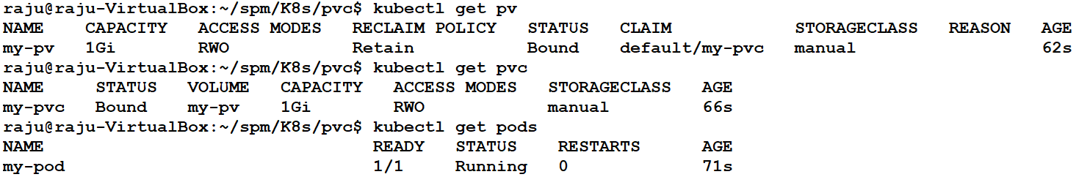

Q4. Persistent Storage with PV and PVC
Step 4: Deploy the Resources
kubectl apply -f persistent-volume.yaml
kubectl apply -f persistent-volume-claim.yaml
kubectl apply -f pod-with-pvc.yaml
Step 5: Verify Persistent Storage and pods (pv and pvc should show Bound status and Pod should show running status)
Read the file inside the pod: kubectl exec -it my-pod -- cat /usr/share/busybox/hello.txt
Verify Data on Minikube Host

Slide 18
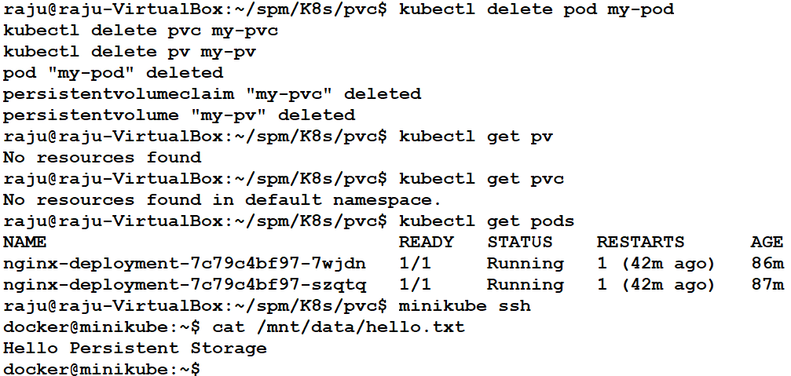
Q4. Persistent Storage with PV and PVC
Verifying Data Persistence After Deleting Kubernetes Resources

Slide 19
Q5. Pod-to-Pod Communication
backend-pod.yaml
frontend-pod.yaml
apiVersion: v1
kind: Pod
metadata:
name: backend
labels:
app: backend
spec:
containers:
- name: backend-container
image: hashicorp/http-echo:latest
args:
- "-text=Hello World from Backend Pod"
ports:
- containerPort: 5678
apiVersion: v1
kind: Pod
metadata:
name: frontend
spec:
containers:
- name: curl-container
image: curlimages/curl:latest
command: ["sh", "-c", "while true; do curl backend-service:5678; sleep 5; done"]
apiVersion: v1
kind: Service
metadata:
name: backend-service
spec:
selector:
app: backend
ports:
- protocol: TCP
port: 5678
targetPort: 5678
backend-service.yaml

Slide 20
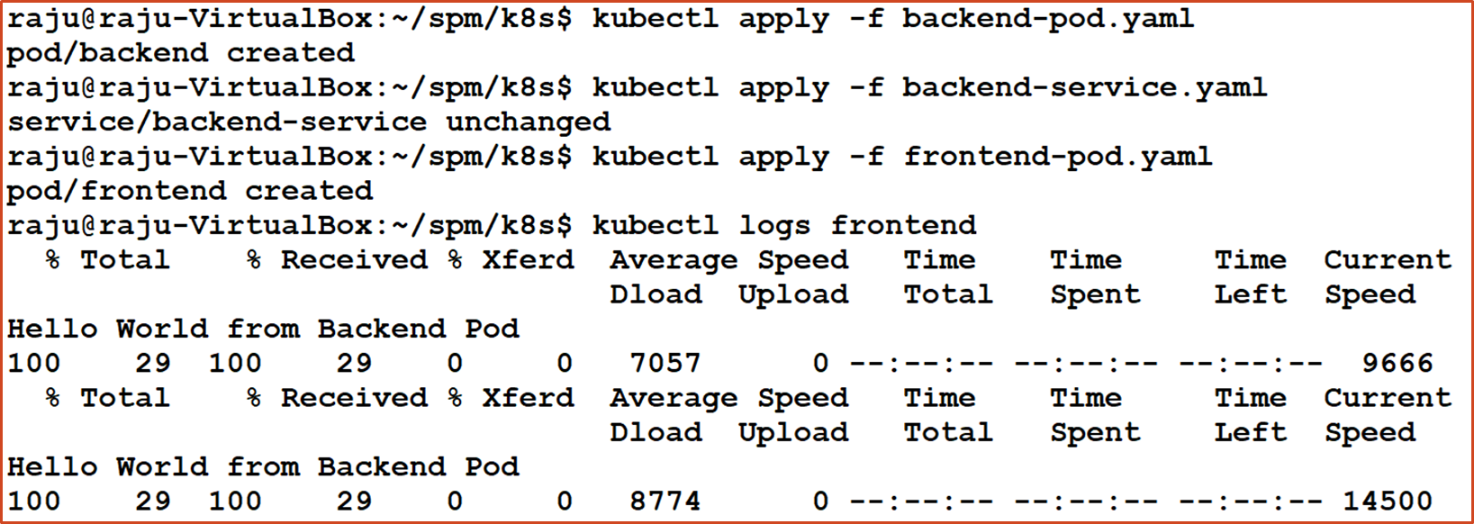
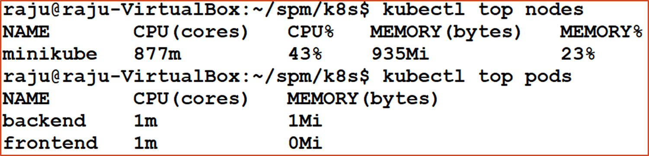
Q5. Pod-to-Pod Communication

Slide 21
Q5. Pod-to-Pod Communication
Access the application inside the pod:
kubectl port-forward pod/backend 8080:5678
raju@raju-VirtualBox:~/spm/K8s/pod-to-pod$ kubectl port-forward pod/backend 8080:5678
Forwarding from 127.0.0.1:8080 -> 5678
Forwarding from [::1]:8080 -> 5678
Handling connection for 8080
Handling connection for 8080
In another terminal: raju@raju-VirtualBox:~/spm/K8s/pod-to-pod$ curl http://localhost:8080
Hello World from Backend Pod

Slide 22
Q6. ClusterIP
apiVersion: apps/v1
kind: Deployment
metadata:
name: nginx-deployment
namespace: demo-environment
spec:
replicas: 3
selector:
matchLabels:
app: nginx
template:
metadata:
labels:
app: nginx
spec:
containers:
- name: nginx
image: nginx:latest
ports:
- containerPort: 80
apiVersion: v1
kind: Service
metadata:
name: nginx-clusterip
namespace: demo-environment
spec:
selector:
app: nginx
ports:
- protocol: TCP
port: 80
targetPort: 80
type: ClusterIP
nginx-deployment.yaml
nginx-clusterip-service.yaml

Slide 23
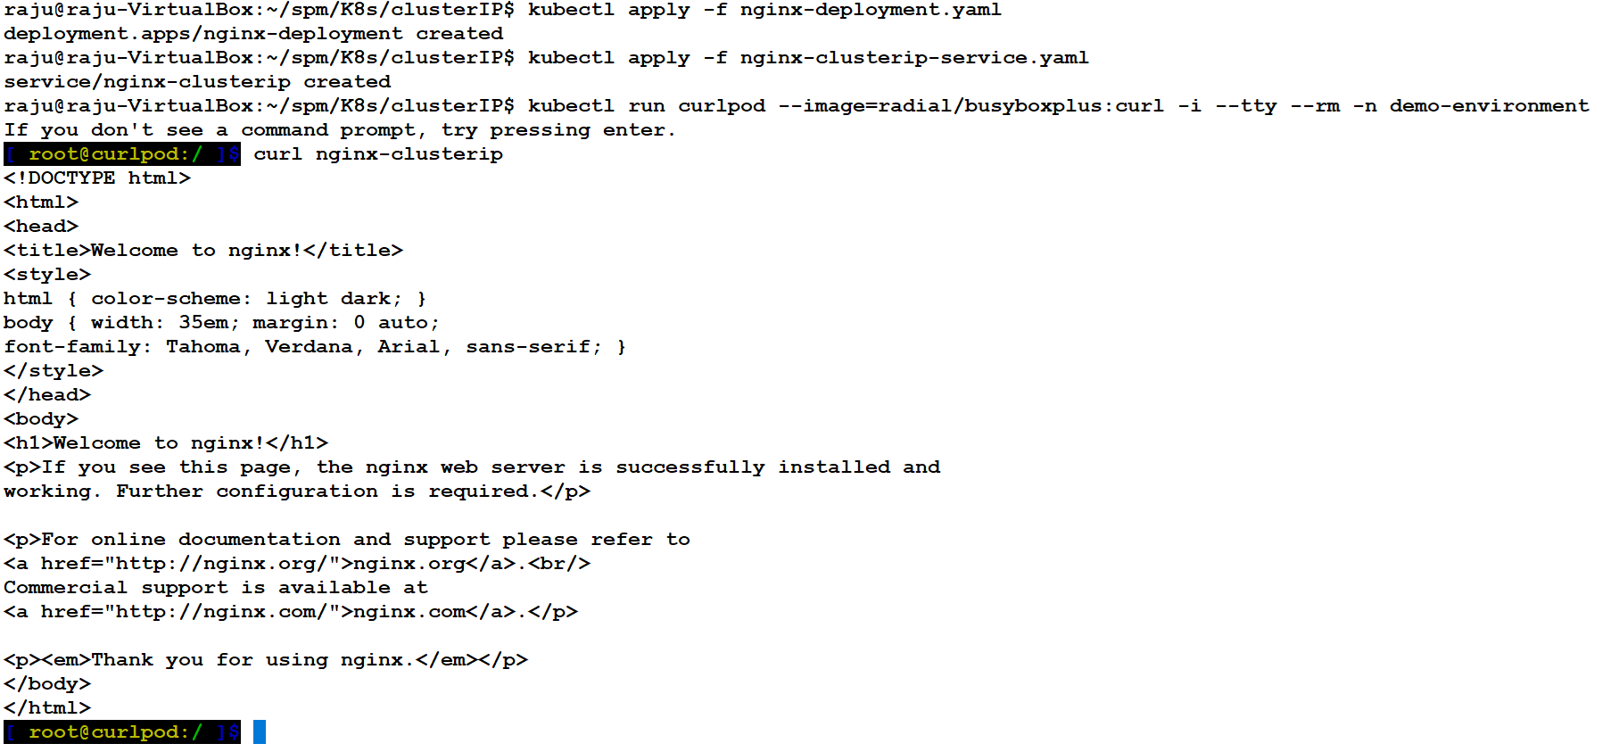
Q6. ClusterIP

Slide 24
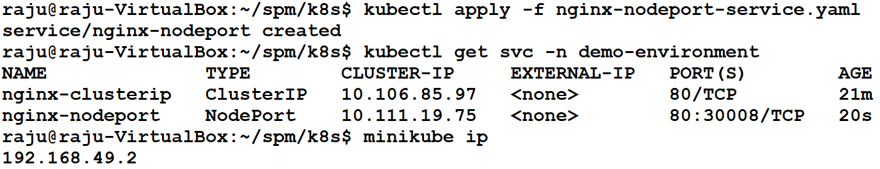
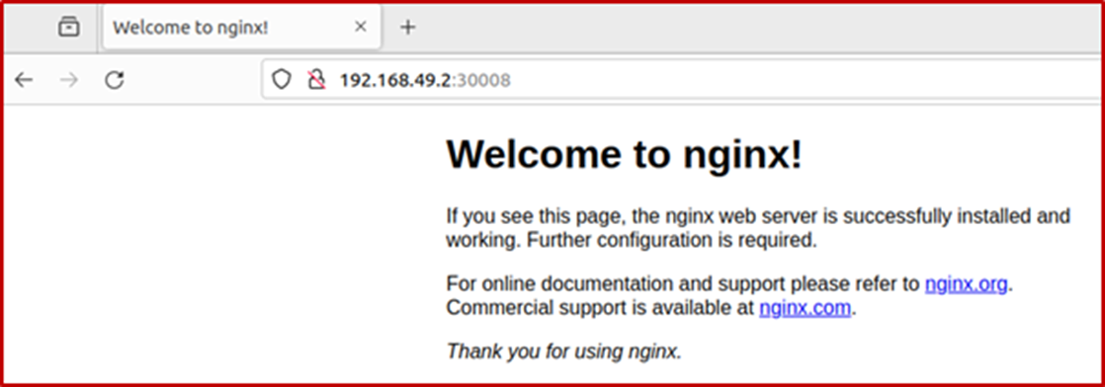
Q7. NodePort
apiVersion: v1
kind: Service
metadata:
name: nginx-nodeport
namespace: demo-environment
spec:
selector:
app: nginx
ports:
- protocol: TCP
port: 80
targetPort: 80
nodePort: 30008
type: NodePort
nginx-nodeport-service.yaml

Slide 25
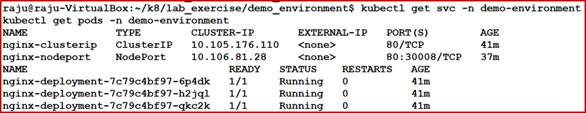
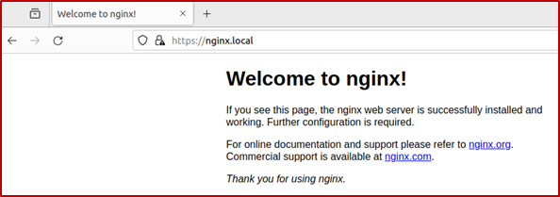
Q8. Ingress
apiVersion: networking.k8s.io/v1
kind: Ingress
metadata:
name: nginx-ingress
namespace: demo-environment
annotations:
nginx.ingress.kubernetes.io/rewrite-target: /
spec:
rules:
- host: nginx.local
http:
paths:
- path: /
pathType: Prefix
backend:
service:
name: nginx-clusterip
port:
number: 80
To access the Ingress, add an entry to your /etc/hosts file to map nginx.local to the Minikube IP.
In our case: 192.168.49.2 nginx.local
Access the Nginx service using the nginx.local hostname: https://nginx.local/
nginx-ingress.yaml
kubectl apply -f nginx-ingress.yaml

Slide 26
Q9. ConfigMaps
apiVersion: v1
kind: ConfigMap
metadata:
name: app-config
namespace: dev-environment
data:
key1: "55555"
apiVersion: v1
kind: Pod
metadata:
name: configmap-pod
namespace: dev-environment
spec:
containers:
- name: configmap-container
image: busybox
command: ["sleep", "3600"]
volumeMounts:
- name: config-volume
mountPath: "/etc/config"
volumes:
- name: config-volume
configMap:
name: app-config
Apply the configuration:
kubectl apply -f configmap.yaml
kubectl apply -f pod-with-configmap.yaml
kubectl exec -it configmap-pod -n dev-environment -- cat /etc/config/key1
configmap.yaml
pod-with-configmap.yaml

Slide 27
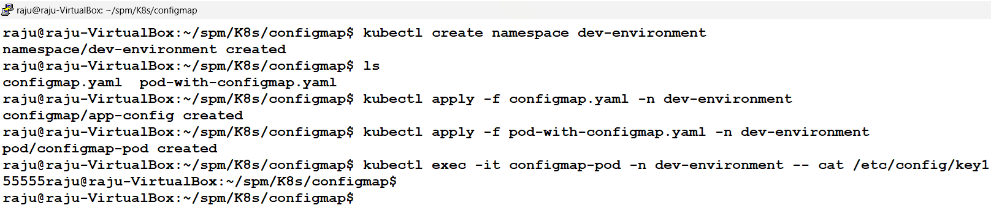
Q9. ConfigMaps

Slide 28
Q10. Secrets
apiVersion: v1
kind: Pod
metadata:
name: secret-pod
namespace: dev-environment
spec:
containers:
- name: secret-container
image: busybox
command: ["sleep", "3600"]
env:
- name: DB_USERNAME
valueFrom:
secretKeyRef:
name: db-secret
key: username
- name: DB_PASSWORD
valueFrom:
secretKeyRef:
name: db-secret
key: password
apiVersion: v1
kind: Secret
metadata:
name: db-secret
namespace: dev-environment
data:
username: c3Bt
password: c3BtQDEyMw==
$ echo -n 'spm' | base64
c3Bt
$ echo -n 'spm@123' | base64
c3BtQDEyMw==
secret.yaml
Apply the configuration:
kubectl apply -f secret.yaml
kubectl apply -f pod-with-secret.yaml
Verify the Secret and Pod creation:
kubectl get secret -n dev-environment; kubectl get pods -n dev-environment
Exec into the Pod and check the environment variables:
kubectl exec -it secret-pod -n dev-environment -- env | grep DB_
You should see the DB_USERNAME and DB_PASSWORD environment variables
with their respective values.
pod-with-secret.yaml

Slide 29
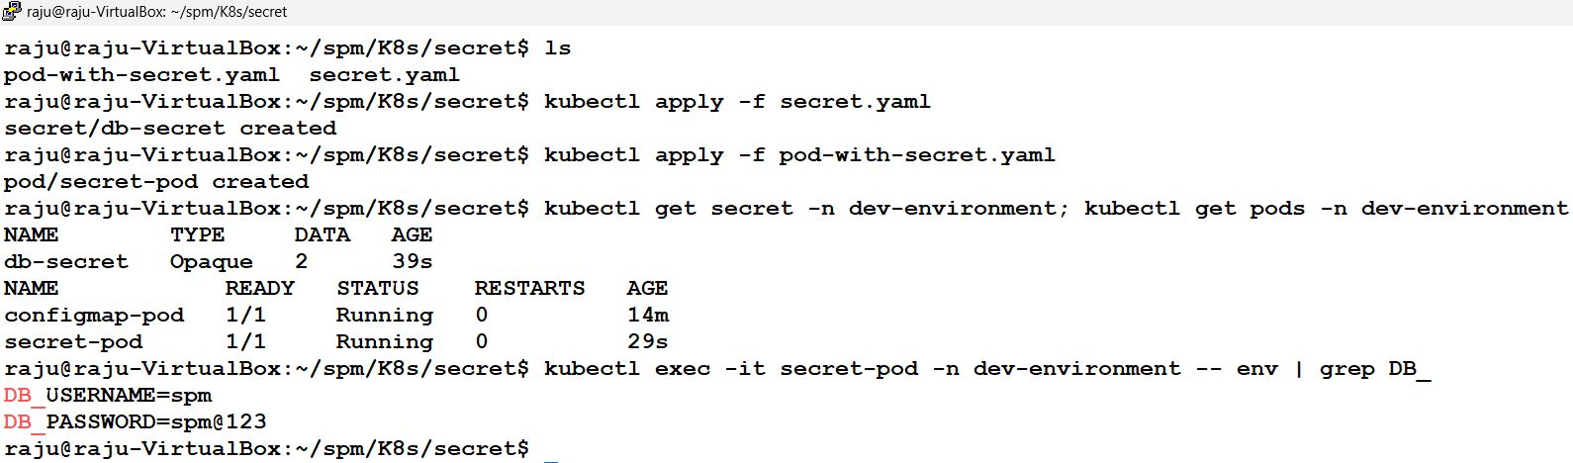
Q10. Secrets

Slide 30
Q11. Live Update
apiVersion: v1
kind: ConfigMap
metadata:
name: nginx-index
namespace: dev-environment
data:
index.html: |
<!DOCTYPE html>
<html>
<head>
<title>Welcome</title>
</head>
<body>
<h1>SPM -Kubernetes Session!</h1>
</body>
</html>
apiVersion: apps/v1
kind: Deployment
metadata:
name: nginx-deployment
namespace: dev-environment
spec:
replicas: 1
selector:
matchLabels:
app: nginx
template:
metadata:
labels:
app: nginx
spec:
containers:
- name: nginx
image: nginx:latest
volumeMounts:
- name: index-volume
mountPath: /usr/share/nginx/html
volumes:
- name: index-volume
configMap:
name: nginx-index
apiVersion: v1
kind: Service
metadata:
name: nginx-service
namespace: dev-environment
spec:
type: NodePort
selector:
app: nginx
ports:
- port: 80
targetPort: 80
nodePort: 30100
deployment.yaml
service.yaml
configmap.yaml

Slide 31
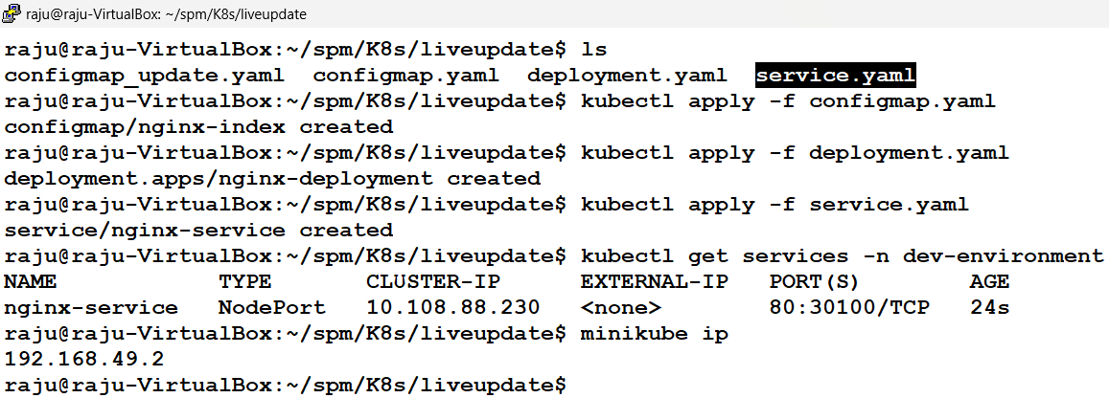

Q11. Live Update

Slide 32
Q11. Live Update
apiVersion: v1
kind: ConfigMap
metadata:
name: nginx-index
namespace: dev-environment
data:
index.html: |
<!DOCTYPE html>
<html>
<head>
<title>Live Update</title>
</head>
<body>
<h1>Live Update Successful! Kubernetes Makes Dynamic Scaling and Updates Easy!</h1>
</body>
</html>
Update the configmap.yaml file

Slide 33
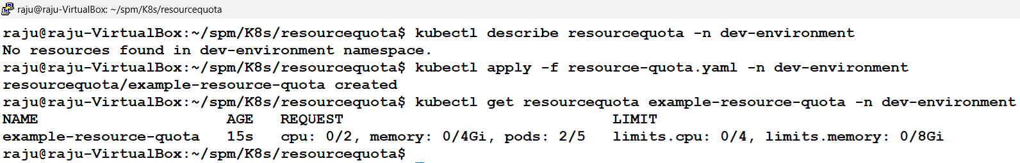
Q12. Resource Quota
apiVersion: v1
kind: ResourceQuota
metadata:
name: example-resource-quota
namespace: dev-environment
spec:
hard:
cpu: "2" # Total CPU requests
memory: 4Gi # Total memory requests
pods: "5" # Maximum number of pods
limits.cpu: "4" # Total CPU limits
limits.memory: 8Gi # Total memory limits
Apply the Configuration and Verify:
kubectl describe resourcequota -n dev-environment
kubectl apply -f resource-quota.yaml -n dev-environment
kubectl get resourcequota example-resource-quota -n dev-environment
resource-quota.yaml

Slide 34
Q13. Resource Limits
apiVersion: v1
kind: LimitRange
metadata:
name: example-limit-range
namespace: dev-environment
spec:
limits:
- type: Container
max:
cpu: "2" # Maximum CPU allowed per container
memory: 4Gi # Maximum memory allowed per container
min:
cpu: "100m" # Minimum CPU required per container
memory: 100Mi # Minimum memory required per container
default:
cpu: "500m" # Default CPU limit applied to containers
memory: 256Mi # Default memory limit applied to containers
defaultRequest:
cpu: "200m" # Default CPU request applied to containers
memory: 128Mi # Default memory request applied to containers
limit-range.yaml
The LimitRange applies to all pods within the dev-environment namespace.
Any pod created in this namespace without explicit resource specifications will inherit the default values (default), and if specified, must fall within the provided range (min to max).
“Resource limits" define the maximum amount of resources a single container can use, while “Quotas" set a total limit on the aggregate resource consumption within a specific namespace

Slide 35
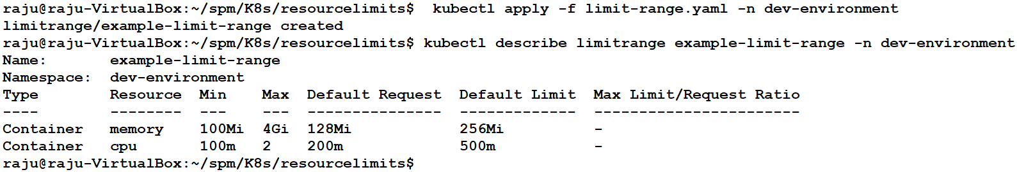
Q13. Resource Limits
Apply the Configuration and Verify:
kubectl apply -f limit-range.yaml -n dev-environment
kubectl describe limitrange example-limit-range -n dev-environment

Slide 36
Q14. HPA
apiVersion: apps/v1
kind: Deployment
metadata:
name: nginx-deployment
spec:
replicas: 2
selector:
matchLabels:
app: nginx
template:
metadata:
labels:
app: nginx
spec:
containers:
- name: nginx
image: nginx
resources:
requests:
cpu: 100m
limits:
cpu: 200m
apiVersion: v1
kind: Service
metadata:
name: nginx-service
spec:
selector:
app: nginx
ports:
- protocol: TCP
port: 80
targetPort: 80
apiVersion: autoscaling/v2
kind: HorizontalPodAutoscaler
metadata:
name: nginx-hpa
spec:
scaleTargetRef:
apiVersion: apps/v1
kind: Deployment
name: nginx-deployment
minReplicas: 2
maxReplicas: 10
metrics:
- type: Resource
resource:
name: cpu
target:
type: Utilization
averageUtilization: 5
Apply Configuration:
kubectl apply –f <*>.yaml
2. Port forward
3. Execute: load-test.sh
4. Monitor.
nginx-service.yaml
nginx-hpa.yaml
nginx-deployment.yaml

Slide 37
Q14. HPA
#!/bin/bash
while true; do
seq 1 100 | xargs -n1 -P 50 curl -s http://localhost:8080 > /dev/null
done
load-test.sh
kubectl port-forward svc/nginx-service 8080:80
By default, the nginx-service defined in Kubernetes is of type ClusterIP, which means it is only accessible inside the cluster.
Running the port-forward command maps port 80 of the service to port 8080 on your local machine, making it accessible via http://localhost:8080 from your local system.
Without port-forwarding, you wouldn't be able to directly access the service from your host machine.

Slide 38
Q14. HPA
Explanation:
seq 1 100 (you can also increase the load to change the value as1000)
Generates a sequence of numbers from 1 to 100.
This creates 100 requests to be processed.
| (pipe operator)
Passes the output of the seq command to the xargs command.
xargs -n1 -P 50 curl -s http://localhost:8080
xargs takes the input numbers (from seq) and executes the curl command for each one.
-n1 → Processes one argument (number) at a time for each curl execution.
-P 50 → Runs up to 50 parallel curl processes at the same time.
curl -s http://localhost:8080 → Makes a silent HTTP request to localhost:8080 (the Nginx service).
> /dev/null
Redirects the output of the curl requests to /dev/null, effectively discarding it.
Prevents cluttering the terminal with HTTP responses.
Purpose of the Command:
Simulates high concurrent traffic to the Nginx server at http://localhost:8080.
Generates 100 HTTP requests, with 50 requests running concurrently at any given time, which helps in stress testing the service.
Helps observe Kubernetes HPA (Horizontal Pod Autoscaler) scaling behavior based on CPU load.
How It Works in Load Testing:
The command starts with 100 requests.
xargs ensures 50 parallel requests are made simultaneously.
The load may trigger autoscaling in Kubernetes if the CPU usage crosses the threshold set in the HPA.
The requests do not produce terminal output, ensuring cleaner logs.

Slide 39
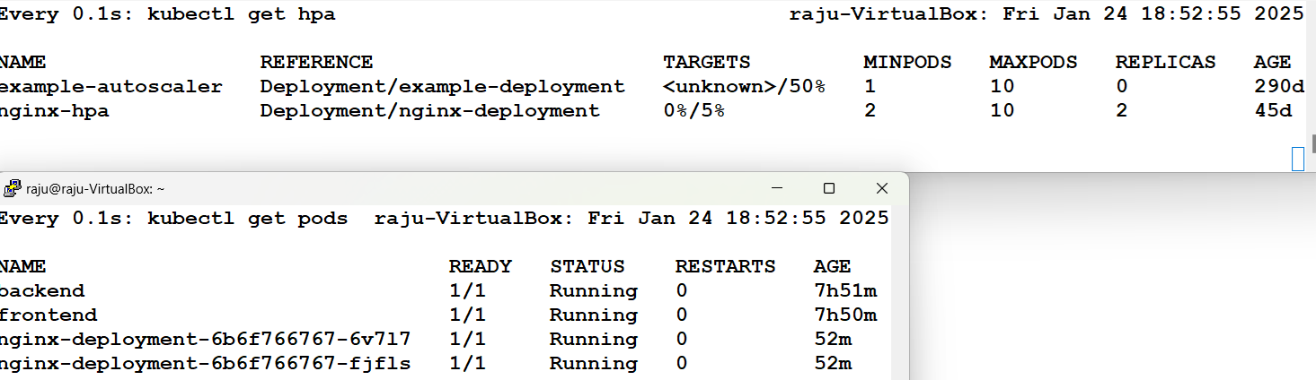
Q14. HPA

Slide 40
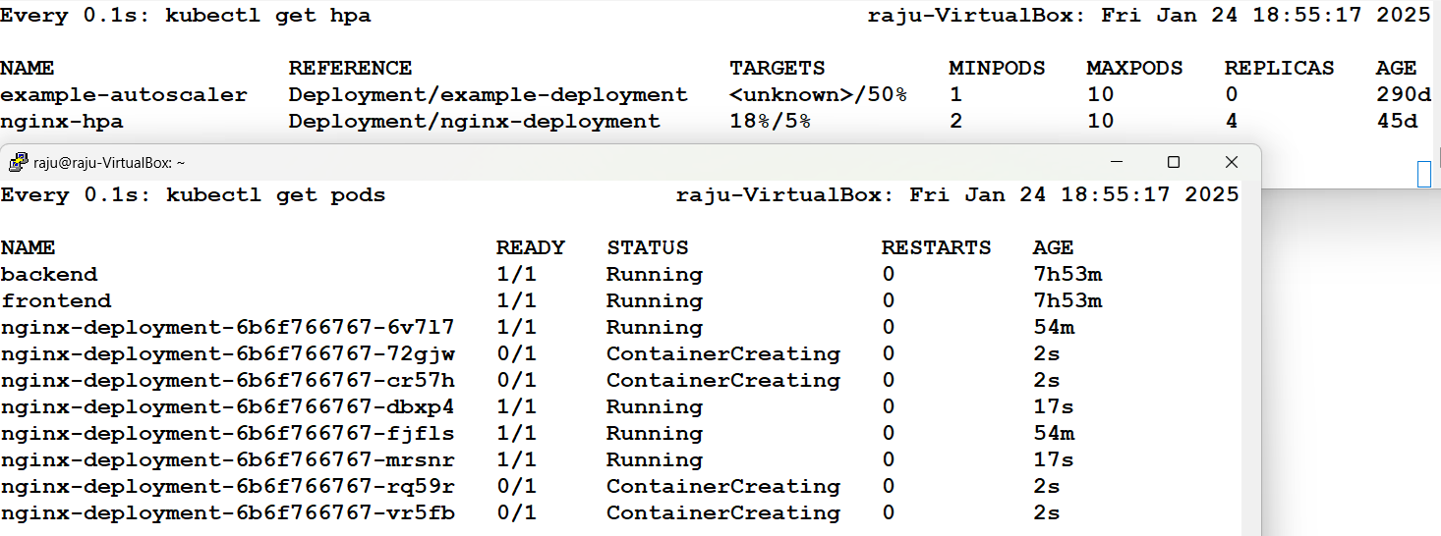
Q14. HPA

Slide 41
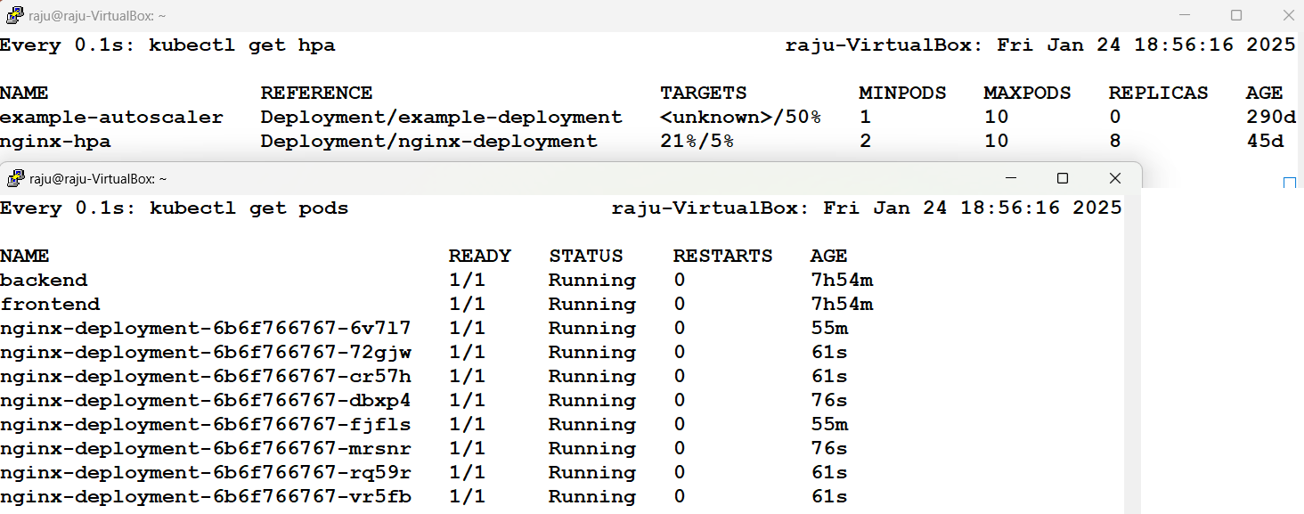
Q14. HPA

Slide 42
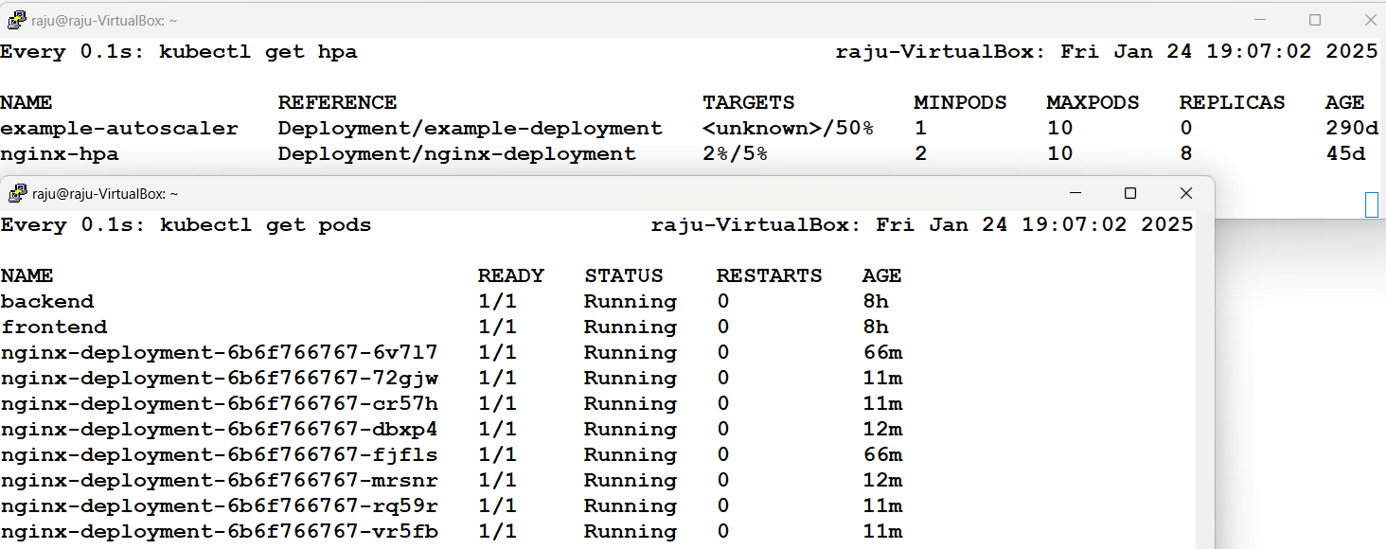
Q14. HPA

Slide 43
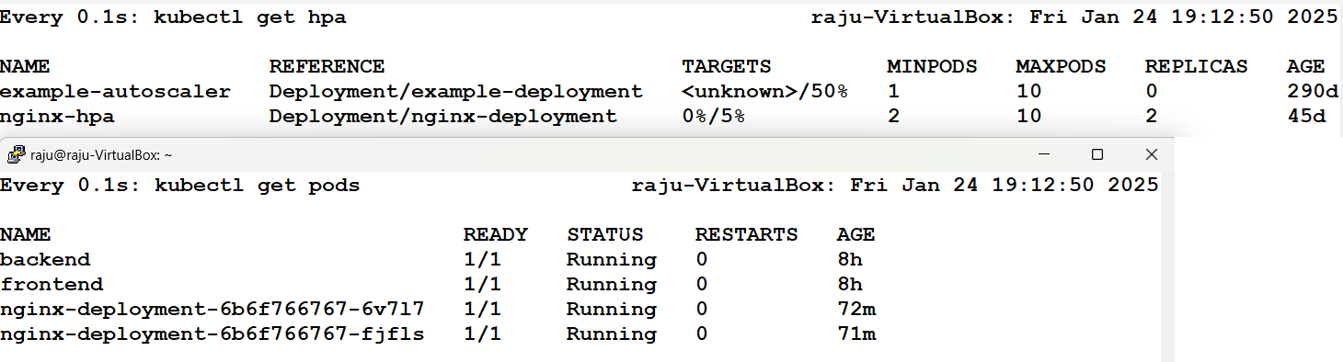
Q14. HPA

Slide 44
Q14. HPA
apiVersion: autoscaling/v2
kind: HorizontalPodAutoscaler
metadata:
name: nginx-hpa
spec:
scaleTargetRef:
apiVersion: apps/v1
kind: Deployment
name: nginx-deployment
minReplicas: 2
maxReplicas: 10
metrics:
- type: Resource
resource:
name: cpu
target:
type: Utilization
averageUtilization: 5
behavior:
scaleDown:
stabilizationWindowSeconds: 60 # Reduce stabilization time to 1 minute
policies:
- type: Percent
value: 50
periodSeconds: 30 # Reduce pods by 50% every 30 seconds
scaleUp:
policies:
- type: Percent
value: 100
periodSeconds: 15 # Increase pods by 100% every 15 seconds
By default, Kubernetes HPA takes up to 5 minutes to scale down after load reduction.
To reduce this time, configure stabilizationWindowSeconds and scale-down policies in the HPA YAML.

Slide 45
Thank You
<number>

