Slide 1
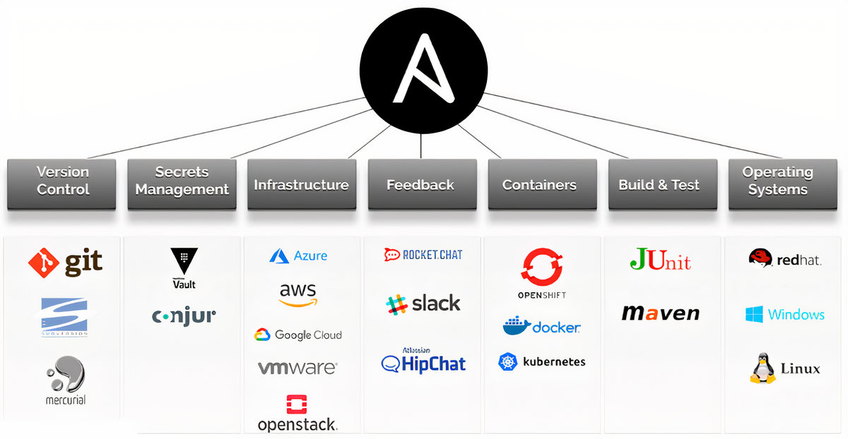
Software Production Engineering
Ansible Lab Exercises

Slide 2
Agenda
Installation and setup on an Ubuntu system.
Inventory Management: Creating inventory files for host and container communication.
Writing Your First Playbook: Creating and executing simple Ansible playbooks.
File Management: Creating different Linux file types using Ansible.
Container Management: Setting up and managing containers with Ansible.
Variable Management: Demonstrating different variable types in playbooks.
Using Templates: Generating dynamic configuration files with templates.
Numerical Loops and Conditionals: Automating tasks with loops and conditional logic.
Advanced Features: Exploring Ansible facts and vault for secure data storage.
Roles and Handlers: Modularizing playbooks with roles and using handlers for task execution.
Disk Monitoring and Alerts: Monitoring disk space and sending alerts via email.
Mini Project: Automating the development, testing, and deployment of a "Hello World" C program using Docker and Ansible.

Slide 3
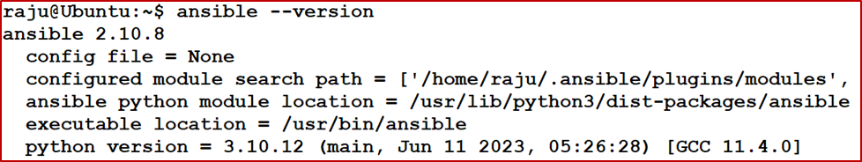
Q1. Ansible Installation
Steps to install Ansible on an Ubuntu system:
Update the System: Command to update your package index: sudo apt update
Install Required Package: Install the software-properties-common package, which is needed to manage PPAs: sudo apt install software-properties-common
Add Ansible PPA: Add the official Ansible PPA (Personal Package Archive) to your system's repository list: sudo add-apt-repository --yes --update ppa:ansible/ansible
Install Ansible: Install Ansible using the following command: sudo apt install ansible
Verify the Installation: Check the Ansible version to confirm the installation: ansible --version

Slide 4
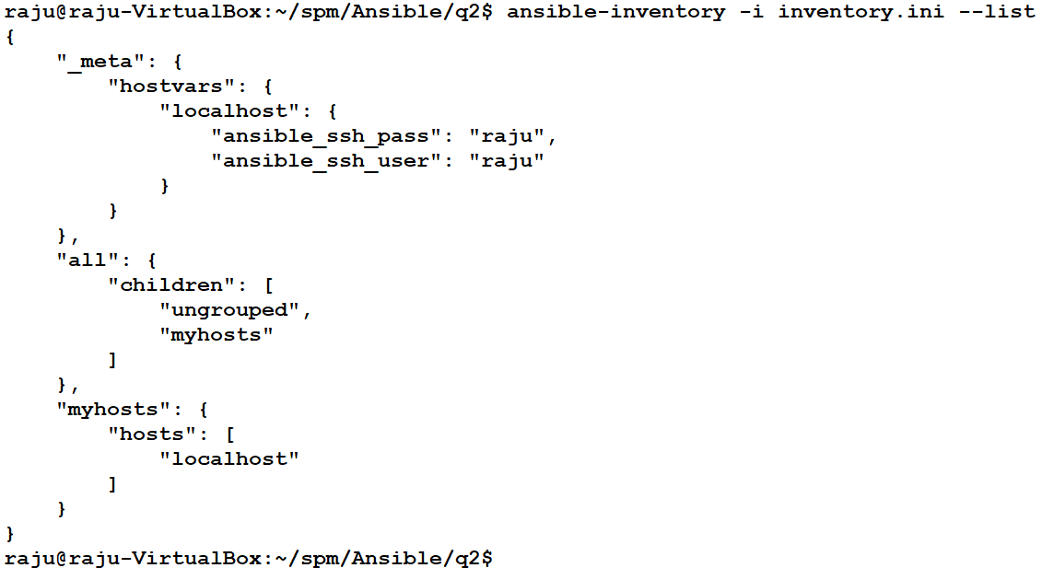
Q2. Ansible Inventory for Host Communication
[myhosts]
localhost ansible_ssh_user=raju ansible_ssh_pass=raju
inventory.ini

Slide 5
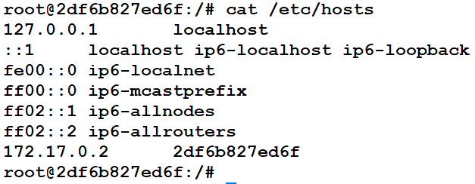
Q3. Ansible Inventory for Container as a Client System
Setting Up a Docker Container to Communicate with the Host System Through Ansible
Steps:
Inside the Host System:
Run a Docker container with an interactive terminal: docker run -it --name ansible_container ubuntu /bin/bash
Inside the Running Container:
Update the package list: apt-get update
Install the required packages: apt-get install -y openssh-server vim python3
Configure SSH to allow root login:
Open the SSH configuration file: vim /etc/ssh/sshd_config; Locate line 33 and change: #PermitRootLogin prohibit-password to PermitRootLogin yes
Start the SSH service: service ssh start
Set a root password: passwd
Obtain the container's IP address: cat /etc/hosts
Inside the Host System:
Remove conflicting SSH keys (if any): ssh-keygen -f "/home/raju/.ssh/known_hosts" -R "172.17.0.2"
Establish the SSH connection with the container: ssh root@172.17.0.2; If prompted, type yes to add the new host key.
Test the SSH connection manually: ssh root@172.17.0.2
Confirm Ansible connectivity by running the ping module: ansible myhosts -m ping -i inventory.ini
Notes:
The command ssh-keygen -f "/home/raju/.ssh/known_hosts" -R "172.17.0.2" is used to remove the stored SSH host key for the IP address 172.17.0.2 from the known_hosts file.
Command: ssh-keygen - This is a tool for generating, managing, and converting authentication keys for SSH.
Option: -f "/home/raju/.ssh/known_hosts"
Specifies the path to the known_hosts file.
Option: -R "172.17.0.2"
Removes all keys associated with the IP address 172.17.0.2 from the known_hosts file.
This is useful when the SSH server on that host has been reinstalled, updated, or its host key has changed, causing a key mismatch.
Why Use This Command?
When you connect to a remote system via SSH, its host key is stored in your known_hosts file. If the host key changes (e.g., after reinstalling the remote system or recreating a Docker container), SSH detects the mismatch and prevents the connection, showing a warning like:
@ WARNING: REMOTE HOST IDENTIFICATION HAS CHANGED! @ To resolve this, you need to remove the outdated key using the ssh-keygen -R command.

Slide 6
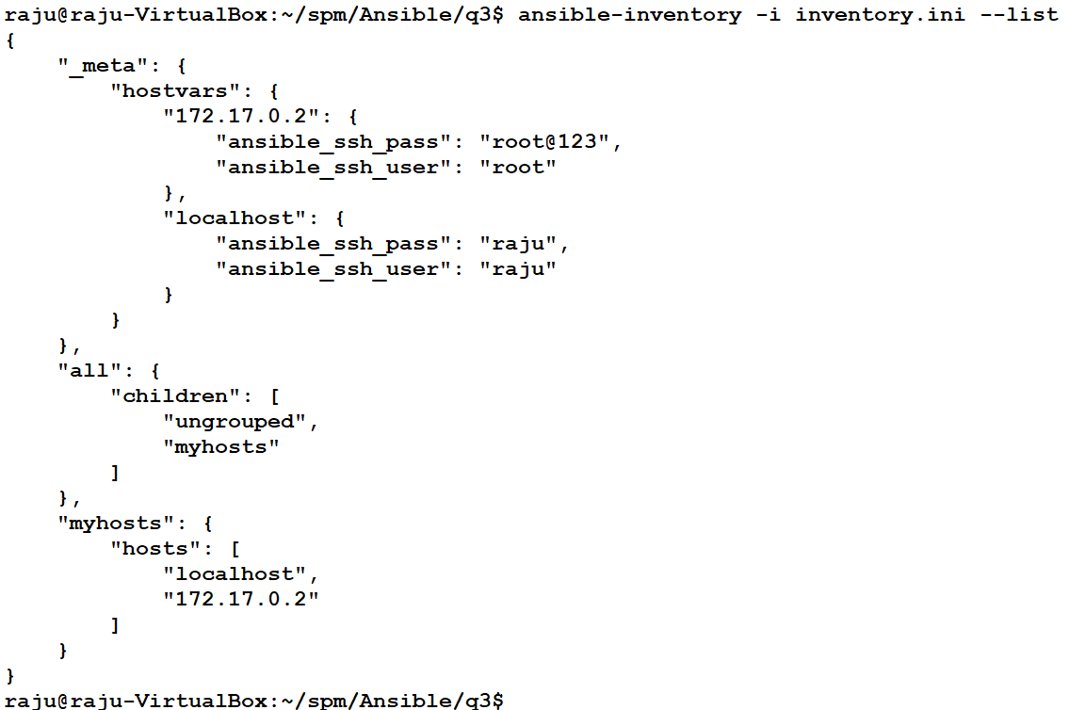
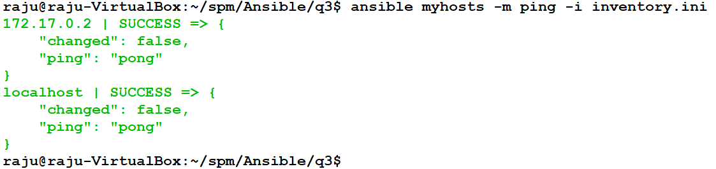
Q3. Ansible Inventory for Container as a Client System
[myhosts]
localhost ansible_python_interpreter=/usr/bin/python3
172.17.0.2 ansible_python_interpreter=/usr/bin/python3
localhost ansible_ssh_user=raju ansible_ssh_pass=raju
172.17.0.2 ansible_ssh_user=root ansible_ssh_pass=root123
inventory.ini

Slide 7
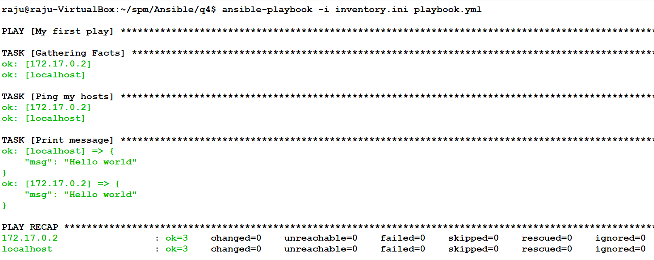
Q4. Writing and Executing Your First Ansible Playbook
- name: My first play
hosts: myhosts
tasks:
- name: Ping my hosts
ansible.builtin.ping:
- name: Print message
ansible.builtin.debug:
msg: Hello world
[myhosts]
localhost ansible_python_interpreter=/usr/bin/python3
172.17.0.2 ansible_python_interpreter=/usr/bin/python3
localhost ansible_ssh_user=raju ansible_ssh_pass=raju
172.17.0.2 ansible_ssh_user=root ansible_ssh_pass=root123
inventory.ini
playbook.yml

Slide 8
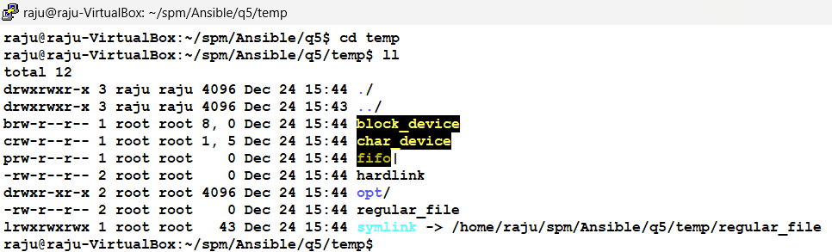
Q5. Creating Linux File Types with Ansible Playbook
---
- name: Create all file types in /home/raju/spm/Ansible/q5/temp directory
hosts: localhost
become: yes
tasks:
- name: Ensure the /home/raju/spm/Ansible/q5/temp directory exists
file:
path: /home/raju/spm/Ansible/q5/temp
state: directory
- name: Create a regular file
file:
path: /home/raju/spm/Ansible/q5/temp/regular_file
state: touch
- name: Create a directory named 'opt'
file:
path: /home/raju/spm/Ansible/q5/temp/opt
state: directory
- name: Create a character device
command: mknod /home/raju/spm/Ansible/q5/temp/char_device c 1 5
- name: Create a block device
command: mknod /home/raju/spm/Ansible/q5/temp/block_device b 8 0
- name: Create a symbolic link
file:
src: /home/raju/spm/Ansible/q5/temp/regular_file
dest: /home/raju/spm/Ansible/q5/temp/symlink
state: link
- name: Create a hard link
command: ln /home/raju/spm/Ansible/q5/temp/regular_file /home/raju/spm/Ansible/q5/temp/hardlink
- name: Create a FIFO file
command: mkfifo /home/raju/spm/Ansible/q5/temp/fifo
playbook.yml
[myhosts]
localhost ansible_python_interpreter=/usr/bin/python3
localhost ansible_ssh_user=raju ansible_ssh_pass=raju ansible_sudo_pass=raju
inventory.ini

Slide 9
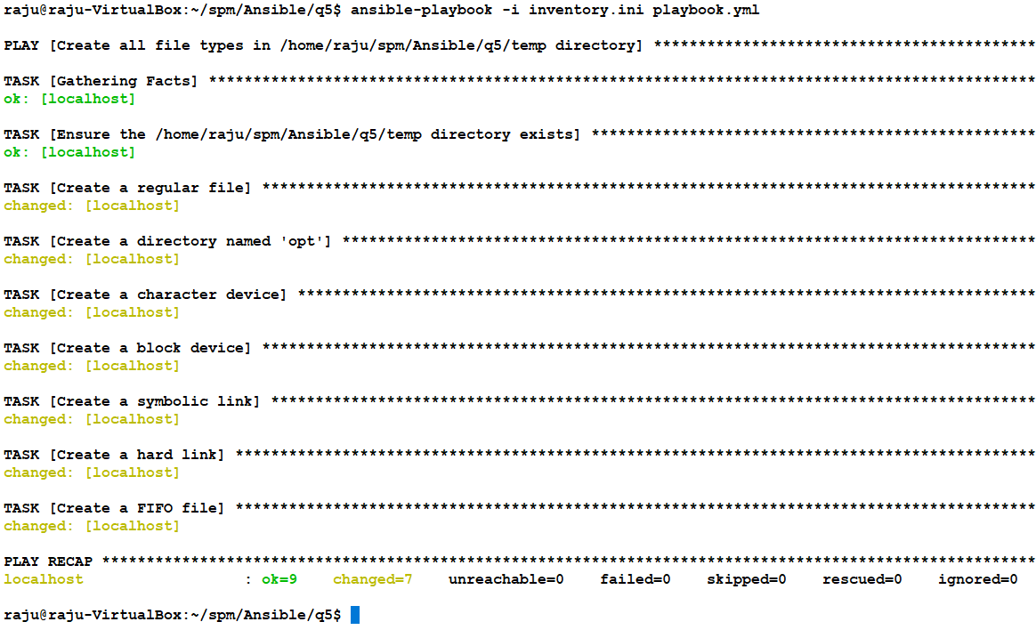
Q5. Creating Linux File Types with Ansible Playbook

Slide 10
Q6. Container Web Server Creation with Ansible
Step-by-Step Process
Run a Container: Start a container to create an isolated environment.
Install OpenSSH Server: Install the OpenSSH server within the container: apt-get install -y openssh-server
Modify SSH Configuration File: Navigate to the /etc/ssh/sshd_config file within the container. Locate line number 33 and change the entry from "#PermitRootLogin prohibit-password" to "PermitRootLogin yes" within the sshd_config file.
Start SSH Service: Activate the SSH service within the container. sudo service ssh restart; Check the status of ssh service: service ssh status
Verify Communication: Ensure proper communication between the host and the container.
Create ssh key in the host.
Copy SSH Public Key: Transfer the SSH public key from the host to the container by executing: ssh-copy-id root@172.17.0.2
Install Python: Install Python within the container and execute the command 'apt update' to update the package.

Slide 11
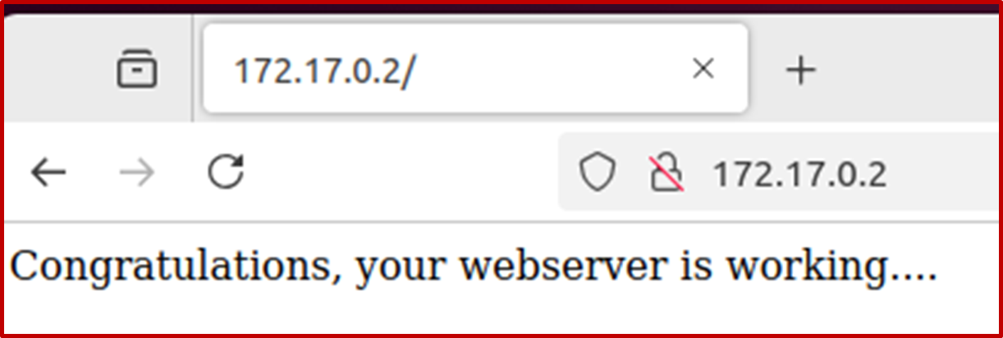
Q6. Container Web Server Creation with Ansible
[myhosts]
172.17.0.2 ansible_ssh_user=root ansible_ssh_pass=root123 ansible_python_interpreter=/usr/bin/python3
inventory.ini
---
- name: Web Server Creation
hosts: myhosts
remote_user: root
become: true
tasks:
- name: Install Apache2
apt:
name: apache2
state: latest
- name: Create content
copy:
content: "Congratulations, your webserver is working...."
dest: /var/www/html/index.html
- name: Start Apache2
shell: |
service apache2 start
Run Playbook from Host: $ansible-playbook -i inventory.ini playbool.yml
Access the container's IP address through a web browser and verify the displayed content.
playbook.yml

Slide 12
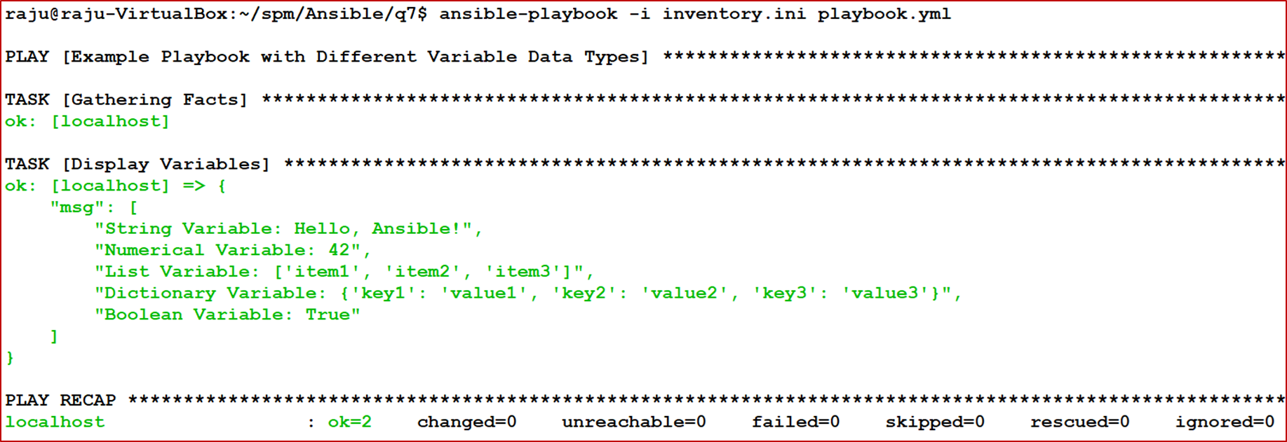
Q7. Demonstrate Variable Types in Ansible
---
- name: Example Playbook with Different Variable Data Types
hosts: localhost
vars:
# String Variable
string_var: "Hello, Ansible!"
# Numerical Variable
num_var: 42
# List Variable
list_var:
- item1
- item2
- item3
# Dictionary Variable
dict_var:
key1: value1
key2: value2
key3: value3
# Boolean Variable
bool_var: true
tasks:
- name: Display Variables
debug:
msg:
- "String Variable: {{ string_var }}"
- "Numerical Variable: {{ num_var }}"
- "List Variable: {{ list_var }}"
- "Dictionary Variable: {{ dict_var }}"
- "Boolean Variable: {{ bool_var }}"
[myhosts]
localhost ansible_python_interpreter=/usr/bin/python3
localhost ansible_ssh_user=raju ansible_ssh_pass=raju
inventory.ini
playbook.yml

Slide 13
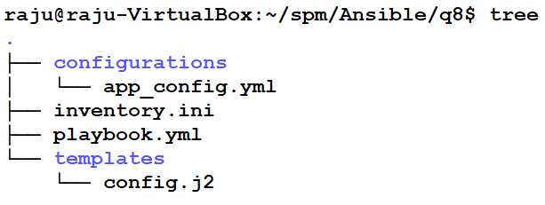
Q8. Ansible Template Demonstration
---
- name: Ansible Template Demonstration
hosts: myhosts
vars:
app_name: "MyApp"
env: "production"
version: "1.0.0"
db_host: "localhost"
db_port: 3306
db_name: "myapp_db"
db_user: "admin"
db_password: "password123"
tasks:
- name: Create destination directory for configuration file
file:
path: /home/raju/spm/Ansible/q8/configurations
state: directory
- name: Generate configuration file using a template
template:
src: templates/config.j2
dest: /home/raju/spm/Ansible/q8/configurations/app_config.yml
- name: Display the generated configuration file
command: cat /home/raju/spm/Ansible/q8/configurations/app_config.yml
register: output
- name: Print the configuration file contents
debug:
msg: "{{ output.stdout }}"
[myhosts]
localhost ansible_python_interpreter=/usr/bin/python3
localhost ansible_connection=local
playbook.yml
inventory.ini
# Configuration File Generated via Ansible Template
application_name: {{ app_name }}
environment: {{ env }}
version: {{ version }}
# Database Configuration
db_host: {{ db_host }}
db_port: {{ db_port }}
db_name: {{ db_name }}
db_user: {{ db_user }}
db_password: {{ db_password }}
config.j2

Slide 14
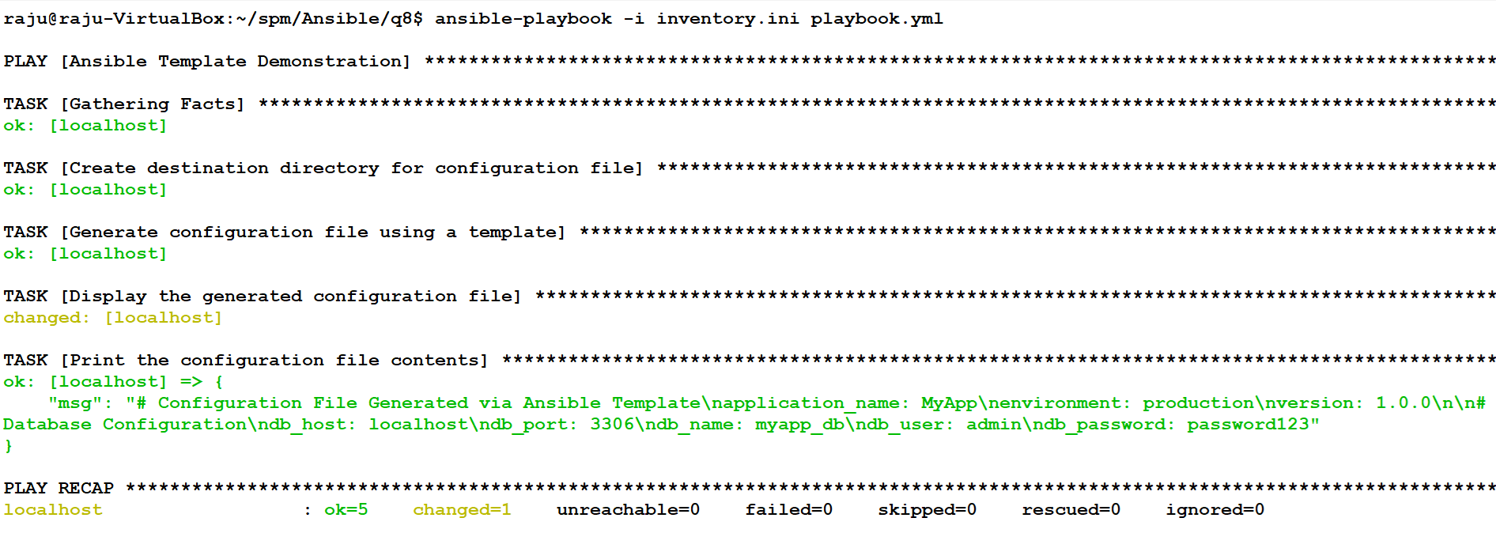
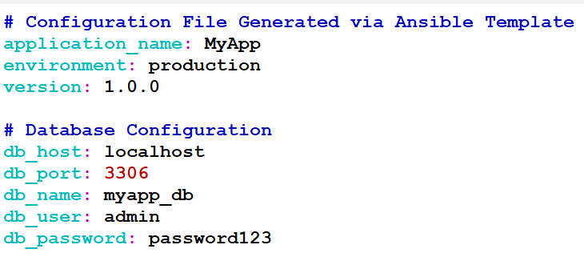
Q8. Ansible Template Demonstration
app_config.yml
raju@raju-VirtualBox:~/spm/Ansible/q8/configurations$ vim app_config.yml

Slide 15
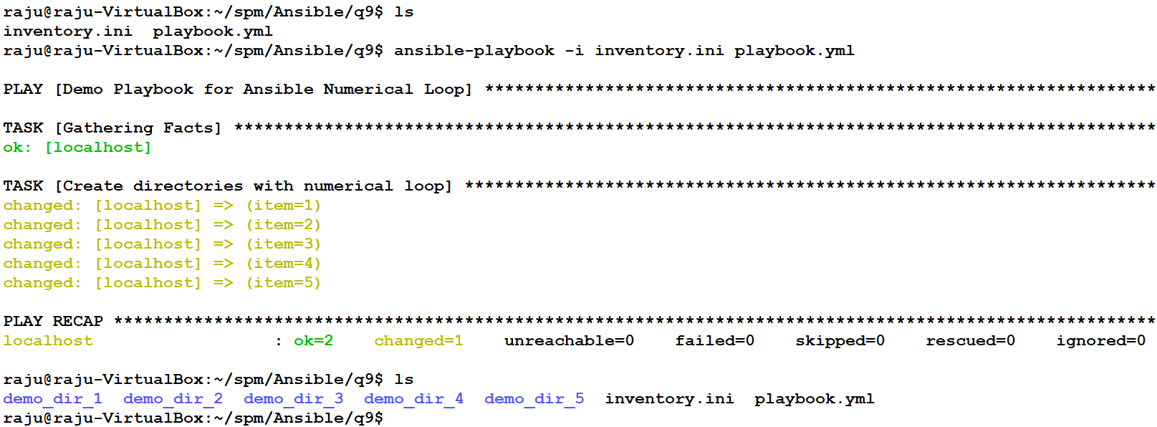
Q9. Demonstrating Numerical Loop
---
- name: Demo Playbook for Ansible Numerical Loop
hosts: localhost
tasks:
- name: Create directories with numerical loop
file:
path: "~/spm/Ansible/q9/demo_dir_{{ item }}"
state: directory
with_sequence: start=1 end=5
inventory.ini
[myhosts]
localhost ansible_python_interpreter=/usr/bin/python3
localhost ansible_connection=local
playbook.yml

Slide 16
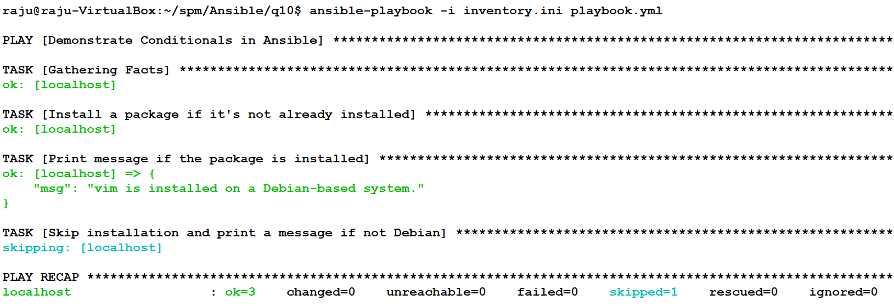
Q10. Demonstrate Conditionals in Ansible
---
- name: Demonstrate Conditionals in Ansible
hosts: localhost
gather_facts: yes
vars:
package_name: "vim"
tasks:
- name: Install a package if it's not already installed
apt:
name: "{{ package_name }}"
state: present
when: ansible_facts['os_family'] == "Debian"
- name: Print message if the package is installed
debug:
msg: "{{ package_name }} is installed on a Debian-based system."
when: ansible_facts['os_family'] == "Debian"
- name: Skip installation and print a message if not Debian
debug:
msg: "This task is skipped because the host OS is not Debian-based."
when: ansible_facts['os_family'] != "Debian"
playbook.yml
[myhosts]
localhost ansible_python_interpreter=/usr/bin/python3
localhost ansible_connection=local
inventory.ini
Condition 1: Installs the vim package only if the OS family is Debian.
Condition 2: Prints a success message if the package is installed and the OS is Debian-based.
Condition 3: Skips the installation and prints a message if the OS is not Debian-based.
This playbook uses ansible_facts to determine the OS family dynamically, making it versatile and realistic.

Slide 17
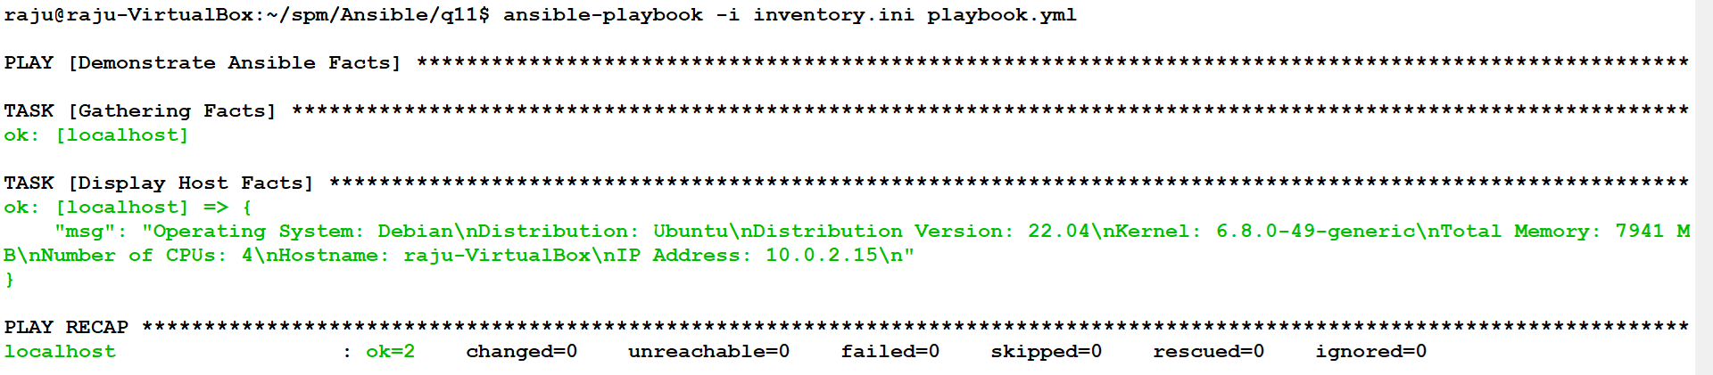
Q11. Exploring Ansible Facts
---
- name: Demonstrate Ansible Facts
hosts: localhost
tasks:
- name: Display Host Facts
debug:
msg: |
Operating System: {{ ansible_facts['os_family'] }}
Distribution: {{ ansible_facts['distribution'] }}
Distribution Version: {{ ansible_facts['distribution_version'] }}
Kernel: {{ ansible_facts['kernel'] }}
Total Memory: {{ ansible_facts['memtotal_mb'] }} MB
Number of CPUs: {{ ansible_facts['processor_cores'] }}
Hostname: {{ ansible_facts['hostname'] }}
IP Address: {{ ansible_facts['default_ipv4']['address'] }}
playbook.yml
inventory.ini
[myhosts]
localhost ansible_python_interpreter=/usr/bin/python3
localhost ansible_connection=local

Slide 18
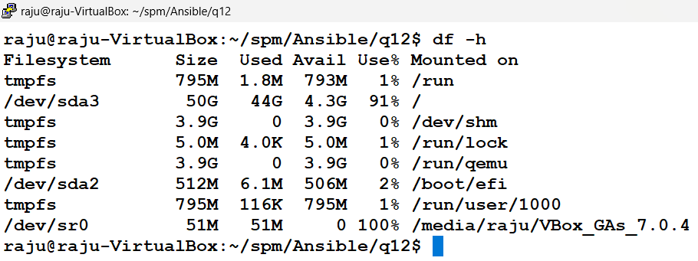
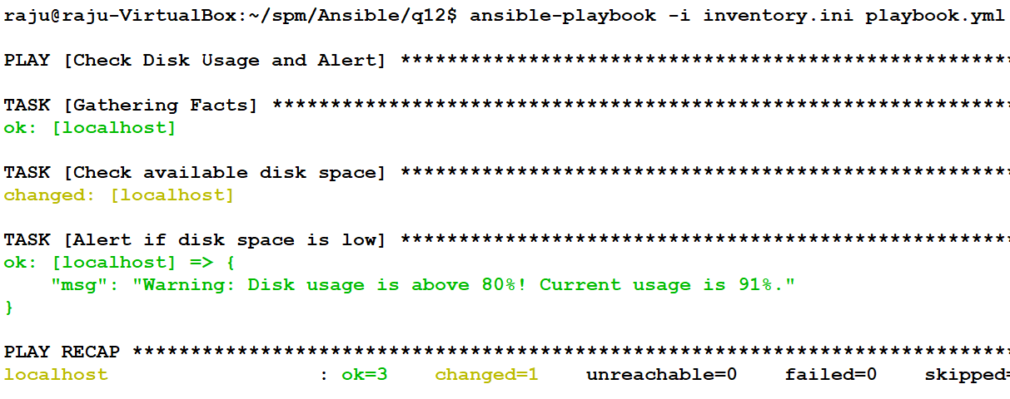
Q12. Disk Space Monitoring with Ansible
---
- name: Check Disk Usage and Alert
hosts: localhost
become: false
tasks:
- name: Check available disk space
shell: df -h | grep '/dev/sda3' | awk '{print $5}' | sed 's/%//'
register: disk_usage
- name: Alert if disk space is low
debug:
msg: "Warning: Disk usage is above 80%! Current usage is {{ disk_usage.stdout }}%."
when: disk_usage.stdout | int > 80
playbook.yml
[myhosts]
localhost ansible_python_interpreter=/usr/bin/python3
localhost ansible_connection=local
inventory.ini

Slide 19
Q13. Disk Space Monitoring with Email Alert
---
- name: Disk Space Monitoring and Email Alert
hosts: localhost
become: false
tasks:
- name: Check available disk space
shell: df -h | grep /dev/sda3 | awk '{print $5}' | sed 's/%//'
register: disk_usage
- name: Send email if disk space is low
mail:
host: smtp.gmail.com
port: 587
username: "drbalat.raju@gmail.com"
password: "ooaf wqnd tksp fmta"
to: "b.thangaraju@iiitb.ac.in"
subject: "Warning: Disk usage is above 80%!"
body: "Current disk usage is {{ disk_usage.stdout }}%. Immediate action is needed."
secure: starttls
when: disk_usage.stdout | int > 80
[myhosts]
localhost ansible_python_interpreter=/usr/bin/python3
localhost ansible_connection=local
inventory.ini
playbook.yml

Slide 20
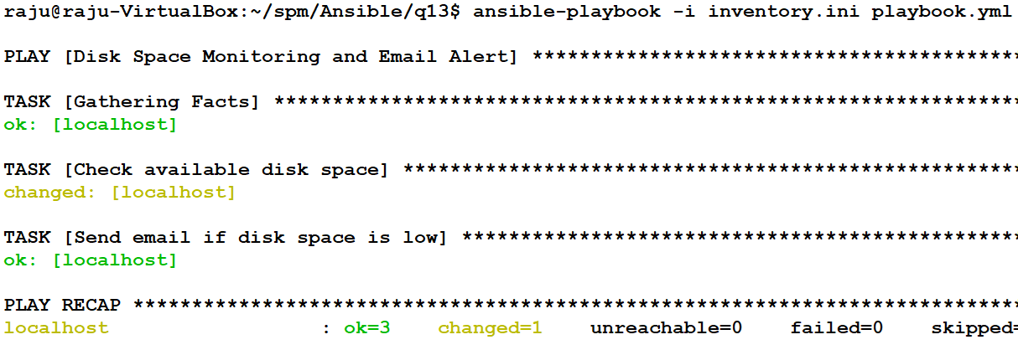
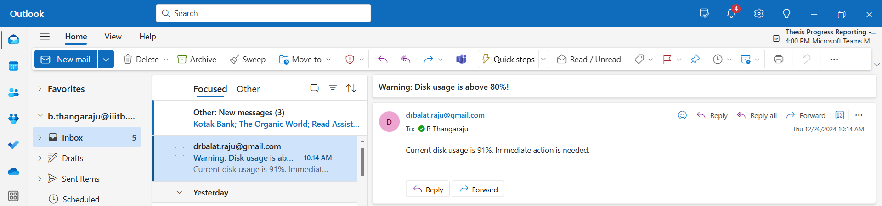
Q13. Disk Space Monitoring with Email Alert

Slide 21
Q14. Demonstrate ignore_errors in Ansible
---
- name: Playbook to demonstrate ignore_errors
hosts: localhost
gather_facts: no
tasks:
- name: Try to remove a non-existent file
command: rm /home/raju/spm/Ansible/q14/non_existent_file
ignore_errors: yes
- name: Display a message regardless of the previous task's success
debug:
msg: "Continuing playbook execution even after failure."
- name: Create a directory as the next step
file:
path: /home/raju/spm/Ansible/q14/example_directory
state: directory
[myhosts]
localhost ansible_python_interpreter=/usr/bin/python3
localhost ansible_connection=local
inventory.ini
playbook.yml

Slide 22
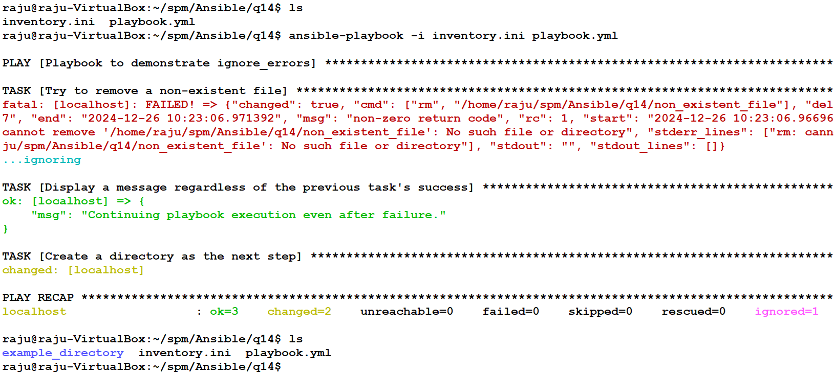
Q14. Demonstrate ignore_errors in Ansible

Slide 23
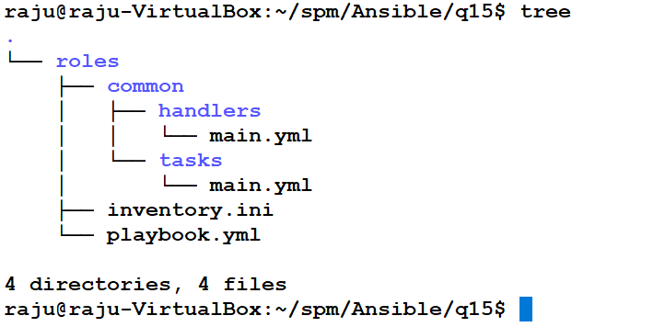
Q15. Implement Ansible Roles
#/home/raju/spm/Ansible/q15/roles/common/tasks/main.yml
---
- name: Ensure the NTP package is installed
apt:
name: ntp
state: present
- name: Ensure the NTP service is started and enabled
service:
name: ntp
state: started
enabled: yes
#/home/raju/spm/Ansible/q15/roles/common/handlers/main.yml
---
- name: Restart NTP Service
service:
name: ntp
state: restarted
---
- name: Example Playbook with Roles
hosts: myhosts
become: true # Run tasks with elevated privileges (sudo)
roles:
- common
playbook.yml
[myhosts]
localhost ansible_python_interpreter=/usr/bin/python3
localhost ansible_ssh_user=raju ansible_ssh_pass=raju ansible_sudo_pass=raju
inventory.ini

Slide 24
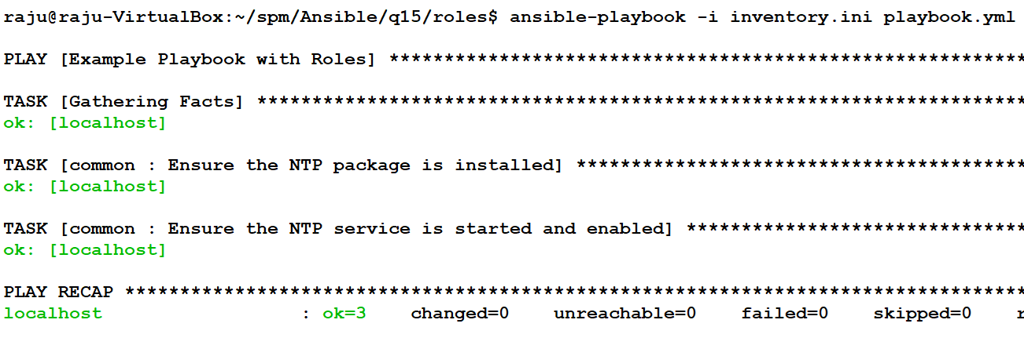
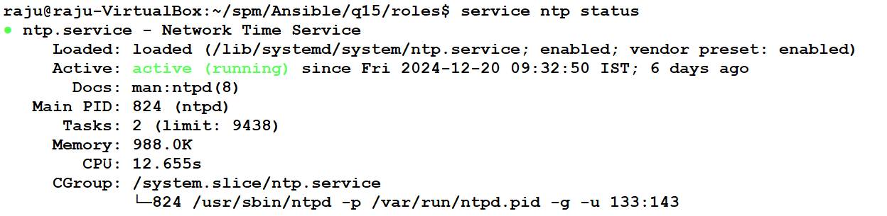
Q15. Implement Ansible Roles

Slide 25
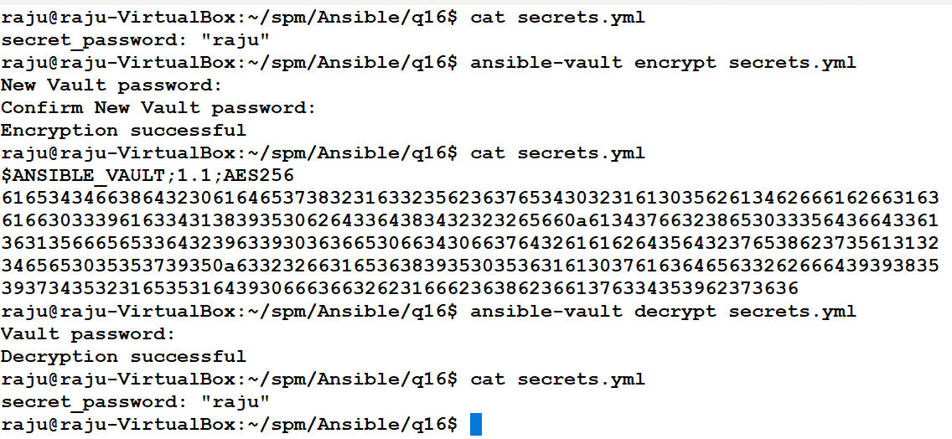
Q16. Demonstrating Vault Usage with Ansible
Create secrets.yml and enter: secret_password: “raju”;
vault passwd: tha

Slide 26
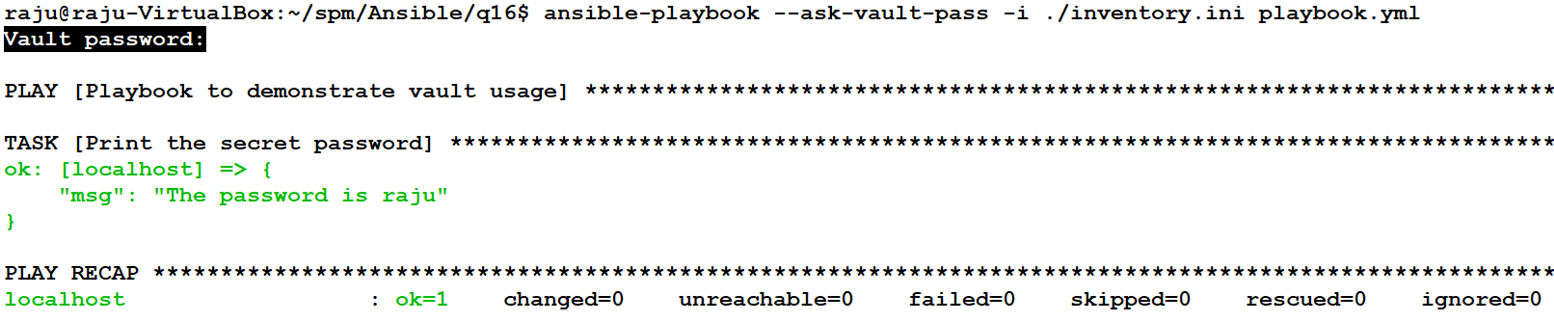
Q16. Demonstrating Vault Usage with Ansible
- name: Playbook to demonstrate vault usage
hosts: local
connection: local
gather_facts: no
vars_files:
- secrets.yml
tasks:
- name: Print the secret password
debug:
msg: "The password is {{ secret_password }}"
inventory.ini
[local]
localhost ansible_connection=local ansible_python_interpreter=/usr/bin/python3
playbook.yml

Slide 27
Mini Project
Setting Up a "Hello World" C Program Environment Using Ansible
Objective:
The goal of this mini-project is to set up an environment for developing, testing, and deploying a "Hello World" C program using Docker containers and Ansible.
You will write an inventory file and create multiple playbooks to automate tasks for development, testing, and deployment stages.

Slide 28
Mini Project
Steps to Prepare and Configure Docker Containers for the Mini Project
Inside the Host System:
Run a Docker Container: Start a Docker container with an interactive terminal using the Ubuntu base image: docker run -it --name ansible_container ubuntu /bin/bash
Inside the Running Container:
Update Package List: Update the package list to ensure all packages are up-to-date: apt-get update
Install Required Packages: Install OpenSSH Server, Vim, and Python3 for configuration and communication: apt-get install -y openssh-server vim python3
Configure SSH for Root Login: Open the SSH configuration file: vim /etc/ssh/sshd_config. Locate line 33 and modify the following line: #PermitRootLogin prohibit-password -Change it to: PermitRootLogin yes
Start SSH Service: Start the SSH service to enable communication: service ssh start
Set Root Password: Set a password for the root user: passwd; Enter and confirm the password as root123.

Slide 29
Mini Project
Freeze the Configured Container as an Image: From the host system, commit the changes to the running container to create a reusable Docker image: docker commit <container_id> mini_proj
Run and Configure Development, Testing, and Deployment Containers:
Run 3 Containers: Use the newly created mini_proj image to start three containers in 3 different terminals with the names dev, test, and deploy and start ssh service:
docker run -it --name dev mini_proj /bin/bash
docker run -it --name test mini_proj /bin/bash
docker run -it --name deploy mini_proj /bin/bash
Get IP Addresses: Retrieve the IP addresses of the dev, test, and deploy containers:
Next Step: Use the retrieved IP addresses to write an inventory.ini file for the Ansible playbooks to communicate with these containers. This inventory file should categorize the containers as development, testing, and deployment targets.

Slide 30
Mini Project
[myhosts]
dev_container ansible_host=172.17.0.2 ansible_ssh_user=root ansible_ssh_pass=root123 ansible_python_interpreter=/usr/bin/python3
test_container ansible_host=172.17.0.3 ansible_ssh_user=root ansible_ssh_pass=root123 ansible_python_interpreter=/usr/bin/python3
deploy_container ansible_host=172.17.0.4 ansible_ssh_user=root ansible_ssh_pass=root123 ansible_python_interpreter=/usr/bin/python3
[development]
dev_container
[testing]
test_container
[deployment]
deploy_container
Inventory.ini
Run the development playbook: ansible-playbook -i inventory.ini dev_playbook.yml
Run the testing playbook: ansible-playbook -i inventory.ini test_playbook.yml
Run the deployment playbook: ansible-playbook -i inventory.ini deploy_playbook.yml

Slide 31
Mini Project
---
- name: Setup development environment
hosts: development
become: yes
tasks:
- name: Install required packages
apt:
name:
- build-essential
- gcc
state: present
update_cache: yes
- name: Create Hello World C program
copy:
dest: /home/dev/hello.c
content: |
#include <stdio.h>
int main() {
printf("Hello, World!\\n");
return 0;
}
- name: Compile Hello World program
command: gcc -o /home/dev/hello /home/dev/hello.c
---
- name: Deploy Hello World program
hosts: deployment
become: yes
tasks:
- name: Create deployment directory
file:
path: /opt/deploy
state: directory
- name: Copy Hello World binary to deployment container
copy:
src: /home/raju/spm/Ansible/miniproject/hello
dest: /opt/deploy/hello
mode: '0755'
- name: Execute Hello World program
command: /opt/deploy/hello
test_playbook.yml
---
- name: Test Hello World program
hosts: testing
become: yes
tasks:
- name: Install required packages
apt:
name:
- gcc
state: present
update_cache: yes
- name: Copy Hello World binary to testing container
copy:
src: /home/raju/spm/Ansible/miniproject/hello
dest: /home/test/hello
mode: '0755'
- name: Run Hello World program
command: /home/test/hello
deploy_playbook.yml
dev_playbook.yml

Slide 32
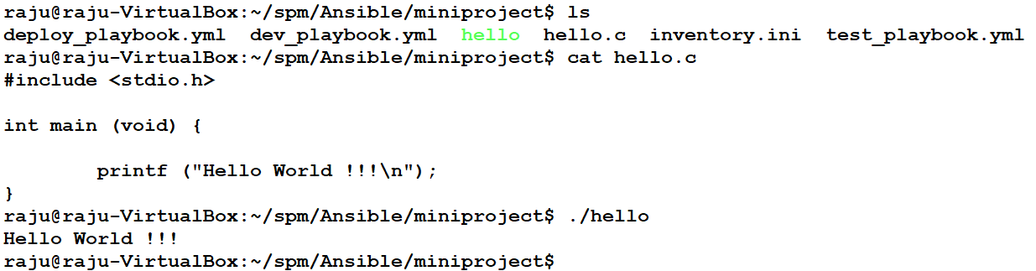
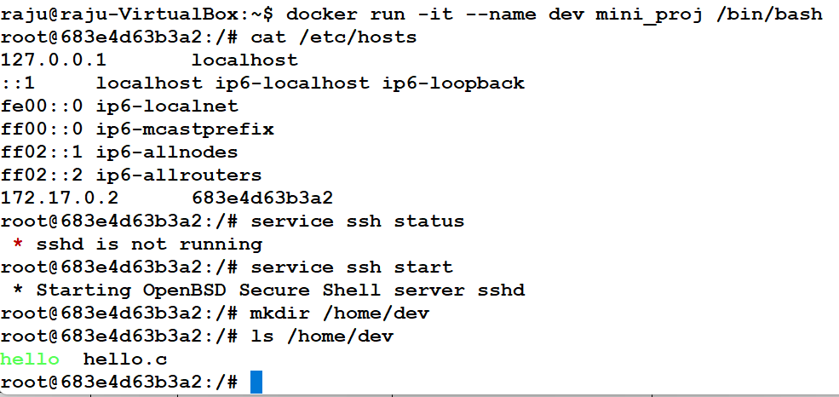
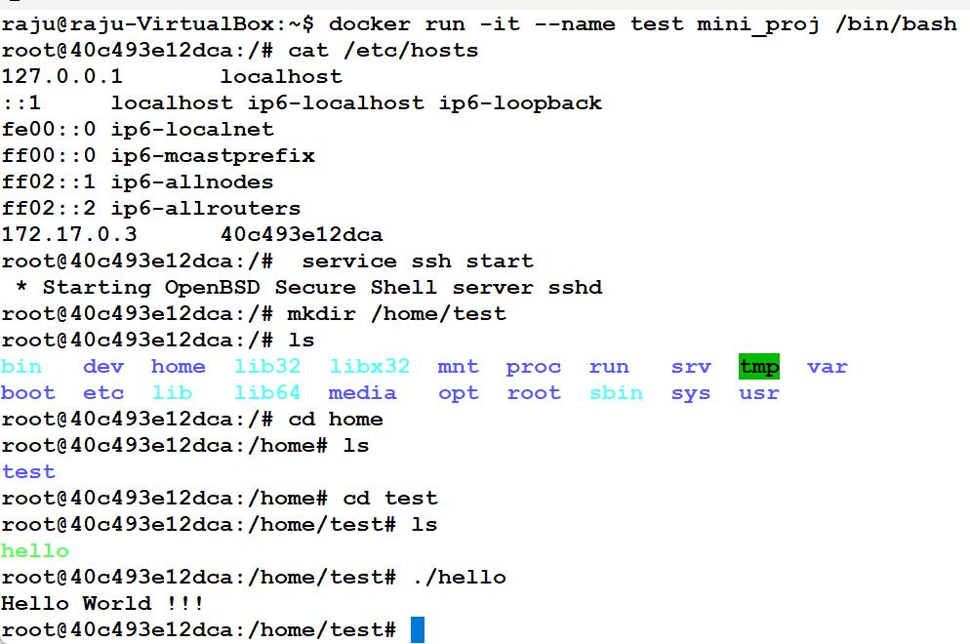
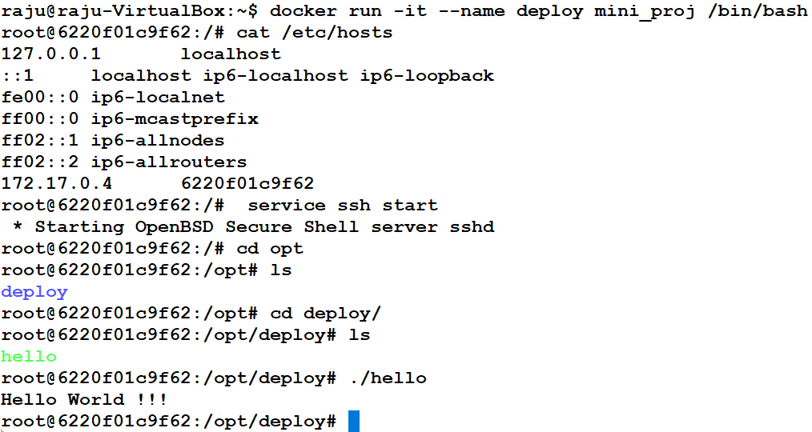
Mini Project
Development Container
Testing Container
Deployment Container

Slide 33
Thank You

