Slide 1
Uber rides and weather
Zahra Razook
Mary (Jiahui) Du
Isa Huseni
Greg Presneill

Slide 2
overview
Introduction
Overview of the process
Approach
Results
Summary
Next steps

Slide 3




Slide 4
Group 4 Project 1
For this project, we will explore the ‘Uber Pickups in New York City’ data for 2014 available from Kaggle and investigate what effect weather conditions had on ride demand (Uber usage).

Slide 5
Overview of the process

Slide 6


Identifying Data Source
New York City data - Apr- Sep 2014 NOAA weather data – Apr- Sep 2014
Retrieving Data
Assemble & Cleaning
Pandas : pd. concat, len(), .Drop …
Analyze & acknowledge limitations
Conclusion

Slide 7
Approach

Slide 8
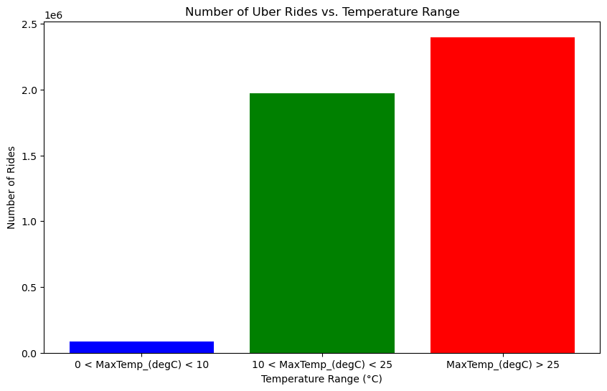
Exploratory Data analysis
In this graph, the data is grouped into three temperature ranges.
This data suggests that the usage of Uber increases during the summer.
Further analysis reveals additional insights into the impact of temperature on the number of rides taken in New York.

Slide 9
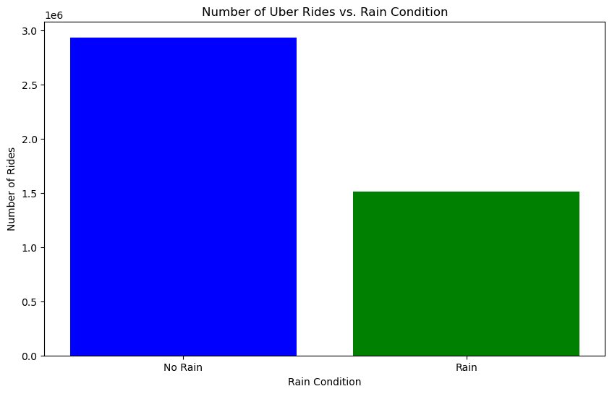
Exploratory Data analysis
The data aims to examine the impact of rainfall on the number of Uber rides.
The data indicates that Uber usage is higher on days without rain.
Again, further analysis provides additional insights into how weather affect the number of rides taken in New York City.

Slide 10
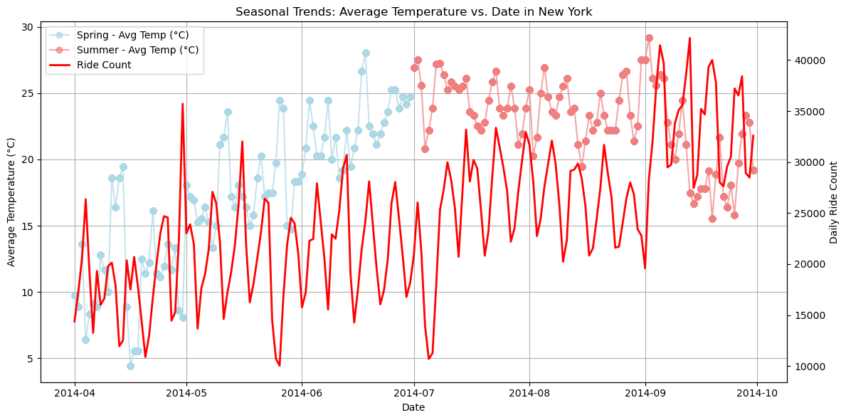
Exploratory Data analysis
The graph illustrates the seasonal trend, depicting the variations in Uber rides relative to the average temperature over the period in the data.
It shows that Uber usage is higher during the summer months.
April is the month with the lowest number of Uber rides.

Slide 11
results

Slide 12
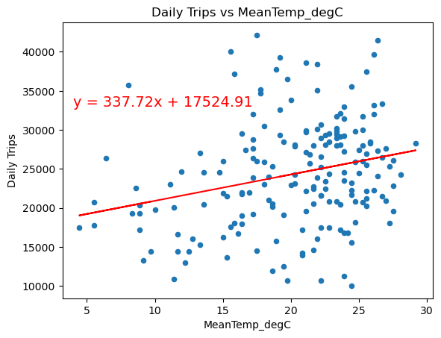
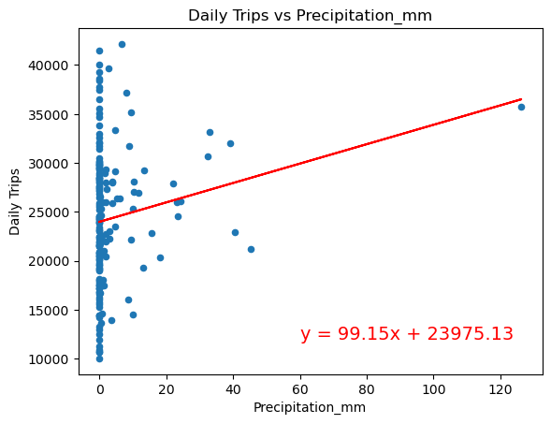
Correlation-Based Analysis: Correlation between Temperature and Ride counts, and Precipitation (Rain + Snow) and Ride counts
The r^2-value is: 0.068423
The r^2-value is: 0.029059
Temperature pattern: suggests a positive correlation between temperature and ride counts. R-squared value suggests a very weak linear relationship between temperature and ride counts.
Precipitation pattern: indicates no linear correlation between rain & snow and ride counts

Slide 13
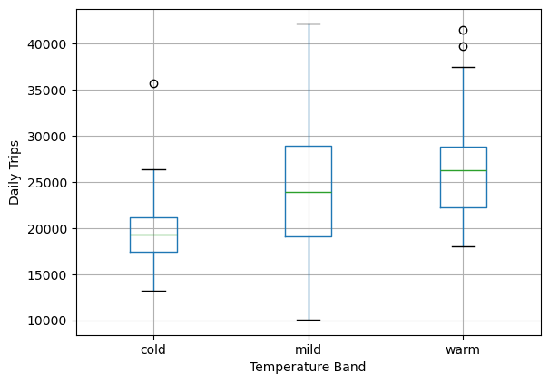
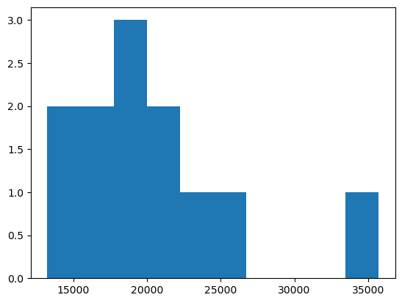
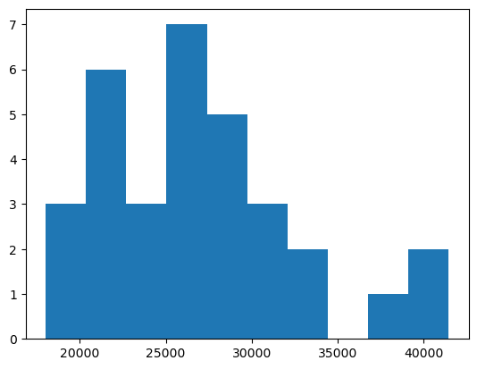
Frequency-Based Analysis: Comparison between Temperature & Ride counts
Null Hypothesis (H₀): There is no significant difference in Uber ride counts across different temperature bands.
Alternative Hypothesis (H₁): Uber ride counts varies significantly across in colder or warmer weather.
Histogram - Cold
Histogram - Warm
Frequency
Daily Trips
Daily Trips
We had planned to use an ANOVA test to decide if mean trip counts during cold or warm weather were significantly different from mild weather. However, analysis indicated the data was not normally distributed.

Slide 14
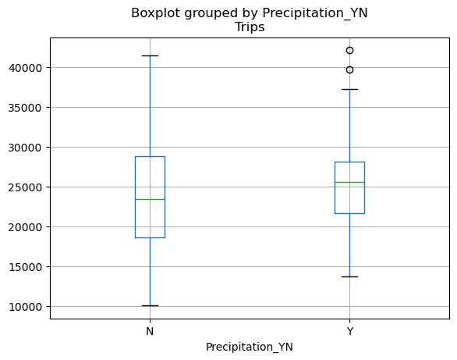
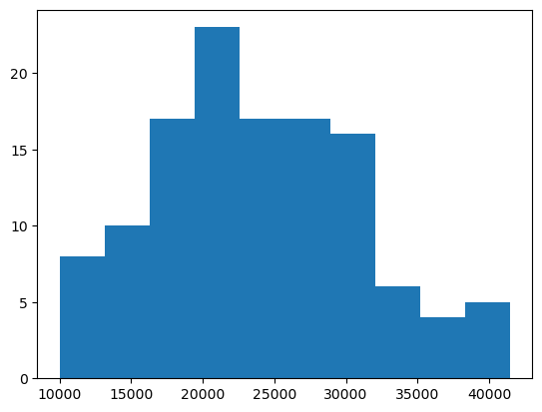
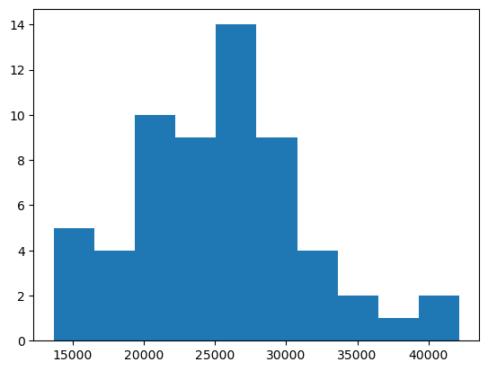
Frequency-Based Analysis: Comparison between Precipitation & Ride counts
Null Hypothesis (H₀): There is no significant difference in Uber ride counts across dry or wet days.
Alternative Hypothesis (H₁): Uber ride counts varies significantly across in wet weather (rain and/or snow).
Histogram - Dry
Histogram - Wet
Frequency
Daily Trips
Daily Trips
We had planned to use a t-test to decide if mean trip counts during rain or snow weather were significantly different from dry weather. However, analysis indicated the data was not normally distributed.

Slide 15
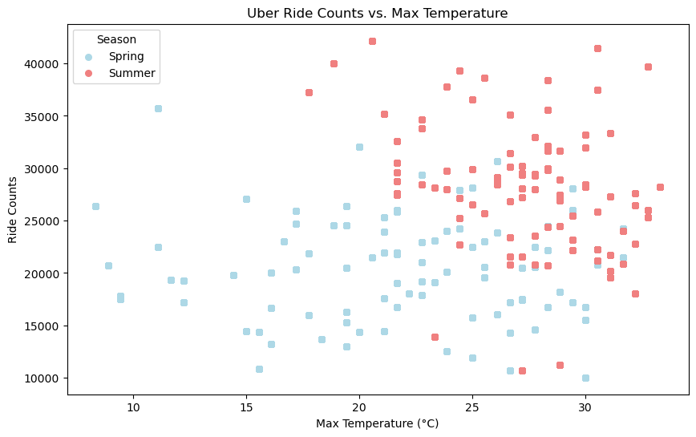
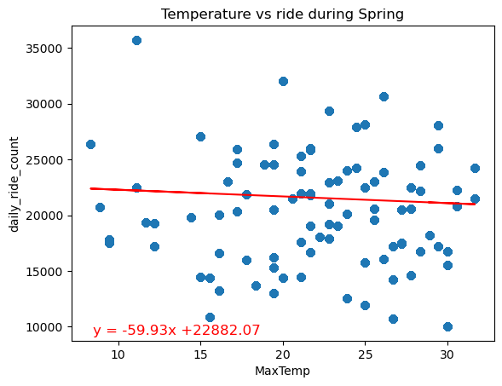
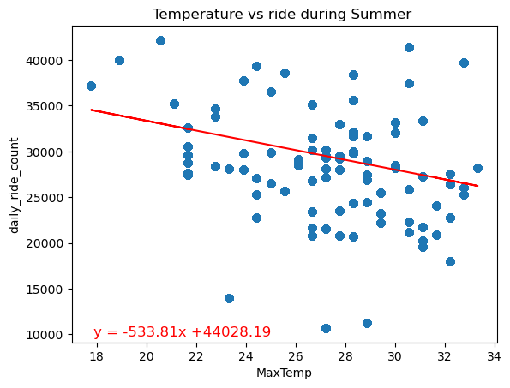
Correlation-Based Analysis: Correlation between Max- Temperature and Ride counts across different Seasons
The r^2-value is: 0.0047
The r^2-value is: 0.103
Spring pattern: Negative correlation between temperature and ride counts during Spring.
R2 value suggests a very weak linear relationship between temperature and ride counts.
Summer pattern: The steeper negative slope compared to spring indicates a negative correlation between temperature and ride counts during summer.
During summer as maximum temperature increases, daily ride counts decrease.

Slide 16
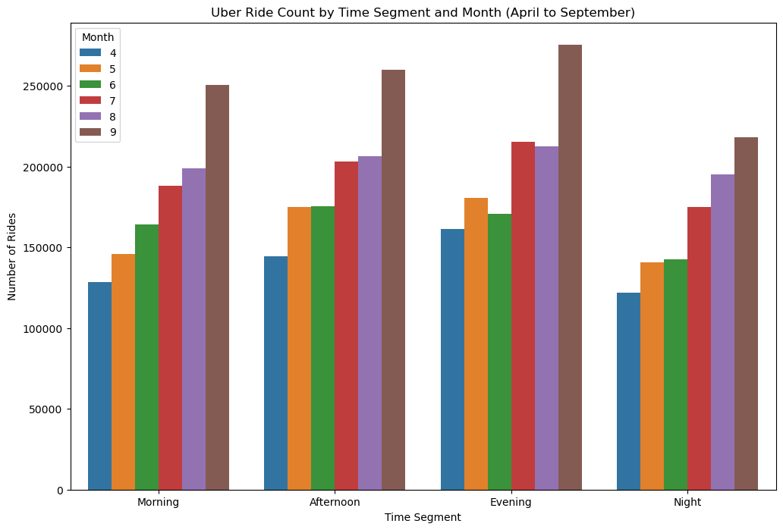
Analyse the Influence of Time of Day on Uber Ride Counts Across Varied Weather Conditions
Null Hypothesis (H₀): There is no significant difference in Uber ride count across different times of the day, regardless of temperature.
Alternative Hypothesis (H₁): Uber ride count varies significantly across different times of the day, influenced by temperature.
We wanted to look at how the time-of-day impacts Uber ride count. However, due to the lack of available hourly temperature data, we were unable to analyse whether the time of day affects Uber ride count in various temperature conditions.

Slide 17
Summary

Slide 18

SUMMARY
We expected that more Uber trips would be taken in wet and cold weather.
The data indicated more of a trend to increased rides in warmer weather.
The trend could also be explained other factors (for example, more Uber drivers on the road during Summer, or more sporting events).
Limitations of the analysis
More detailed analysis would require more Uber trips data

Slide 19
Next steps

Slide 20
NEXT STEPS
Next steps
Get 12 months or more of Uber trip data
More recent Uber trips data
Weather data for more locations in New York (or other cities)

