Slide 1
Uber rides and weather
By Greg , Zahra , Jiahui and Isa

Slide 2
overview
Introduction
Overview of the process
Approach
Results
Summary
Next steps

Slide 3




Slide 4
Group 4 Project 1
For this project, we will explore the ‘Uber Pickups in New York City’ data for 2014 available from Kaggle, and investigate what effect weather conditions had on ride demand (Uber usage).

Slide 5
Overview of the process

Slide 6
Data sources:
Describe the source of your data and why you chose it for your project.
Describe the collection, exploration, and cleanup process.

Slide 7
Describe the collection, exploration, and cleanup process.
Add diagram , flow chart

Slide 8
Approach

Slide 10


Identifying Data Source
New York City’ data - Apr- Sep 2014 NOAA weather data – Apr- Sep 2014
Retrieving Data
Assemble & Cleaning
Panads : pd. concat, len(), .Drop …
Analyze & acknowledge limitations
Conclusion

Slide 11
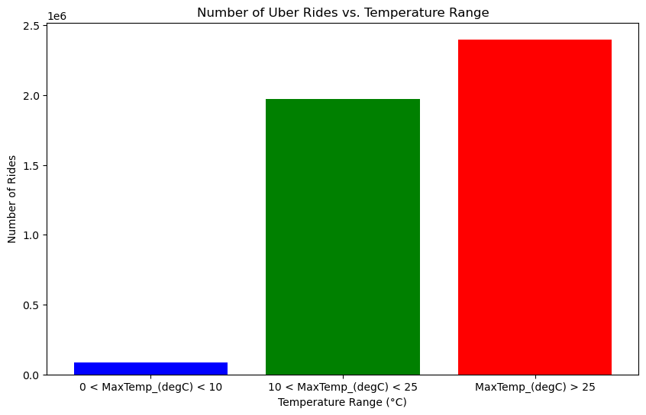
EDA

Slide 13
approach that your group took to achieve the project goals:
Include any relevant code or demonstrations of the application or analysis.
Discuss any unanticipated insights or problems that arose and how you resolved them.

Slide 14
Add graph

Slide 15
results

Slide 16
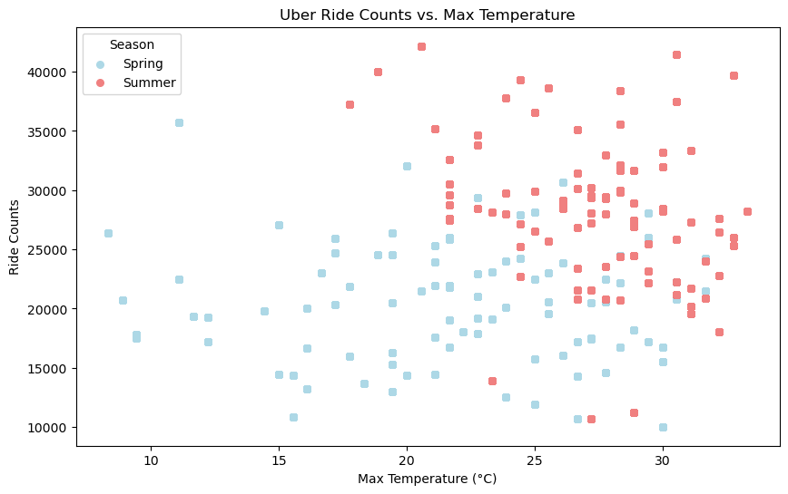
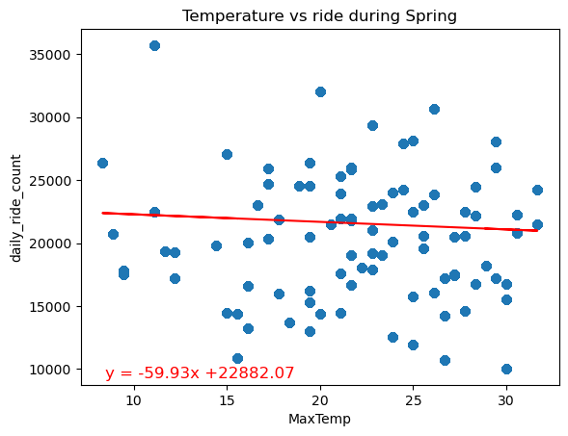
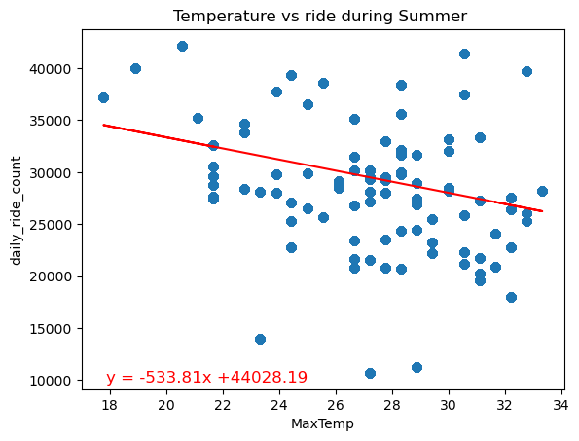
Time-Based Analysis: Correlation between Temperature and Ride counts across different Seasons
The r^2-value is: 0.0047
The r^2-value is: 0.103
Spring pattern: Negative correlation between temperature and ride counts during Spring.R2 value suggests a very weak linear relationship between temperature and ride counts during spring season.
Summer pattern: The steeper negative slope compared to spring indicates a stronger negative correlation between temperature and ride counts during summer.

Slide 17
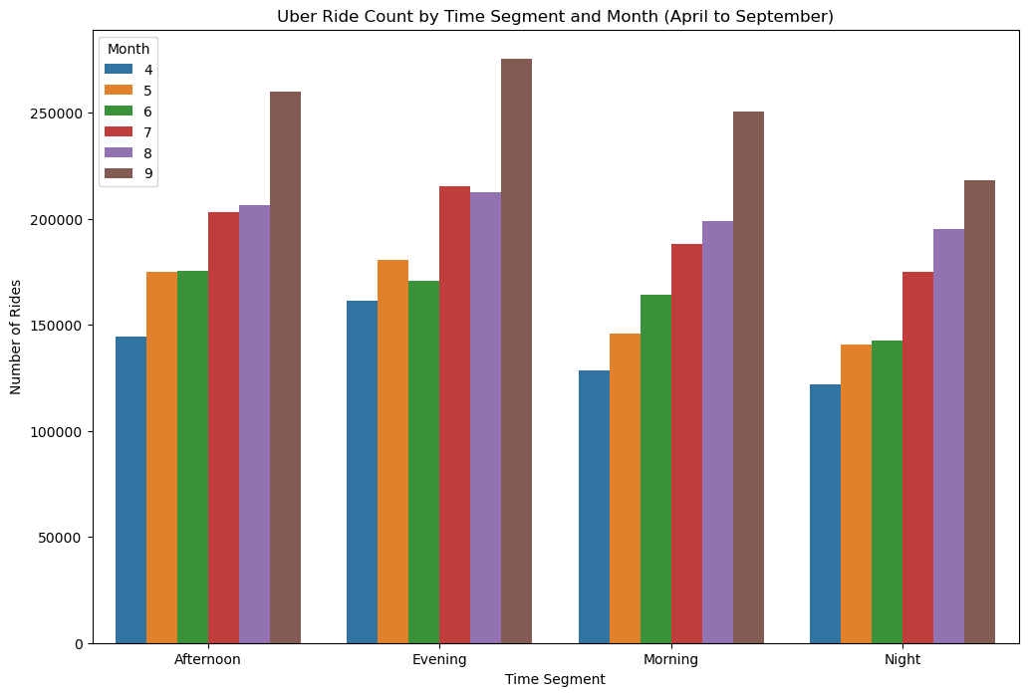
Analyse the Influence of Time of Day on Uber Ride Frequency Across Varied Weather Conditions
Null Hypothesis (H₀): There is no significant difference in Uber ride frequency across different times of the day, regardless of weather conditions.
Alternative Hypothesis (H₁): Uber ride frequency varies significantly across different times of the day, influenced by varying weather conditions.
We looked at how the time of day impacts Uber ride frequency. However, due to the lack of available hourly temperature data, we were unable to analyze whether the time of day affects Uber ride frequency in various weather conditions.

Slide 18
Summary

Slide 20
Next steps

Slide 22
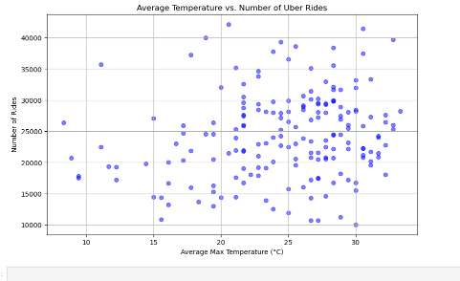
Analysis
How does weather affect the demand for Uber rides?
Temperature and Uber usage appear to be positively correlated. In other words, as temperatures rise, the number of Uber rides tends to increase as well.
Does weather influence people's decision to use ride-sharing services?

Slide 23
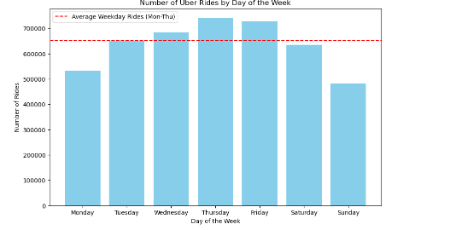
Analysis
Days of the week do affect the amount of rides
Thursdays are the Peak of the Week as they average more Uber rides per day compared to other days of the week

