Slide 1
Uber rides and weather
By Greg , Zahra , Jiahui and Isa

Slide 2
overview
Introduction
Overview of the process
Approach
Results
Summary
Next steps

Slide 3


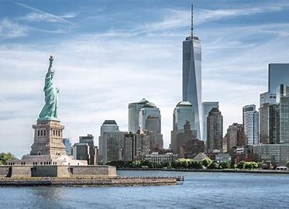

Slide 4
Group 4 Project 1
For this project, we will explore the ‘Uber Pickups in New York City’ data for 2014 available from Kaggle, and investigate what effect weather conditions had on ride demand (Uber usage).

Slide 5
Overview of the process

Slide 6
Data sources:
Describe the source of your data and why you chose it for your project.
Describe the collection, exploration, and cleanup process.

Slide 7
Describe the collection, exploration, and cleanup process.
Add diagram , flow chart

Slide 8
Approach

Slide 9
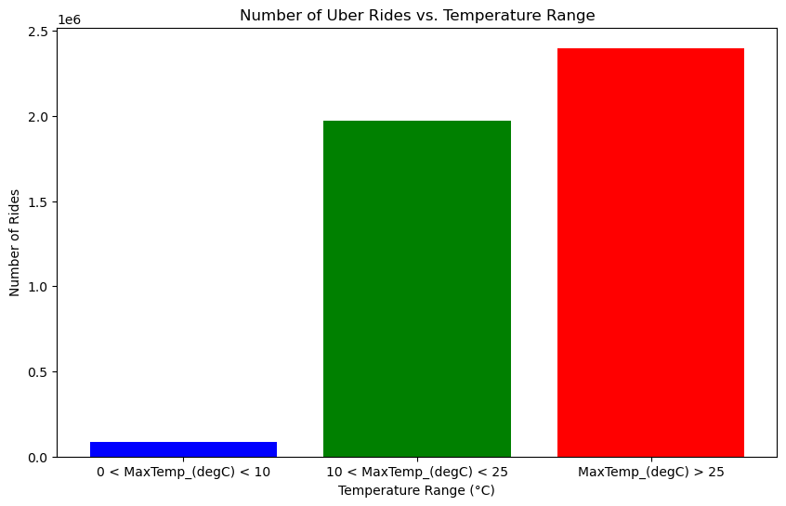
eda
Grouped into three temperature range
Looks like people use ubers more when its warm

Slide 10
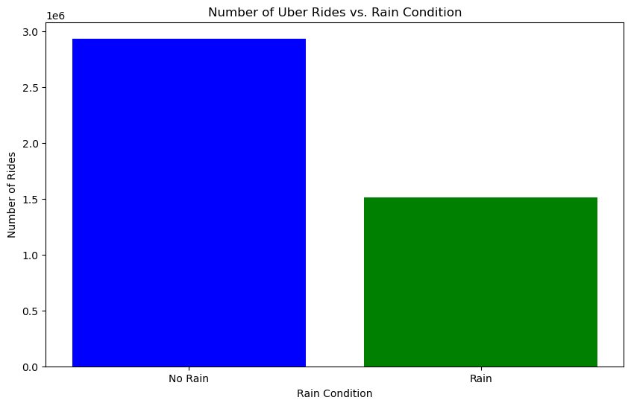
EDA
Group by rain condition
From this graph, people take more ubers without rain.
In following slides we may find out different result or prove it.

Slide 12
approach that your group took to achieve the project goals:
Include any relevant code or demonstrations of the application or analysis.
Discuss any unanticipated insights or problems that arose and how you resolved them.

Slide 13
Add graph

Slide 14
results

Slide 15
results/conclusions of the application or analysis:
Include relevant images or examples to support your work.
If the project goal was not achieved, discuss the issues and how you attempted to resolve them.

Slide 16
Add graph

Slide 17
Summary

Slide 19
Next steps

Slide 21
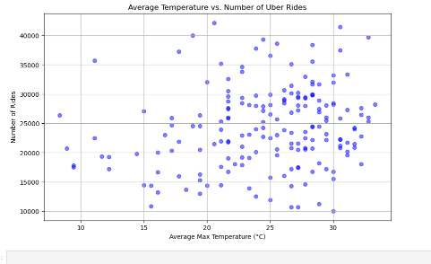
Analysis
How does weather affect the demand for Uber rides?
Temperature and Uber usage appear to be positively correlated. In other words, as temperatures rise, the number of Uber rides tends to increase as well.
Does weather influence people's decision to use ride-sharing services?

Slide 22
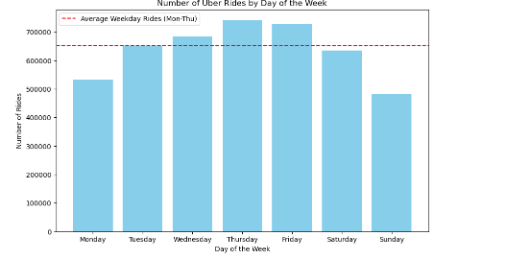
Analysis
Days of the week do affect the amount of rides
Thursdays are the Peak of the Week as they average more Uber rides per day compared to other days of the week

