Slide 1
Uber rides and weather
Zahra Razook
Mary (Jiahui) Du
Isa Huseni
Greg Presneill

Slide 2
overview
Introduction
Overview of the process
Approach
Results
Summary
Next steps

Slide 3




Slide 4
Group 4 Project 1
For this project, we will explore the ‘Uber Pickups in New York City’ data for 2014 available from Kaggle and investigate what effect weather conditions had on ride demand (Uber usage).

Slide 5
Overview of the process

Slide 6


Identifying Data Source
New York City’ data - Apr- Sep 2014 NOAA weather data – Apr- Sep 2014
Retrieving Data
Assemble & Cleaning
Pandas : pd. concat, len(), .Drop …
Analyze & acknowledge limitations
Conclusion

Slide 7
Remove later Data sources:
Describe the source of your data and why you chose it for your project.
Describe the collection, exploration, and cleanup process.

Slide 8
Approach

Slide 9
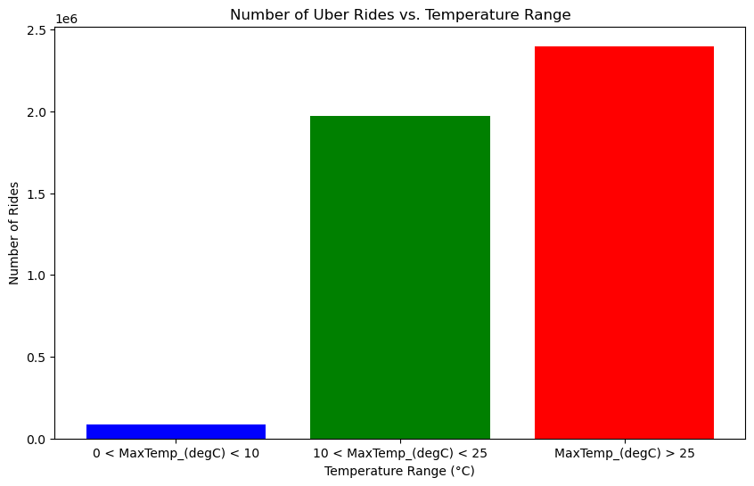
Exploratory Data analysis
In this graph, the data is grouped into three temperature ranges.
This data suggests that the usage of Uber increases during the summer.
However, further analysis reveals additional insights into the impact of temperature on the number of rides taken in New York.

Slide 10
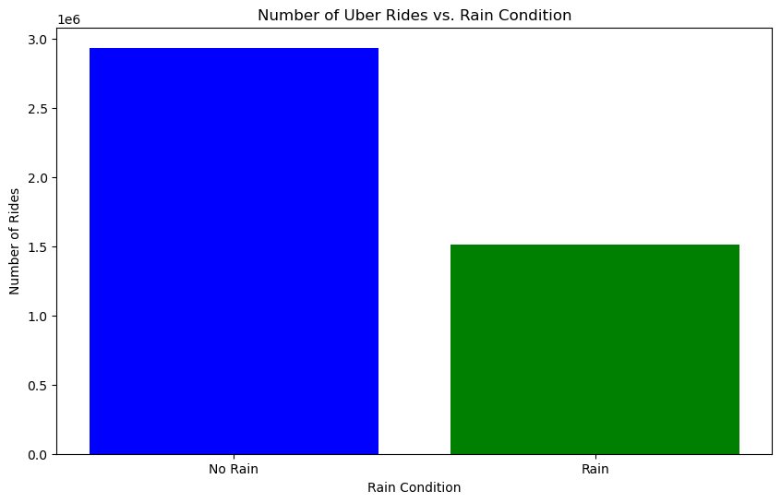
Exploratory Data analysis
The data aims to examine the impact of rainfall on the number of Uber rides.
The data indicates that Uber usage is higher on days without rain.
Again, further analysis provides additional insights into how weather affect the number of rides taken in New York City.

Slide 11
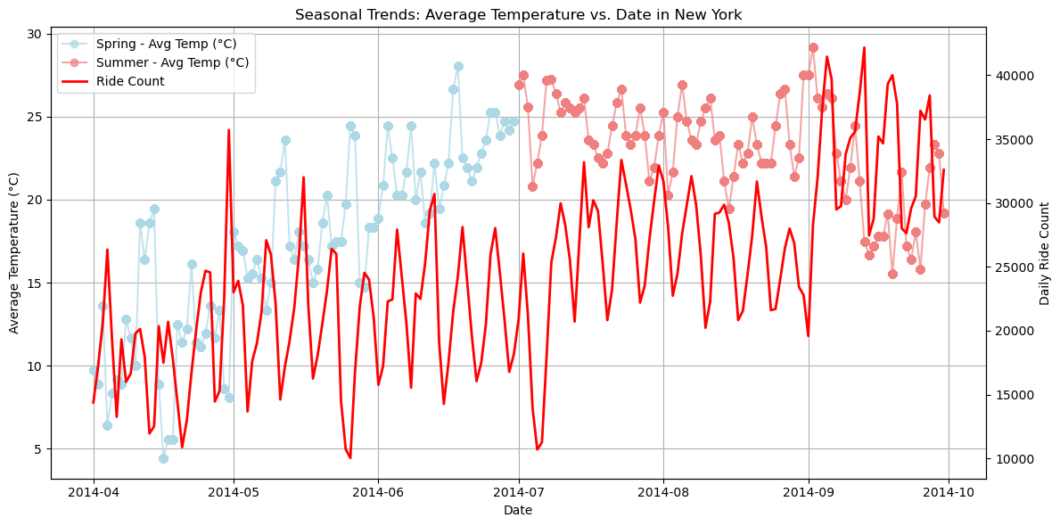
Exploratory Data analysis
The graph illustrates the seasonal trend, depicting the variations in Uber rides relative to the average temperature over the period in the data.
It shows that Uber usage is higher during the summer months.
April is the month with the lowest number of Uber rides.

Slide 12
Remove laer approach that your group took to achieve the project goals:
Include any relevant code or demonstrations of the application or analysis.
Discuss any unanticipated insights or problems that arose and how you resolved them.

Slide 13
results

Slide 16
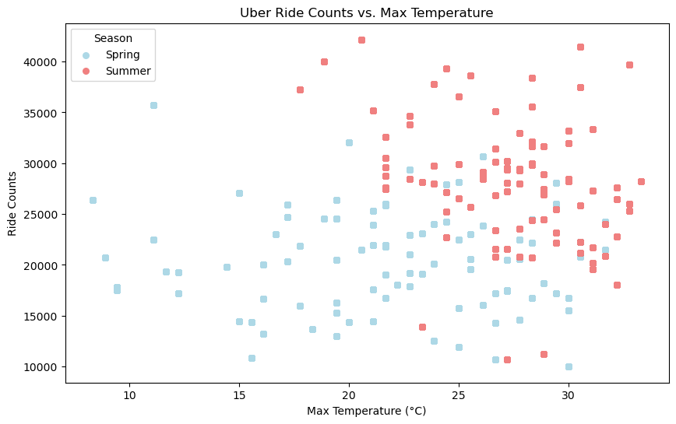
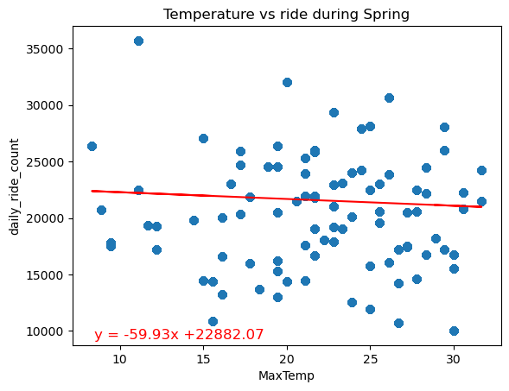
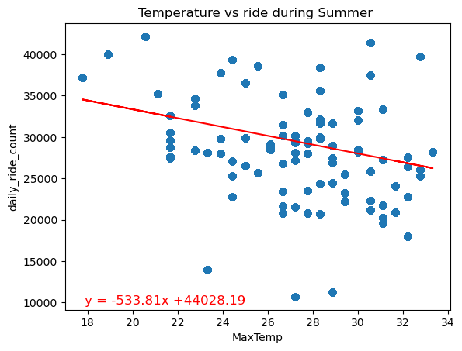
Time-Based Analysis: Correlation between Temperature and Ride counts across different Seasons
The r^2-value is: 0.0047
The r^2-value is: 0.103
Spring pattern: Negative correlation between temperature and ride counts during Spring. R2 value suggests a very weak linear relationship between temperature and ride counts during spring season.
Summer pattern: The steeper negative slope compared to spring indicates a stronger negative correlation between temperature and ride counts during summer.

Slide 17
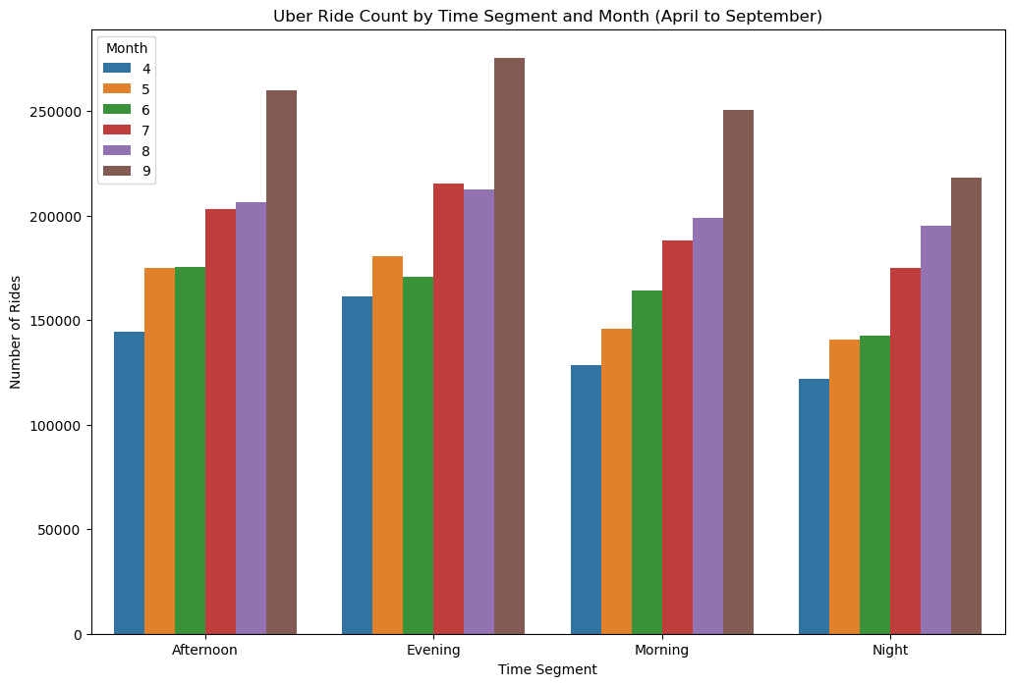
Analyse the Influence of Time of Day on Uber Ride Frequency Across Varied Weather Conditions
Null Hypothesis (H₀): There is no significant difference in Uber ride frequency across different times of the day, regardless of weather conditions.
Alternative Hypothesis (H₁): Uber ride frequency varies significantly across different times of the day, influenced by varying weather conditions.
We wanted to look at how the time-of-day impacts Uber ride frequency. However, due to the lack of available hourly temperature data, we were unable to analyse whether the time of day affects Uber ride frequency in various weather conditions.

Slide 18
Summary

Slide 20
Next steps

