Slide 1

Transforming Your Career Journey!
Objective:
Empower individuals in achieving their career goals by providing a personalized and efficient platform for planning and tracking skill development.
Approach
Utilize AI-driven technology to create tailored skill roadmaps, daily action plans, and seamless task tracking within the UpSkillMe platform.
Why UpSkillMe?
In a rapidly evolving job market, continuous skill development is essential for career growth.
Why is it Important?
UpSkillMe streamlines the learning process, making it accessible, personalized, and motivating.
UpSkillMe

Slide 2


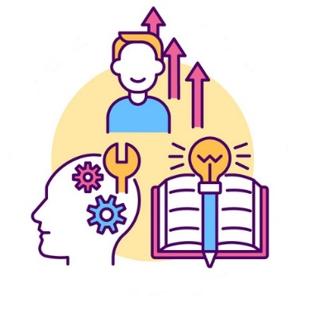


UpSkillMe
Chat
Profile
Setting
Upload your CV
Upload your CV
Resume_2023_v2.pdf
Upload
Resume_2023_v2.pdf
Upload
My dream job is:
My dream job is:
Submit
Senior Machine Learning
Submit
Senior Machine Learning Research Scientist at Google Brain, specializing in cutting-edge deep learning models
Progress
Upgrade your skills
Match jobs

Slide 3


UpSkillMe
Chat
Profile
Setting
Match jobs based on your cv
Machine Learning Engineer
Apply your skills in Python and ML to extract meaningful insights from complex datasets. You can analyze and interpret data, build predictive models, support data-driven decision-making. This is the best match as a job experience to reach to you dream job
Data Scientist
AI Research Scientist
Software Engineer (Specializing in AI/ML)

Slide 4

UpSkillMe
Chat
Profile
Setting
Upload your CV
Resume_2023_v2.pdf
Upload
My dream job is:
Senior Machine Learning
Submit
Progress
Upgrade your skills
Match jobs

Slide 5

UpSkillMe
Chat
Profile
Setting
Upgrade your skills
Python is a versatile and readable high-level programming language widely utilized for its simplicity and applicability in diverse domains, including, data science, and artificial intelligence.
Get the plan
Skill 1: Python
Statistical analysis is a process of collecting, interpreting, and drawing meaningful insights from numerical data. It involves applying statistical methods to uncover patterns.
Get the plan
Skill 2: Statistical Analysis
Skill 3: Data Handling and Analysis
Skill 3: Machine Learning

Slide 6


UpSkillMe
Chat
Profile
Setting
Task: Learning Python
Week 1: Getting Started with Python Basics
Week 2
Week 4
Week 3
Sub-task 1: Install Python:
Download and install the latest version of Python from the official website.
Verify the installation by checking the Python version in the terminal.
Sub-task 2: Understand Python Syntax:
Familiarize yourself with basic Python syntax, including indentation, variables, data types, and basic operators.
Sub-task 3: Work with Control Structures:
Learn about conditional statements (if, elif, else) and loops (for, while).
Practice writing simple programs using control structures.

Slide 7



UpSkillMe
Frame Work
Week1:
Google Cloud Platform
* basic principles
* APIs for programming
security controls
Week2:
security controls
* Learn the basics
* build models
* optimize machine learning
Working in Google as AI expertise
Google Cloud Platform
• TensorFlow
• Applied research in Natural Language Processing
• Computer Vision
Weekly schedule to learn new skills to fill the Gaps
PDF to TXT
Gaps
LangChain by OpenAI API
Using LLM Chain + Prompt Template
• Developed machine learning to analyze medical data
• Advanced ML, Visual analytics, Deep Learning, Pattern Recognition, Probabilistic graph models, Evolutionary Process, Multi-agent systems, Recommender systems
• Applied research in health data science
• Software: Python, PyTorch, JAVA, R, C
1. Machine Learning Engineer
2. Data Scientist
3. Research Scientist in Health Data Science
Top 3 most suitable jobs + most relevant
My Skills List

Slide 8
The Change We Envision UpSkillMe empowers users to take control of their career journey, fostering confidence, and ensuring efficient skill acquisition. Uniqueness and Advantages Personalized Skill Roadmaps Smart Skill Gap Analysis Daily Action Plans Progress Tracking

Slide 9
Conclusion
UpSkillMe is not just an app; it's a transformative tool paving the way for a future where individuals are equipped with the skills they need to succeed.
ChatGPT :P

