Slide 1
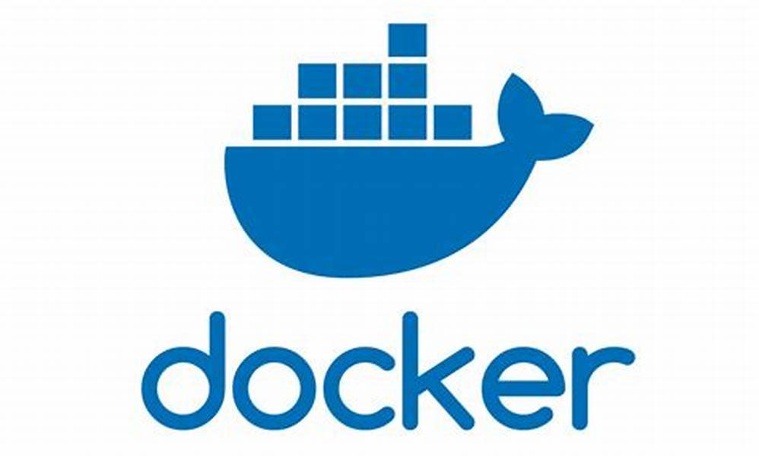
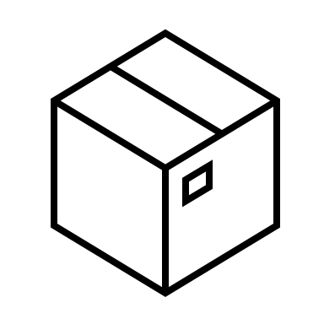
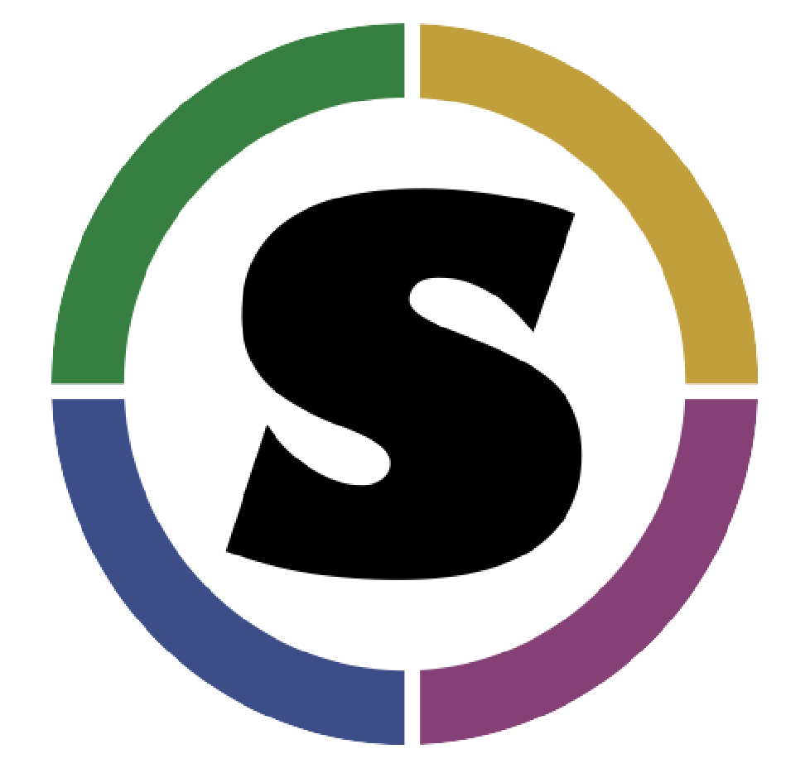
pyclmuapp
Pull image
Run container
Run case
Get results
Create forcing
Create surface
…
CLMU-App
CLM ENV
CLM >
(hosted by NCAR)
GitHub: https://github.com/ESCOMP/CTSM
Run CLM/CTSM in container
CLMU
./create_case …
./xmlchange …
…
./case.build
./preview_namelists
./case.submit
Linux
macOS
Windows
AMD
64
ARM
64

