Slide 1
MAS study: LeShop Dynamic Pricing
Update 15.02.2019, Erich Naef

Slide 2
Project Overview
Intro
Dynamic Pricing
Executive Summary
Dynamic pricing is a critical value proposition for online supermarkets. In order to stabilize growth without compromising margins, the proposal is to introduce dynamic pricing to increase yearly growth by 2% to 5%.
Problem Statement
Although of its strong product base and a pioneer in online shopping, Le Shop has lost market share to Swiss competitors Coop and Farmy during the last three years. This is mainly due to increased retail competition (discounters, cross-border shopping, non-sector online initiatives) and due to limited online services (same-day, broad and individual offerings, fresh food & ecological initiatives).
Goal Statement
This project has been scoped to simulate LeShop’s potential growth increase to the expected overall online market growth of 2% to 5% with an appropriate dynamic pricing strategy.
Proposed Solution
In order to increase growth with minimized costs, a time-based pricing optimization of the LeShop assortment shall improve sales and reduce costs. Since dynamic pricing in online-supermarket is new to Swiss customers, LeShop has the opportunity to take the lead. But this also means to apply a step-by-step approach with a tailormade and expandable concept. The time-based pricing machine shall optimize prices with continuously verified constant elasticities considering demand, operations and competition. The effectivity will be verified with back-testing on LeShop’s assortment.

Slide 3







Business Canvas
Emphatize
Key Partners | Key Activities | Value Propositions | Customer Relationship | Customer Segments
Cost Structure |  | Revenue Stream
Migros:
>100% Owner
>Key Supplier
>Office renting
SCM (Logistics, Sourcing)
Assortment (13’500)
-Fresh&Frozen Food & Liq.
-Hygiene & beauty
-Cleaning, maintenance &
some Gardening
-Some Electronics
-Pet food & Babys
Online Platform
Private Households:
Warehouse Operations
Customer Service by Phone
 | A | B | C
*Large | 60% | 15% | 2%
Singles | 10% | 5% | 2%
Wealthy | 5% | 1% | -%
Platform, IT-Infra.&Process
Mainly Private
Migros Labels
Other Suppliers
Key Resources
Order Mnmgt
More Assistance via: Website, Facebook, Mobile App
Quality Control
Home Delivery
Low Cost
-Next Day 7 slots
-Qual. (Money Back)
HR & Finance
A: Big City Centers
B: Populated Agglos
C: Rural
* Mainly Families
PostLogistics:
LastMile with 34Centers
Distribution Channels
Key Resources
Pick-up
No Cost
-Next Day 7 slots
-Qual. (Money Back)
Gerster Transport:
FTL
2 Freshfood Warehouses
Home Deliveries
Employees: ~ 330
PickMup Migros Stores
Logistic & HW Equip.
Migros Cumulus Prgr.
SW (Platforms, DB, Algos, App)
Advertisements via: Website, Facebook, Mobile App
Brand
Mainly variable Costs:
>Infrastructure Renting
>Gerster FTL , PostLogistics, Notime
Fixed Costs:
>HR, Warehouses, Equipment
>Delivery fee Next-Day:
>Delivery Subscription:
>Refundable Package fees:
>Average Product Basket:
>Fresh Food Ops for Migros
7.9CHF/ 99 CHF … 2.9CHF >200CHF/
11.9CHF/ 1 Month … 118.8CHF/ 12 Month
5CHF … 30CHF
14/a x 250 CHF
…CHF
Profit Margin: Low to Medium

Slide 4
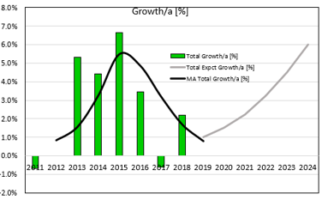
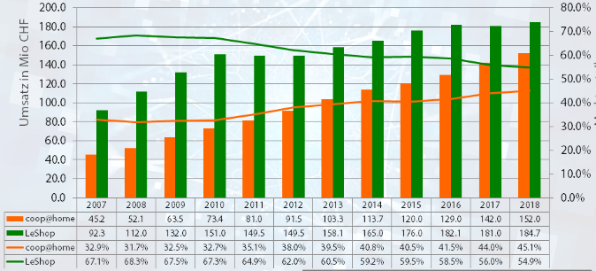
Problem Statement
Emphatize
Global Market
Online grocery growth is accelerating and expected between 8% (UK,Japan) and 30% (China)
Le Shop & Swiss Market
> Swiss online grocery gowth potential between 6% (current) and 20% (Germany)
- High growth phase timing due to young consumers: 2018-2020 (no unexpct. events)
- Online market share expected between 10% and 50%
Problem: Due low growth <2% LeShop lost market share (limited services/ fresh products, price competition)
https://blog.appscrip.com/global-grocery-delivery-market-2019-projections-key-players/
https://blog.carpathia.ch/2016/11/13/onlineaneil-50-prozent/
Revenue [MCHF]
Market share
https://blog.carpathia.ch/2019/01/19/lebensmittel-online-leshop-coophome-farmy-2018/
Globally, there is a strong growth in retail grocery e-commerce. Experience has shown, that once the 5% market share is reached, growth gains momentum.

Slide 5
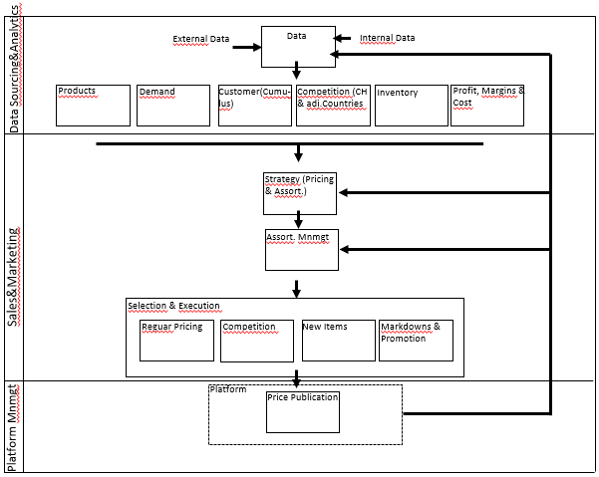
Initial Process Flow
Emphatize
Intro
Clear hierarchical organization with all necessary functions for monthly to weekly cycles. Nevertheless, this ad-hoc and rule-based organization with almost no automation prevents fast and flexible analyses, decisions and adjustments.

Slide 6

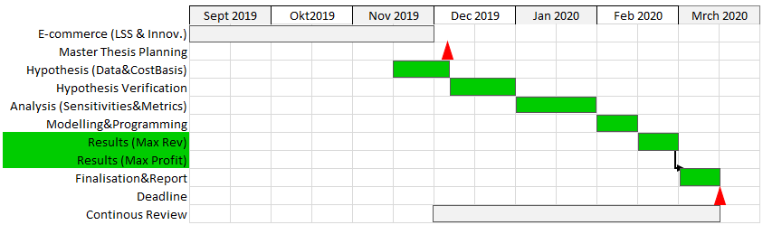
Schedule
Define
Intro

Slide 7
Value Proposition
Define
Stakeholder | Value Proposition | Risk to avoid
Customer (Young & Mid-Low Budget) | >Very competitive prices (over supply/low demand) >Various low price opportunities >Transparency >Satisfying & competent service | >Risk of discrimination >Complexity >Too high fluctuations
Customer (Wealthy) | >Competitive prices (limited supply/high demand) >Transparency >Satisfying & competent service | >Exploitation of urgencies (Surge) >Risk of discrimination >Complexity >Too high fluctuations
Sales & Marketing | >Automation >Faster response >Improved utilisation & flexibility >Loyality >Learning effect with detailed monitoring | >Risk of Race to the bottom >Black box >Higher Job requirement
IT & Data Mngmt | >Easy maintenance >Reduced complexity >Standardization | >Complexity (price changes, algos, data interaction) >Higher Job requirement
Migros | >Dynamic pricing metrics >Real time competition monitoring >Detailed customer segmentation (Project start 2020) for individual (next) best offers | >Risk of Race to the bottom >Black box >Higher Job requirement

Slide 8
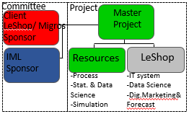
Project Charter
Define
Goal Statement:
CTQ’s:
LeShop Dynamic Pricing
Increase revenues with time depended pricing
Keep or improve pricing costs with automation
Continously review and optimize pricing considering new data
Value for money ratings
Dynamic Pricing Metrics (Frequency, Magnitude)
Growth and Margins
Problem Statement:
Definition of Project Risks & Defects
Project risks
Data quality/ amount (Testing, Step by Step impl., focus on KVIs)
Price discrimination (Time dependend-pricing for everyone)
Losing trust (Hybrid Pricing: moderate freq. & mag. (Surge Pricing))
Defects
Information/ Feedback - weekly update (change to hourly)
Quality – Improved forecast with better understanding pricing (learning)
Growth –
Cust. loyality – attract young cust. with competitive online services
Cust. Segment – improved offer to low price segment
Reduced sales growth due to non competitive pricing & limited services
Limited understanding & experience with short term price changes
Current Price change process is manually, slow (>4h) and costly
Business Case:
• Project’s payback < 5 Y (Expct. cost: … kCHF/benefit: … kCHF)
Proof of concept to provide decision base for testing in Lausanne
Integrated solution on existing processes
Provision of sustainable (flexible interfaces, state-of the-art, moderate risk) solution
Customers
& Stakeholders:
Business Impact:
Cost reduction from automation
Cost reduction from improved inventory management
Expected growth from competitive pricing
In Scope / Out of Scope:
Deliverables:
In Scope:
Pricing with interfaces (WH, O-Platform, S&OP, Ordering)
SLA, Swiss regulations, simulation with required data
Distribution Centers Ecublens, Daillens (apprx. 1’600 customers)
Initial situation
Out of Scope:
Phase 2 - final implementation with detailed data (regression)
Changes to : price, macro economics, contracts, restructurings
Changes to : business model, customer behaviour, …
Project report (Master), Kick-off PPT (Thesis), approved steps, Simulation model (GitHub)
Detailed data and results and all other docs (GitHub)
Timeline (5 Step Design)
https://empathizeit.com/design-thinking-models-stanford-d-school/
07-Dec-19
15-Jan-20
01-Feb-20
15-Feb-20
13-Mrs-20
E
D
I
P
T
Notes:
Examine this process in order to make it more business and customer focus, more efficient and less expensive
Amend existing process to reflect recent Networks Re-org
As workload growing, efficiencies need to be made in order to deliver more with current amount of resources.
Reduce the areas of pain to bring staff sat.
on teams (e.g. re-work required as Handover documentation incomplete; Distribution of workload is not evenly distributed)
3.The current process is based on handover among teams without clear overall responsibility. Recent re-org
MSV – Different project? Savings might be achieved by including all relevant resources early in the process to identify all hidden costs of a site before agreement with landlord is reached.

Slide 9
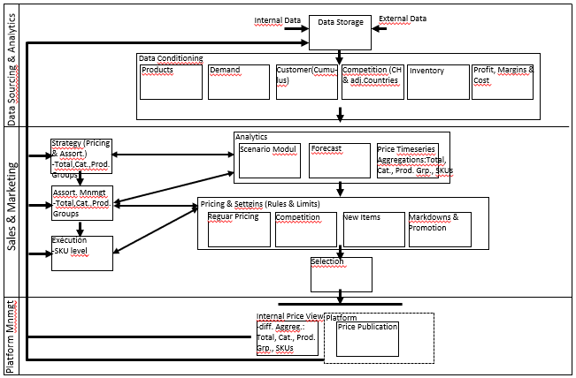
New Process Flow
Ideate
New Concept with defined responsibilities and real time data access (open in the begin-ning). Fast and flexible mnmgt. with Machine Learning and full data process automation.

Slide 10
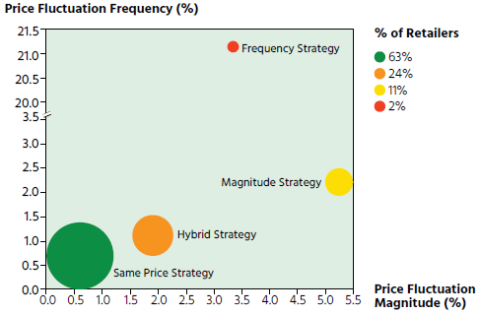
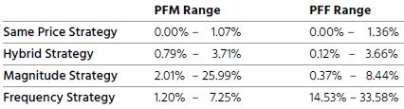
Pricing Strategy
Ideate
Charateristics
>Promotional Pricing with loyalty program (Migros Cumulus)
>Average product prices slightly higher than physical stores
>Some Migros private labels (<40%)
>Assortment covers average Swiss household customer
- limited number (ca. 13’000 Products) of products with focus on KVI
Dynamic pricing proposal based on frequency & fluctuation magnitude
>Most Swiss online channels follow a same price strategy (63%), followed by a hybrid strategy (24%)
>Because the extrem freq.& magnitude strategies are less favored by customers
https://www.alexandria.unisg.ch/257932/1/The%20Dose%20Makes%20The%20Poison.pdf
Proposal: continue promotional pricing with hybrid strategy and its according metric ranges.

Slide 11
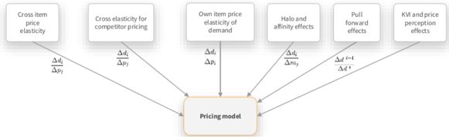
Prototype
Prototype
Dynamic Pricing Model
>Applied to regular, new Item and markdown/- up pricing
>Dynamic pricing concept with: competition monitoring, elasticity module,
>Time-based pricing machine with constant elasticity (log/log)
>Testing in Lausanne area

Slide 12
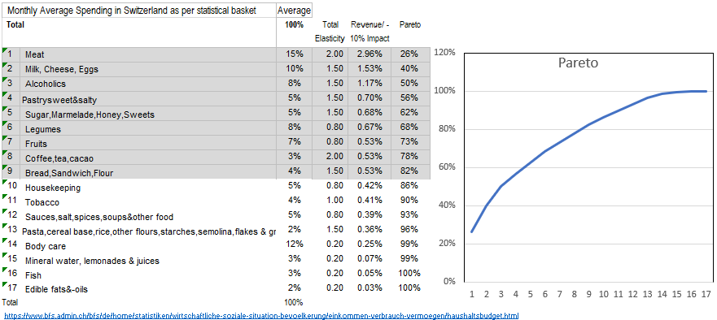
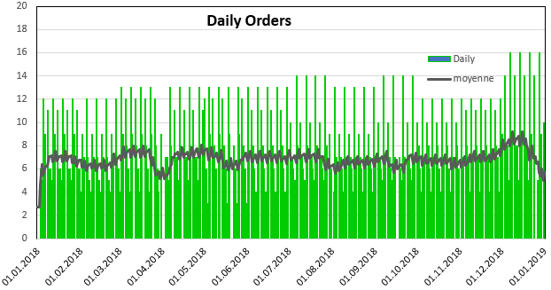
Base Case
Test
Assortment
Basket sample with evaluated elasticities and
Total Demand

Slide 13
Price Simulation Cases
Test
Simulation of hybrid strategy (max. frequency & magnitude)
1)How much do the single prices have to decreased (incr.) to increase (decr.) to rev. growth targets?
- Minimized losses, const. income, no. ops. restrictions, base case 2019 (assortment, prices, revenues)
2)How many price changes are required to decreased (incr.) to increase (decr.) to rev. growth targets?
- minimized losses, constant income, constant price changes, no. ops. restrictions, base case 2019 (assortment, prices,
revenues)
3)What price change magnitudes are required to decreased (incr.) to increase (decr.) to rev. growth targets?
- minimized losses, constant income, constant price frequencies, no. ops. restrictions, base case 2019 (assortment,
prices, revenues)
4)What is the maximum achievable growth/ profit?
- minimized losses, constant income, max price frequencies/-changes, no. ops. restrictions, base case 2019 (assort-
ment, prices, revenues)

Slide 14
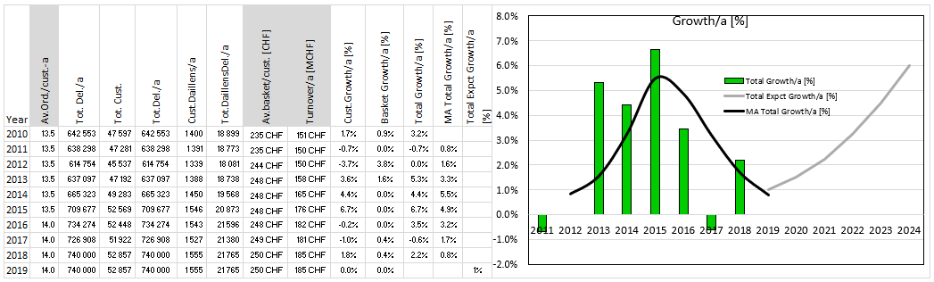
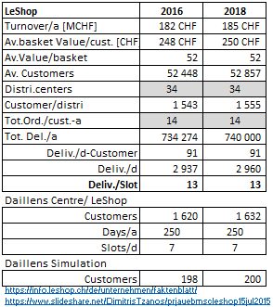
Annex1: LeShop Fact-sheet
Business Figures & Growth
Operational Figures

