Slide 1
Innovation Study Case: LeShop Same-Day Delivery
30.11.2019, Erich Naef

Slide 2
Project Overview
Intro
Same-Day Delivery
Executive Summary
Same-day delivery is a critical value proposition for online supermarkets. In order to stabilize growth without compromising margins, the proposal is to introduce Same-day delivery to increase yearly growth by 2% to 4%.
Problem Statement
Although of its strong product base and a pioneer in online shopping, Le Shop has lost market share to Swiss competitors Coop and Farmy during the last three years. This is mainly due to limited services on fast delivery and limited fresh food initiatives. Especially younger and urban customers demand modern service solutions (same-day, broad product offering, reduced waste,….), which aren’t offered by LeShop at the moment.
Goal Statement
This project has been scoped to increase LeShop growth to match the expected overall online market growth with services for urban customers in 11 Swiss cities. Of the three main service values (fresh food, same-day delivery and transport fee), LeShop is a cost leader in Switzerland (Annex2). Therefore, the service must be offered at or below Coop’s Same-day offering (Annex2) in the Swiss Market.
Solution
The root causes for the loss of market share is mainly due to limited delivery services. Improvement action is the implementation of competitive cost Same-day delivery with the collaboration of notime.ch to offer delivery service with their time forecast & routing optimization on state-of the art technology. With this, mainly customer sales growth, but also trsp efficiency are expected to improve. A real customer testing is required to proof this concept.

Slide 3
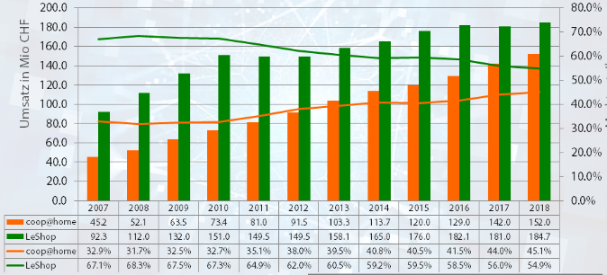
Market Analysis
Emphatize
Global Market
Online grocery growth is accelerating and expected between 8% (UK,Japan) and 30% (China)
Le Shop & Swiss Market
> Swiss online grocery gowth potential between 6% (current) and 20% (Germany)
- High growth phase timing due to young consumers: 2018-2020 (no unexpct. events)
- Online market share expected between 10% and 50%
> Problem: LeShop lost market share
https://blog.appscrip.com/global-grocery-delivery-market-2019-projections-key-players/
https://blog.carpathia.ch/2016/11/13/onlineaneil-50-prozent/
Revenue [MCHF]
Market share
https://blog.carpathia.ch/2019/01/19/lebensmittel-online-leshop-coophome-farmy-2018/
Globally, there is a strong growth in retail grocery e-commerce. Experience has shown, that once the 5% market share is reached, growth gains momentum.

Slide 4
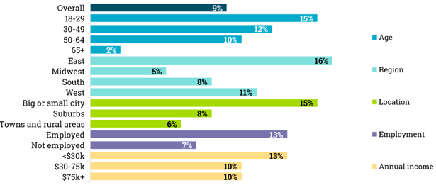
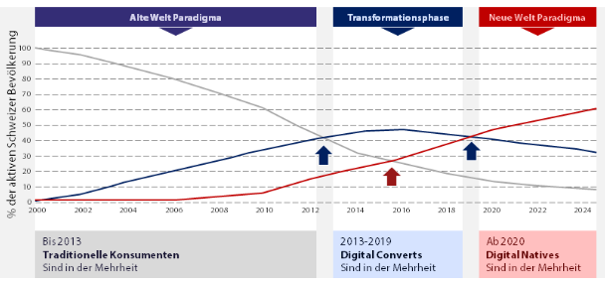
Customer Segmentation
Emphatize
General E-Commerce Markets
Timing
https://www.marketingcharts.com/industries/cpg-and-fmcg-79612/attachment/gallup-share-us-adults-online-grocery-shopping-by-demo-aug2017
https://blog.carpathia.ch/2016/11/13/onlineaneil-50-prozent/
LeShop focuses mainly on families and big consumers. Globally, the main customer group are below 29 years old and living in ctities. Starting 2018/2019 a higher growth phase is expected.

Slide 5
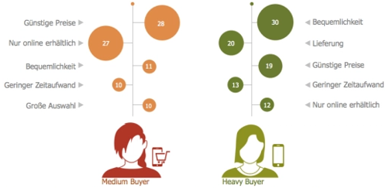
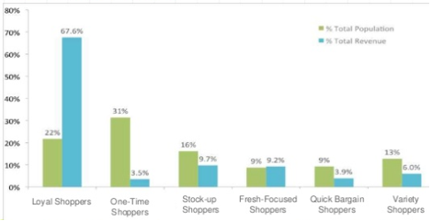
Customer Preference
Emphatize
Main Customer Motivation
Revenue Driver
Price
Online only
Convenience
Time
Large Assort.
Convenience
Delivery
Price
Time
Online only
https://blog.carpathia.ch/2016/11/13/onlineaneil-50-prozent/
Motivation are clearly price, convenience and delivery. Further experience in Switzerland (Farmy) shows also growing preference for fresh food and low waste (green) with trustful picking. Although a challenge (Migros & young shoppers), loyality is key for revenue.

Slide 6
Porter’s 5 Forces
Emphatize
Threat of New Entrants (ALDI/LIDL/Farmy/Miacar.)
- Medium to High
Threat of Substitutes
(Regular S-Market,..)
- Medium to High
Bargaining Power of Suppliers
(Migros Congl.)
- Medium to High
Competitive Rivalry (Coop,…)
- High
Bargaining Power of Buyers
(Simple change to competitors)
- High
There are many initiatives, but the real threat is still the well established market players (Coop, ALDI, LIDL). Also, there must be a long-term strategy how to win consumer loyality.

Slide 7
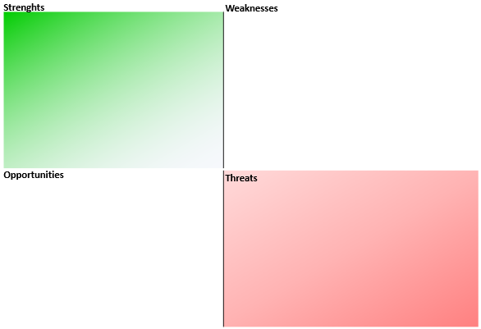
SWOT
Emphatize
Central Freshfood Warehouse for Migros
Only one customer segment
Low Transport cost & fee (CH)
Limited product assort. (13’500)
Migros Suppliers
Low Control-Cooperative
Eff. Pick&Pack Operation
Broad Slots (1,5h – 3,5h)
Long Deadlines (21h-32h)
TaxSaving-Cooperative
Market Share Growth=0
No Same-Day capability
Migros Owner fear cannibalization & loss on fixed assets
Limited Fresh Product Initiatives
Old Age of Migros Management
Migros Shop Network
Migros Cumulus Database & Program
Competitive Rivalry (Coop)
Bargaining Power of Buyers
Threat of Substitutes
Threat of New Entrants (Adli, Lidl, Farmy, Miacar)
Bargaining Power of Suppliers

Slide 8
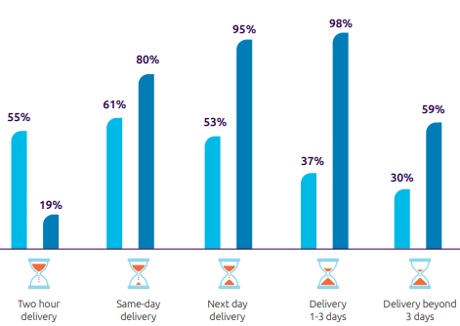
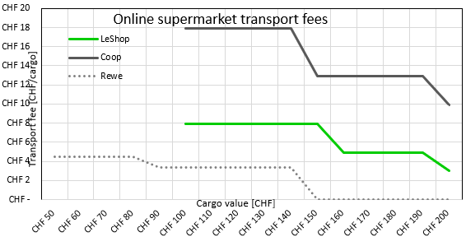
Project Case
Define
Customer Value Proposition & Pricing
> Customers expect short Lead Time (LT) and would even pay for Same-day delivery (Coop reference price)
Proposed Solution & Expected Impact
>Same-day delivery at lowest cost as a project proposition
>Expected Average daily Same-day order volume (Annex3) for Lausanne: 40
>Testing in Lausanne/ final applied to 11 cities:
>At least achieve market growth (>6% Annex1) and stabilize market share at least above 50%
https://www.capgemini.com/wp-content/uploads/2019/01/Report-Digital-%E2%80%93-Last-Mile-Delivery-Challenge1.pdf

Slide 9
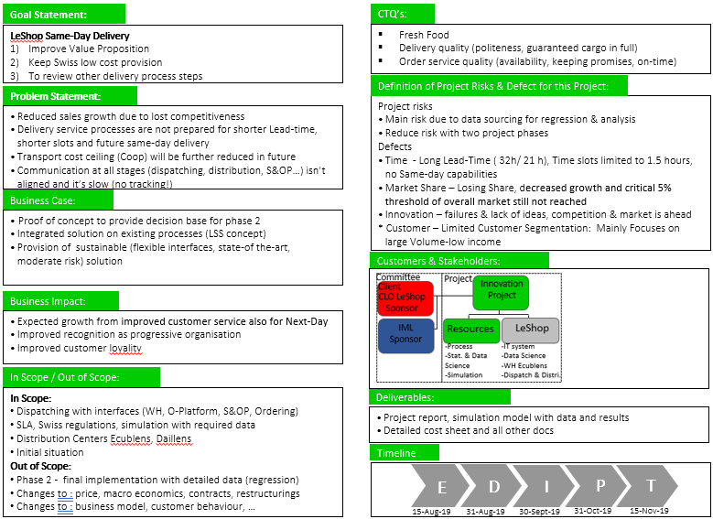
Project Charter
Define

Slide 10
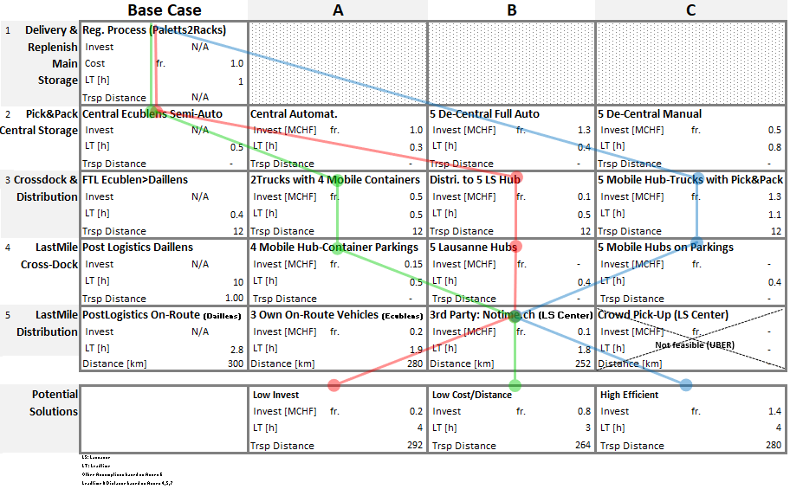
Process Flow Analysis
Ideate

Slide 11
Comparison
Ideate
Pro/ Con
 | Low Invest | Low Cost/ Distance | High Efficient
Pro | -High Synergies -Little Investment | -Low Cost -Outsourcing Potential (Fixed cost vs Control) -Local Last Mile Distributor | -Flexible -Low Distance (Fuel,CO2,potential EV) -Local Last Mile Distributor
Con | -Inefficient cross docking -Low Flexibility (Dispatch Risk) -Longest Distance -Long Travel Time -High Cost | -Additional Container Mnmgt -Required Parking Spaces (could be solved with M-Supermarkets) | -High Invest -Only Fast if a lot of manpower for mobilePick&Pack -Low Truck utilisation -High Cost (Truck Pick&Pack Personnal) -Highest Fixed Cost -Addtional mobile Pick&Pack
All three solution are feasible. The low Cost/Distance solution has been chosen due to low cost, modular concept and expansion potential. Depending on the chosen Hub, the investment for containers might not be needed.

Slide 12







New Business Canvas
Prototype
Key Partners | Key Activities | Value Propositions | Customer Relationship | Customer Segments
Cost Structure |  | Revenue Stream
Migros:
>100% Owner
>Key Supplier
>Office renting
SCM (Logistics, Sourcing)
Household Assort.(13’500)
-Fresh&Frozen Food & Liq.
-Hygiene & beauty
-Cleaning, maintenance &
some Gardening
-Some Electronics
-Pet food & Babys
Online Platform
Private Households:
Warehouse Operations
Customer Service by Phone
 | A | B | C
*Large | 60% | 15% | 2%
Singles | 10% | 5% | 2%
Wealthy | 5% | 1% | -%
Mainly Private
Migros Labels
Order Mnmgt
Other Suppliers
Key Resources
Platform, IT-Infra.&Process
More Assistance via: Website, Facebook, Mobile App
Quality Control
Home Delivery
Low Cost
-Next Day 7 slots
-Same-Day
-Qual. (Money Back)
HR & Finance
A: Big City Centers
B: Populated Agglos
C: Rural
* Mainly Families
PostLogistics:
LastMile with 34Centers
Distribution Channels
Key Resources
Pick-up
No Cost
-Next Day 7 slots
-Same-Day
-Qual. (Money Back)
Gerster Transport:
FTL
Same-Day Hub Delivery
2 Freshfood Warehouses
Home Deliveries
Employees: ~ 330
PickMup Migros Stores
Notime:
Same-Day Optimization & Trsp
Logistic & HW Equip.
Migros Cumulus Prgr.
SW (Platforms, DB, Algos, App)
Advertisements via: Website, Facebook, Mobile App
Brand
Mainly variable Costs:
>Infrastructure Renting
>Gerster FTL , PostLogistics, Notime
Fixed Costs:
>HR, Warehouses, Equipment
>Delivery fee Same-Day:
>Delivery fee Next-Day:
>Delivery Subscription:
>Refundable Package fees:
>Average Product Basket:
>Fresh Food Ops for Migros
18CHF/ 99 CHF … 10CHF >200CHF/
7.9CHF/ 99 CHF … 2.9CHF >200CHF/
11.9CHF/ 1 Month … 118.8CHF/ 12 Month
5CHF … 30CHF
14/a x 250 CHF
…CHF
Profit Margin: Low to Medium

Slide 13
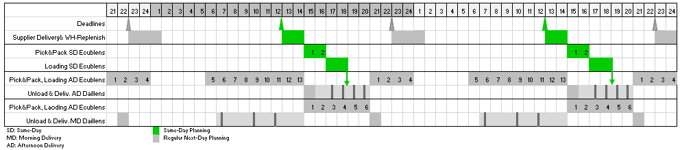
Proposed Solution
Prototype
Delivery as per following description
Same-day order deadline 12:00, delivery deadline 20:00, no deliveries on Saturdays or Half-days before Holidays
Max. Customers <10 /tour
Distribution vehicles located in Lausanne
Hubs: selecetd Migros Supermarkets, Notime hubs, train-station Renens or Lausanne for large local deliveries
Delivery Chain: Gerster Truck to Ecublens (if no stocks), Pick&Pack, 1 Truckload with LeShop boxes to Lausanne Hubs (Migros-Supermarkets, Notime Hubs or even train station Renens/Lausanne for large deliveries in the future) , Optimization & Distribution with Notime vans (Normal or EV)
Feasibility of Ecublens Scheduling including Same-Day

Slide 14
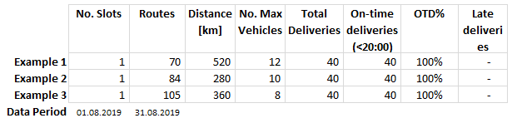
Simulation Result
Test
Delivery simulation
> as per Prototype specification and Annex Models/ files
https://github.com/envest99/LeShop-Same-Day
The simulations confirmed the technical feasibility. In order to confirm the economic feasa-bility some more detailed evaluation with no-time is required.

Slide 15
Conclusion & Outlook
Summary
Project Execution
Based on the case study of LeShop, the innovation of the elaborated change proposal is an incremental step. The proposed solution is realistically based on costs and data from public sources.
Simulation Results
The model simulation confirmed the assumed distances. Therefore the proposed solution could be realized as per specification: low cost with low investments. The growth scenario wasn’t simulated and would have to be tested on a real case.
Expected Return
The expected payback is 1.5 Y
Next Step
Contact LeShop regarding a possible follow-up project with refined specification and further detailed information.

Slide 16
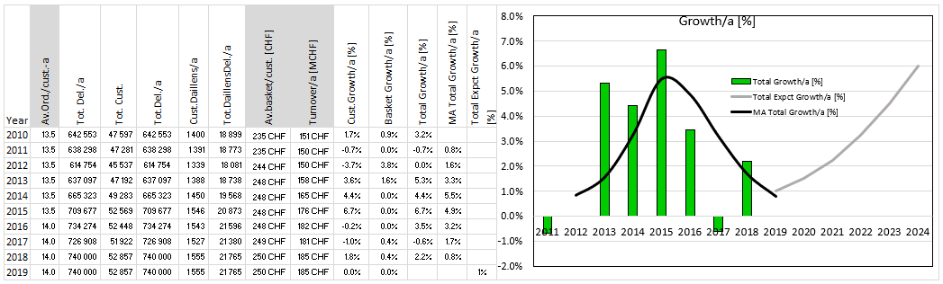
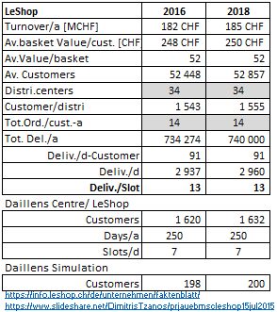
Annex1: LeShop Fact-sheet
Business Figures & Growth
Operational Figures

Slide 17
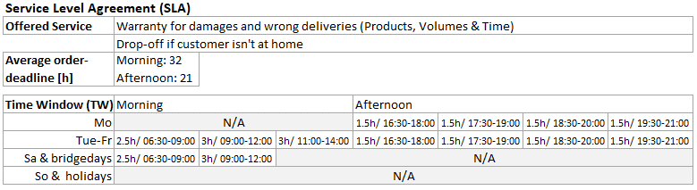
Annex2: SLA& Price Comparison
SLA
Most relevant Services
Other Propositions & Constraints
https://www.leshop.ch/files/help/en/legal/cgv/produits.html
Price Comparison

Slide 18
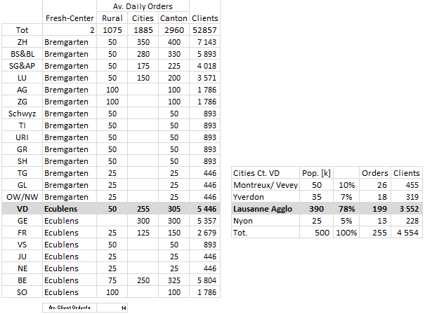
Annex3: Regional Order Distribution

Slide 19
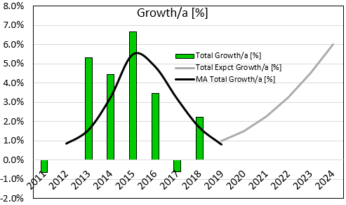
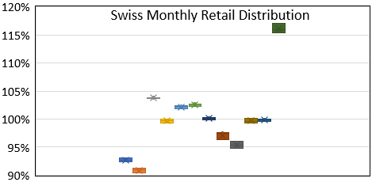
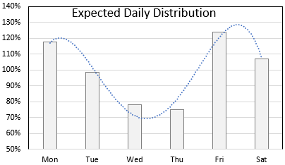
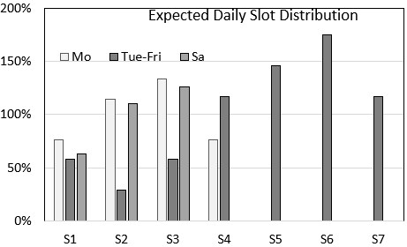
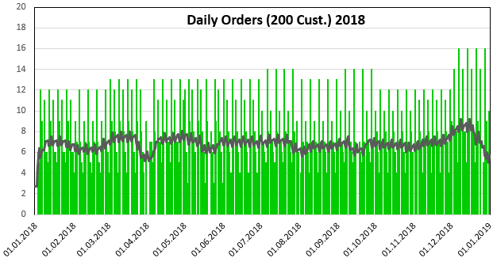
Annex4: Demand Model
Simple empirical Model based on yearly trend and seasonality structure

Slide 20
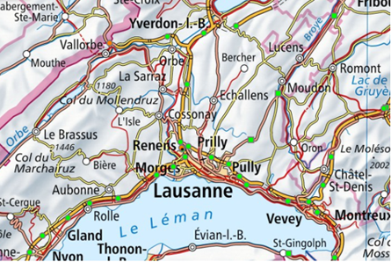
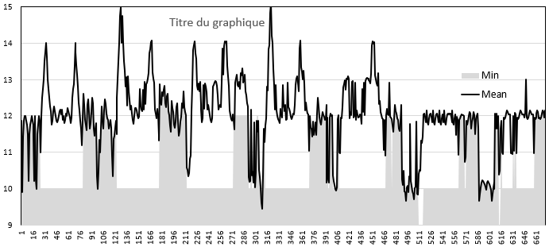
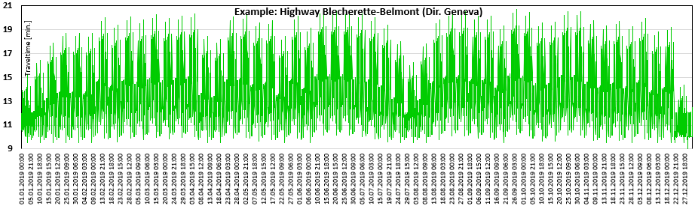
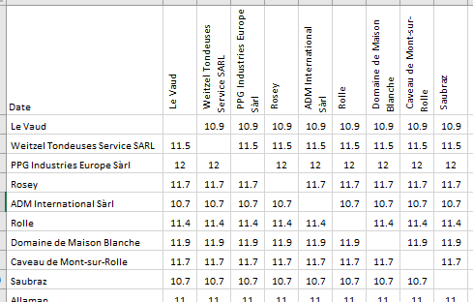
Annex5: Travel Time Model
Simple empirical Travel Time Model based on yearly trend and seasonality structure
Hist. Travel time: Google API
Traffic: ASTRA,…
Hourly Travel time Matrix (8760 files/a)

Slide 21
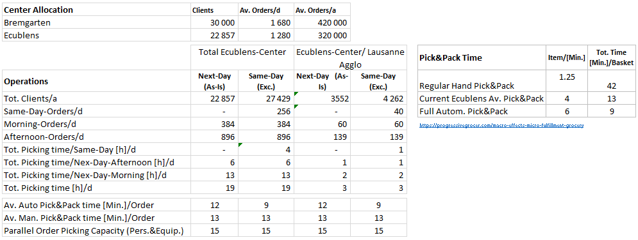
Annex6: Operations
Key Operation Figures

Slide 22
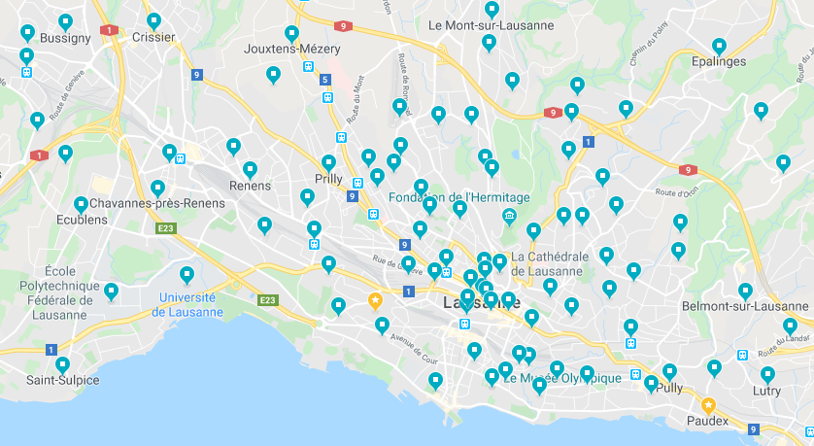
Annex7: Lausanne Map
List of random addresses for Goggle API

