Slide 1

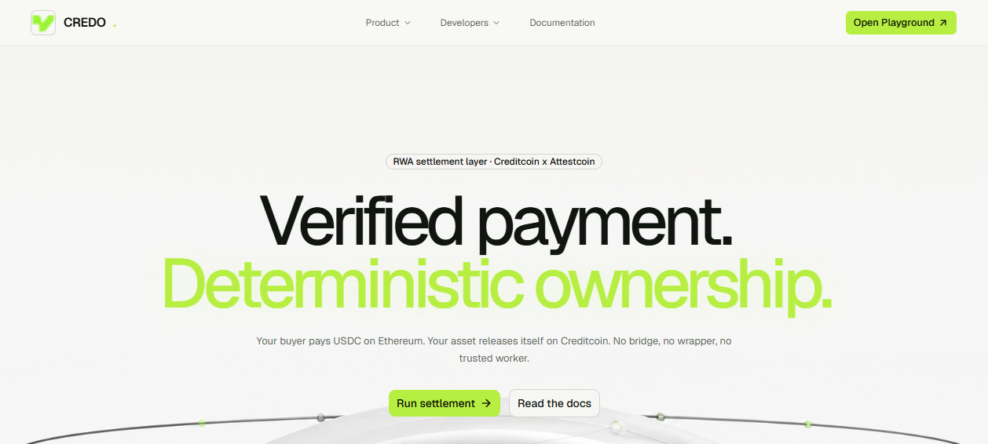
CREDO
Move ownership with
verifiable payment.
USDC stays final on Ethereum. The RWA stays native on Creditcoin. Only cryptographic proof crosses chains.
Proof-triggered RWA settlement
BUIDL CTC 2026 · RWA TRACK · CREDITCOIN × ATTESTCOIN
01
Notes:
[Sources]
- Project positioning and architecture: repository README and docs evidence.
- Live product screenshot captured from https://credo.becoder.xyz/ on 26 August 2026.

Slide 2
CREDO
THE PROBLEM
02
Cross-chain RWA settlement breaks at the trust boundary.
Payments may be final, yet delivery still depends on bridges, wrappers, or privileged operators.
01
BRIDGE RISK
Final USDC becomes wrapped exposure.
02
ORACLE TRUST
A backend assertion replaces cryptographic evidence.
03
OPERATOR POWER
One compromised key can redirect settlement.
04
WEAK BINDING
A payment can settle the wrong buyer, asset, amount, or window.
BUIDL CTC 2026 · RWA TRACK · CREDITCOIN × ATTESTCOIN
02
Notes:
[Sources]
- docs/submission/credo-deck.pdf, source slides 2–3.

Slide 3
CREDO
THE ANSWER
03
Move proof—not money or assets.
Credo separates what must remain native from what must cross.
PAYMENT
EVIDENCE
OWNERSHIP
ETHEREUM SEPOLIA
ATTESTCOIN
CREDITCOIN CC3
USDC stays final
Receipt + continuity proof
ERC-1155 changes owner
NO BRIDGE
ONLY THIS CROSSES
CONTRACT DECIDES
BUIDL CTC 2026 · RWA TRACK · CREDITCOIN × ATTESTCOIN
03
Notes:
[Sources]
- docs/evidence/payment/sepolia-tx.json.
- docs/evidence/settlement/creditcoin-tx.json.
- docs/evidence/contracts/addresses.json.

Slide 4
CREDO
MECHANISM
04
One payment. One proof. One release.
The worker observes; Attestcoin proves; the contract owns the decision.
1
2
3
4
5
SELLER
BUYER
WORKER
ATTESTCOIN
CONTRACT
Escrows ERC-1155
Pays native USDC
Discovers receipt
Builds proof
Verifies + releases
PAYMENT STAYS ON ETHEREUM
OWNERSHIP STAYS ON CREDITCOIN
BUIDL CTC 2026 · RWA TRACK · CREDITCOIN × ATTESTCOIN
04
Notes:
[Sources]
- contracts/src/SettleRWA.sol.
- contracts/src/PaymentVerifierUSC.sol.
- worker/ implementation and USC SDK integration.

Slide 5
CREDO
VERIFICATION
05
Settlement has one admissible path: exact proof match.
Verified bytes—not worker claims—must satisfy every on-chain constraint.
✓
Verifier precompile accepts inclusion + continuity
✓
Receipt status is successful
✓
Emitter is official Sepolia USDC
✓
Buyer, seller, amount, token, and window match
✓
Exactly one Transfer event matches
✓
Query ID has never been used
BUIDL CTC 2026 · RWA TRACK · CREDITCOIN × ATTESTCOIN
05
Notes:
[Sources]
- contracts/src/PaymentVerifierUSC.sol.
- docs/threat-model/README.md.

Slide 6
CREDO
SECURITY
06
The worker carries evidence—never authority.
Settlement power remains inside non-upgradeable contract logic.
CONTRACT ENFORCES
OPERATOR CANNOT
+
Release and replay marker are atomic
—
Force-settle escrowed assets
+
Checks-effects-interactions + reentrancy guard
—
Mark arbitrary proofs as verified
+
One open sale per exact payment tuple
—
Change buyer after sale creation
+
Reclaim only after payment window + grace
—
Touch funds or hold privileged roles
BUIDL CTC 2026 · RWA TRACK · CREDITCOIN × ATTESTCOIN
06
Notes:
[Sources]
- docs/threat-model/README.md.
- docs/evidence/security/slither.md.
- contracts/src/SettleRWA.sol.

Slide 7
CREDO
LIVE EVIDENCE
07
A complete testnet settlement closes the loop.
Distinct buyer and seller wallets; official Sepolia USDC; final ownership on CC3.
489 s
2
1 / 0
TRUE
PAYMENT → SETTLEMENT
INDEPENDENT WALLETS
BUYER / ESCROW BALANCE
REPLAY MARKER
SEPOLIA PAYMENT
CREDITCOIN SETTLEMENT
5 USDC · block 11,566,178
Status SETTLED · token 1001
Query 0x4c94e8b1…d853e655
Tx 0xcf9dd953…56eff96
BUIDL CTC 2026 · RWA TRACK · CREDITCOIN × ATTESTCOIN
07
Notes:
[Sources]
- docs/evidence/payment/sepolia-tx.json.
- docs/evidence/attestcoin/proof-run.json.
- docs/evidence/settlement/creditcoin-tx.json.
- docs/evidence/rwa/after.json.

Slide 8
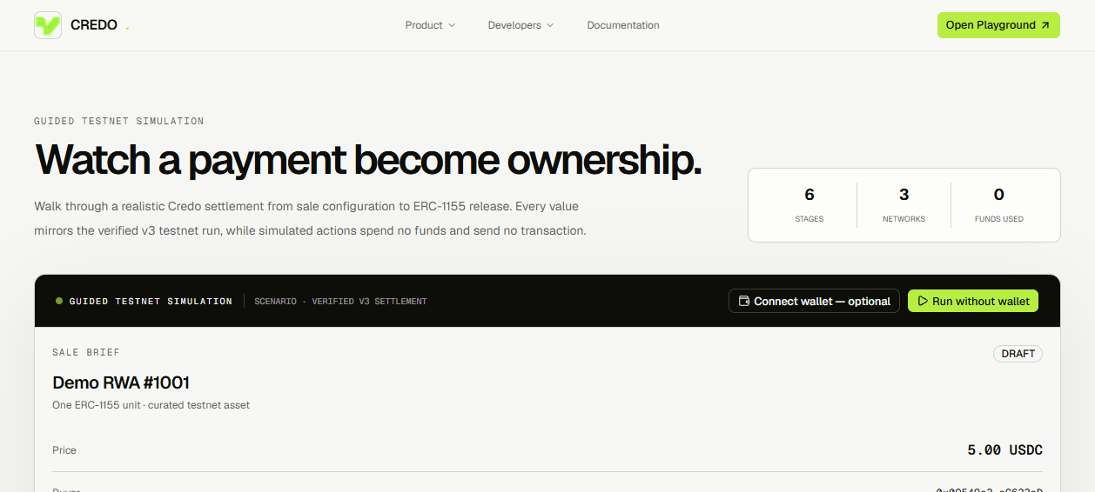
CREDO
PRODUCT
08
The protocol is already usable through a guided playground.
Builders can inspect the flow, open evidence, and integrate against documented contracts.
WHAT SHIPS
•
Wallet-free simulation
•
Evidence links for each state
•
API reference + ABI downloads
•
Typed errors and request IDs
•
Worker automation path
BUIDL CTC 2026 · RWA TRACK · CREDITCOIN × ATTESTCOIN
08
Notes:
[Sources]
- Live playground screenshot captured from https://credo.becoder.xyz/playground on 26 August 2026.
- docs/TDD-AUDIT.md.
- In-app documentation under /infra.

Slide 9
CREDO
ENGINEERING
09
The stack is tested from contract to application.
The latest recorded audit verifies the deployed v3 path and its settlement invariants.
19 / 19
9 / 9
256k
CLEAN
APPLICATION TESTS
FOUNDRY TESTS
INVARIANT CALLS
TYPECHECK + LINT + BUILD
Security posture
Reentrancy finding resolved. Remaining Slither note is the intentional reclaim timestamp comparison.
BUIDL CTC 2026 · RWA TRACK · CREDITCOIN × ATTESTCOIN
09
Notes:
[Sources]
- docs/TDD-AUDIT.md, re-audit sessions 3–4.
- docs/evidence/security/slither.md.

Slide 10
CREDO
ADOPTION
10
Credo is a settlement layer—not a marketplace.
The protocol owns truth; ecosystem products own discovery, pricing, compliance, and experience.
CREDO CORE
BUILDER SURFACE
Escrow + deterministic release
RWA marketplaces
Attestcoin verification
OTC and private sales
Payment-intent uniqueness
Issuance + compliance apps
Replay protection
Portfolio and analytics products
Worker automation
Any DvP-enabled experience
BUIDL CTC 2026 · RWA TRACK · CREDITCOIN × ATTESTCOIN
10
Notes:
[Sources]
- docs/submission/credo-deck.pdf, source slide 9.
- docs/INFRA-WORKPLAN.md.

Slide 11
CREDO
ROADMAP
11
Scale the primitive without weakening the trust model.
The current testnet release is proven; the next phases expand access and asset coverage.
NOW
NEXT
THEN
LATER
SETTLEMENT PRIMITIVE
RESERVATIONS
ASSET ADAPTERS
TWO-WAY DVP
Shipped on CC3
Remove double-buyer race
ERC-20 / 721 / 3643
Requires reverse write-back
HONEST LIMIT: payment is irreversible before Creditcoin release; this is proof-triggered settlement, not an atomic two-chain swap.
BUIDL CTC 2026 · RWA TRACK · CREDITCOIN × ATTESTCOIN
11
Notes:
[Sources]
- docs/submission/credo-deck.pdf, source slides 10–11.
- docs/TDD-AUDIT.md, open gates.

Slide 12
CREDO
Proof crosses.
Ownership moves.
No bridge. No wrapped USDC. No trusted worker.
Build on the settlement layer
GitHub · Live playground · Testnet evidence
BUIDL CTC 2026 · RWA TRACK · CREDITCOIN × ATTESTCOIN
12
Notes:
[Sources]
- Repository root and docs/evidence directory.

