Slide 1
Central Valley Well Data

Slide 2
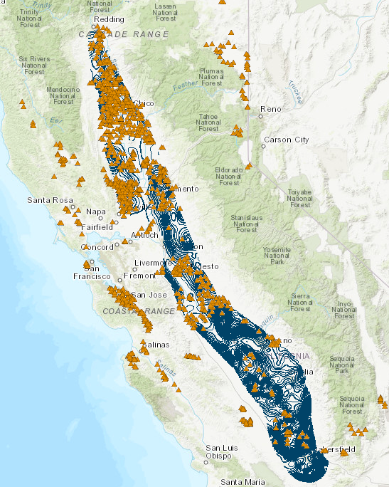
We have well data from DWR used in their seasonal reports
A contour is provided by them, but we don’t trust it/want to improve it

Slide 3
Not all wells are made equal
Some wells, like monitoring wells, are high quality
Other wells are low quality

Slide 4
How can we determine the uncertainty in each data point?

Slide 5
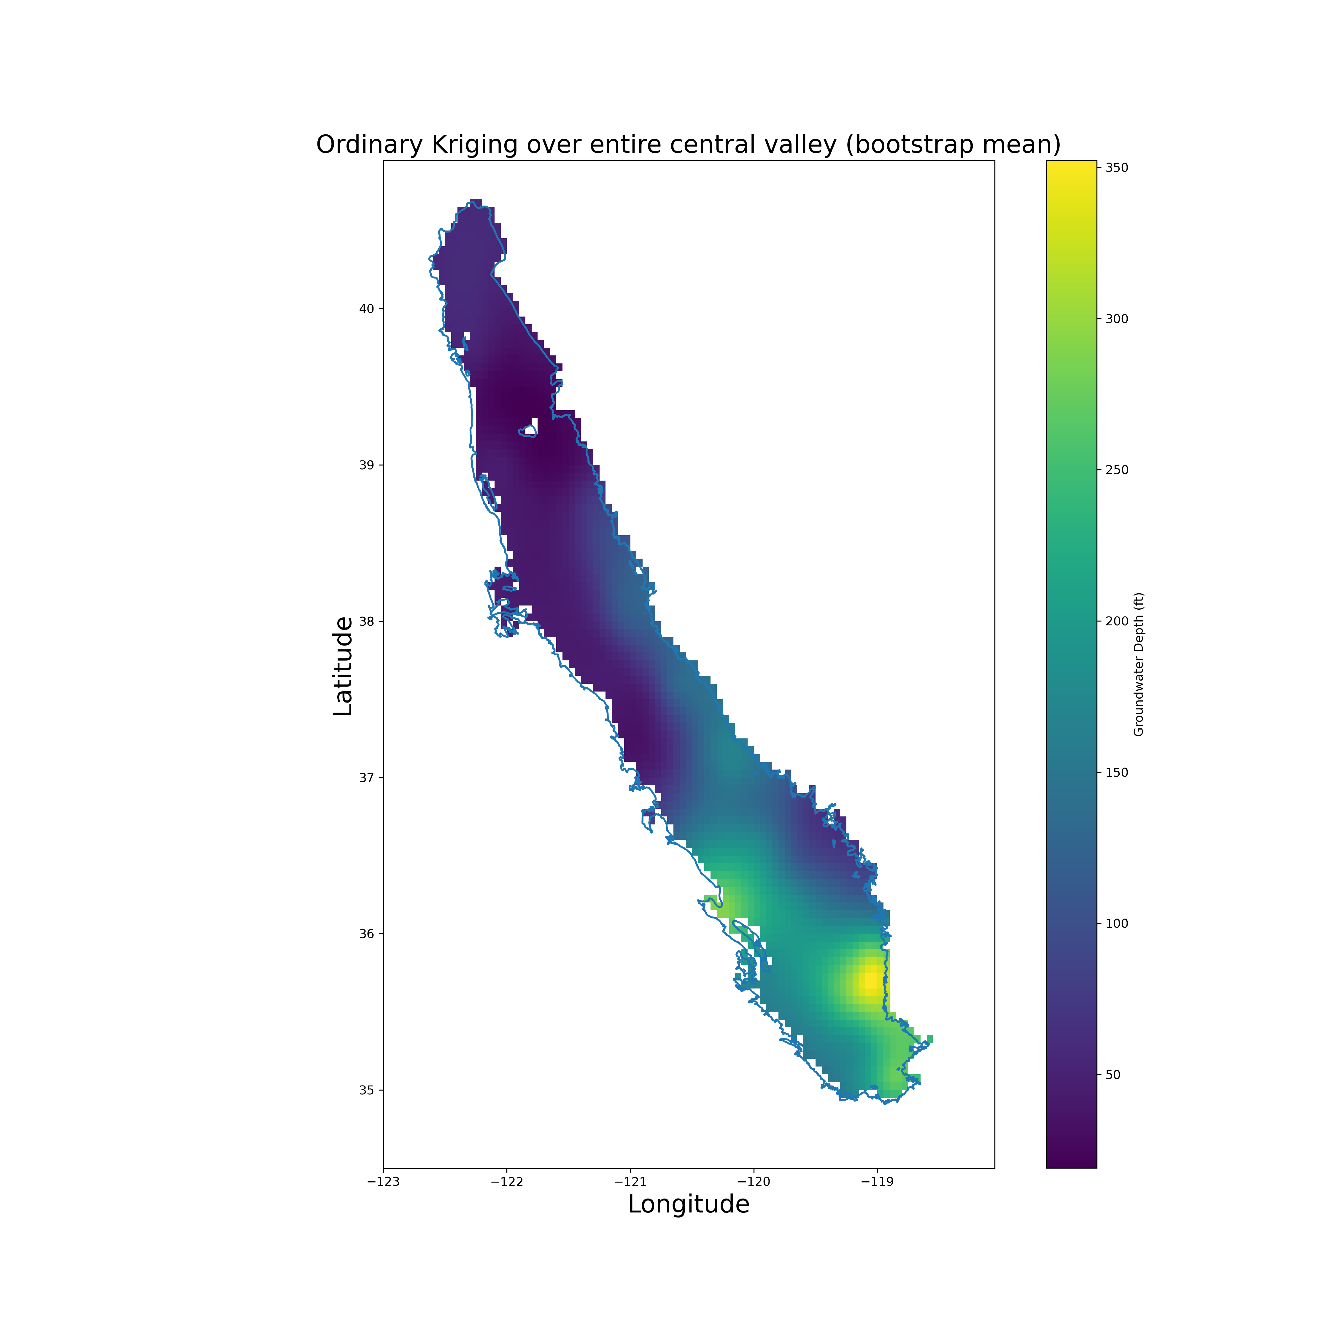
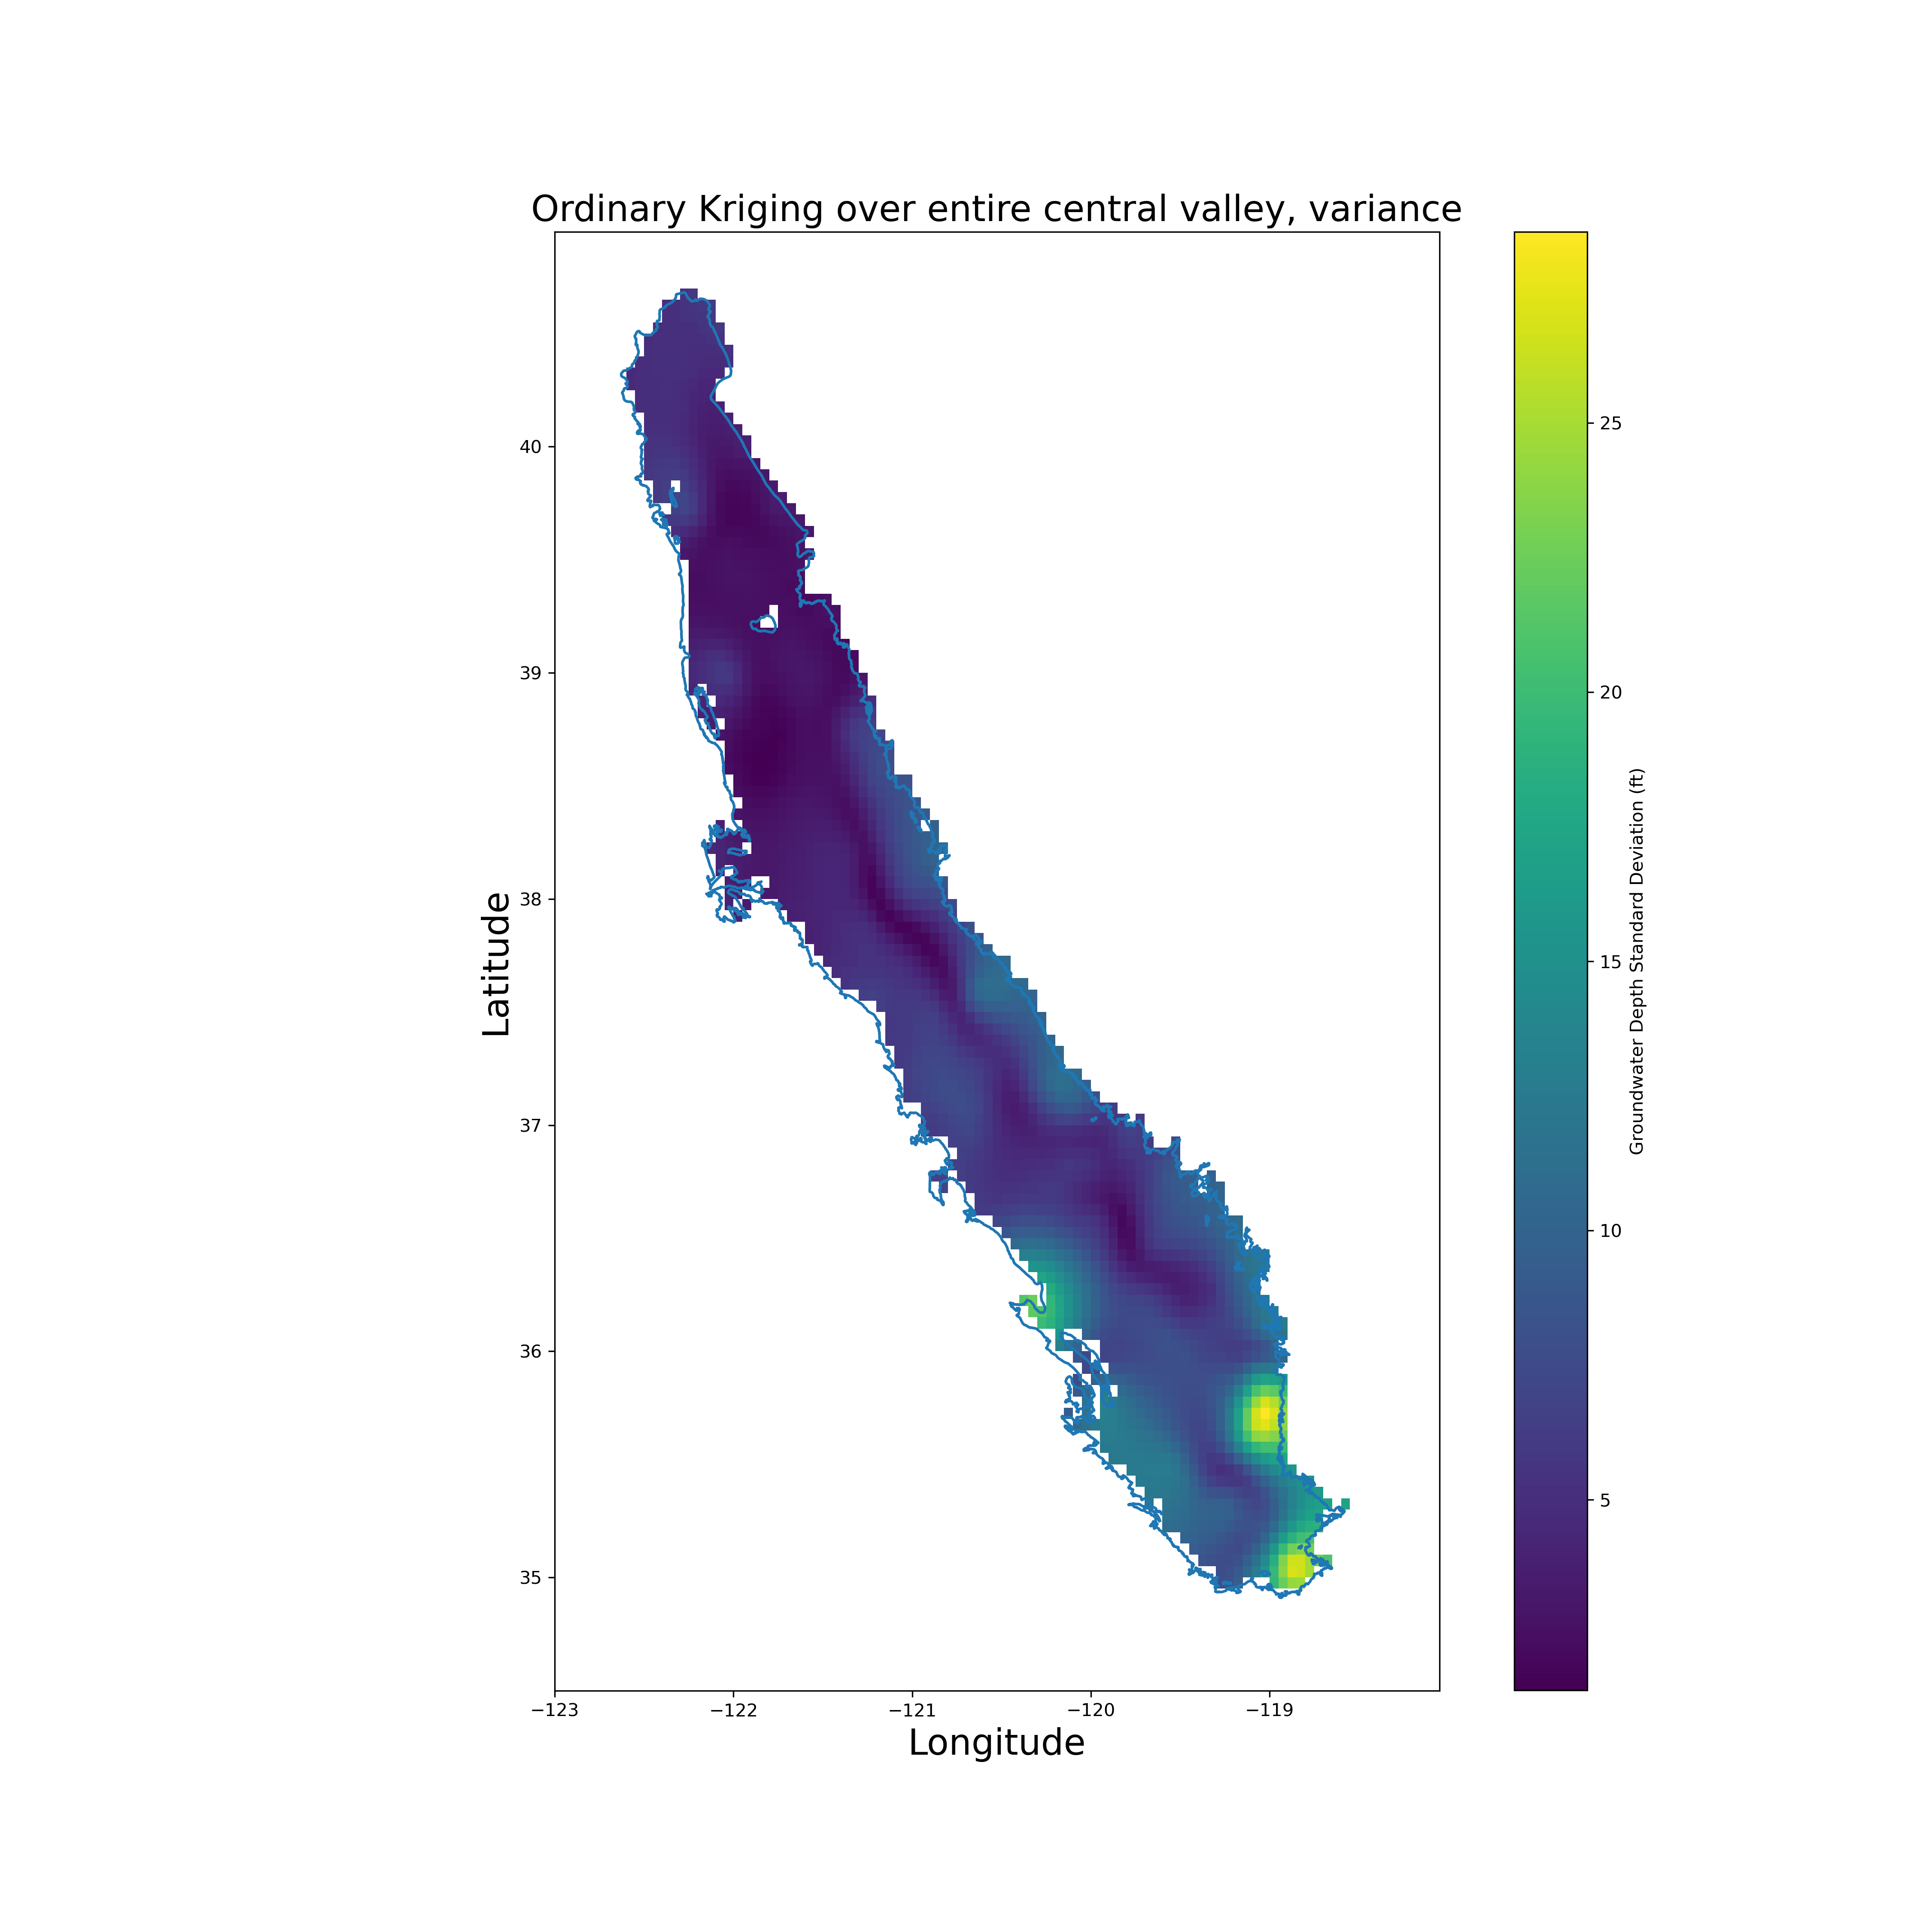
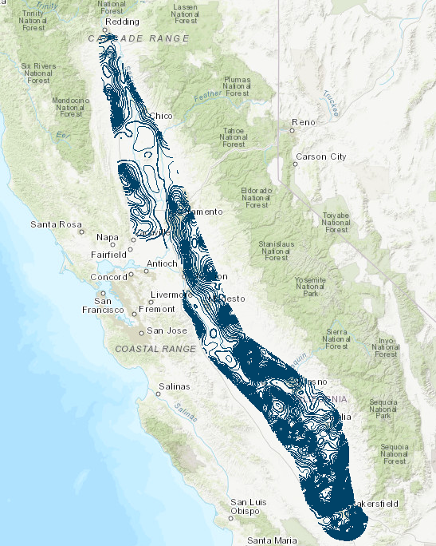
Exploring Brewster’s Work

