Slide 1
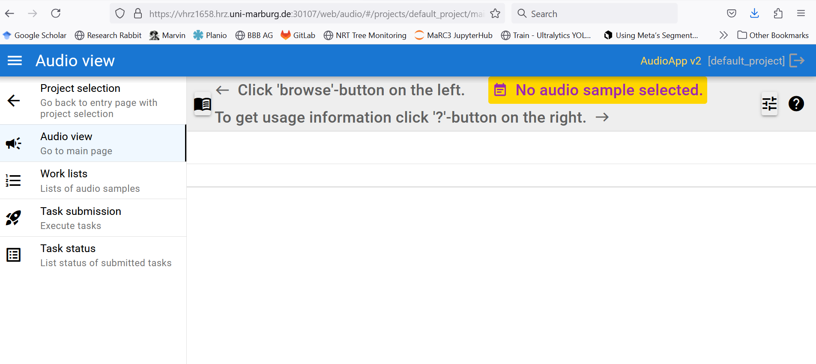
http://localhost:8080/web/audio

Slide 2
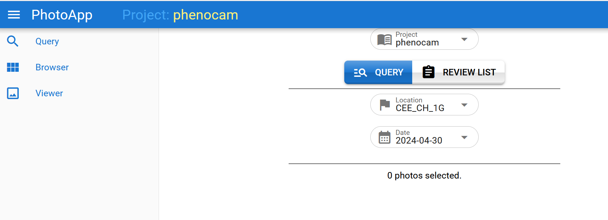
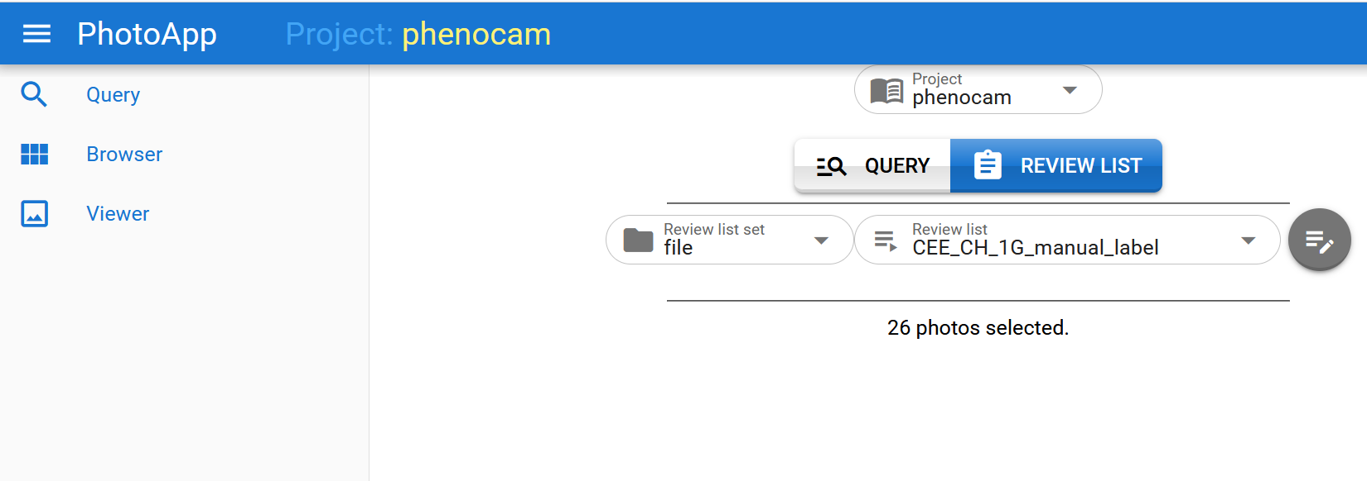
Germany
Germany_manual_label
Germany_manual_label_list

Slide 3
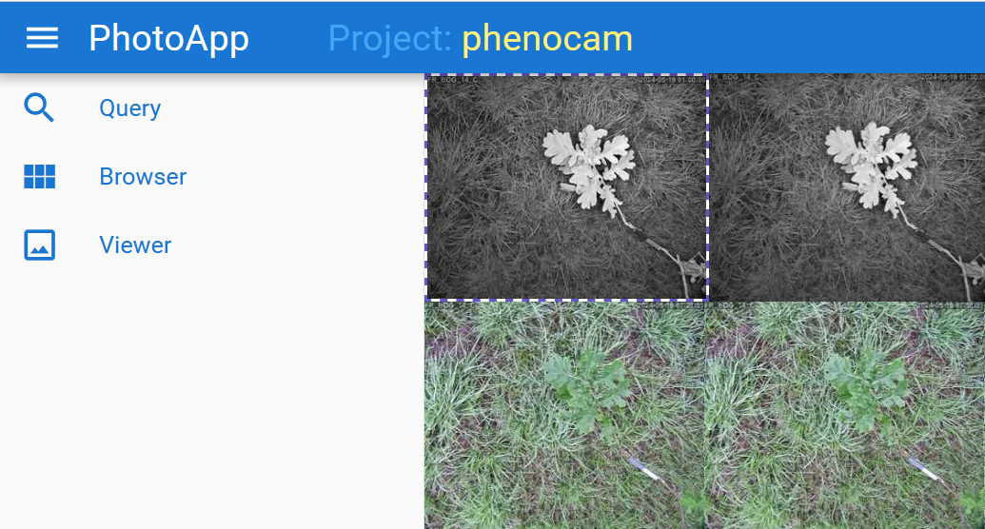

Slide 4
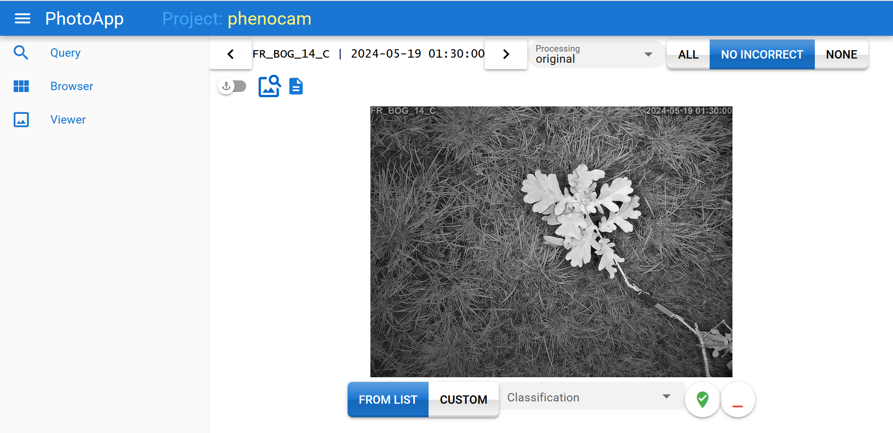
a
c
e
Germany_tree1
d
b
f
g
h

Slide 5
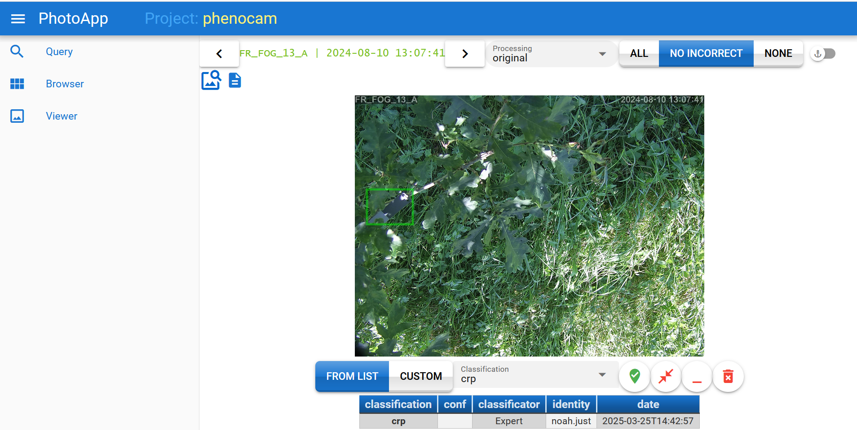
a
b
d
e
f
g
c

Slide 6
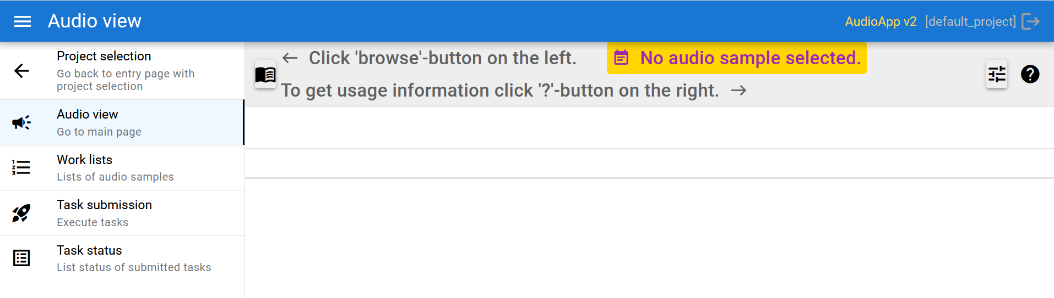
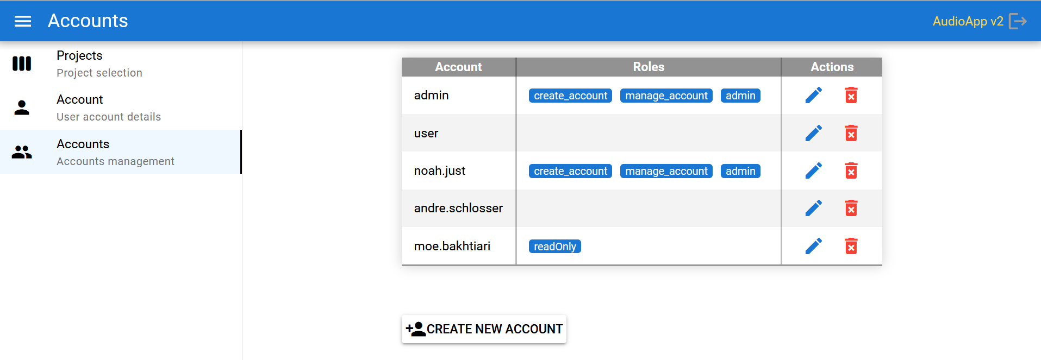
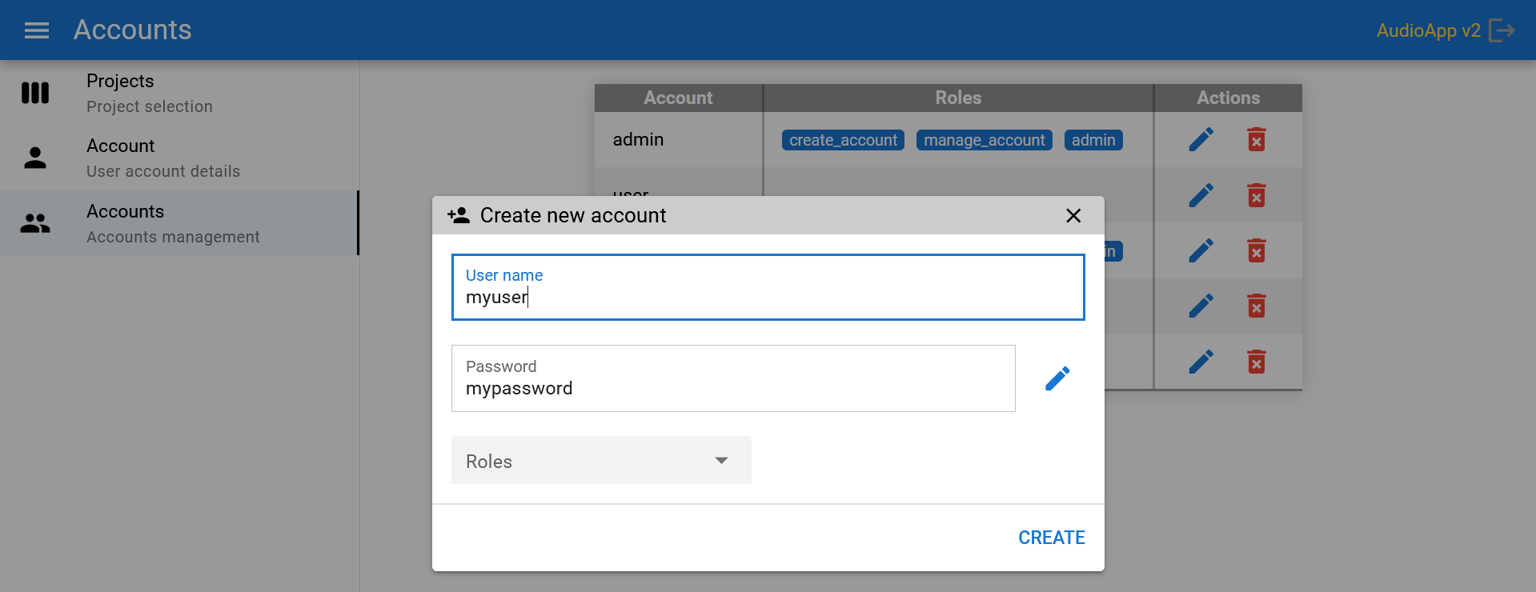
http://localhost:8080/web/audio
http://localhost:8080/web/audio
admin
user1
user2
user3
user4
http://localhost:8080/web/audio

Slide 7
