Slide 2
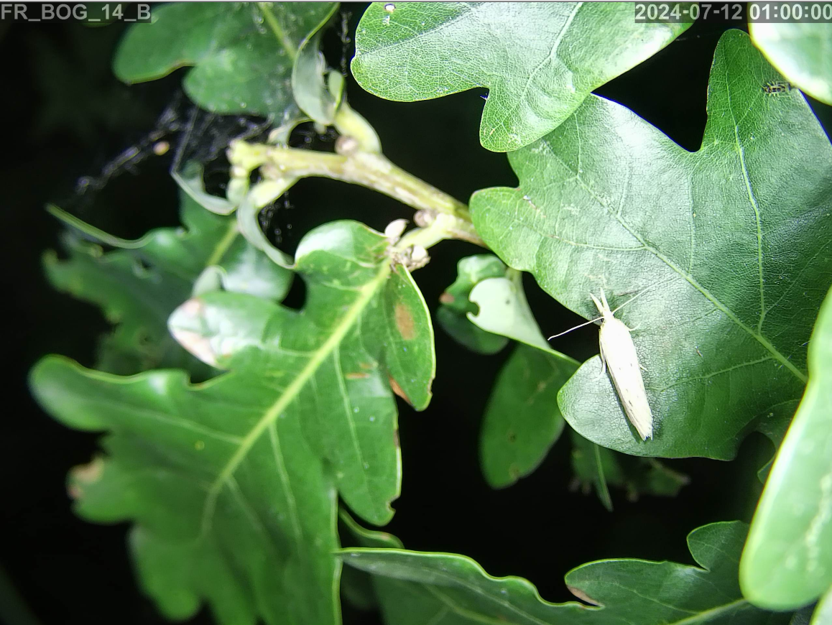
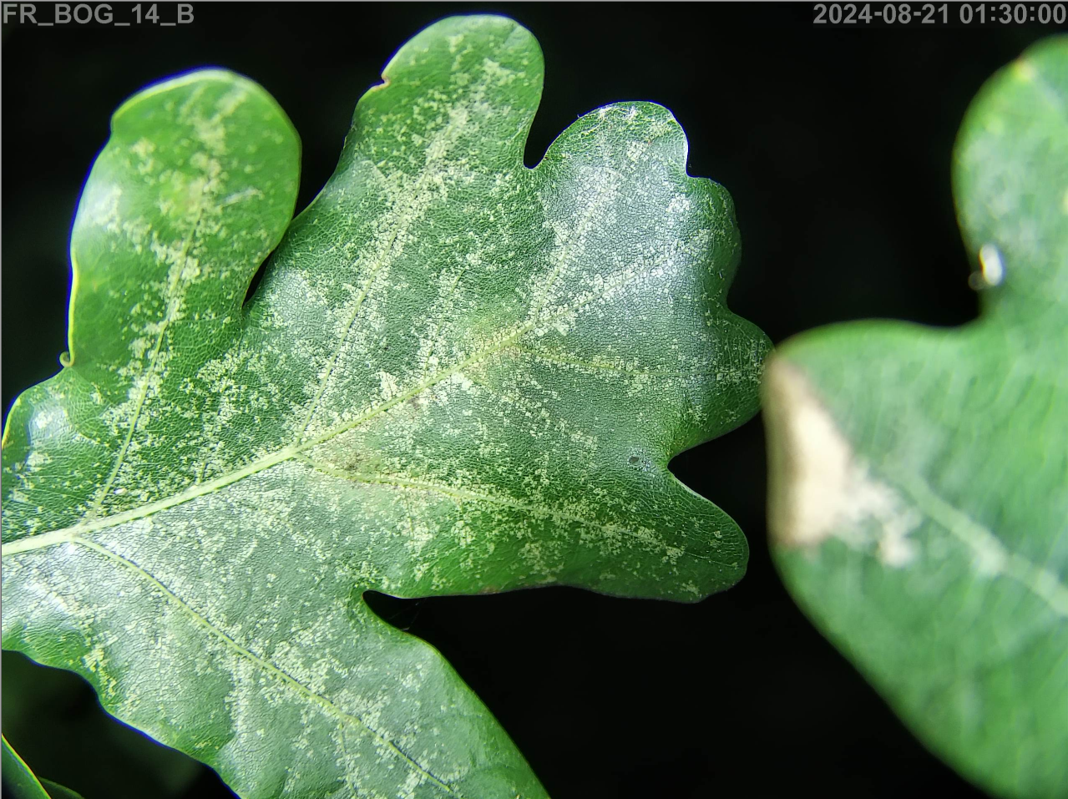
PhotoSens: v1.0
file: P24082511114410.jpg location: Germany
date: 2024-08-25T11:11:44
log:
action: create yaml
date: 2024-08-25T12:00:06
action: run MegaDetector
date: 2024-08-25T12:00:38 contains_person: no
detections:
- bbox: [0.1, 0.3, -0.1, 0.1]
classifications:
- {classification: insect,
classificator: Expert,
identity: noah.just,
date: '2025-03-25T14:42:57'}

