Slide 2
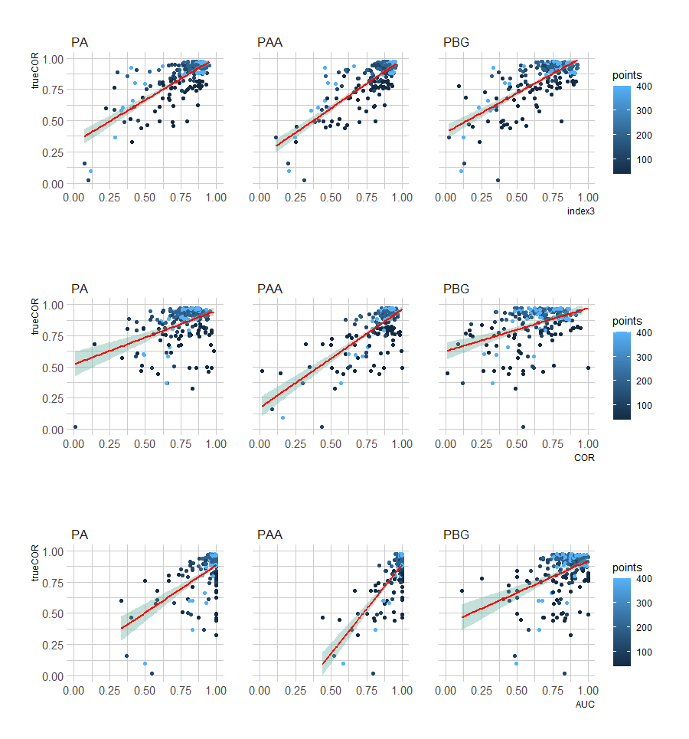
AUC_{ROC} on PA data
AUC_{ROC} on PBG data
Index on PAA data
Pearson correlation between suitability raster and prediction raster of virtual species
RMSE: 0.19
R²: 0.53
RMSE: 0.2
R²: 0.28
RMSE: 0.12
R²: 0.76
Absence data needed
Calculated on Presence-Only data
PA Presence-Absence
PBG Presence-Background
PAA Presence-Artificial-Absence

Slide 3
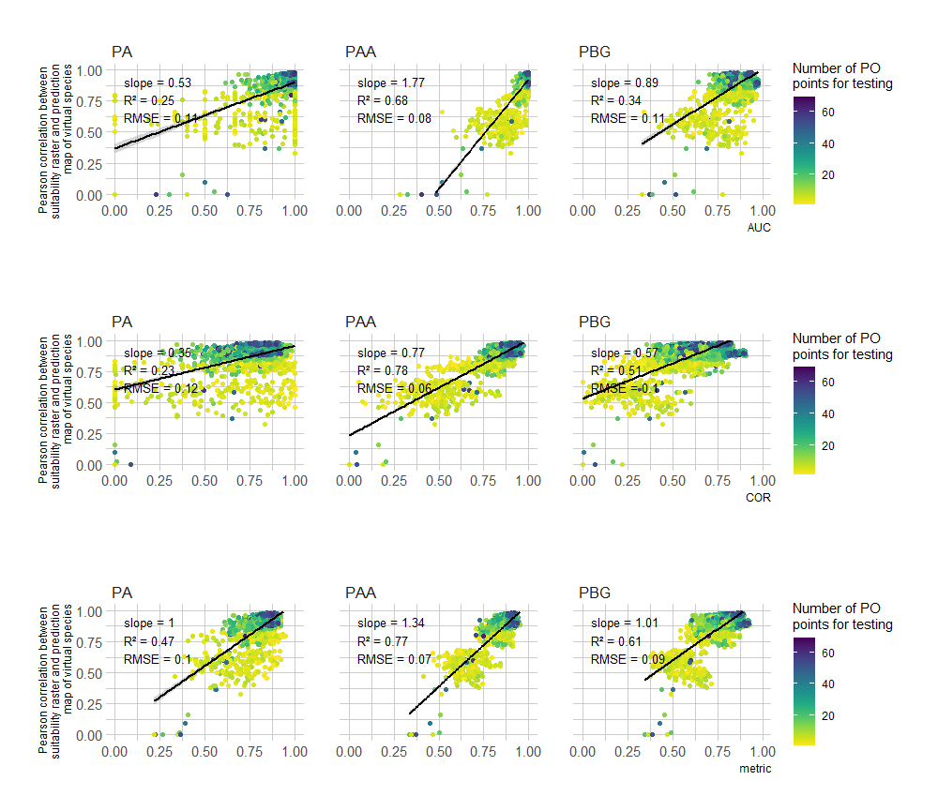
AUC_{ROC} on PA data
AUC_{ROC} on PBG data
Index on PAA data
AUC_{ROC}
AUC_{ROC}
Index
Absence data needed
Calculated on Presence-Only data
PA Presence-Absence
PBG Presence-Background
PAA Presence-Artificial-Absence

