Slide 1

POSSIBILIDADES DE DISPLAY – CARBON ANALYTIC
Série temporal de
biomassa ou carbono
Slide 2 ou 3
(dependendo do tipo de gráfico selecionado)
ESTOQUE
Um momento de
biomassa ou carbono
Slide 4
(dependendo do tipo de gráfico selecionado)
Slide 5
CHANGE

Slide 2
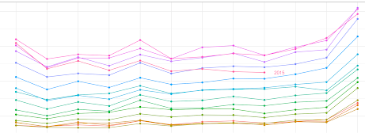
Metric
Layer 1
Layer 2
Product
Estoque
Change
Biomassa
Carbono
N
N
Period
Start
End
Color bar
Region of interest
Rectangle
Polygon
Point
Upload
Scale
Scale
Administrative Areas
Graph Type
Filter
Country
Biome
Watershed
State
City
Forest Type
Type 1
Biomass/Carbon
Color
Ano
Summary
Total 999999 Mg Biomass
or Mg Carbon
Year | Estoque Biomass/Carbon | Min | Max
1 | xxx
2 | xxx
3 | xxx
n | xxx

Slide 3
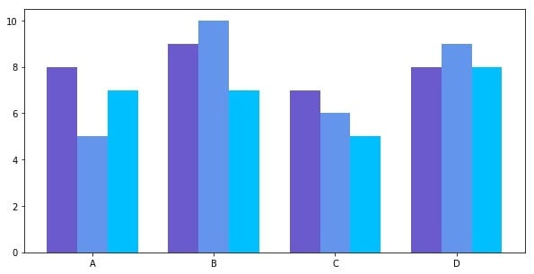
Metric
Layer 1
Layer 2
Product
Estoque
Change
Biomassa
Carbono
N
N
Period
Start
End
Color bar
Region of interest
Rectangle
Polygon
Point
Upload
Scale
Scale
Administrative Areas
Graph Type
Filter
Country
Biome
Watershed
State
City
Forest Type
Type 2
Biomass/Carbon
Color
Ano
Summary
Total 999999 Mg Biomass
or Mg Carbon
Year | Estoque Biomass/Carbon | Min | Max
1 | xxx
2 | xxx
3 | xxx
n | xxx

Slide 4
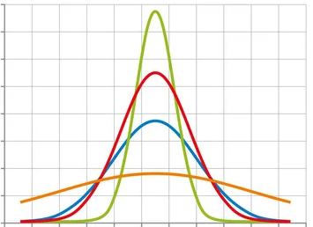
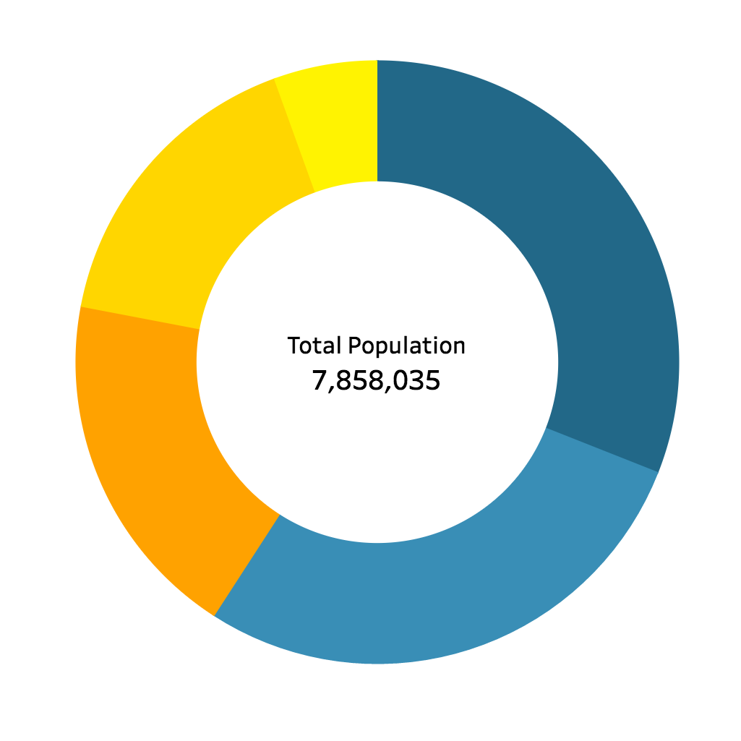

Metric
Layer 1
Product
Estoque
Change
Biomassa
Carbono
N
Period
Start
End
Color bar
Region of interest
Rectangle
Polygon
Point
Upload
Scale
Administrative Areas
Filter
Forest Type
Country
Biome
Watershed
State
City
Forest Type
freq
Legend
Color
B/C
Summary
Forest Type | Estoque Biomass/Carbon | SD | Area
a | xxx
b | xxx
c | xxx
n | xxx
Total 999999 Mg Biomass
or Mg Carbon
LI e LS do IC 95% P

Slide 5
Metric
Year 1
Year 2
Product
Estoque
Change
Biomassa
Carbono
N
Period
Start
End
Color bar
Region of interest
Rectangle
Polygon
Point
Upload
Scale
Administrative Areas
Graph Type
Filter
Country
Biome
Watershed
State
City
Forest Type
Change in
Biomass/Carbon
Color
Yn-1/Yn
Y1/Y2
Summary
Total 999999 Mg Biomass
or Mg Carbon
Type | Y1/Y2 | Y2/Y3 | Y3/Y4 | Y4/Y5 | Yn-1/Yn
Gain
Loss
Balance

