Slide 1
第11次习题课
2022-5-16

Slide 2
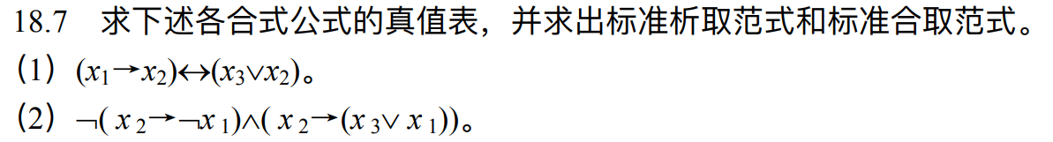
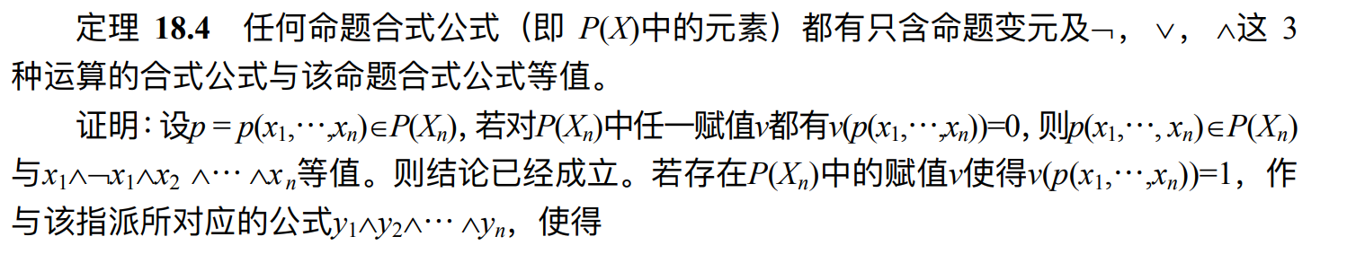
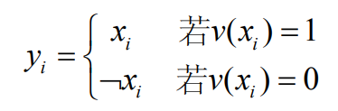
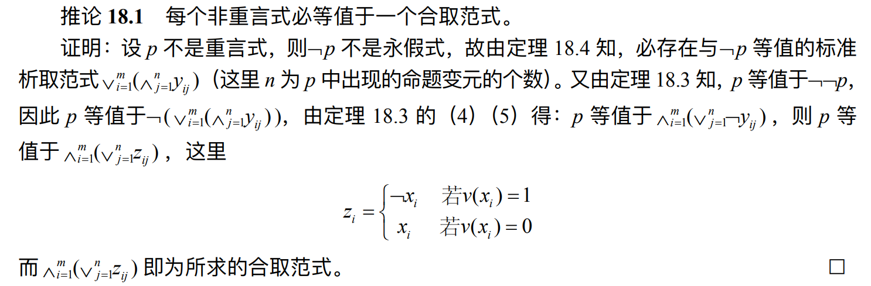

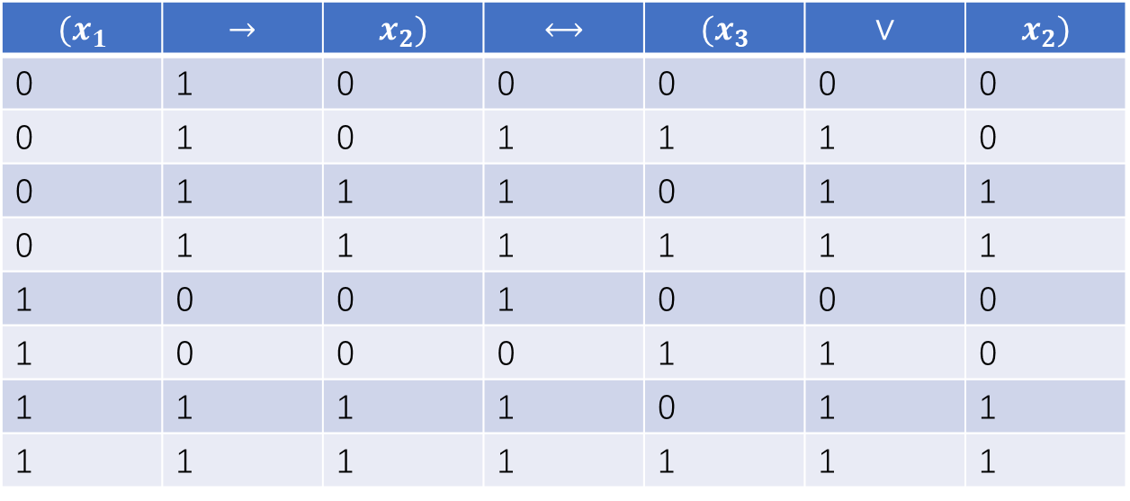
（1）
标准析取范式：$\left(¬x_{1}∧¬x_{2}∧x_{3}\right)∨\left(¬x_{1}∧x_{2}∧¬x_{3}\right)∨\left(¬x_{1}∧x_{2}∧x_{3}\right)∨\left(x_{1}∧¬x_{2}∧¬x_{3}\right)∨\left(x_{1}∧x_{2}∧¬x_{3}\right)∨(x_{1}∧x_{2}∧x_{3})$
标准合取范式：$\left(x_{1}∨x_{2}∨x_{3}\right)∧(¬x_{1}∨x_{2}∨¬x_{3})$
$$(x_{1}$$ | $$→$$ | $$x_{2})$$ | $$⟷$$ | $$(x_{3}$$ | $$∨$$ | $$x_{2})$$
0 | 1 | 0 | 0 | 0 | 0 | 0
0 | 1 | 0 | 1 | 1 | 1 | 0
0 | 1 | 1 | 1 | 0 | 1 | 1
0 | 1 | 1 | 1 | 1 | 1 | 1
1 | 0 | 0 | 1 | 0 | 0 | 0
1 | 0 | 0 | 0 | 1 | 1 | 0
1 | 1 | 1 | 1 | 0 | 1 | 1
1 | 1 | 1 | 1 | 1 | 1 | 1

Slide 3
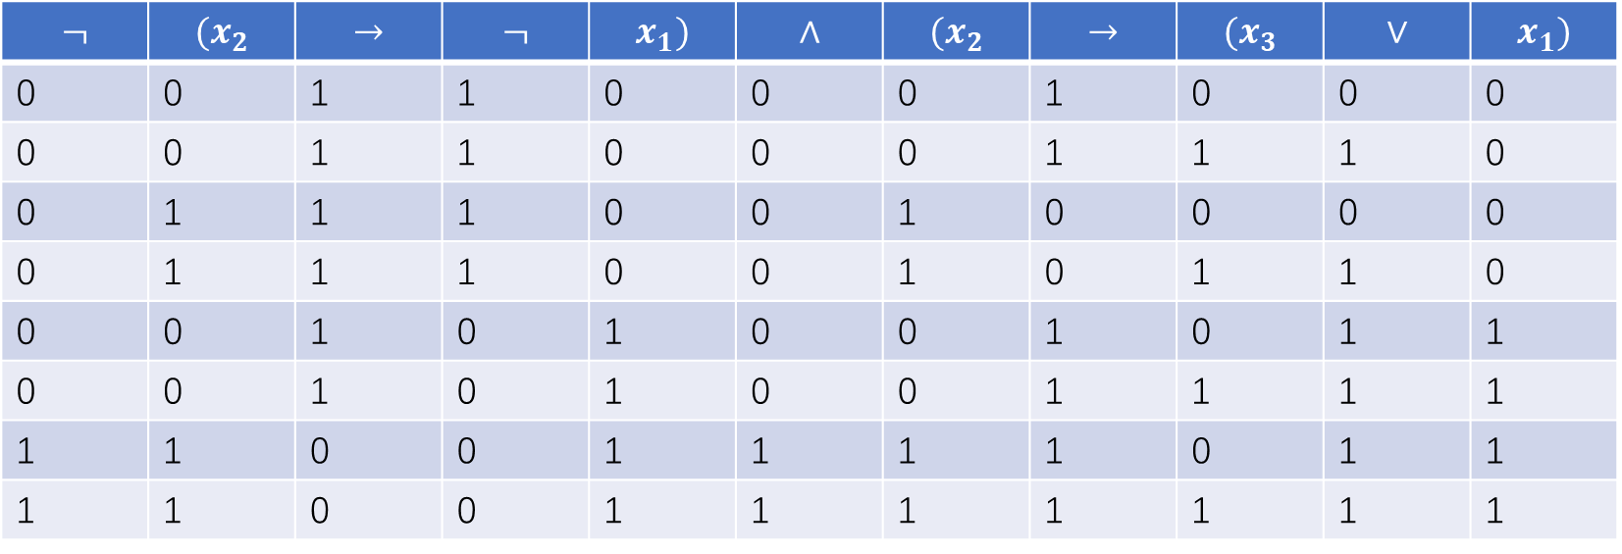

$$¬$$ | $$(x_{2}$$ | $$→$$ | $$¬$$ | $$x_{1})$$ | $$∧$$ | $$(x_{2}$$ | $$→$$ | $$(x_{3}$$ | $$∨$$ | $$x_{1})$$
0 | 0 | 1 | 1 | 0 | 0 | 0 | 1 | 0 | 0 | 0
0 | 0 | 1 | 1 | 0 | 0 | 0 | 1 | 1 | 1 | 0
0 | 1 | 1 | 1 | 0 | 0 | 1 | 0 | 0 | 0 | 0
0 | 1 | 1 | 1 | 0 | 0 | 1 | 0 | 1 | 1 | 0
0 | 0 | 1 | 0 | 1 | 0 | 0 | 1 | 0 | 1 | 1
0 | 0 | 1 | 0 | 1 | 0 | 0 | 1 | 1 | 1 | 1
1 | 1 | 0 | 0 | 1 | 1 | 1 | 1 | 0 | 1 | 1
1 | 1 | 0 | 0 | 1 | 1 | 1 | 1 | 1 | 1 | 1
（2）
标准析取范式：$\left(x_{1}∧x_{2}∧¬x_{3}\right)∨(x_{1}∧x_{2}∧x_{3})$
标准合取范式：$\left(x_{1}∨x_{2}∨x_{3}\right)∧\left(x_{1}∨x_{2}∨¬x_{3}\right)∧\left(x_{1}∨¬x_{2}∨x_{3}\right)∧\left(x_{1}∨¬x_{2}∨¬x_{3}\right)$ $∧\left(¬x_{1}∨x_{2}∨x_{3}\right)∧\left(¬x_{1}∨x_{2}∨¬x_{3}\right)$

Slide 4

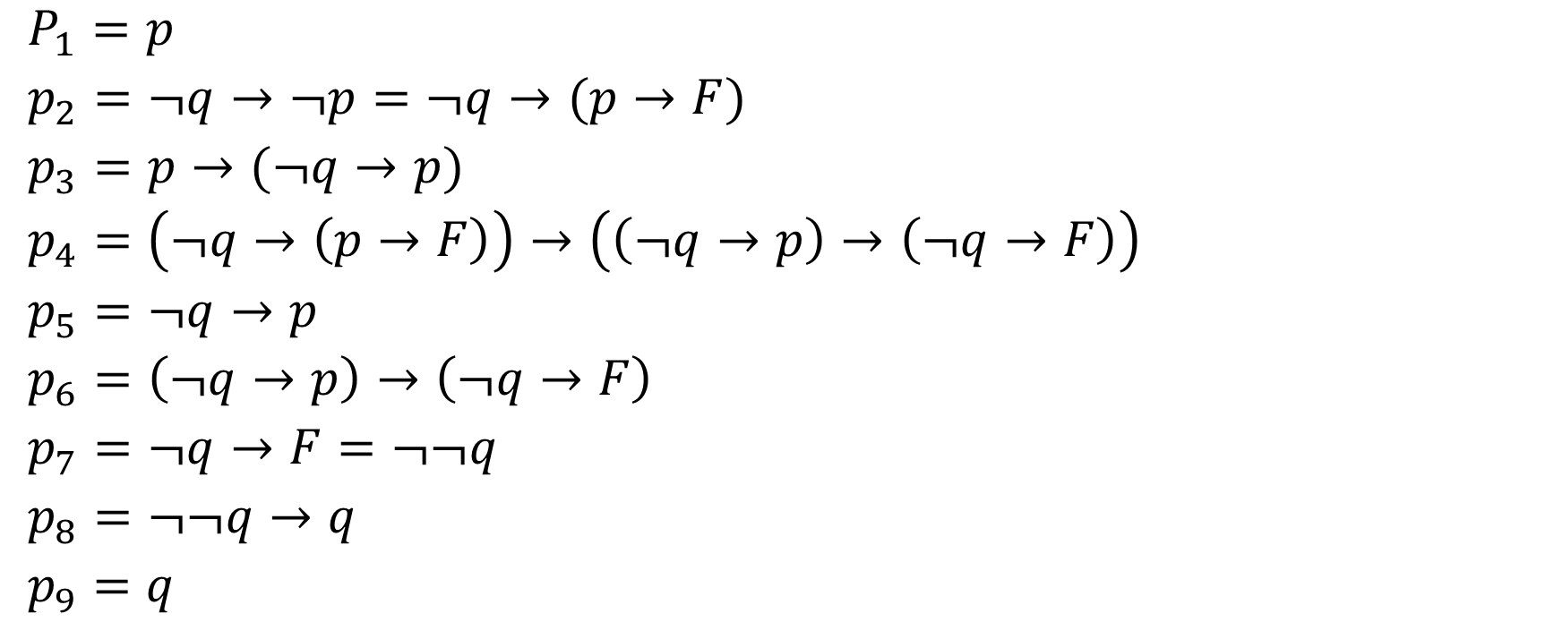

$𝒜$
$𝒜$
$𝒜_{1}$
$𝒜_{2}$
$p_{1}p_{3}MP$
$p_{2}p_{4}MP$
$p_{5}p_{6}MP$
$𝒜_{3}$
$$p_{7}p_{8}MP$$
$P_{1}=p$
$p_{2}=¬q→¬p=¬q→(p→F)$
$p_{3}=p→(¬q→p)$
$p_{4}=\left(¬q→\left(p→F\right)\right)→\left(\left(¬q→p\right)→\left(¬q→F\right)\right)$
$p_{5}=¬q→p$
$p_{6}=\left(¬q→p\right)→\left(¬q→F\right)$
$p_{7}=¬q→F=¬¬q$
$p_{8}=¬¬q→q$
$p_{9}=q$

Slide 5



$├ p→(¬p→F)$
通过演绎定理证明$\left\{p,¬p\right\}├ F$
$p_{1}=p$
$p_{2}=¬p=p→F$
$p_{3}=F$
即新的命题是成立的，也即原命题成立。
$$𝒜$$
$$𝒜$$
$$p_{1}p_{2}MP$$

Slide 6
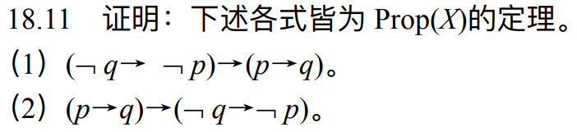
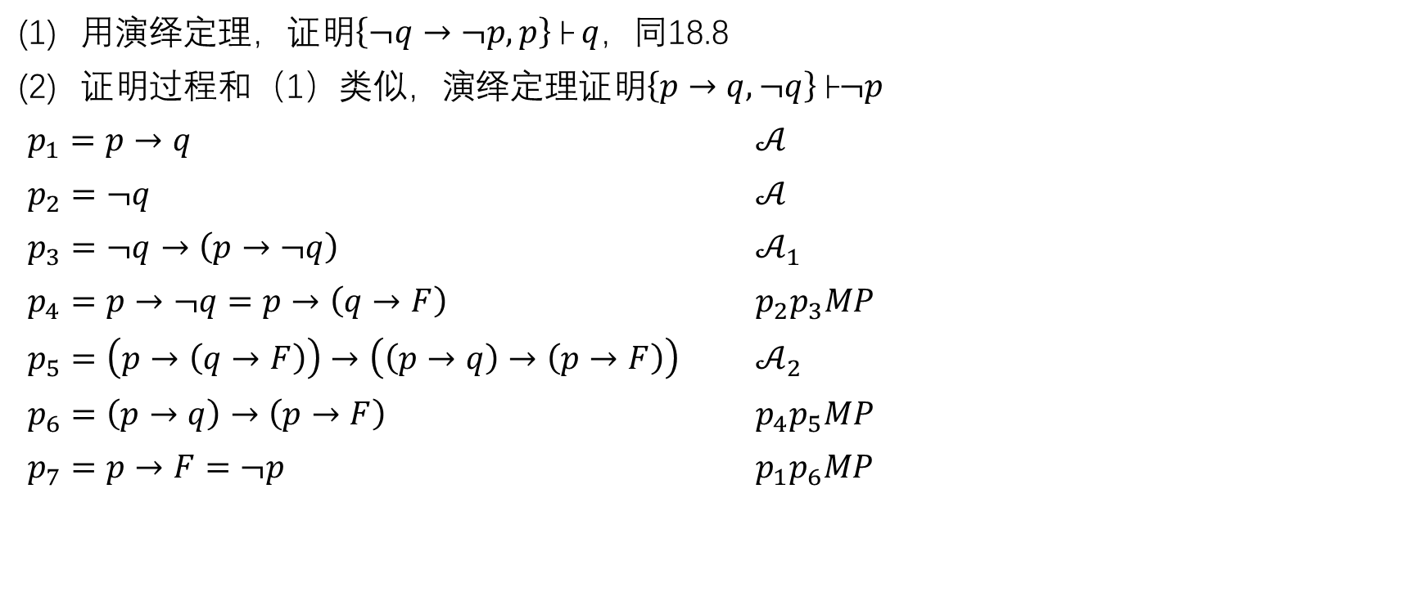
用演绎定理，证明$\left\{¬q→¬p,p\right\}├ q，$同18.8
证明过程和（1）类似，演绎定理证明$\left\{p→q,¬q\right\}├¬p$
$p_{1}=p→q$ $𝒜$
$p_{2}=¬q$ $𝒜$
$p_{3}=¬q→\left(p→¬q\right)$ $𝒜_{1}$
$p_{4}=p→¬q=p→\left(q→F\right)$ $p_{2}p_{3}MP$
$p_{5}=\left(p→\left(q→F\right)\right)→\left(\left(p→q\right)→\left(p→F\right)\right)$ $𝒜_{2}$
$p_{6}=\left(p→q\right)→\left(p→F\right)$ $p_{4}p_{5}MP$
$p_{7}=p→F=¬p$ $p_{1}p_{6}MP$

Slide 7
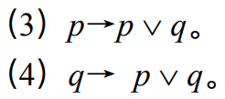

（3）$p∨q=¬p→q，$使用演绎定理，证明$\left\{p,¬p\right\}├q$
$p_{1}=p$ $𝒜$
$p_{2}=¬p=p→F$ $𝒜$
$p_{3}=F$ $p_{1}p_{2}MP$
$p_{4}=F→q$ 例18.7
$p_{5}=q$ $p_{3}p_{4}MP$
（4）$p_{1}=q→\left(¬p→q\right)$ $𝒜_{1}$
$p_{2}=q$ $𝒜$
$p_{3}=¬p→q$ $p_{1}p_{2}MP$

Slide 8


（5） $p∨q=¬p→q$，$q∨p=¬q→p，$使用演绎定理，$\left\{¬p→q,¬q\right\}├p$
$p_{1}=¬p→q$ $𝒜$
$p_{2}=\left(¬p→q\right)→\left(¬q→¬¬p\right)$ 第二小问结论(2)
$p_{3}=¬q→¬¬p$ $p_{1}p_{2}MP$
$p_{4}=¬q$ $𝒜$
$p_{5}=¬¬p$ $p_{3}p_{4}MP$
$p_{6}=¬¬p→p$ $𝒜_{3}$
$p_{7}=p$ $p_{5}p_{6}MP$

Slide 9

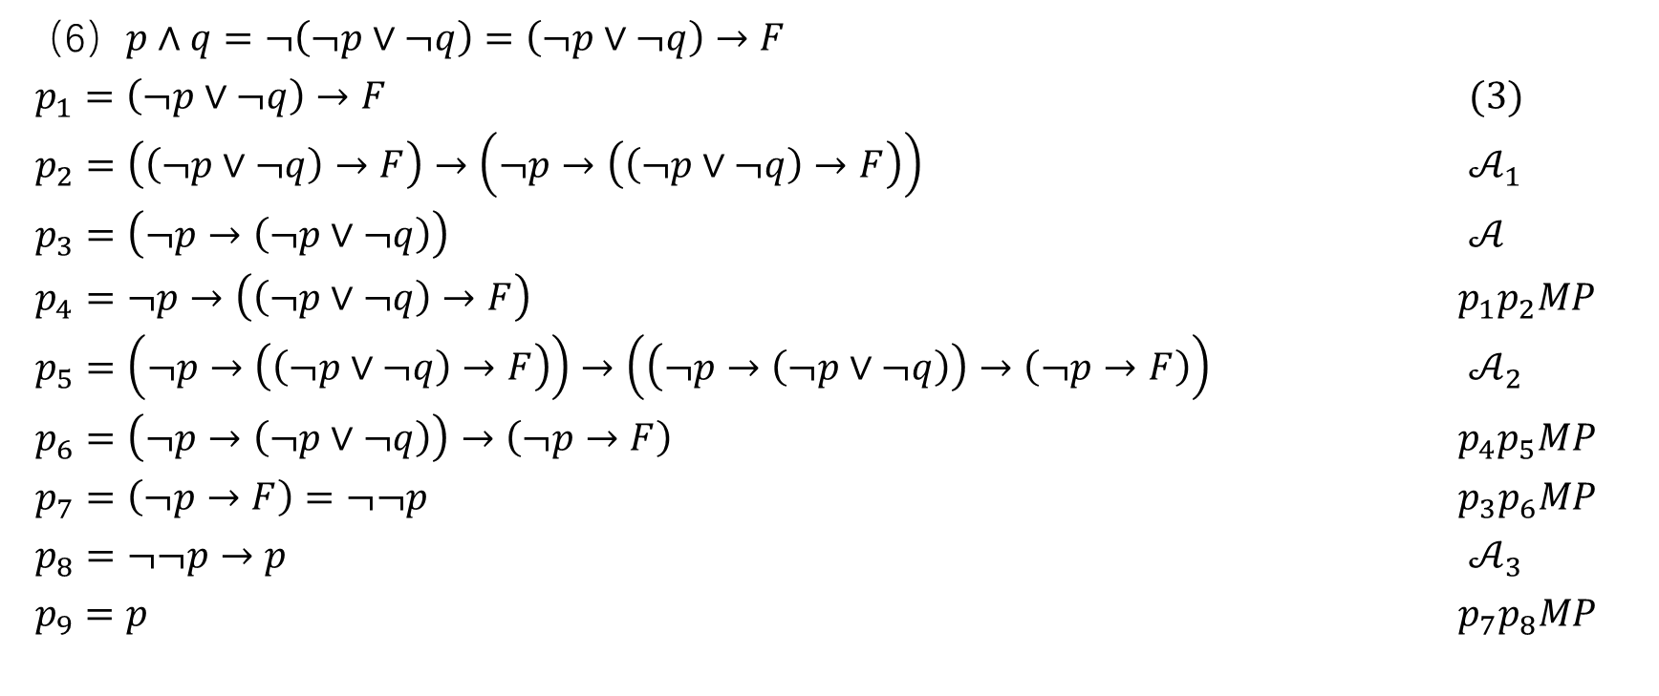
（6）$p∧q=¬\left(¬p∨¬q\right)=\left(¬p∨¬q\right)→F$
$p_{1}=\left(¬p∨¬q\right)→F$ $(3)$
$p_{2}=$ $\left(\left(¬p∨¬q\right)→F\right)→\left(¬p→\left(\left(¬p∨¬q\right)→F\right)\right)$ $𝒜_{1}$
$p_{3}=\left(¬p→\left(¬p∨¬q\right)\right)$ $𝒜$
$p_{4}=$ $¬p→\left(\left(¬p∨¬q\right)→F\right)$ $p_{1}p_{2}MP$
$p_{5}=$ $\left(¬p→\left(\left(¬p∨¬q\right)→F\right)\right)→\left(\left(¬p→\left(¬p∨¬q\right)\right)→\left(¬p→F\right)\right)$ $𝒜_{2}$
$p_{6}=\left(¬p→\left(¬p∨¬q\right)\right)→\left(¬p→F\right)$ $p_{4}p_{5}MP$
$p_{7}=\left(¬p→F\right)=¬¬p$ $p_{3}p_{6}MP$
$p_{8}=¬¬p→p$ $𝒜_{3}$
$p_{9}=p$ $p_{7}p_{8}MP$

Slide 10
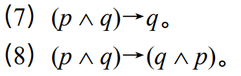
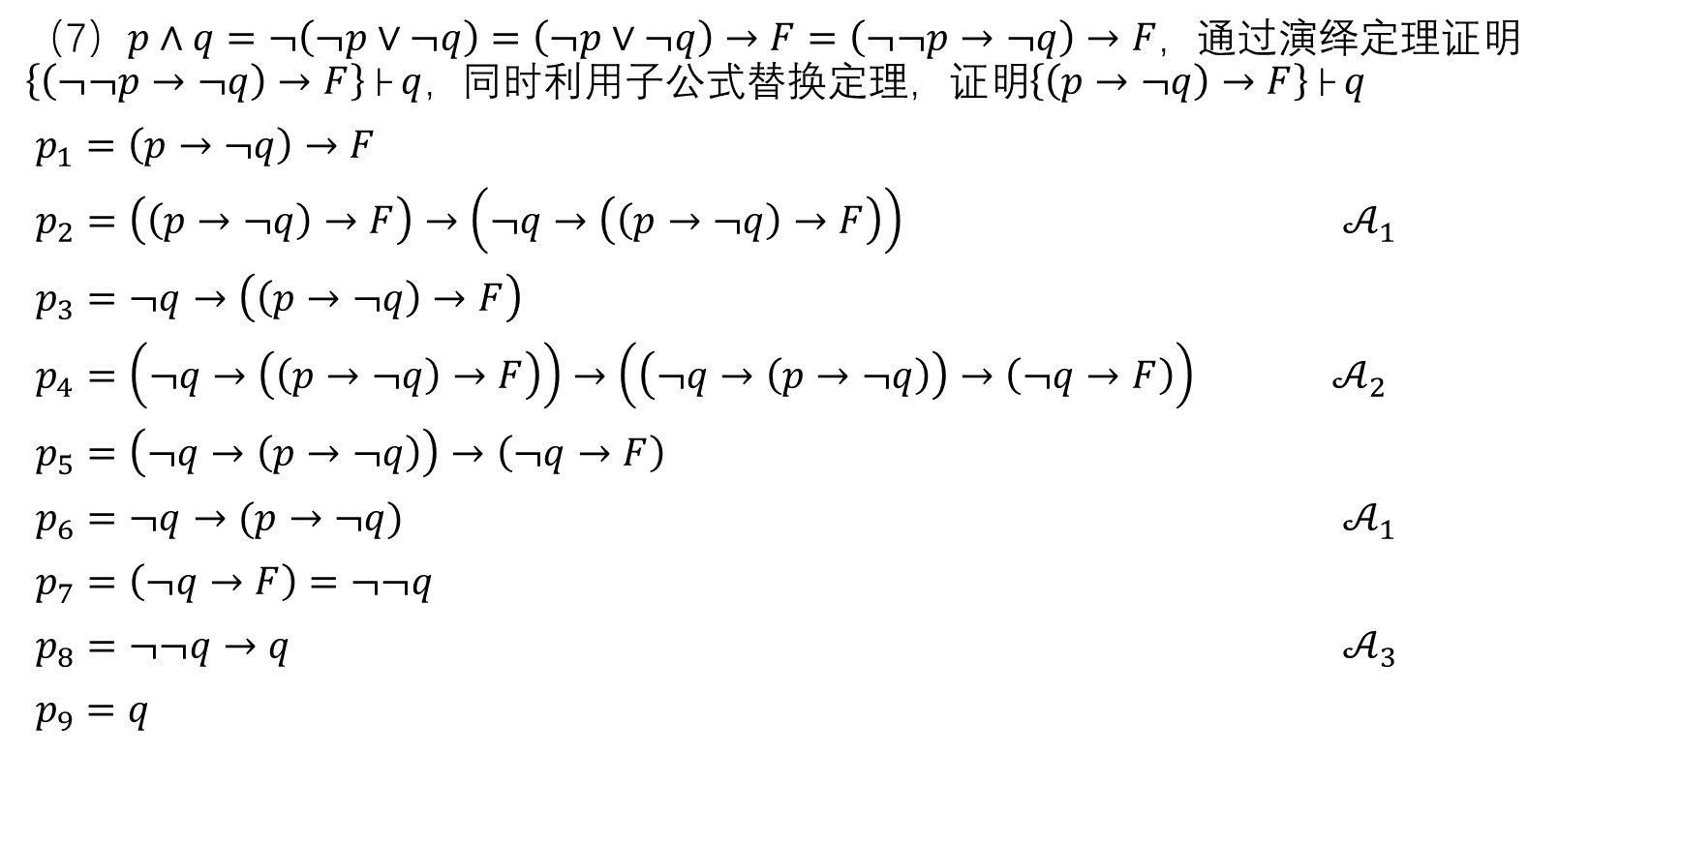
（7）$p∧q=¬\left(¬p∨¬q\right)=\left(¬p∨¬q\right)→F=\left(¬¬p→¬q\right)→F，$通过演绎定理证明$\left\{\left(¬¬p→¬q\right)→F\right\}├ q，$同时利用子公式替换定理，证明$\left\{\left(p→¬q\right)→F\right\}├ q$
$p_{1}=\left(p→¬q\right)→F$
$p_{2}=\left(\left(p→¬q\right)→F\right)→\left(¬q→\left(\left(p→¬q\right)→F\right)\right)$ $𝒜_{1}$
$p_{3}=$ $¬q→\left(\left(p→¬q\right)→F\right)$
$p_{4}=$ $\left(¬q→\left(\left(p→¬q\right)→F\right)\right)→\left(\left(¬q→\left(p→¬q\right)\right)→\left(¬q→F\right)\right)$ $𝒜_{2}$
$p_{5}=\left(¬q→\left(p→¬q\right)\right)→\left(¬q→F\right)$
$p_{6}=¬q→(p→¬q)$ $𝒜_{1}$
$p_{7}=\left(¬q→F\right)=¬¬q$
$p_{8}=¬¬q→q$ $𝒜_{3}$
$p_{9}=q$

Slide 11

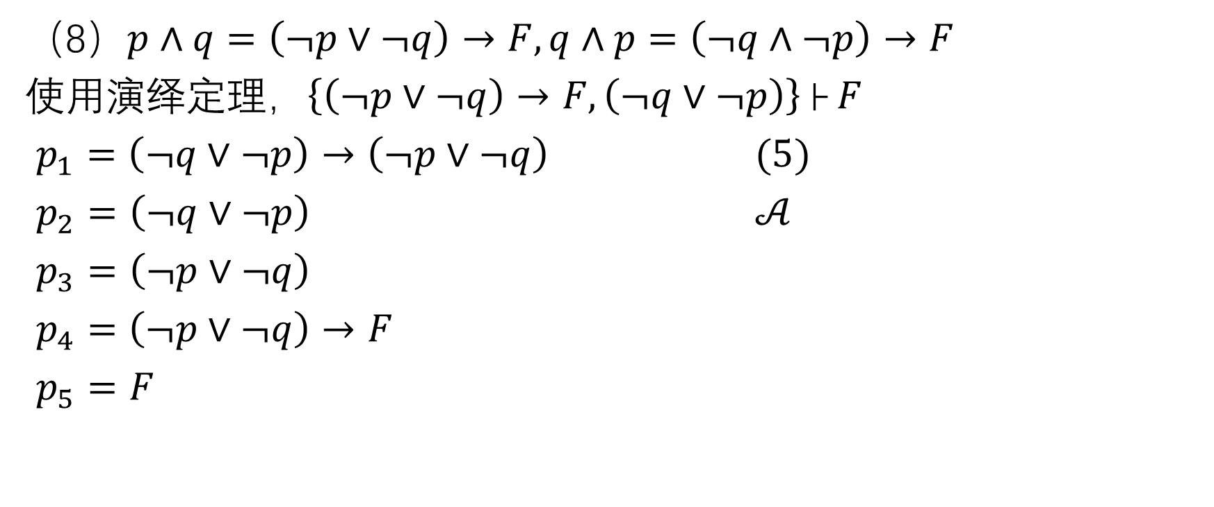
（8）$p∧q=\left(¬p∨¬q\right)→F,q∧p=\left(¬q∧¬p\right)→F$
使用演绎定理，$\left\{\left(¬p∨¬q\right)→F,\left(¬q∨¬p\right)\right\}├ F$
$p_{1}=\left(¬q∨¬p\right)→\left(¬p∨¬q\right)$ $(5)$
$p_{2}=\left(¬q∨¬p\right)$ $𝒜$
$p_{3}=\left(¬p∨¬q\right)$
$p_{4}=$ $\left(¬p∨¬q\right)→F$
$p_{5}=F$

Slide 12
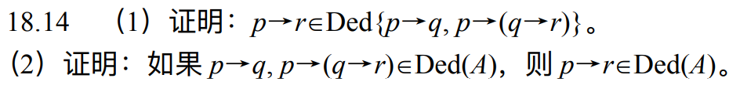
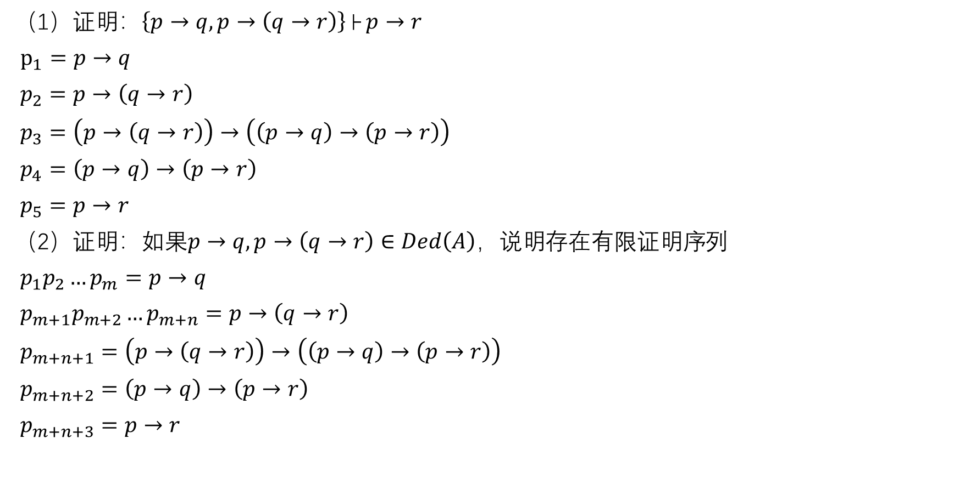
（1）证明：$\left\{p→q,p→\left(q→r\right)\right\}├ p→r$
$p_{1}=p→q$
$p_{2}=p→\left(q→r\right)$
$p_{3}=\left(p→\left(q→r\right)\right)→\left(\left(p→q\right)→\left(p→r\right)\right)$
$p_{4}=\left(p→q\right)→\left(p→r\right)$
$p_{5}=p→r$
（2）证明：如果$p→q,p→\left(q→r\right)∈Ded\left(A\right)，说明$存在有限证明序列
$p_{1}p_{2}…p_{m}=p→q$
$p_{m+1}p_{m+2}…p_{m+n}=p→\left(q→r\right)$
$p_{m+n+1}=$ $\left(p→\left(q→r\right)\right)→\left(\left(p→q\right)→\left(p→r\right)\right)$
$p_{m+n+2}=\left(p→q\right)→\left(p→r\right)$
$p_{m+n+3}=p→r$

