Slide 1

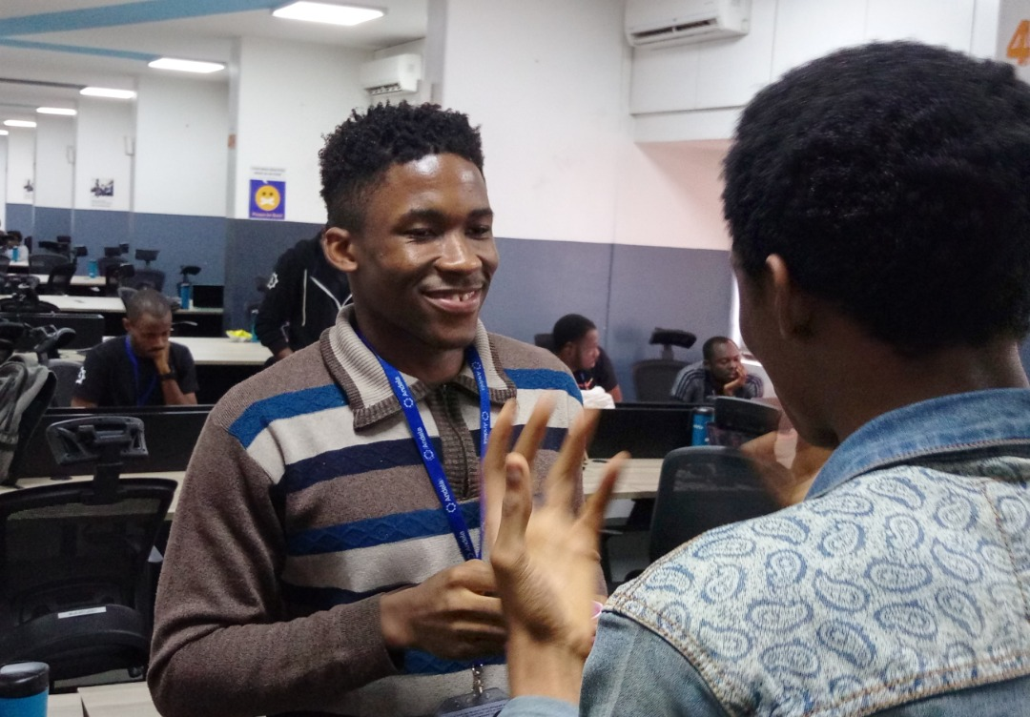
SUNSHINE GROUP OF COMPANY motto: Arise & Shine We do produce all kinds of food for the consumption of man kind, we also offer good computer Education to Graduates, Undergraduates, and workers of any kind. Contact us on: 07069179843 ogechukwo15@yahoo.com

