Slide 1
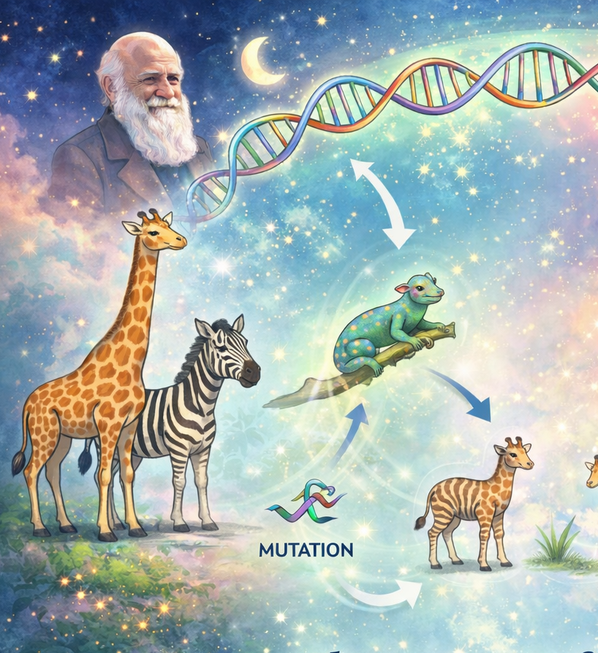

The magic of evolution…
…and how to adapt it to the transportation world

Slide 2








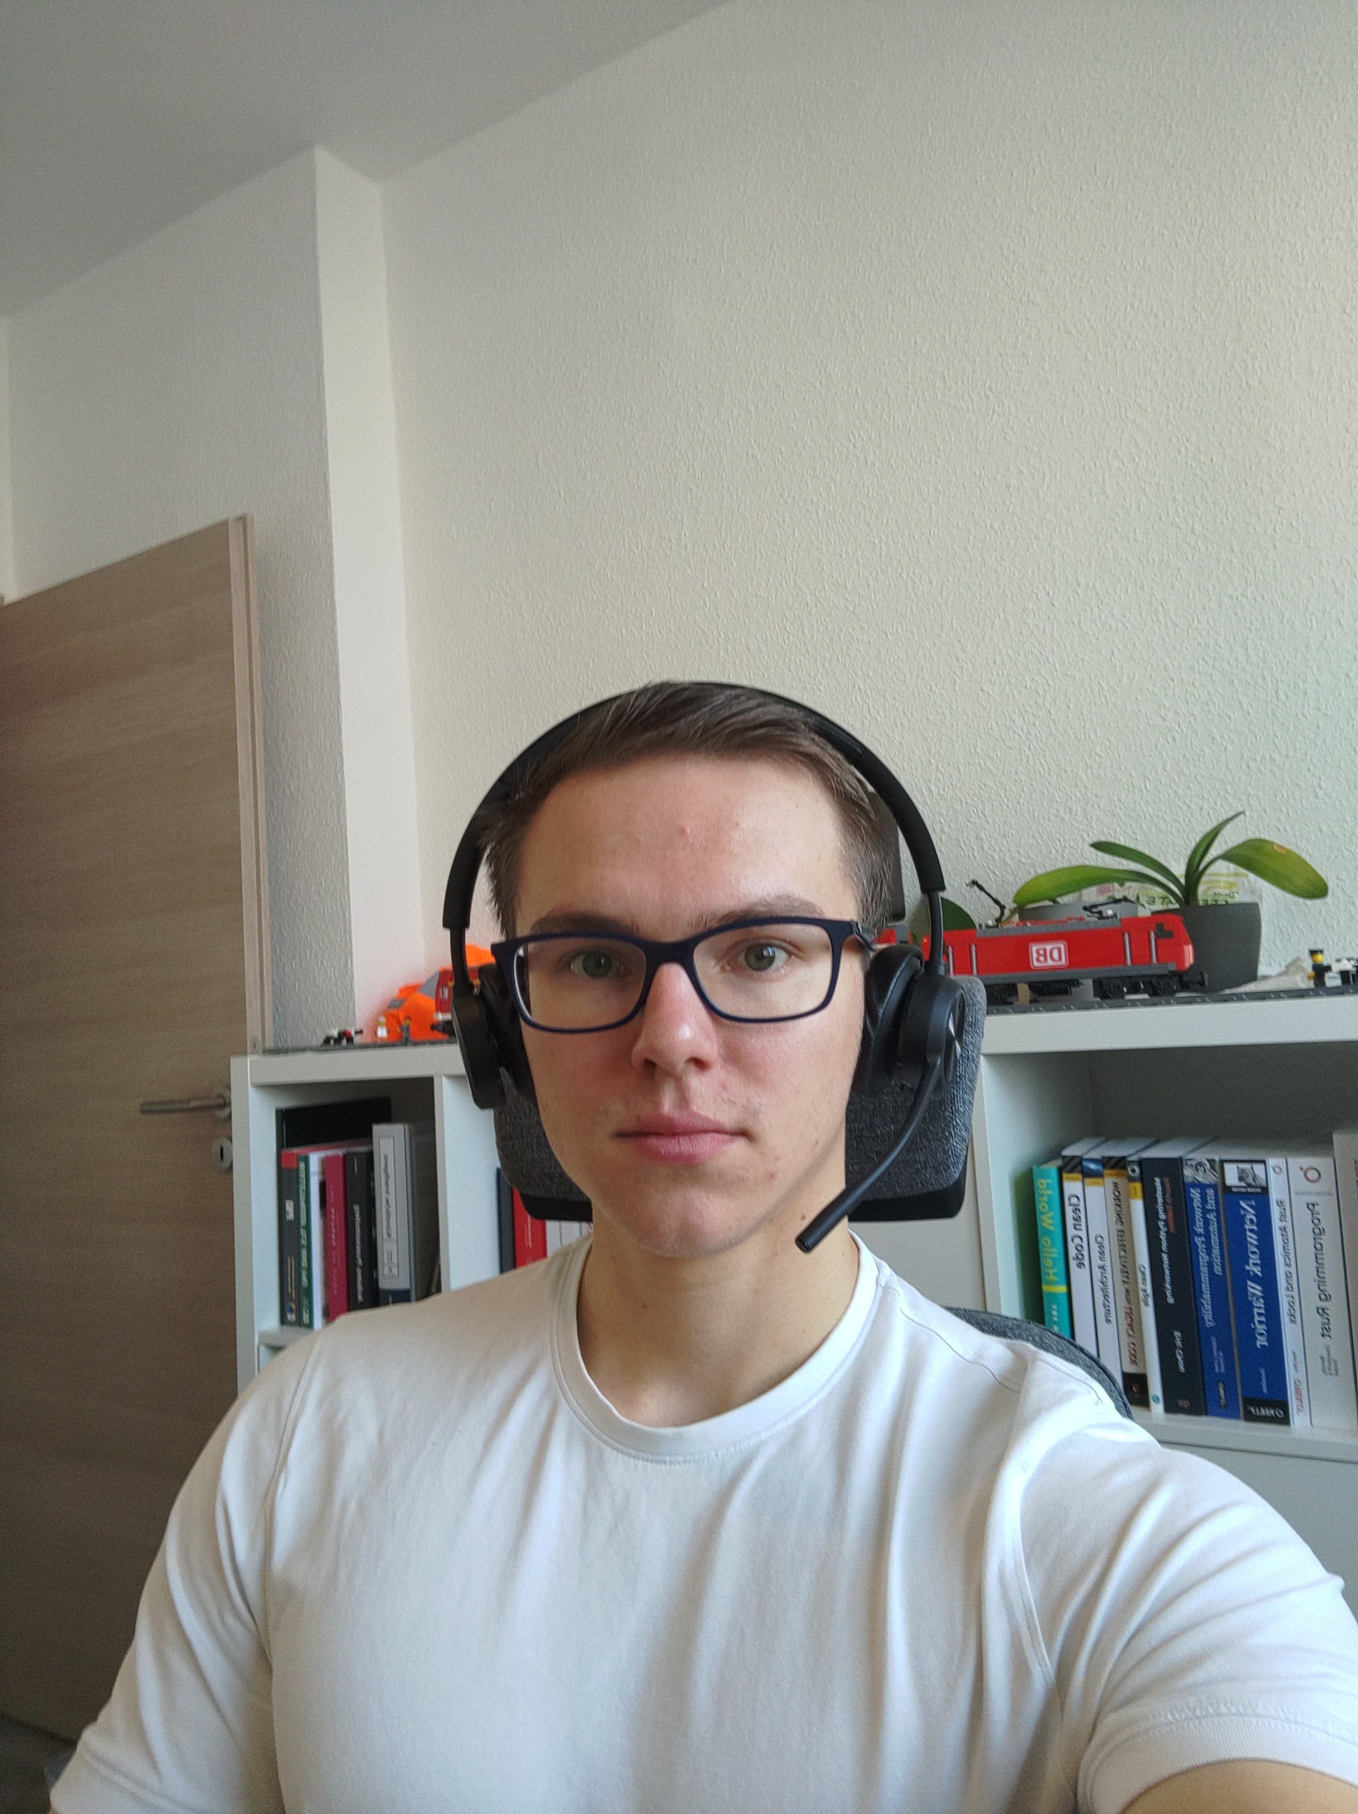


«Rigi Railway is closed due to switch construction! Didn't they replace them recently? »
«The Rigi cable car and railway are closed due to parallel construction! I hate public transport! »
…within one mode of transport
…within several modes of transport
The Problem:
Synchronizing construction projects…
The Team
Elio
M.Sc. Elektrotechnik
Pascal
DB Systel
Luís
M.Sc. Infrastructure, Logistics and Mobility
Jannik
SBB

Slide 3
Why is the Rigi Railway closed due to switch construction work? Didn't they already replace the switches last year?
«Once again, the cable car and Zahradbahn railway are closed due to parallel construction work! I hate public transport on the Rigi!”
…within one mode of transport
…within several modes of transport
The Problem:
Synchronizing construction projects…
The Team
Elio
M.Sc. Elektrotechnik
Pascal
DB Systel
Luís
M.Sc. Infrastructure, Logistics and Mobility
Jannik
SBB
Notes:
00:45

Slide 4
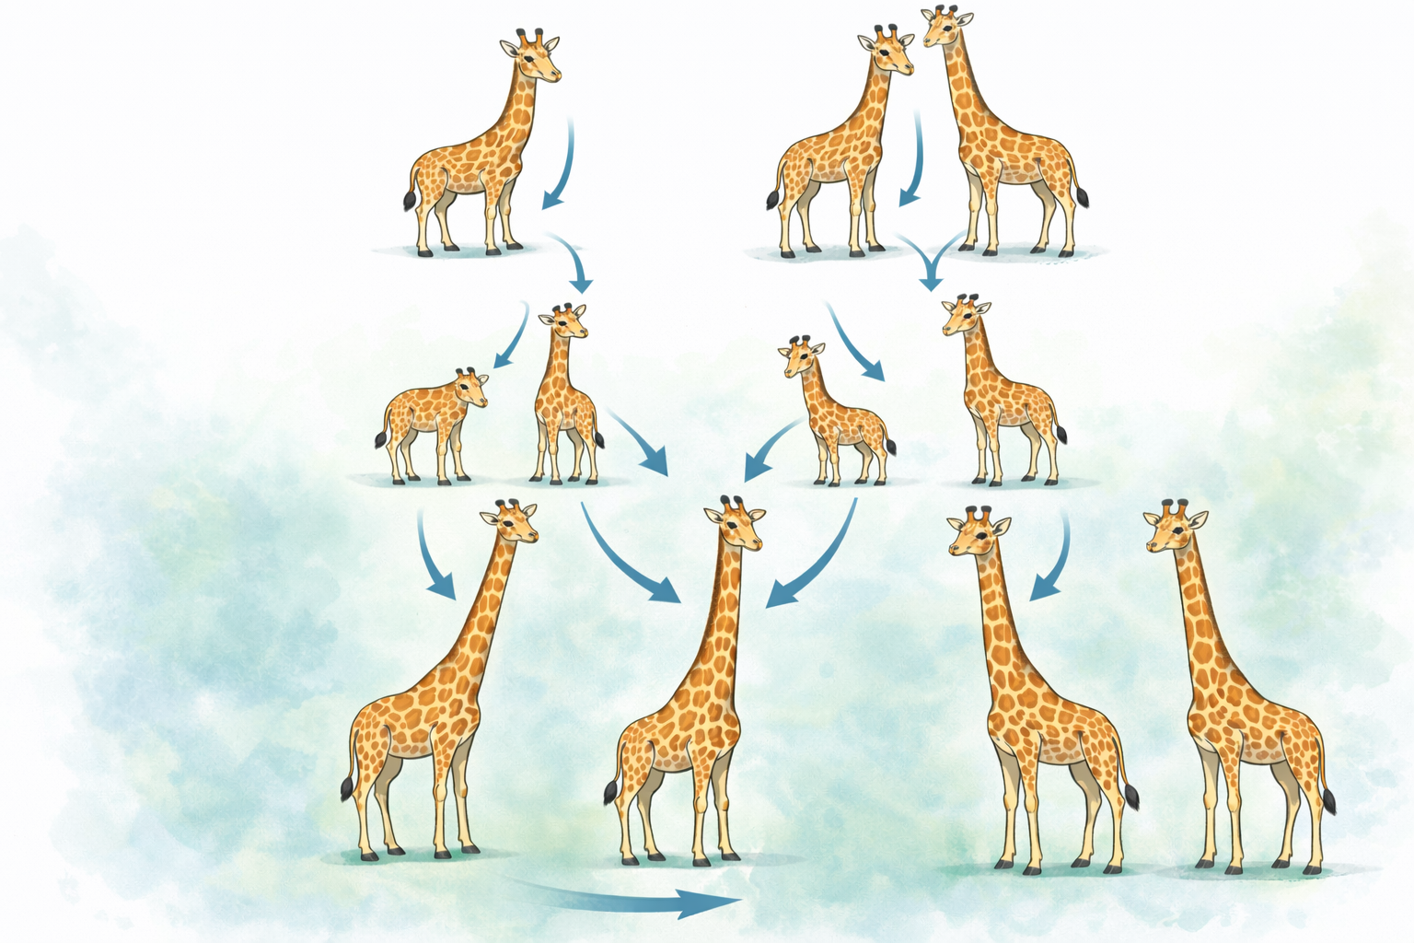
Current Challenges – Let’s try something completly new!
Infrastructure, rolling stock & maintenance are interdependent
Strong non-linearities
Idea: Isn’t nature also very complicated too?
Asset condition affects travel time
Maintenance impacts capacity & condition
Large, tightly coupled system
Utilization affects asset degradation
Time-dependent behavior
Maintenance windows, demand profiles, dynamic routing decisions
Discrete & continuous decision variables
e.g. maximize transported units vs. min. travel time
Multiple competing objectives
Why not adapte the «Evolution» and use it for traffic system?
Notes:
Until now there is no «traditional» algorithmic approach, which is capable ob handeling the complexity of the presented challenge, due to calculation needs and restrictions.
Why Traditional Optimization Methods Reach Their Limits:
Linear and Convex Optimization
Loss of realism and decision relevance
Exact Methods (MILP, Branch & Bound)
Combinatorial Explosion
Rule-based or Greedy Heuristics
Highly dependent on rule set and initial assumption

Slide 5
Current Challenges – Let’s try something completly new!
Infrastructure, rolling stock & maintenance are interdependent
Strong non-linearities
Idea: Isn’t nature also very complicated too?
Asset condition affects travel time
Maintenance impacts capacity & condition
Large, tightly coupled system
Utilization affects asset degradation
Time-dependent behavior
Maintenance windows, demand profiles, dynamic routing decisions
Discrete & continuous decision variables
e.g. maximize transported units vs. min. travel time
Multiple competing objectives
Why not adapte the «Evolution» and use it for traffic system?
Notes:
01:45
Until now there is no «traditional» algorithmic approach, which is capable ob handeling the complexity of the presented challenge, due to calculation needs and restrictions.
Why Traditional Optimization Methods Reach Their Limits:
Linear and Convex Optimization
Loss of realism and decision relevance
Exact Methods (MILP, Branch & Bound)
Combinatorial Explosion
Rule-based or Greedy Heuristics
Highly dependent on rule set and initial assumption

Slide 6


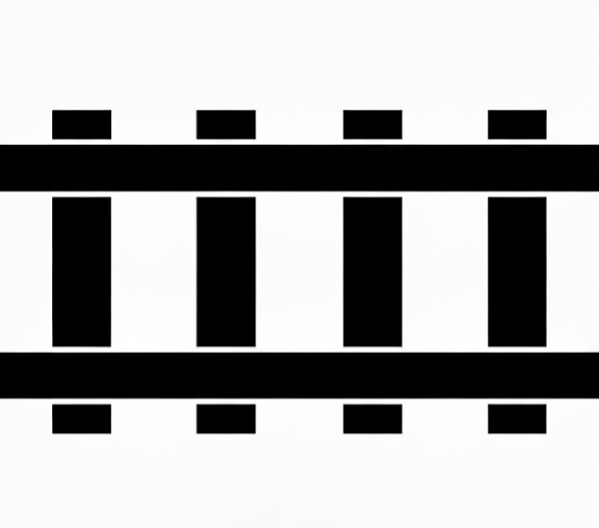

Solution – Scenario
2 Days
1 Day

Slide 7
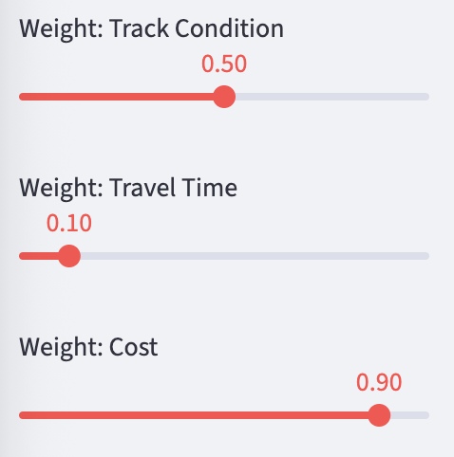
Solution – Set priorities

Slide 8
Solution – Create first generation
 | D1 | D2 | D3 | D4 | D5 | D6 | D7
Tunnel
Bridge
 | D1 | D2 | D3 | D4 | D5 | D6 | D7
Tunnel
Bridge
 | D1 | D2 | D3 | D4 | D5 | D6 | D7
Tunnel
Bridge

Slide 9
Solution – Evaluate generation
 | D1 | D2 | D3 | D4 | D5 | D6 | D7
Tunnel
Bridge
 | D1 | D2 | D3 | D4 | D5 | D6 | D7
Tunnel
Bridge
 | D1 | D2 | D3 | D4 | D5 | D6 | D7
Tunnel
Bridge

Slide 10
Solution – Kill worst parents
 | D1 | D2 | D3 | D4 | D5 | D6 | D7
Tunnel
Bridge
 | D1 | D2 | D3 | D4 | D5 | D6 | D7
Tunnel
Bridge
 | D1 | D2 | D3 | D4 | D5 | D6 | D7
Tunnel
Bridge

Slide 11
Solution – Create children
 | D1 | D2 | D3 | D4 | D5 | D6 | D7
Tunnel
Bridge
Paring
 | D1 | D2 | D3 | D4 | D5 | D6 | D7
Tunnel
Bridge

Slide 12
Solution – Create children
 | D1 | D2 | D3 | D4 | D5 | D6 | D7
Tunnel
Bridge
Paring
Mutations
 | D1 | D2 | D3 | D4 | D5 | D6 | D7
Tunnel
Bridge

Slide 13
Solution – Create children
 | D1 | D2 | D3 | D4 | D5 | D6 | D7
Tunnel
Bridge
Paring
Mutations
 | D1 | D2 | D3 | D4 | D5 | D6 | D7
Tunnel
Bridge
 | D1 | D2 | D3 | D4 | D5 | D6 | D7
Tunnel
Bridge

Slide 14
Solution – Evaluate children
 | D1 | D2 | D3 | D4 | D5 | D6 | D7
Tunnel
Bridge
 | D1 | D2 | D3 | D4 | D5 | D6 | D7
Tunnel
Bridge
 | D1 | D2 | D3 | D4 | D5 | D6 | D7
Tunnel
Bridge

Slide 15
Solution – Choose favoirte child
 | D1 | D2 | D3 | D4 | D5 | D6 | D7
Tunnel
Bridge
 | D1 | D2 | D3 | D4 | D5 | D6 | D7
Tunnel
Bridge
 | D1 | D2 | D3 | D4 | D5 | D6 | D7
Tunnel
Bridge

Slide 16
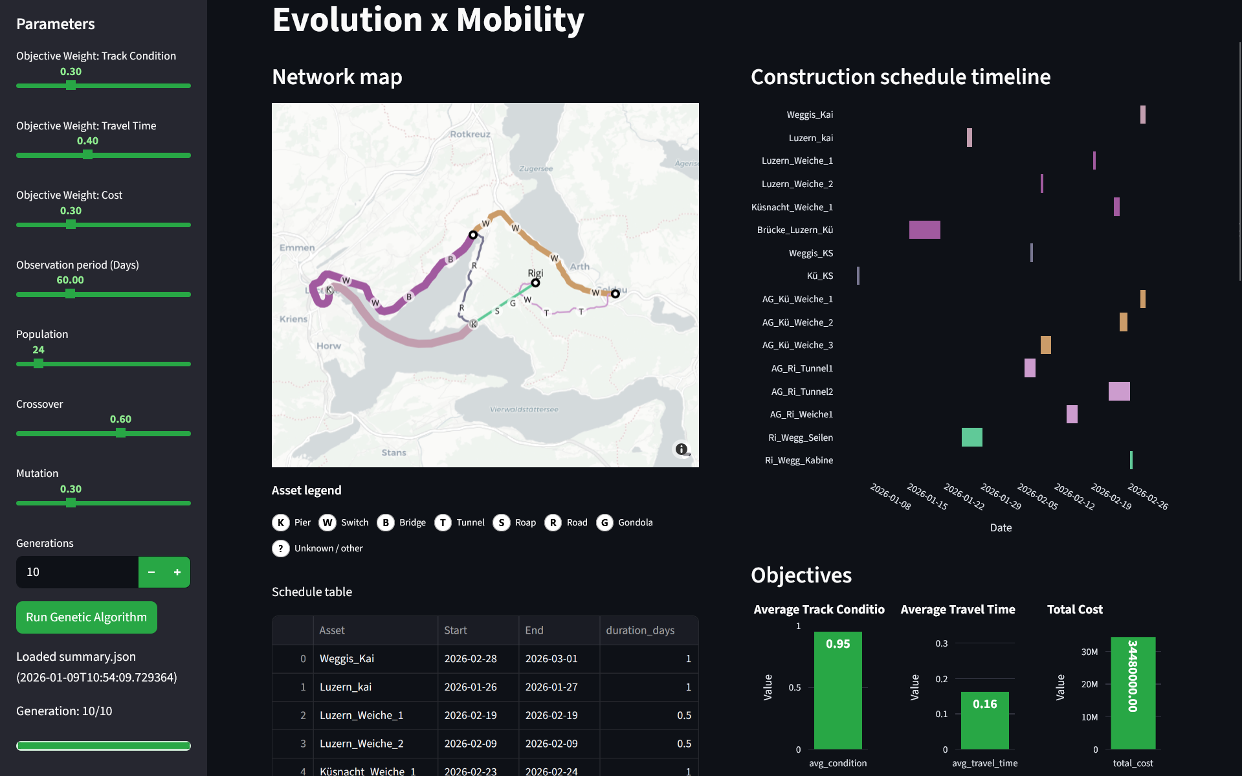
LIVE DEMO
Notes:
03:00

Slide 17

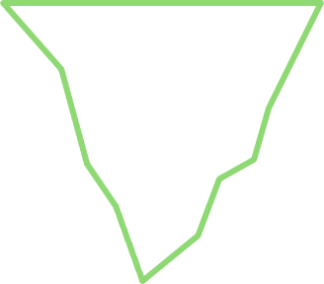
Status Quo – What we have achieved so far?
Create a construction site schedule based on predefined parameters that improves the initial status
Solution respects any mode of transport, multiple instances and environments
Bypassing the restrictions of previous approaches: Computationally efficient, inexpensive, scalable, traceable
Currently, a simplified transport network is optimized -> It can be expanded to a full dimensioned network
Improvement of input data and validating our current constraints
Adding new constraints, e.g. different average speeds, potential of each instance to clear e.g. a rail pathway
Notes:
04:00

Slide 18





Roadmap – How bright is the future?
Program majurity
Status quo
Planned Phases
Owner’s solution
Programming phase
Implementation phase
Pilot phase
Vacation phase
Owner-based designed solution
.
Data collection and validation
Finalizing the program prototype
Integrate real infrastructure data
Spend a part of 25 000 CHF :-)
Notes:
04:30

Slide 19

What we achieved using biology and Rigi
Solving a real-world issue
Path to success
Easy to use UI
Novel Genetic Algorithm
Positive impact on passengers
Works with all modes of transport
Working prototype
Notes:
05:00

