Slide 1
Home Prices
Notes:
Thank you for join on presentation on homeprices and morgataged backed sercurites.

Slide 2
Overview
The problem
Background/ Overview
Hypotheses
Method
Results
Conclusions/ Recommendations
Notes:
1. Overall quality of build

Slide 3
Problem Statement
Given historical attributes and selling prices of homes we have been tasked to analyze this data and provide our suggestions to the team on where we should allocate our investment.

Slide 4
Background - Data
We were given a dataset that consisted of 1460 records and 81 columns (including id), that consisted of numerical, categorical, and date variables.
Well known factors that could affect home prices:
Neighborhood
Square footage of home
Size of plot area
Number of bedrooms/ rooms/ bathrooms
Age of the home/ date of last renovation/ overall quality
Notes:
We know there are there inituitive things one might think about when buying/selling a home. There are other factors we can explore that we can explore other maybe unknown factors

Slide 5
Hypotheses
Homes that have heating quality rated as “fair” or better sell for an average higher price than homes that are rated as “good” or below.
Do homes with fireplaces sell more than those without?
Homes that sold in the summer months of May, June, and July sell for more than houses sold in all other months.
Notes:
I decided to look into more less naturally thought about factors that may go into a price when selling.
Number 2 thought is no-one likes to go house hunting in the winter therefore supply most likely the same while demand low
Number 1 being from the north homes with better heating save me money in the winter and most likely won’t have to cool as much in summer also
From this it led into further research on if home with fireplaces sold for more whether its either psychological people like the option or it adds to the heating.

Slide 6
Exploratory Data Analysis
Correlation plot
Confirmation of well-known factors
Descriptive Analysis on our hypotheses
Statistical Analysis on our hypotheses – A/B tests.
Method –
Approach
Notes:
Looked at what variable most correlated to sale price--- confirmed our initial thoughts on what comes to mind when buying a home.
My hypothesis was to look at the non-naïve favors , so we analyzied that data set both descriptively and statistically.

Slide 7
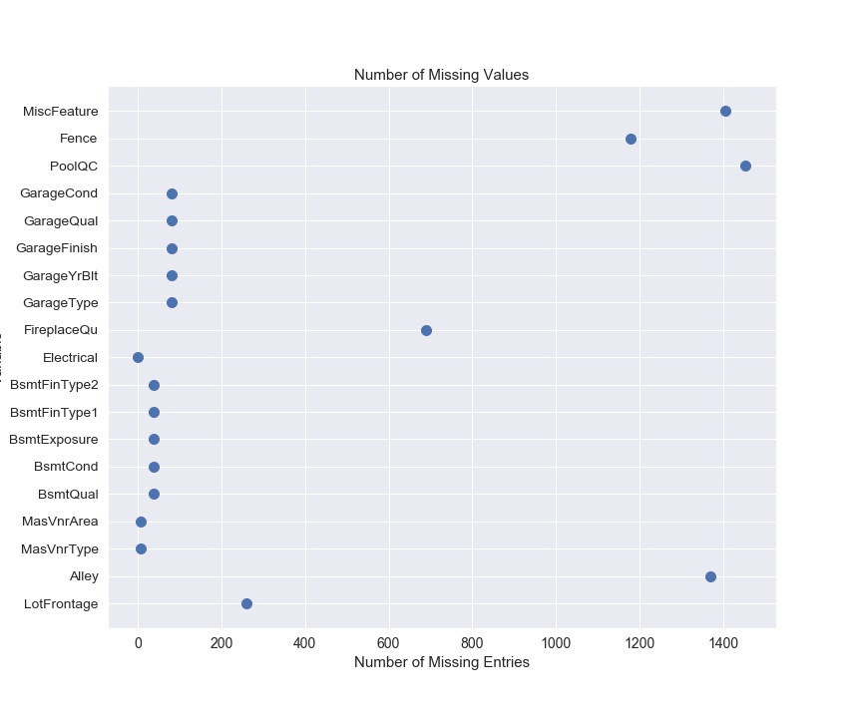
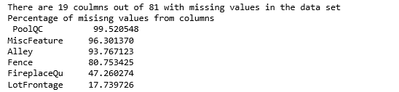
Exploratory Data Analysis
Missing Values
Notes:
Rows that did not have values for these columns were counted as missing
Taking the percentage of missing values vs total number of records gave a baseline understanding of what would most likely not add much insight into our analysis
Explain percentages and dropped columns…

Slide 8
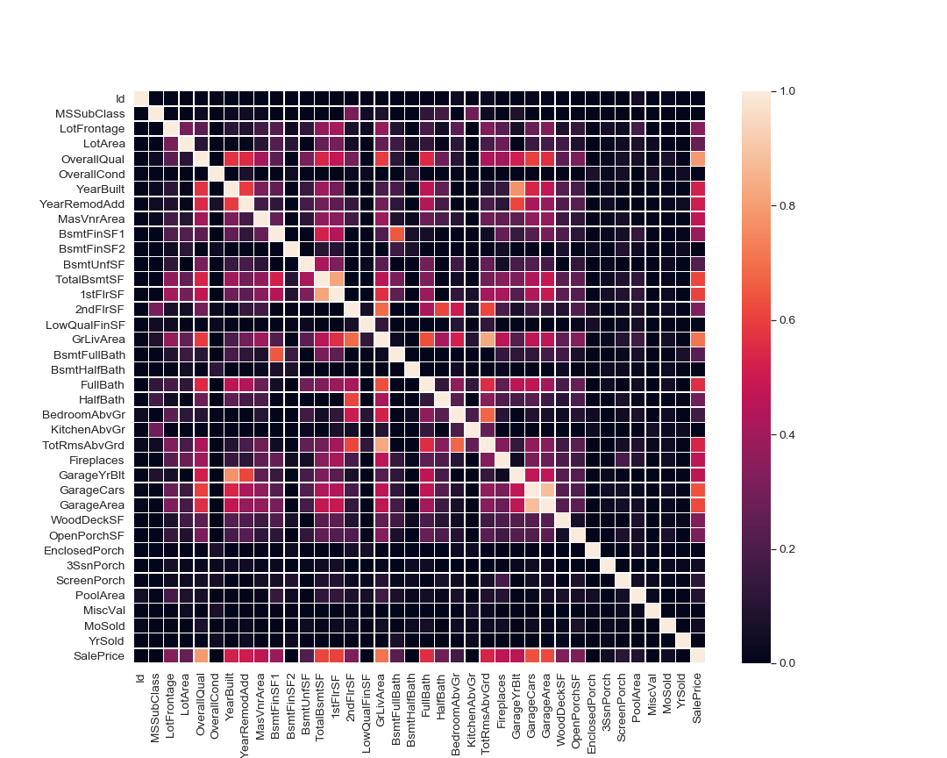
Exploratory Data Analysis
Correlation
Notes:
First though was to do a correlation plot to see which variables correlated the most with SalesPrice
That brought the issue of inter correlation variables and bad data
Started with large correlation plot of all numerical variables ( one hot encoding seemed out of the scope)
Narrowed it down to top 10 correlated
Looking at large correlation see corelatons such as GrLivArea and TotRoomsAbove ground which mean intercorrelation we have to be aware of when analyzing or building models for future work.

Slide 9
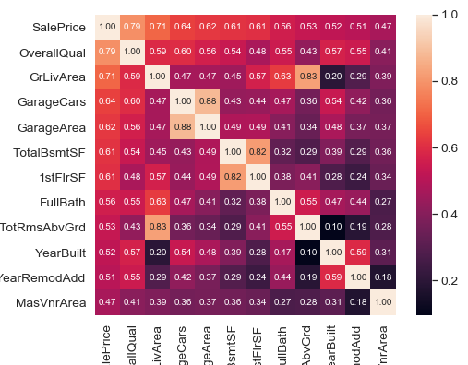
Exploratory Data Analysis
Notes:
From there further EDA on our target (SalePrice)

Slide 10
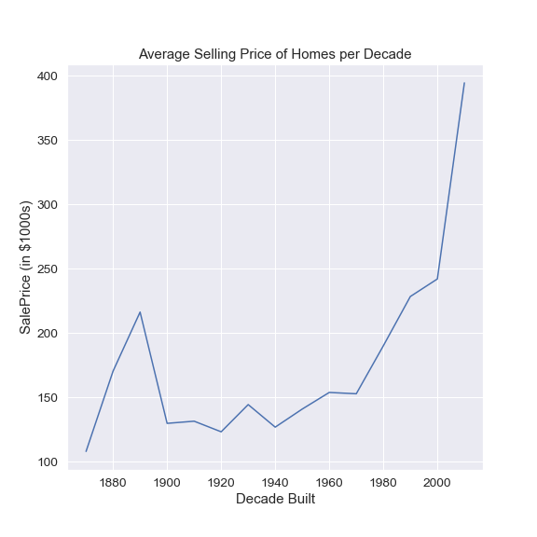
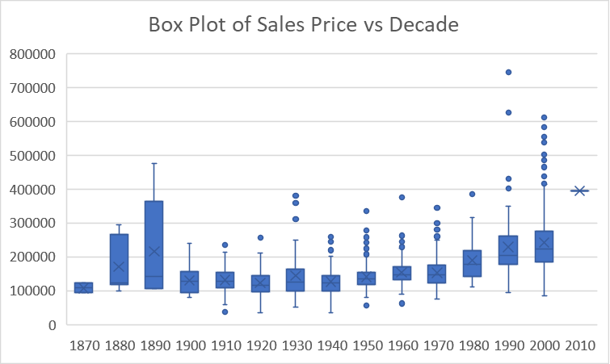
EDA – Target (SalePrice)
Notes:
First thought was to look at our missing values. Variables with large % missing we can assume there is no valuable insights to gather other than what the missing value means
Here are top 5 missing percentages from that can drop these and impute mean, and mode for the more manageable sample sizes (future work)
From cleaner data able to look at correlation between variables and saleprice

Slide 11
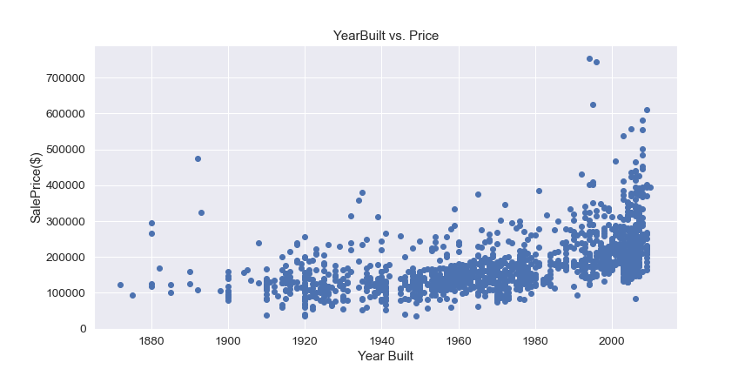
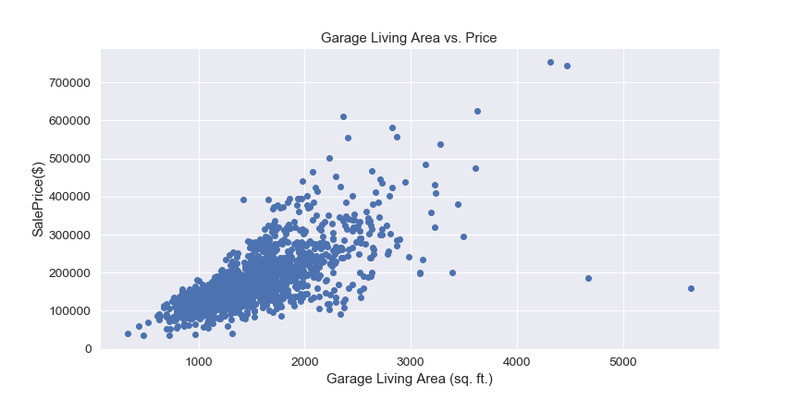
Exploratory Data Analysis
Notes:
And just because we have data over time we can see the average price of home sales by decade .
We could do this EDA for all the variables and see the different correlations and if there was any type of linear behavior that could be modeled for future work

Slide 12
Hypotheses
1.Heating quality impacts the sale price of the home
2.Houses in summer months sell for more

Slide 13
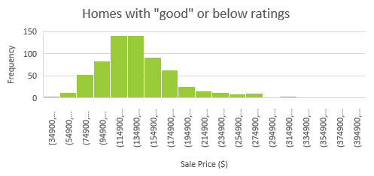
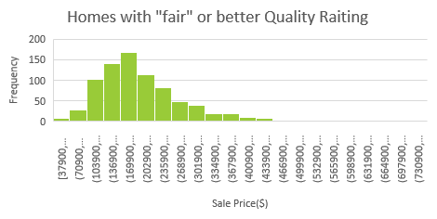
Descriptive Analysis of Heating Quality
Descriptive Stats of "good" and below
Mean | 147494.4761
Standard Error | 1924.810613
Median | 139700
Mode | 140000
Standard Deviation | 49822.48741
Sample Variance | 2482280251
Kurtosis | 3.642480545
Skewness | 1.415820081
Range | 360100
Minimum | 34900
Maximum | 395000
Sum | 98821299
Count | 670
Descriptive Stats of "fair" and above
Mean | 209270.4392
Standard Error | 3144.633359
Median | 191000
Mode | 190000
Standard Deviation | 88386.01687
Sample Variance | 7812087979
Kurtosis | 5.265224129
Skewness | 1.670909065
Range | 717100
Minimum | 37900
Maximum | 755000
Sum | 165323647
Count | 790

Slide 14
Statistical Analysis – Fair and above vs. good and below
 | SalePrice in 1000s | SalePrice in 1000s
Mean | 209.2760759 | 147.4970149
Variance | 7812.654471 | 2482.232667
Observations | 790 | 670
Hypothesized Mean Difference | 0
df | 1279
t Stat | 16.75573575
P(T<=t) one-tail | 2.00648E-57
t Critical one-tail | 1.646045871
P(T<=t) two-tail | 4.01296E-57
t Critical two-tail | 1.961820497
total sample size | 1460
mean difference | 61.77906102
standard error of difference | 3.687039587
confidence interval of std error | 7.233309835
lower c.i limit | 54.54575119
upper c.i limit | 69.01237086
Here we can reject the null hypothesis theory and with 95% confidence, the difference is between 54.5 and 69 thousand.

Slide 15
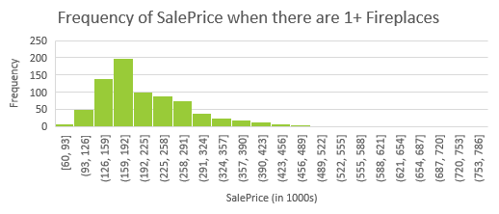
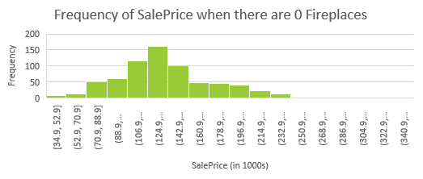
Descriptive Analysis of Heating Quality
Descriptive Stats of Homes with 0 Fireplaces(in $1000s)
Mean | 141.3350725
Standard Error | 1.689951813
Median | 135
Mode | 140
Standard Deviation | 44.39140255
Sample Variance | 1970.59662
Kurtosis | 1.264158257
Skewness | 0.765640006
Range | 307.8
Minimum | 34.9
Maximum | 342.7
Sum | 97521.2
Count | 690
Descriptive Stats of Homes with 1 or More Fireplaces(in $1000s)
Mean | 217.0825
Standard Error | 3.361417
Median | 190
Mode | 180
Standard Deviation | 88.29719
Sample Variance | 7796.394
Kurtosis | 5.474991
Skewness | 1.790051
Range | 695
Minimum | 60
Maximum | 755
Sum | 149786.9
Notes:
First though was to do a correlation plot to see which variables correlated the most with SalesPrice
That brought the issue of inter correlation variables and bad data
Started with large correlation plot of all numerical variables ( one hot encoding seemed out of the scope)
Narrowed it down to top 10 correlated

Slide 16
Statistical Analysis – Number of Fireplaces
t-Test: Two-Sample Assuming Unequal Variances
 | Sum of SalePrice in 1000s | Sum of SalePrice in 1000s
Mean | 141.3350725 | 216.4025
Variance | 1970.59662 | 7542.371
Observations | 690 | 770
Hypothesized Mean Difference | 0
df | 1172
t Stat | -21.1049864
P(T<=t) one-tail | 2.32678E-84
t Critical one-tail | 1.646154806
P(T<=t) two-tail | 4.65356E-84
t Critical two-tail | 1.961990163
total sample size | 1460
mean difference | -75.06739507
standard error of difference | 3.556855884
confidence interval of std error | 6.978516257
lower c.i limit | -82.04591133
upper c.i limit | -68.08887881
Here we can reject the null hypothesis theory and with 95% confidence, the absolute value of the difference is between 82 and 68.1 thousand
Notes:
After these findings decided to test another weather based hypothesis. Houses sold in summer sold for more than other months – simple supply and demand, supply stays the same demand increases.

Slide 17
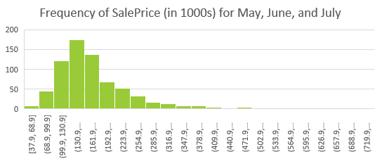
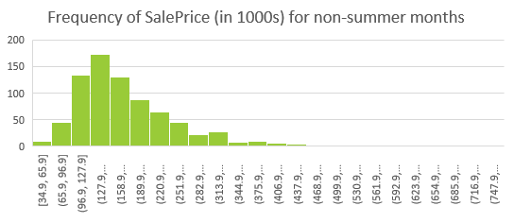
Descriptive Analysis of Month Sold
Homes sold in May, June, July
Mean | 178.9230101
Standard Error | 2.952467116
Median | 160
Mode | 155
Standard Deviation | 77.6111454
Sample Variance | 6023.48989
Kurtosis | 7.867579928
Skewness | 2.091648565
Range | 707.1
Minimum | 37.9
Maximum | 745
Sum | 123635.8
Count | 691
Homes sold in Other months
Mean | 182.7247
Standard Error | 2.923296
Median | 165
Mode | 140
Standard Deviation | 81.06547
Sample Variance | 6571.611
Kurtosis | 5.570285
Skewness | 1.716754
Range | 720.1
Minimum | 34.9
Maximum | 755
Sum | 140515.3
Count | 769
Notes:
First though was to do a correlation plot to see which variables correlated the most with SalesPrice
That brought the issue of inter correlation variables and bad data
Started with large correlation plot of all numerical variables ( one hot encoding seemed out of the scope)
Narrowed it down to top 10 correlated

Slide 18
Statistical Analysis – Month Sold
 | Homes sold in May, June, July | Homes sold in Other months
Mean | 178.9230101 | 182.8335
Variance | 6023.48989 | 6572.18
Observations | 691 | 770
Hypothesized Mean Difference | 0
df | 1453
t Stat | -0.941472473
P(T<=t) one-tail | 0.173309643
t Critical one-tail | 1.645903006
P(T<=t) two-tail | 0.346619286
t Critical two-tail | 1.961597993
total sample size | 1461
mean difference | -3.910496363
standard error of difference | 4.153596067
confidence interval of std error | 8.147685711
lower c.i limit | -12.05818207
upper c.i limit | 4.237189348
Here we Fail to reject the null hypothesis theory and with 95% confidence, the difference is between -12.1 and 4.23 thousand
Notes:
After these findings decided to test another weather based hypothesis. Houses sold in summer sold for more than other months – simple supply and demand, supply stays the same demand increases.

Slide 19

Conclusion/ Recommendation
Homes with better heating quality based on the ratings provided at https://www.kaggle.com/c/house-prices-advanced-regression-techniques/data sell for more than homes than “good” and below
The month the house is sold does not have a significant influence on the price of the house sold.
Notes:
We were able to prove

Slide 20
Future Work
Normalizing the data, either logarithmic or by omitting outliers
Further Analysis on the correlation between heating quality and fireplaces
Analysis on physical aspects of home including fireplaces and locations of such extremities.

