Slide 1

Assessing Web Vulnerabilities and Penetration Testing Methodologies
June 17, 2023
Enxhi Tabaku

Slide 2
Agenda
Introduction
Cyber Fundamentals
OWASP Top 10
01
02
03
Security Tests
C.I.T Ethically Hacked
04
05
NOTE: This is a synthetic presentation of a comprehensive diploma thesis.

Slide 3
It takes 20 years to build a reputation and few minutes of cyber-incident to ruin it.
Stephane Nappo

Slide 4
Introduction

Slide 5
abstract
Goals and motivation
The research uncovers the inherent vulnerabilities and security weaknesses that make no software application totally immune to intrusions by using a theoretical model and practical technique involving comprehensive vulnerability testing. The results show the value of robust application control and testing procedures and draw attention to the enduring existence of serious vulnerabilities in a variety of web applications, as described in the "OWASP Top 10" project.
Demonstrate Real-World Risks
Enhance Security Posture of C.I.T
Raise Security Awareness
Passion

Slide 6
+ =
Qualitative
Quantitative
Comprehensive Research
Penetration testing provides:
Practical insights
First-hand data
Third party sources provides:
Broader context
Statistical supportive information

Slide 7
Cyber Fundamentals

Slide 8
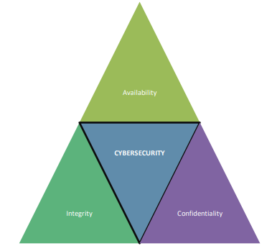
C I A Triade
C - only authorized people or organizations should have access to sensitive information
I - information doesn't change in an unintentional way and stays trustworthy during
the transfer and storage processes
A - the quality of being accessible and usable upon request by an authorized entity

Slide 9
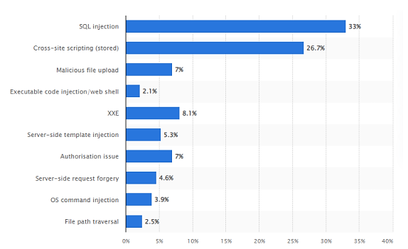
Vulnerabilities
Plug-in Vulnerability:
security weakness present in a software plug-in or extension
arise due to programming errors, outdated versions
Zero Day Vulnerability:
security flaw in a software application that is unknown to the software vendor.
provide attackers with the advantage of surprise, as there is no known defense against them
Open-Source Vulnerability:
security weaknesses present in open-source software components or libraries
arise due to outdated/unmaintained libraries or the inclusion of vulnerable software dependencies
Web application critical vulnerabilities worldwide as of 2021

Slide 10
OWASP Top 10

Slide 11
Open Web Application Security Project
An active open-source initiative focused on enhancing web application security.
Primary Goal:
Raise Software Security Awareness
Importance and Benefits:
Community Collaboration
Industry Standard
Compliance Alignment
Enhanced Application Security
Risk Mitigation

Slide 12

“Top 10” Project
Vulnerabilities
Proactive Controls
Broken Access Control
Cryptographic Failure
Injection
Insecure Design
Security Misconfiguration
Vulnerable & Outdated Components
Identification & Authentication Failures
Software & Data Integrity Failures
Security Logging & Monitoring Failures
Server-Side Request Forgery
Define Security Requirements
Leverage Security Frameworks and Libraries
Secure Database Access
Encode and Escape Data
Validate All Inputs
Implement Digital Identity
Enforce Access Controls
Protect Data Everywhere
Implement Security Logging and Monitoring
Handle All Errors and Exceptions

Slide 13
Security tests

Slide 14
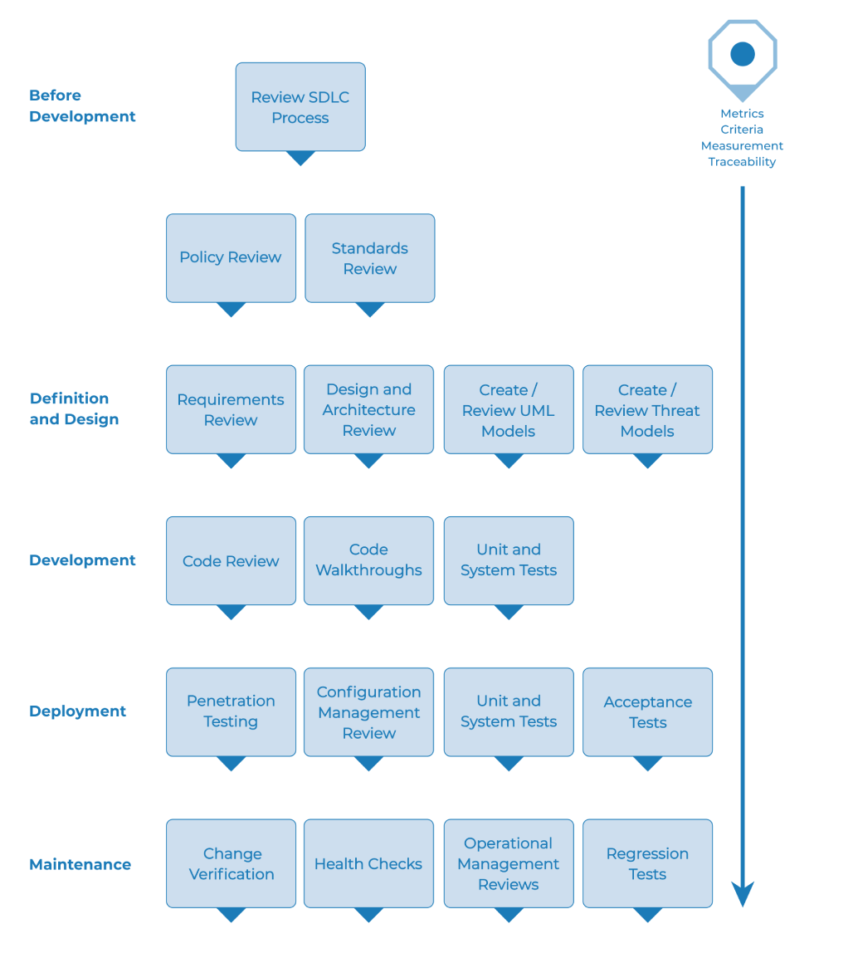
SDLC Testing workflow

Slide 15
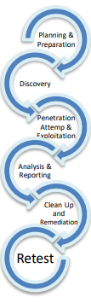
Penetration test
A proactive security assessment technique that simulates real-world attacks to identify vulnerabilities.
Goals:
Identify Vulnerabilities
Assess Security Posture
Measure Resilience
Benefits:
Vulnerability Discovery
Risk Mitigation
Improved Incident Response
Stakeholder Confidence
Enhanced Security Awareness

Slide 16
C.I.T Ethically Hacked

Slide 17
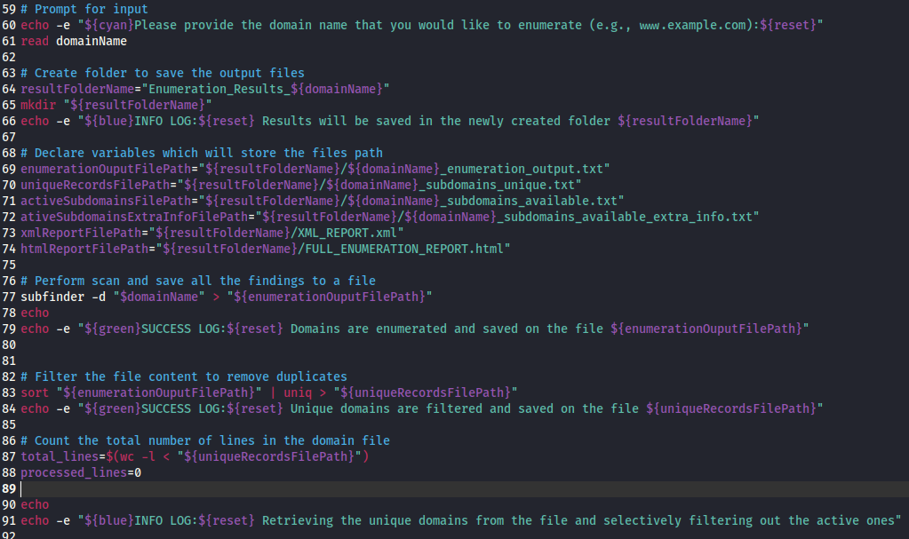
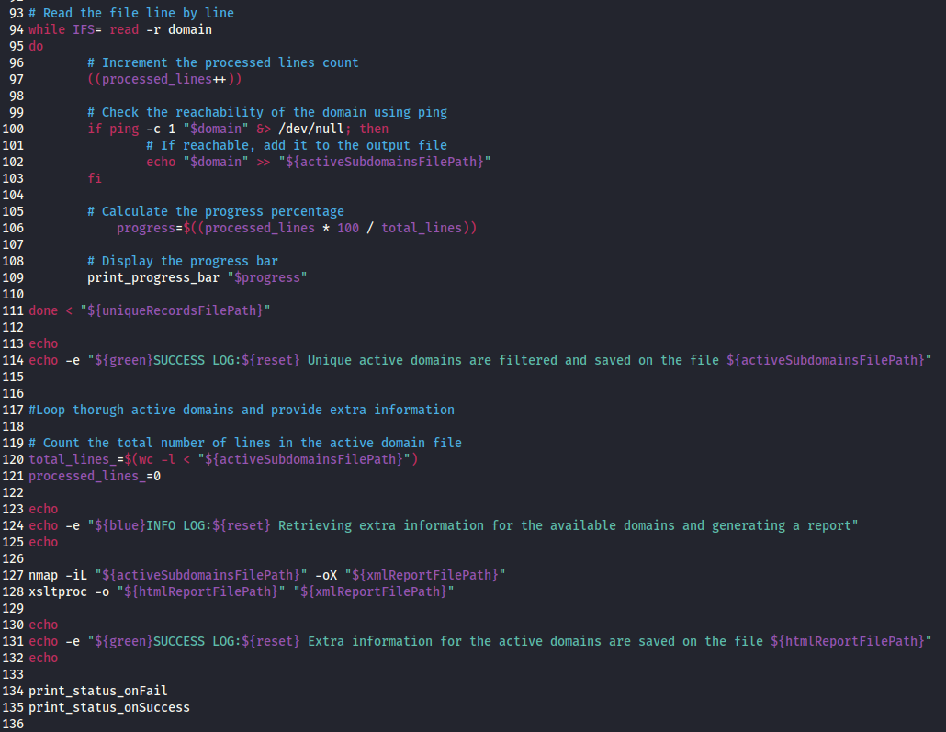
Reconnaissance and Scanning
Custom Script
subfinder - used to passively look for legitimate subdomains connected to the target.
nmap - used to identify running services,
locate open ports, and find potential entry points.

Slide 18
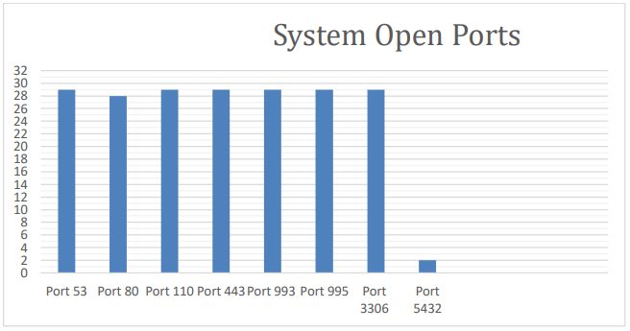
Results
50 Domains
22 Online
28 Unreachable

Slide 19
Vulnerability assessment Results
Alert Type | Risk | Count
PII Disclosure | High | 35
SQL Injection | High | 1
Absence of Anti-CSRF Tokens | Medium | 2545
Content Security Policy (CSP) Header Not Set | Medium | 2076
HTTP to HTTPS Insecure Transition in Form Post | Medium | 3
Hidden File Found | Medium | 12
Missing Anti-clickjacking Header | Medium | 1874
Vulnerable JS Library | Medium | 7
Application Error Disclosure | Low | 1
Cookie No HttpOnly Flag | Low | 1446
Cookie Without Secure Flag | Low | 1869
Cookie without SameSite Attribute | Low | 1856
Cross-Domain JavaScript Source File Inclusion | Low | 299
Information Disclosure - Debug Error Messages | Low | 50
Private IP Disclosure | Low | 286
Secure Pages Include Mixed Content | Low | 8
Server Leaks Information via "X-Powered-By" HTTP Response Header Field(s) | Low | 4297
Strict-Transport-Security Header Not Set | Low | 11571
Timestamp Disclosure - Unix | Low | 54
X-Content-Type-Options Header Missing | Low | 10633
Total |  | 20
Tools:
Burp Suite
OWASP ZAP

Slide 20
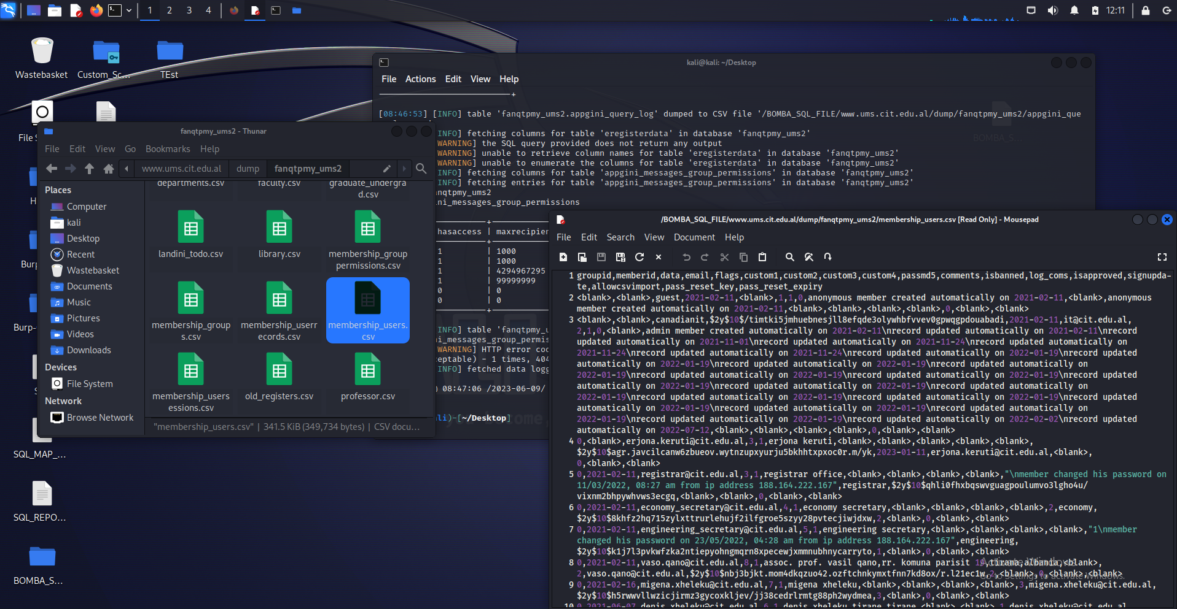
Critical vulnerabilities exploitation
Tools:
Custom Script
SQLMAP
SQL Injection – Retrieved UMS Database

Slide 21
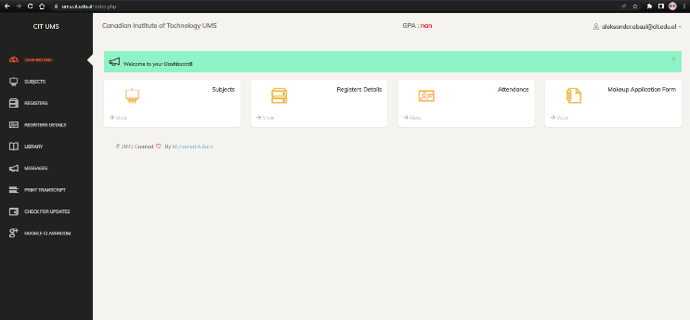
Critical vulnerabilities exploitation
Tools:
Custom Script
sqlmap
hashcat
Account Takeover

Slide 22
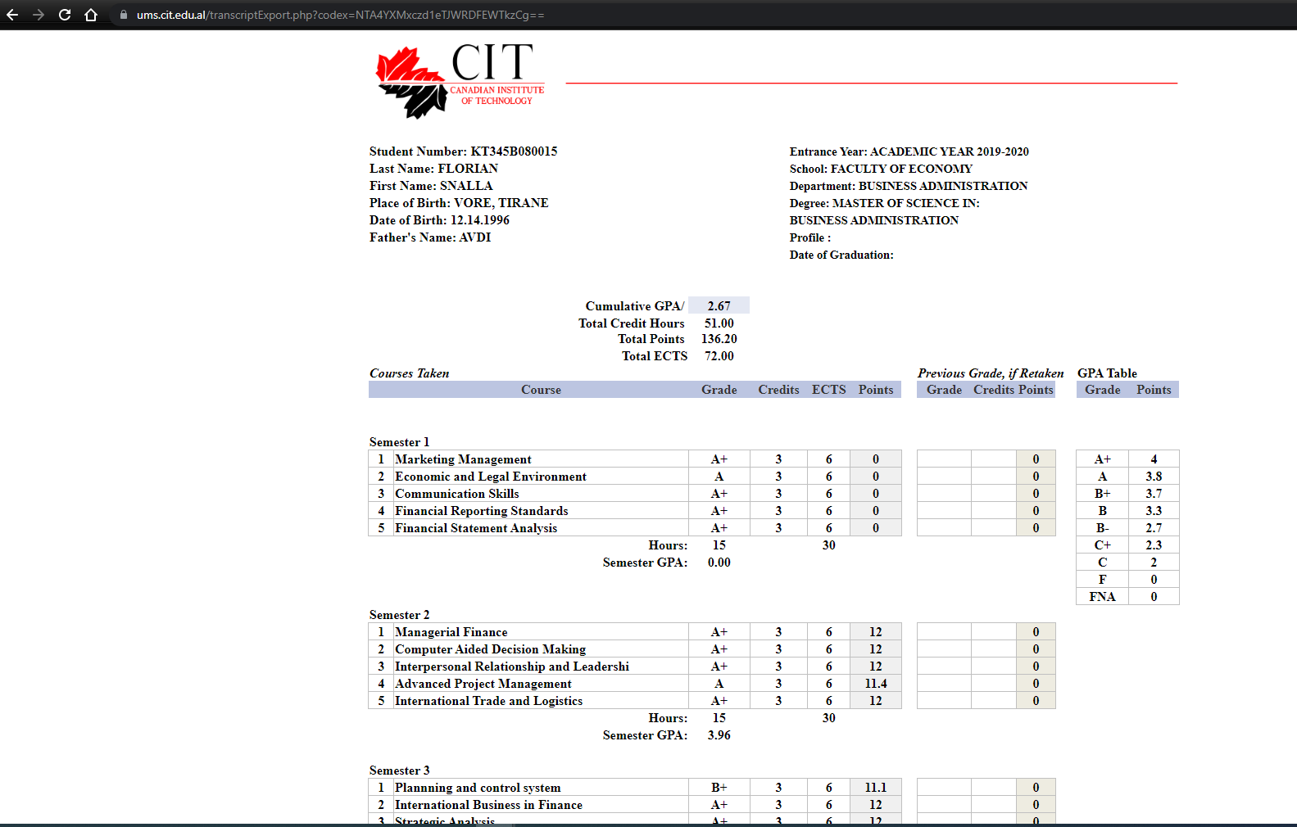
Critical vulnerabilities exploitation
Tools:
Manually Exploited
IDOR & Private Data Exposure

Slide 23
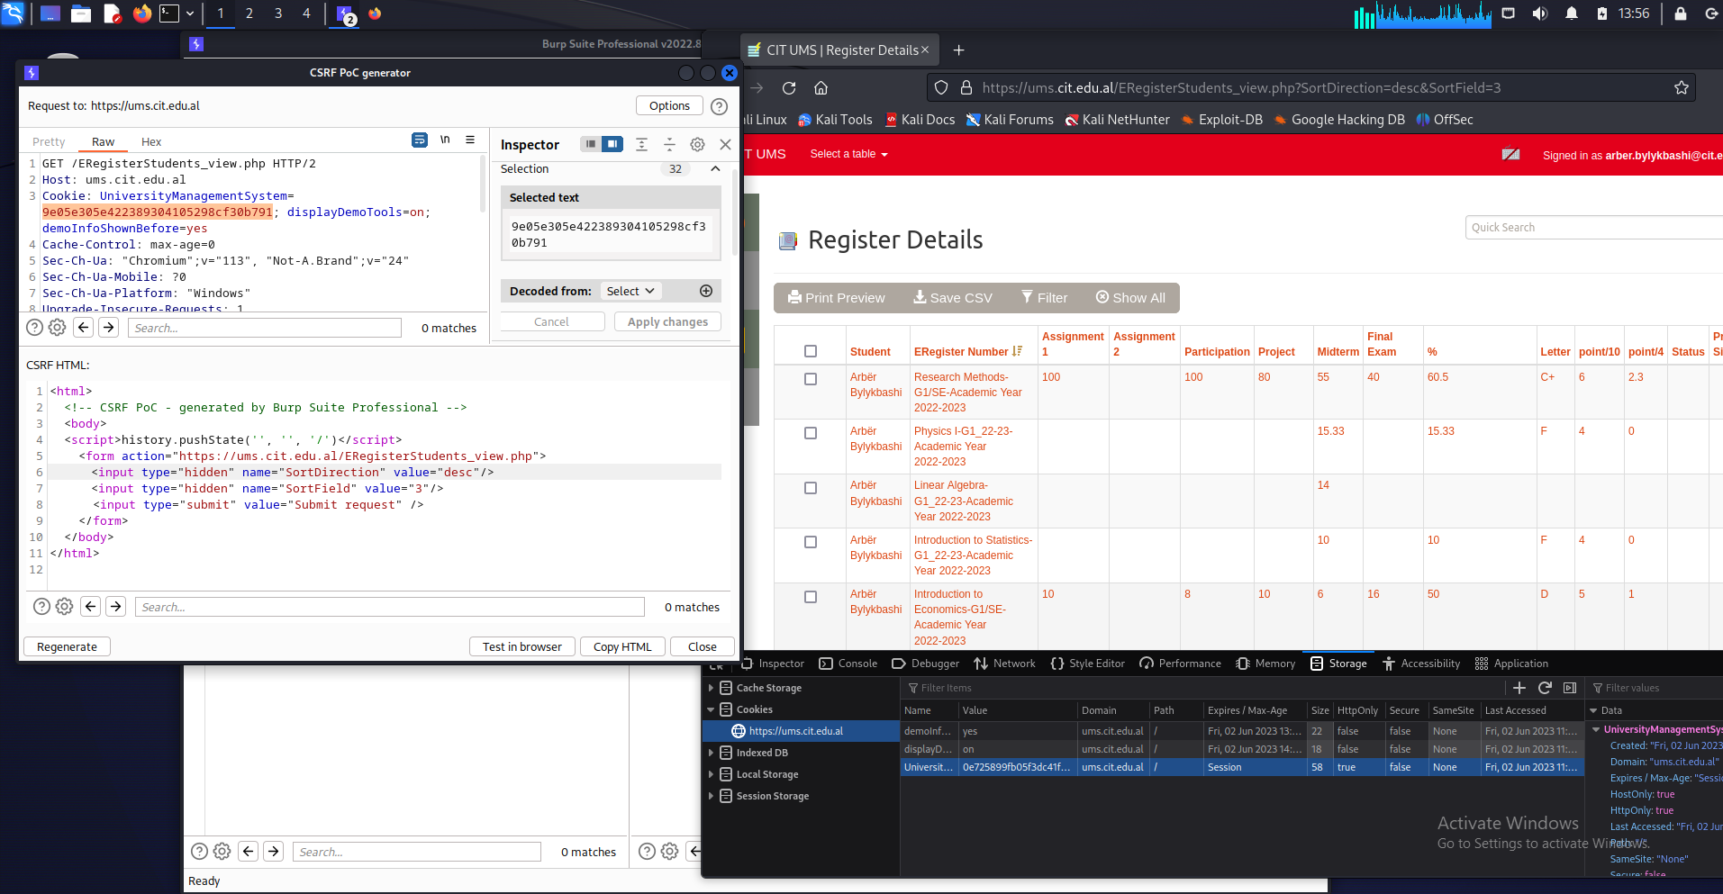
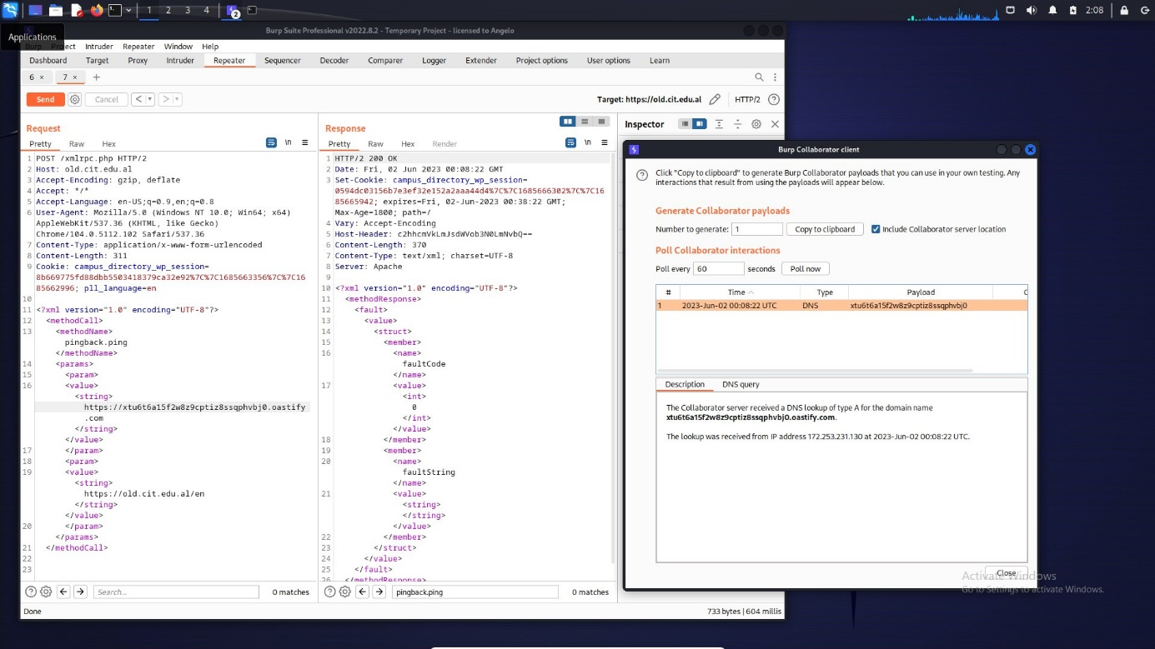
Critical vulnerabilities exploitation
Tools:
Burp Suite
CRSF
SSRF

Slide 24
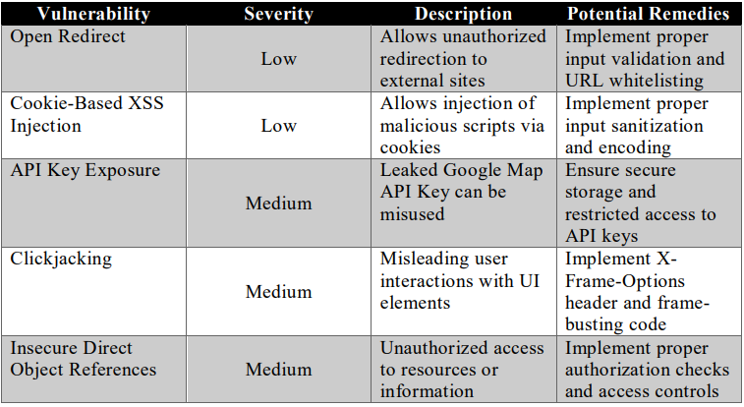
other vulnerabilities exploitation
Remedies for each of the exploited vulnerabilities and other specific security best practices are addressed in the research paper.

Slide 25
Thank You!

Slide 26

Q & A

