Slide 1

Graph Anonymization: Degree Anonymization with Dynamic Programming and Realizability of Degree Sequences with Constraints
TERRACCIANO Vincenzo
USAI Giacomo
2019/2020

Slide 2
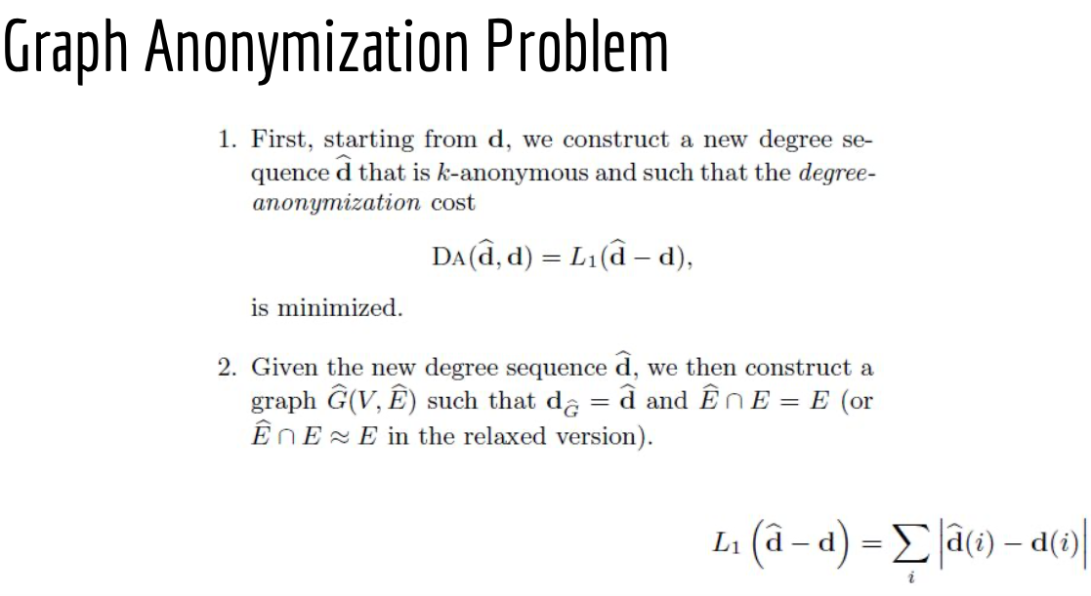
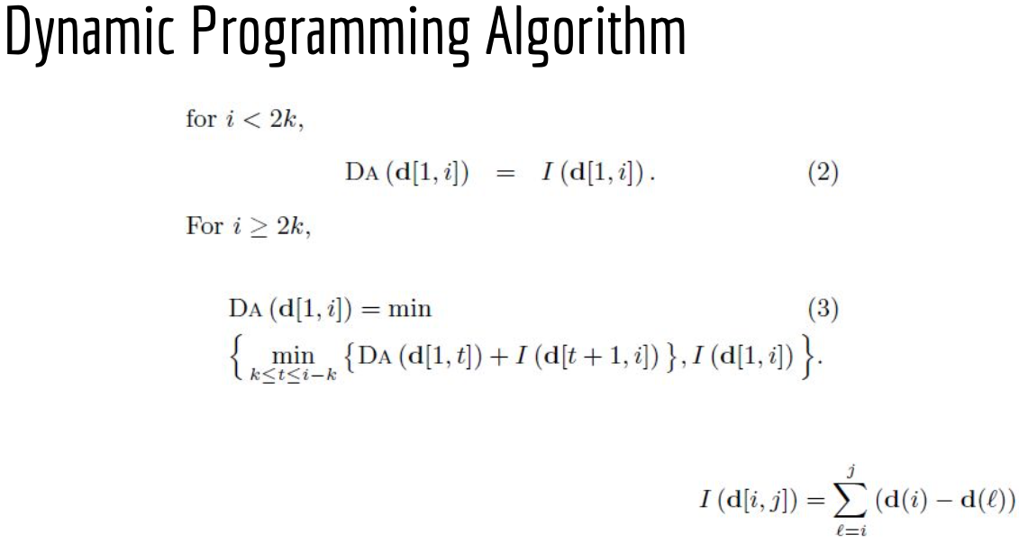
Starting Point
DYNAMIC PROGRAM

Slide 3

What do we want to do?
We will solve the problem with DP algorithm and we will show how to improve the running time of the DP algorithm from O(n²) to O(nk).
The core idea for this speedup lies in the simple observation that no anonymous group should be of size larger than 2k − 1. If any group is larger than or equal to 2k, it can be broken into two subgroups with equal or lower overall degree-anonymization cost.
RECURSION CAN BE WRITTEN AS FALLOWS

Slide 4
The substantial difference between Greedy and Dynamic Programming is the approach adopted:
Greedy algorithm makes an optimal local choice;
Dynamic Programming algorithm makes a choice based on the one considered above
This also affects the optimization of the set of arches obtained.
Our solution is tested on a fake Dataset of graph friend (we used datasets saw in class) because with real Dataset greedy alghoritm doesnt’work.

Slide 5
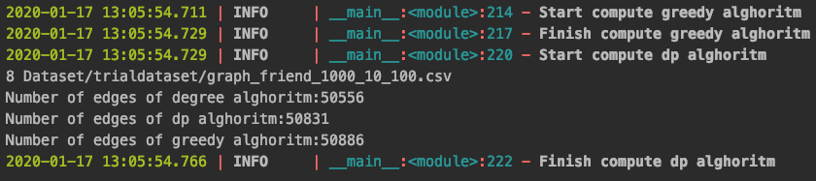
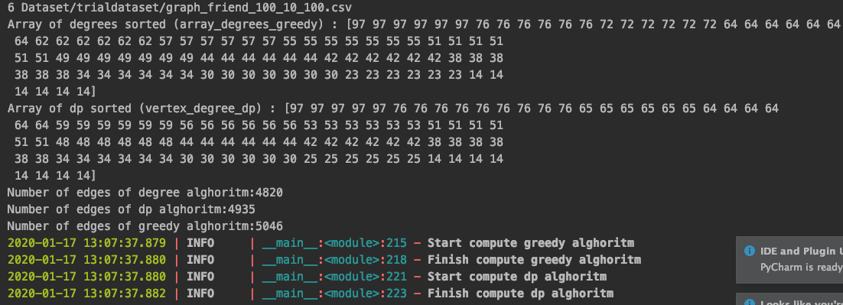
*In this case, we don’t use the Construct Graph for create a Graph, but we show only the degree anonymization

Slide 6
RESULT
Greedy alghoritm is linear-time algorithm but this algorithm is not guaranteed to find the optimal anonymization of the input sequence. Our experiments show that it performs extremely well in practice, achieving anonymizations with costs very close to the optimal.
The greedy algorithm presents some computation problems with high k values.
By testing with values that return a correct result, we have found that the greedy algorithm is much more powerful than the dynamic programming, even if the latter is still fast enough.
Greedy alghoritm is on the order of hundredths of a second, the second is on tenths of a second.
This higher cost is due to the construction of the indexes for the array at each step with the values to be considered for anonymization.

Slide 7
Corrisponde alla pagina prima
DP vs GREEDY
L’algoritmo greedy presenta alcuni problemi di computazione con alti valori di k.
Testando con valori che ritornano un risultato corretto, abbiamo constatato che il l’algoritmo greedy è molto più performante del dp, anche se quest’ultimo comunque è abbastanza veloce.
il greedy è sui centesimi di secondo, il secondo è sui decimi di secondo.
Questo costo è dovuto alla costruzione ad ogni passo gli indici per l’array con ii valori da considerare per l’anonimizzazione.

Slide 8
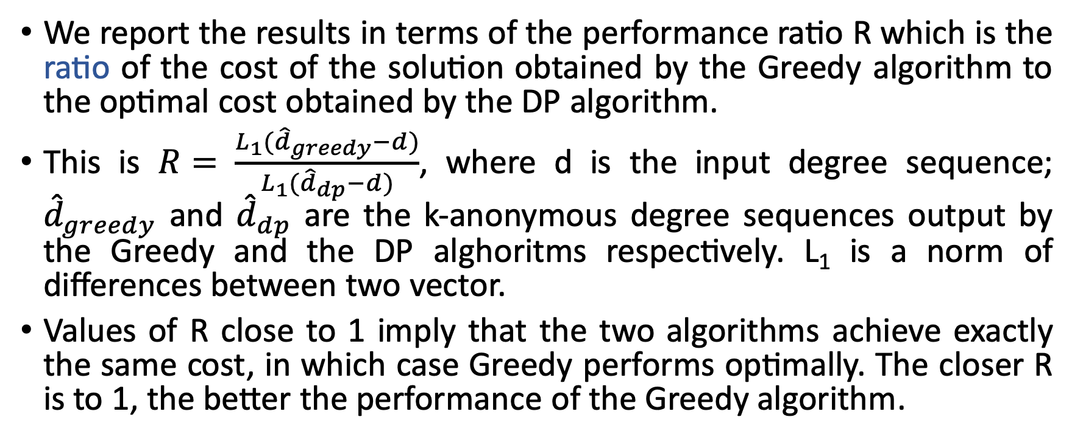
METRIC
We report the results in terms of the performance ratio R which is the ratio of the cost of the solution obtained by the Greedy algorithm to the optimal cost obtained by the DP algorithm.
This is $R= \frac{L_{1}({\hat{d}}_{greedy}−d)}{L_{1}({\hat{d}}_{dp}−d)}$, where d is the input degree sequence; ${\hat{d}}_{greedy}$ and ${\hat{d}}_{dp}$ are the k-anonymous degree sequences output by the Greedy and the DP alghoritms respectively. L₁ is a norm of differences between two vector.
Values of R close to 1 imply that the two algorithms achieve exactly the same cost, in which case Greedy performs optimally. The closer R is to 1, the better the performance of the Greedy algorithm.

Slide 9
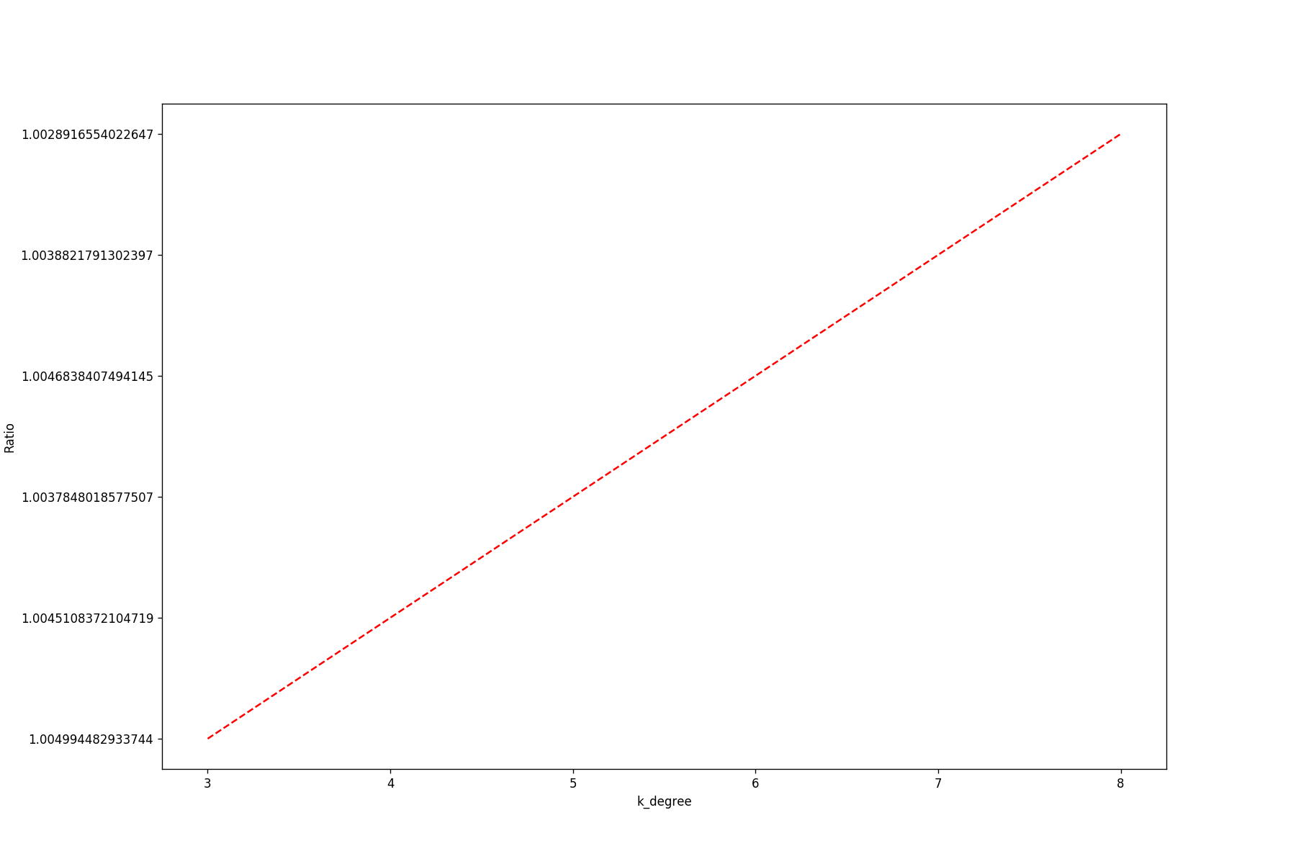
Created with fake dataset : Graph friend with 1000 nodes, minimum 10 edges and maximum 100 edges for node
As the value of k increases,
the greedy algorithm increasingly moves away from the optimal anonymization values, in a directly proportional way.

Slide 10
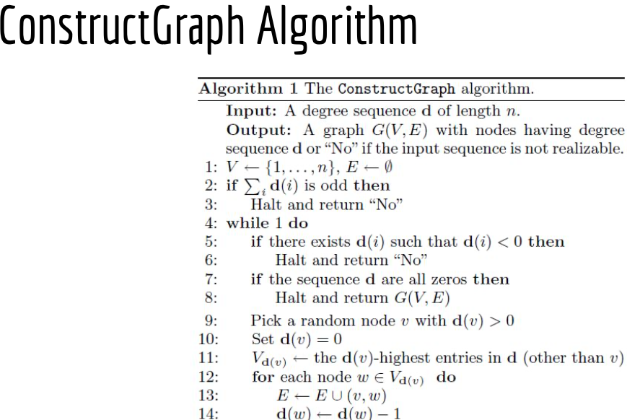
Second Point
Graph construction with Constraints
In class we saw the algorithm on the left .
This algorithm allows to create a graph with the same nodes( label with number instead real name ) and for each node consider the degree of anonymization and add edge with no constraints.
IS IT POSSIBLE CREATE AN ANONYMIZATION GRAPH WITH THE START EDGE?

Slide 11
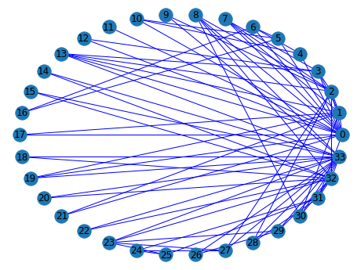
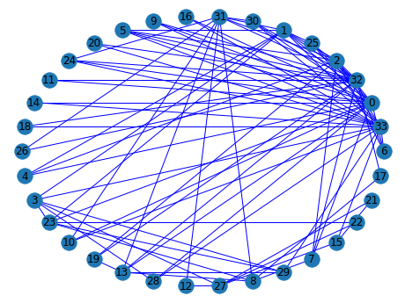
Starting graph
Graph create with ConstructGraph algorithm
*this image are made on no real dataset(karate_club_graph is a graph inside networkX library of Pyhton) because on a real dataset is more complex understand the different

Slide 12
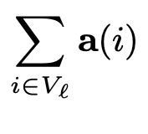
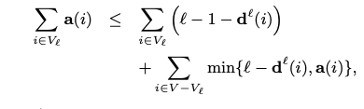
ASSUMPTIONS
Given input graph G(V,E), we say that degree sequence d̂ is realizable subject to G , if and only if there exists a simple graph G~(V,E~) whose nodes have precisely the degrees suggested by d̂ and E ⊆ E~.
Consider :
the vector a = d̂- d;
the set V_{l} that is an ordered set of l nodes with l largest a(i) values, sorted in decreasing order;
d^{l}(i) is the degree of node i in the input graph G when counting only edges in G that connect node i to one of the nodes in V_{l};
l = | V_{l} | is a number prior the we decide.
If
is even
&&

Slide 13
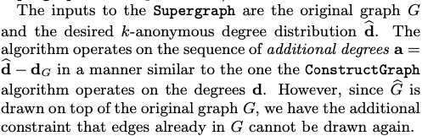
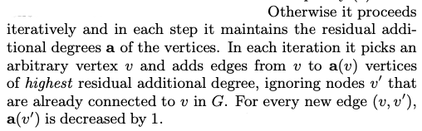
We can consider the Supergraph algorithm

Slide 14
Keys of our algorithm
Our implementation initially compute the degree anonymization algorithm.
Create a new graph with mapping between name of label and number (logically for anonymization).
Use the same structure of ConstructGraph with few difference:
In particular when all the values of vector a are zero, we control if the number of edges added in a graph are equal to half of the sum of values of a.
If this condition is satisfied return the new graph otherwise return null.
The real difference between ConstructGraph and Supergraph is:
ConstructGraph is an oracle and if it retruns null means that not exist a graph for that degree anonymization;
When the Supergraph returns null, it doesn’t mean that not exist a supergraph, but our implementation not allow to find it.
With other approach (example probing scheme) it’s possible to force our supergraph algorithm with a little extra cost for to find a supergraph .

Slide 15
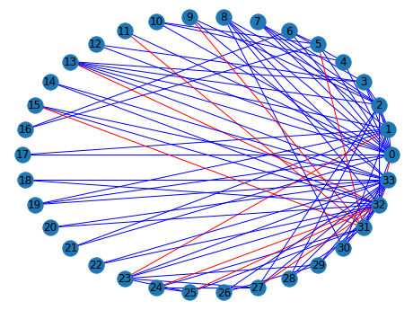
Images of karate_club_graph
Starting graph
Supergraph

Slide 16
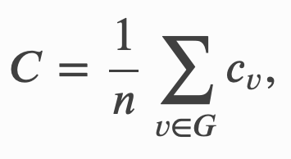
METRICS IN ORDER TO EVALUE THE SUPERGRAPH ALGHORITM
Anonymization cost L₁(d_{A} − d): This is the L₁ norm of the vector of differences between the k-anonymous degree sequence obtained using supergraph and the degree sequence of the original graph. The smaller the value of L₁(d_{A} − d) the better the qualitative performance of the algorithm.
Average Clustering Coefficient (CC): We additionally compare the clustering coefficients of the anonymized graphs with the clustering coefficients of the original graphs. In graph theory, a clustering coefficient is a measure of the degree to which nodes in a graph tend to cluster together. Evidence suggests that in most real-world networks, and in particular social networks, nodes tend to create tightly knit groups characterised by a relatively high density of ties.
where c_{v} is clustering coefficent of each node

Slide 17
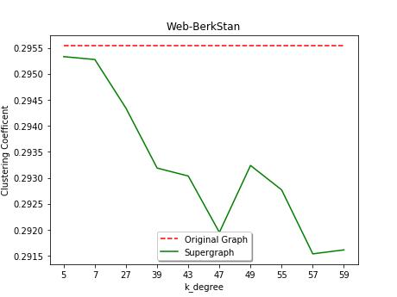
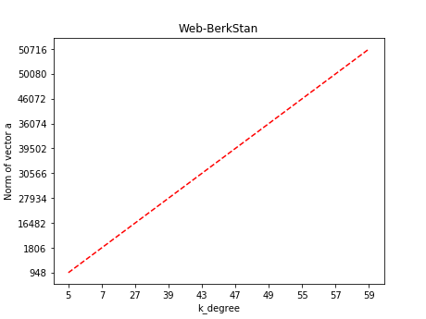
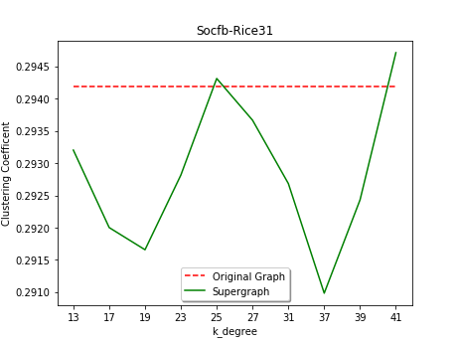
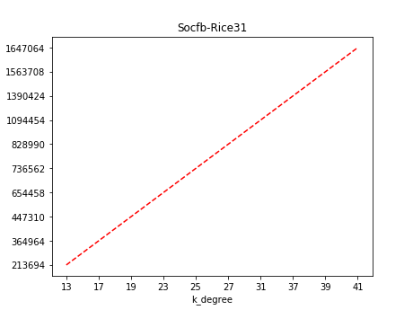

Slide 18
The norm of vector a is directly proportional way to value of k-degree.
Infact the performances of alghoritm decrease when k-degree increases.
CC da relazionare e capire il significato della metrica

Slide 19
RESULTS
We tested the algorithms mainly on two real datasets: web-BerkStan and socfb-Rice312. The supergraph is not always obtained (as is the construct graph). It could happen because there are nodes that can connect only with certain other nodes of the vector a (a very small range). If the latter are connected with nodes with a greater connection availability, the algorithm does not add the number of arcs necessary because the former will have no nodes to connect to. A solution to always obtain a supergraph is the one adopted by the probing scheme which attempts by choosing, in a causal way, some links until it finds the solution.
In a README file we say how we have tested datasets

Slide 20
CODE
The code is written in Python and published on GitHub (https://github.com/enz93/k-degree). All the code is written inside PyCharm. Read the file README inside the folder and you follow the instruction for execute the programm

Slide 21
REFERENCE
Kun Liu and Evimaria Terzi. “Towards identity anonymization on graphs”. In: Proceedings of the 2008 ACM SIGMOD international conference on Management of data. ACM. 2008, pp. 93–106.

