Slide 1
《软件工程与计算II 》
Ch18 代码设计
丁二玉
南京大学软件学院

Slide 2
主要内容
设计易读的代码
设计易维护的代码
设计可靠的代码
使用模型辅助设计复杂代码
为代码开发单元测试用例
代码复杂度度量

Slide 3
18.1 设计易读的代码
维护的需要
团队协作的需要

Slide 4
代码规范
格式
命名
注释
...

Slide 5
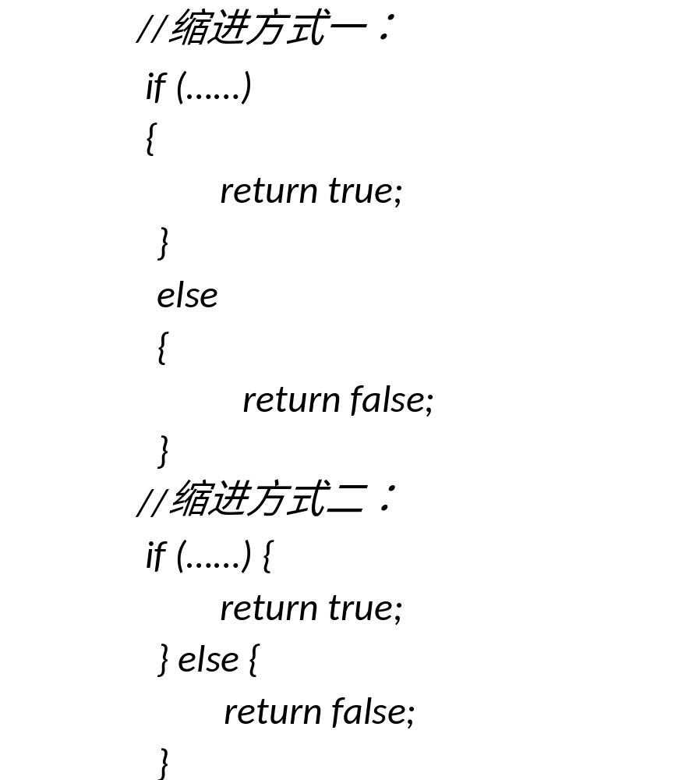
布局格式
使用缩进与对齐表达逻辑结构

Slide 6
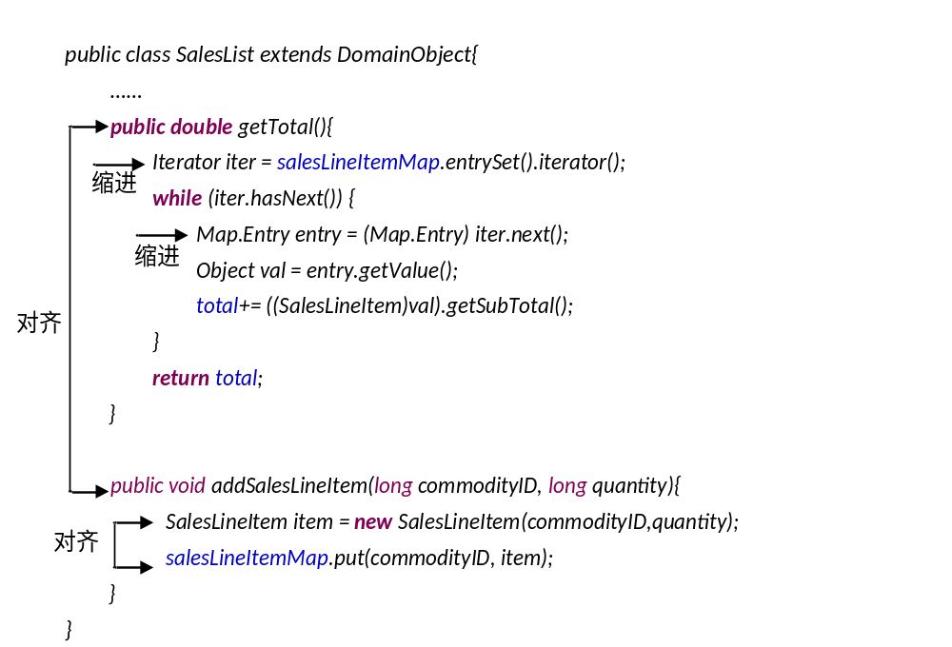
缩进与对齐格式示例

Slide 7
How To Write Unmaintainable Code
if(a)
if(b)x = y;
else x = z;

Slide 8
How To Write Unmaintainable Code
11. Never use an automated source code tidier to keep code aligned. Lobby to have them banned on the grounds they create false deltas in CVS or that every programmer should have his own indenting style held forever sacrosanct for any module he wrote. ……You are now free to accidentally misalign the code to give the optical illusion that bodies of loops and ifs are longer or shorter than they really are, or that else clauses match a different if than they really do.

Slide 9
How To Write Unmaintainable Code
13. Never put in any { } surrounding your if/else blocks unless they are syntactically obligatory. If you have a deeply nested mixture of if/else statements and blocks, especially with misleading indentation, you can trip up even an expert maintenance programmer.

Slide 10
布局格式
将相关逻辑组织在一起
  类的逻辑组织
    成员变量声明；
    构造方法与析构方法；
    public 方法；
    protected 方法；
    private 方法。
使用空行分割逻辑

Slide 11
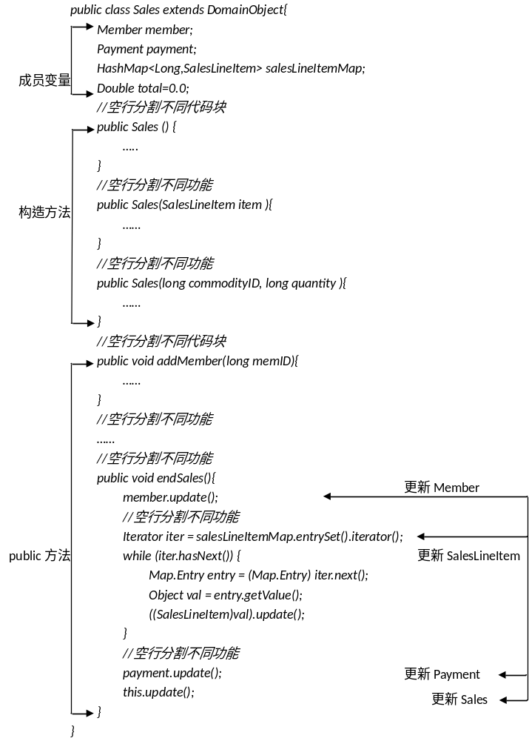
逻辑组织清晰的代码

Slide 12

布局格式
语句分行

Slide 13
How To Write Unmaintainable Code
9. Try to pack as much as possible into a single line. This saves the overhead of temporary variables, and makes source files shorter by eliminating new line characters and white space.
  Tip: remove all white space around operators. Good programmers can often hit the 255 character line length limit imposed by some editors. The bonus of long lines is that programmers who cannot read 6 point type must scroll to view them.

Slide 14
How To Write Unmaintainable Code
31. Nest as deeply as you can. Good coders can get up to 10 levels of ( ) on a single line and 20 { } in a single method. C++ coders have the additional powerful option of preprocessor nesting totally independent of the nest structure of the underlying code. You earn extra Brownie points whenever the beginning and end of a block appear on separate pages in a printed listing. Wherever possible, convert nested ifs into nested [? :] ternaries.

Slide 15
命名
使用有意义的名称进行命名。例如对“销售信息”类，命名为Sales 而不是ClassA。
  使用名词命名类、属性和数据；
  使用名词或者形容词命名接口；
  使用动词或者“动词+名词”命名函数和方法；
  使用合适的命名将函数和方法定义的明显、清晰，包括返回值、参数、异常等。
名称要与实际内容相符。例如，使用Payment 命名“账单”类明显比使用“Change”更相符，因为“账单”类的职责不仅仅是计算“Change”，还要维护账单数据。
如果存在惯例，命名时要遵守惯例。例如，Java 语言的命名惯例是：使用小写词命名包；类、接口名称中每个单词的首字母大写；变量、方法名称的第一个单词小写，后续单词的首字母大写；常量的每个单词大写，单词间使用“_”连接。

Slide 16
命名
临时变量命名要符合常规。像for 循环计数器、键盘输入字符等临时变量一般不要求使用有意义的名称，但是要使用符合常规的名称，例如使用i、j 命名整数而不是字符，使用c、s 命名字符而不是整数。
不要使用太长的名称，不利于拼写和记忆。
不要使用易混字符进行命名，常见的易混字符例如“I”（大写i）、“1”（数字1）与“l”（小写L）、0（数字零）与O（字母）等。使用易混字符的命名例如D0Calc 与DOCalc。
不要仅仅使用不易区分的多个名称，例如Sales与Sale，SalesLineItem与SalesLineitem。
不要使用没有任何逻辑的字母缩写进行命名，例如wrttn、wtht、vwls、smch、trsr……

Slide 17
How To Write Unmaintainable Code
3. Make sure that every method does a little bit more (or less) than its name suggests. As a simple example, a method named isValid(x) should as a side effect convert x to binary and store the result in a database.
4. Use acronyms to keep the code terse(简洁). Real men never define acronyms; they understand them genetically.

Slide 18
How To Write Unmaintainable Code
10. Cd wrttn wtht vwls s mch trsr. When using abbreviations inside variable or method names, break the boredom with several variants for the same word, and even spell it out longhand once in while. This helps defeat those lazy bums who use text search to understand only some aspect of your program. Consider variant spellings as a variant on the ploy, e.g. mixing International colour, with American color and dude-speak kulerz. If you spell out names in full, there is only one possible way to spell each name. These are too easy for the maintenance programmer to remember. Because there are so many different ways to abbreviate a word, with abbreviations, you can have several different variables that all have the same apparent purpose. As an added bonus, the maintenance programmer might not even notice they are separate variables

Slide 19
How To Write Unmaintainable Code
15. Use very long variable names or class names that differ from each other by only one character, or only in upper/lower case. An ideal variable name pair is swimmer and swimner. Exploit the failure of most fonts to clearly discriminate between ilI1| or oO08 with identifier pairs like parselnt and parseInt or D0Calc and DOCalc. l is an exceptionally fine choice for a variable name since it will, to the casual glance, masquerade as the constant 1. Create variable names that differ from each other only in case e.g. HashTable and Hashtable.

Slide 20
How To Write Unmaintainable Code
23.To break the boredom, use a thesaurus to look up as much alternate vocabulary as possible to refer to the same action, e.g. display, show, present. Vaguely hint there is some subtle difference, where none exists. However, if there are two similar functions that have a crucial difference, always use the same word in describing both functions (e.g. print to mean write to a file, and to a print on a laser, and to display on the screen). Under no circumstances, succumb to demands to write a glossary with the special purpose project vocabulary unambiguously defined. Doing so would be unprofessional breach of the structured design principle of information hiding.

Slide 21
How To Write Unmaintainable Code
24. In naming functions, make heavy use of abstract words like it, everything, data, handle, stuff, do, routine, perform and the digits e.g. routineX48, PerformDataFunction, DoIt, HandleStuff and do_args_method.

Slide 22
How To Write Unmaintainable Code
73. If you cannot find the right English word to convey the meaning of a temporary variable (and you ignore the other suggestions about not giving meaningful names to variables), you may use a foreign language word as the name of the variable. For example, instead of using variable "p" for a "point", you may use "punkt", which is the German word for it. Maintenance coders without your firm grasp of German will enjoy the multicultural experience of deciphering the meaning. It breaks the tedium of an otherwise tiring and thankless job.

Slide 23
注释
注释类型(Java)
  语句注释（//）
  标准注释(/* */)
  文档注释(/** */)

Slide 24
文档注释的内容
包的总结和概述，每个包都要有概述；
类和接口的描述，每个类和接口都要有概述；
类方法的描述，每个方法都要有功能概述，都要定义完整的接口描述；
字段的描述，重要字段含义、用法与约束的描述。

Slide 25
Javadoc
在描述类与接口时，Javadoc常用的标签是：
  @author：作者名
  @version：版本号
  @see：引用
  @since：最早使用该方法/类/接口的JDK版本
  @deprecated 引起不推荐使用的警告

Slide 26
Javadoc
在描述方法时，Javadoc常用的标签是：
  @param 参数及其意义
  @return 返回值
  @throws 异常类及抛出条件
  @see：引用
  @since：最早使用该方法/类/接口的JDK版本
  @deprecated 引起不推荐使用的警告

Slide 27
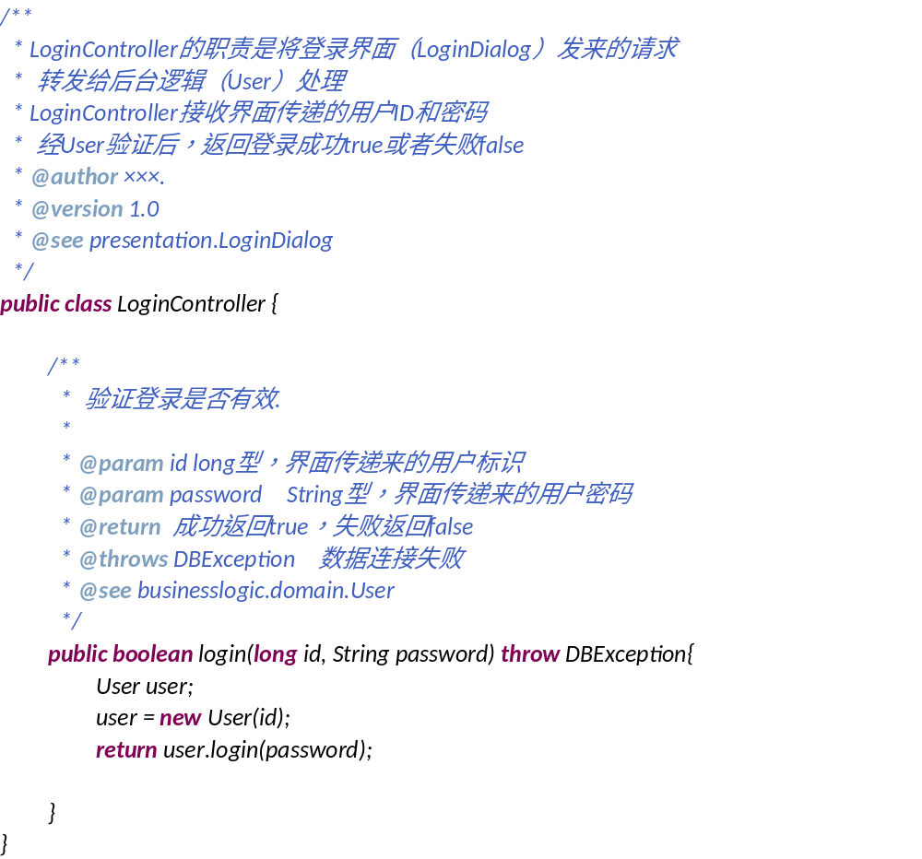

Slide 28
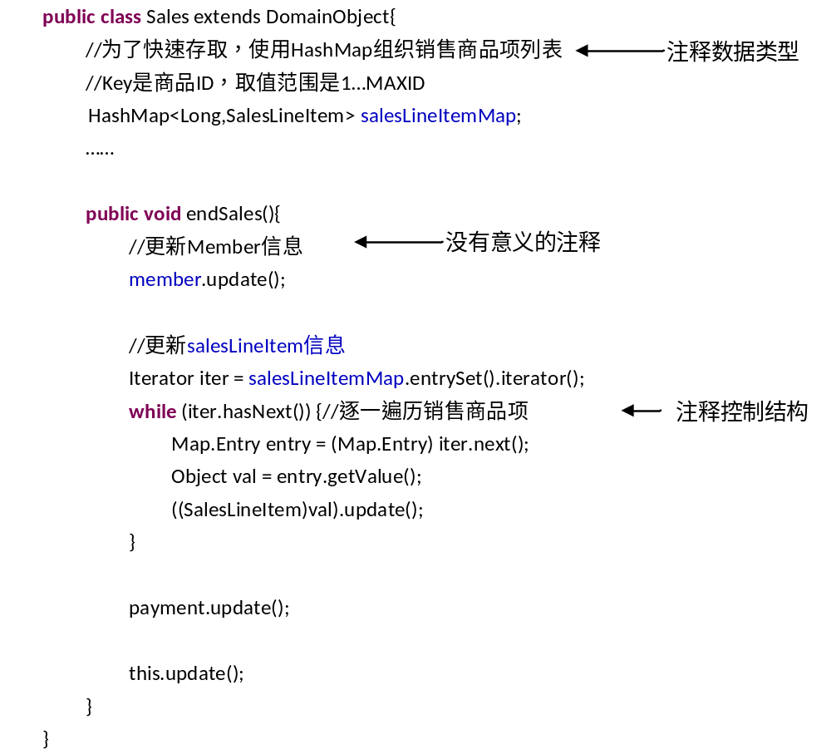
内部注释
注释要有意义，不要简单重复代码的含义
重视对数据类型的注释
重视对复杂控制结构的注释

Slide 29
How To Write Unmaintainable Code
1. Lie in the comments. You don't have to actively lie, just fail to keep comments as up to date with the code.
3. Pepper the code with comments like /* add 1 to i */ however, never document stuff like the overall purpose of the package or method.

Slide 30
How To Write Unmaintainable Code
8. Never put a comment on a variable. Facts about how the variable is used, its bounds, its legal values, its implied/displayed number of decimal points, its units of measure, its display format, its data entry rules, when its value can be trusted etc. should be gleaned from the procedural code. If your boss forces you to write comments, lard(填满) method bodies with them, but never comment a variable, not even a temporary!

Slide 31
主要内容
设计易读的代码
设计易维护的代码
设计可靠的代码
使用模型辅助设计复杂代码
为代码开发单元测试用例
代码复杂度度量

Slide 32
18.2 设计易维护的代码
1 小型任务
  要让程序代码可修改，就要控制代码的复杂度。这首先要求每个函数或方法的代码应该是内聚的，恰好完成一个功能与目标。
  如果内聚的代码本身比较简单，复杂性可控，那么它就具有比较好的可维护性。反之，内聚的代码也可以比较复杂，典型表现是完成一个功能需要多个步骤、代码比较长，那么就需要将其进一步分解为多个高内聚、低耦合的小型任务。
  封装该任务

Slide 33
How To Write Unmaintainable Code
5. In the interests of efficiency, avoid encapsulation. Callers of a method need all the external clues they can get to remind them how the method works inside.
6. If, for example, you were writing an airline reservation system, make sure there are at least 25 places in the code that need to be modified if you were to add another airline. Never document where they are. People who come after you have no business modifying your code without thoroughly understanding every line of it.

Slide 34
How To Write Unmaintainable Code
7. In the name of efficiency, use cut/paste/clone/modify. This works much faster than using many small reusable modules.
46. Instead of using a parameters to a single method, create as many separate methods as you can. For example instead of setAlignment(int alignment) where alignment is an enumerated constant, for left, right, center, create three methods: setLeftAlignment, setRightAlignment, and setCenterAlignment. Of course, for the full effect, you must clone the common logic to make it hard to keep in sync.

Slide 35
How To Write Unmaintainable Code
48. Declare every method and variable public. After all, somebody, sometime might want to use it. Once a method has been declared public, it can't very well be retracted, now can it? This makes it very difficult to later change the way anything works under the covers. It also has the delightful side effect of obscuring what a class is for. If the boss asks if you are out of your mind, tell him you are following the classic principles of transparent interfaces.

Slide 36
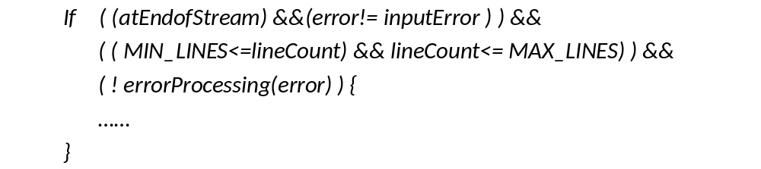
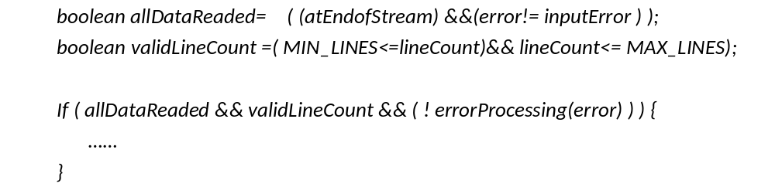
设计易维护的代码
2 复杂决策
  使用新的布尔变量简化复杂决策

Slide 37
设计易维护的代码
2 复杂决策
  使用有意义的名称封装复杂决策
    对于决策“ If( (id>0) && (id<=MAX_ID))”，可以封装为“If ( isIdValid(id) )”，方法isIdValid(id)的内容为 “return ((id>0) && (id<=MAX_ID) )”。
  表驱动编程

Slide 38
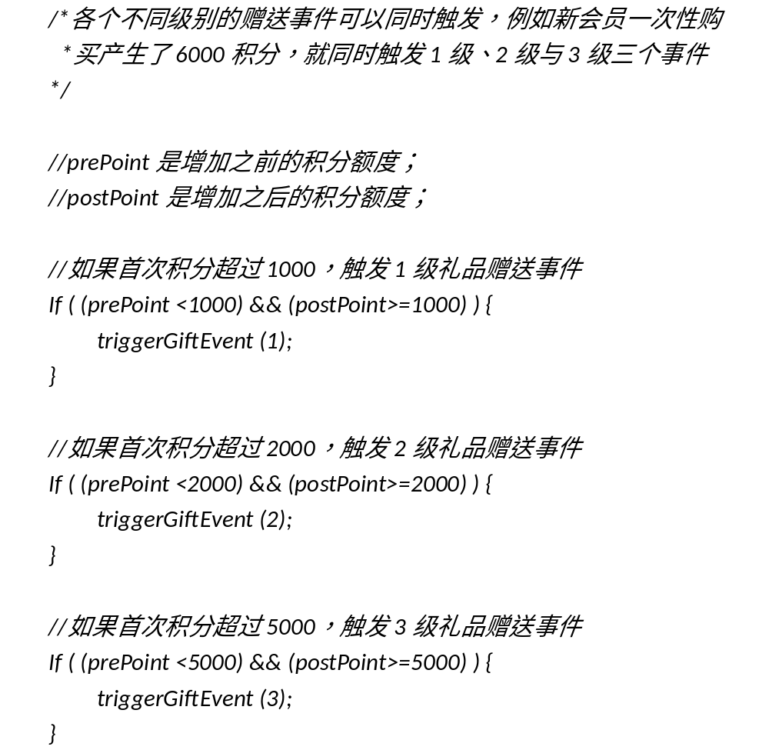

Slide 39
prePoint(小于) | postPoint（大于等于） | Event Level
1000 | 1000 | 1
2000 | 2000 | 2
5000 | 5000 | 3

Slide 40
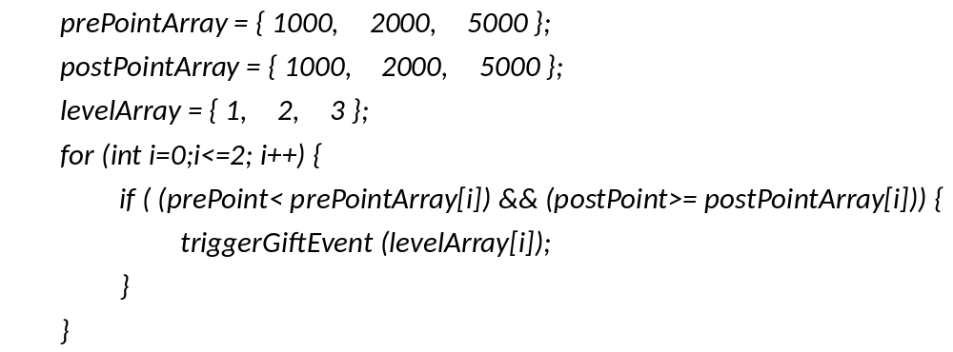

Slide 41
设计易维护的代码
3 数据使用
  （1）不要将变量应用于与命名不相符的目的。例如使用变量total表示销售的总价，而不是临时客串for循环的计数器。
  （2）不要将单个变量用于多个目的。在代码的前半部分使用total表示销售总价，在代码后半部分不再需要“销售总价”信息时再用total客串for循环的计数器也是不允许的。
  （3）限制全局变量的使用，如果不得不使用全局变量，就明确注释全局变量的声明和使用处。
  （4）不要使用突兀的数字与字符，例如15（天）、“MALE”等，要将它们定义为常量或变量后使用。

Slide 42
How To Write Unmaintainable Code
16. Wherever scope rules permit, reuse existing unrelated variable names. Similarly, use the same temporary variable for two unrelated purposes (purporting to save stack slots). For a fiendish variant, morph the variable, for example, assign a value to a variable at the top of a very long method, and then somewhere in the middle, change the meaning of the variable in a subtle way, such as converting it from a 0-based coordinate to a 1-based coordinate. Be certain not to document this change in meaning.

Slide 43
How To Write Unmaintainable Code
19. Never use i for the innermost loop variable. Use anything but. Use i liberally for any other purpose especially for non-int variables. Similarly use n as a loop index.
20. Never use local variables. Whenever you feel the temptation to use one, make it into an instance or static variable instead to unselfishly share it with all the other methods of the class. This will save you work later when other methods need similar declarations. C++ programmers can go a step further by making all variables global.

Slide 44
How To Write Unmaintainable Code
29. If you have an array with 100 elements in it, hard code the literal 100 in as many places in the program as possible. Never use a static final named constant for the 100, or refer to it as myArray.length. To make changing this constant even more difficult, use the literal 50 instead of 100/2, or 99 instead of 100-1. You can futher disguise the 100 by checking for a == 101 instead of a > 100 or a > 99 instead of a >= 100.

Slide 45
设计易维护的代码
4 明确依赖关系
  类之间模糊的依赖关系会影响到代码的理解与修改，非常容易导致修改时产生未预期的连锁反应。
  ，对于这些模糊的依赖关系，需要进行明确的注释（Javadoc中的@see）

Slide 46
How To Write Unmaintainable Code
24. In Java, all primitives passed as parameters are effectively read-only because they are passed by value. The callee can modify the parameters, but that has no effect on the caller's variables. In contrast all objects passed are read-write. The reference is passed by value, which means the object itself is effectively passed by reference. The callee can do whatever it wants to the fields in your object. Never document whether a method actually modifies the fields in each of the passed parameters. Name your methods to suggest they only look at the fields when they actually change them.

Slide 47
主要内容
设计易读的代码
设计易维护的代码
设计可靠的代码
使用模型辅助设计复杂代码
为代码开发单元测试用例
代码复杂度度量

Slide 48
18.3 设计可靠的代码
契约式设计
  异常方式
  断言方式
防御式编程

Slide 49
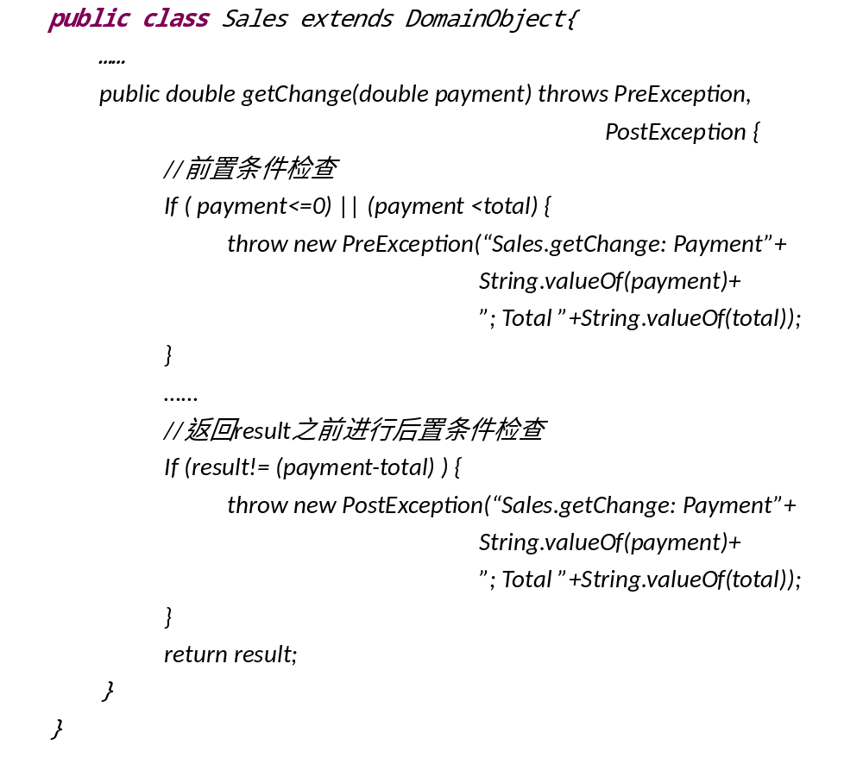
契约式设计的异常实现

Slide 50
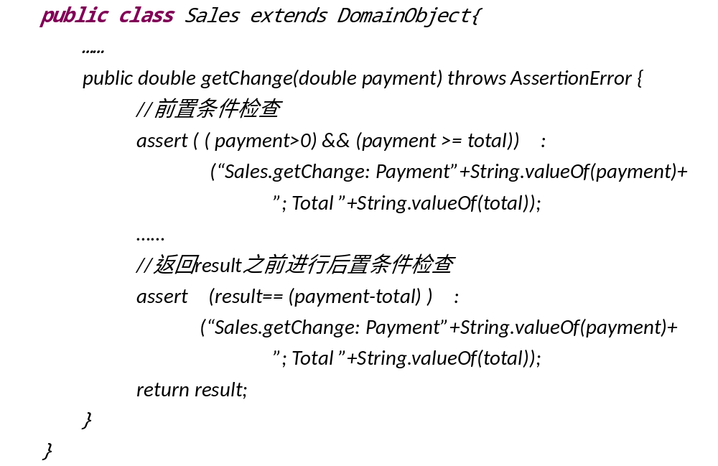
契约式设计的断言实现

Slide 51
Java的断言语句
assert Expression1( : Expression2) ：
  Expression1 是一个布尔表达式，在契约式设计中可以将其设置为前置条件或者后置条件；
  Expression2 是一个值，各种常见类型都可以；
  如果Expression1 为true，断言不影响程序执行；
  如果Expression1 为false，断言抛出AssertionError 异常，如果存在Expression2 就使用它作为参数构造AssertionError。

Slide 52
防御式编程常见场景
防御式编程的基本思想是：在外界发生错误时，保护方法内部不受损害。
常见场景
  输入参数是否合法？
  用户输入是否有效？
  外部文件是否存在？
  对其他对象的引用是否为NULL？
  其他对象是否已初始化？
  其他对象的某个方法是否已执行？
  其他对象的返回值是否正确？
  数据库系统连接是否正常？
  网络连接是否正常？
  网络接收的信息是否有效？
异常和断言都可以用来实现防御式编程，两种实现方式的差异与契约式设计的实现一样。

Slide 53
How To Write Unmaintainable Code
27. I am going to let you in on a little-known coding secret. Exceptions are a pain in the behind. Properly-written code never fails, so exceptions are actually unnecessary. Don't waste time on them. Subclassing exceptions is for incompetents who know their code will fail. You can greatly simplify your program by having only a single try/catch in the entire application (in main) that calls System.exit().Just stick a perfectly standard set of throws on every method header whether they could throw any exceptions or not.

Slide 54
主要内容
设计易读的代码
设计易维护的代码
设计可靠的代码
使用模型辅助设计复杂代码
为代码开发单元测试用例
代码复杂度度量

Slide 55
18.4 使用模型辅助设计复杂代码
决策表
伪代码
程序流程图

Slide 56
决策表
条件和行动 | 规则
条件声明（Condition Statement） | 条件选项（Condition Entry）
行动声明（Action Statement） | 行动选项（Action Entry）
条件和行动 | 规则
prePoint | <1000 | <2000 | <5000
postPoint | >=1000 | >=2000 | >=5000
Gift Event Level 1 | X
Gift Event Level 2 |  | X
Gift Event Level 3 |  |  | X

Slide 57
伪代码
结合使用程序语言的逻辑结构和自然语言的表达能力描述程序逻辑：
  叙述上采用了编程语言的三种控制结构：顺序、条件决策和循环；
  使用了一些类似于编程语言关键字的词语来表明叙述的逻辑，例如IF、THEN、ELSE、DO、DO WHILE、DO UNTIL等等；
  在格式上，使用和编程语言相同的缩进方式来表明程序逻辑结构。
  尽量使用简短语句以利于理解，只使用名词和动词，避免使用容易产生歧义的形容词和副词。

Slide 58
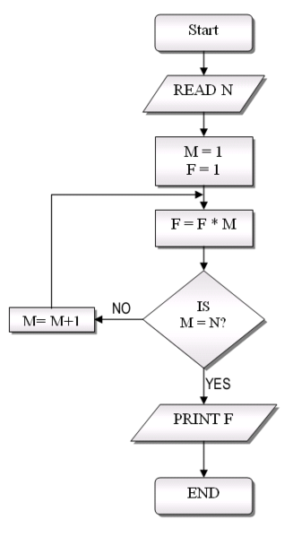
程序流程图

Slide 59
主要内容
设计易读的代码
设计易维护的代码
设计可靠的代码
使用模型辅助设计复杂代码
为代码开发单元测试用例
代码复杂度度量

Slide 60
18.5 为代码开发单元测试用例
为方法开发测试用例主要使用两种线索：
  （1）方法的规格；
    根据第一种线索，可以使用基于规格的测试技术开发测试用例，等价类划分和边界值分析是开发单元测试用例常用的黑盒测试方法。
  （2）方法代码的逻辑结构。
    根据第二种线索，可以使用基于代码的测试技术开发测试用例，对关键、复杂的代码使用路径覆盖，对复杂代码使用分支覆盖，简单情况使用语句覆盖。

Slide 61
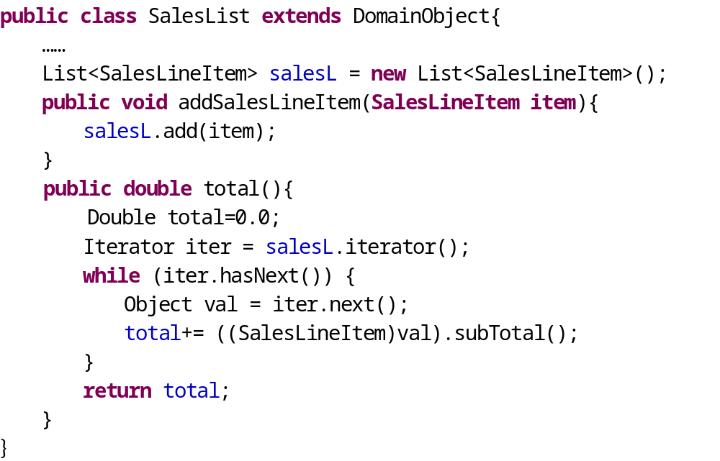
Sales.total()方法代码

Slide 62
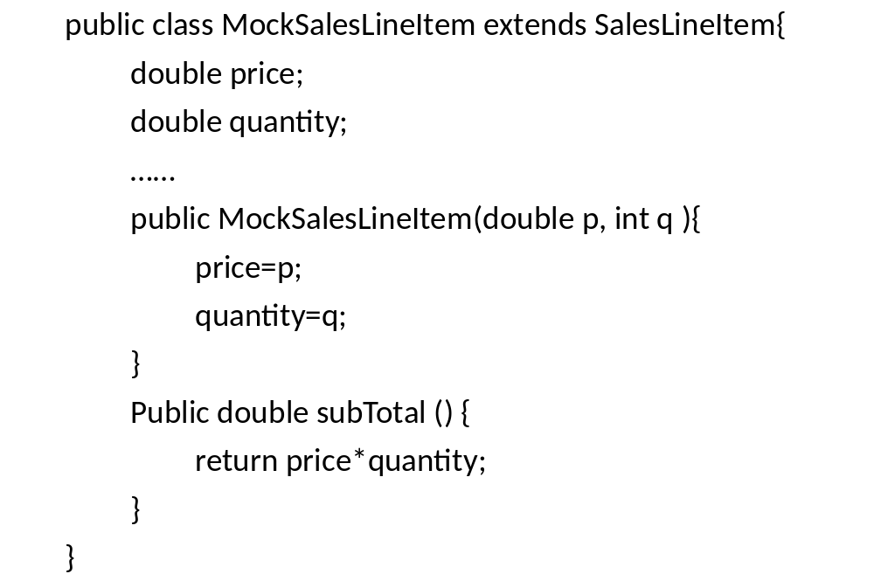
Mock Object

Slide 63
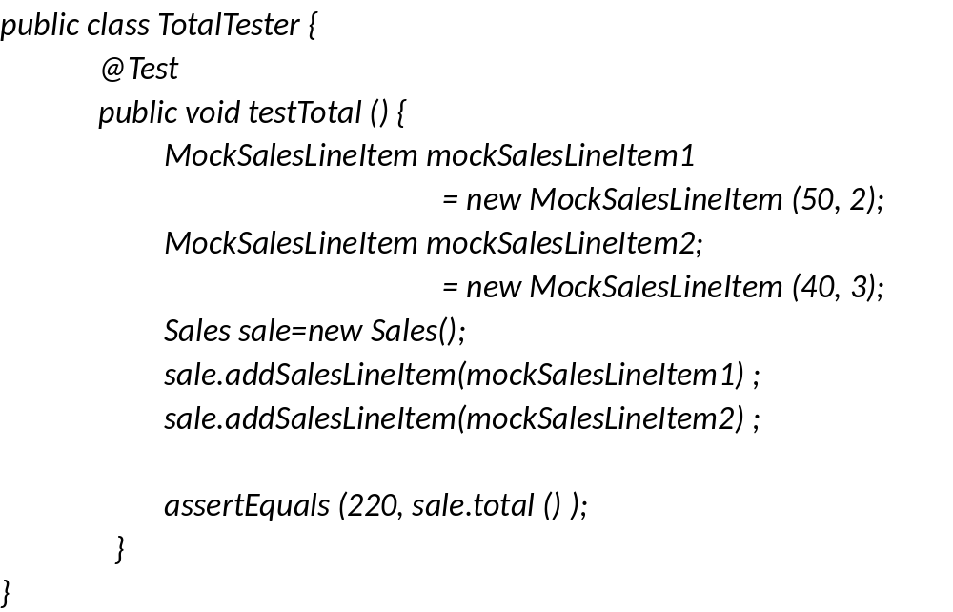
JUnit测试代码

Slide 64
为类开发测试用例
在复杂类中，常常有着多变的状态，每次一个方法的执行改变了类状态时，都会给其他方法带来影响，也就是说复杂类的多个方法间是互相依赖的。
所以，除了测试类的每一个方法之外，还要测试类不同方法之间的互相影响情况。

Slide 65
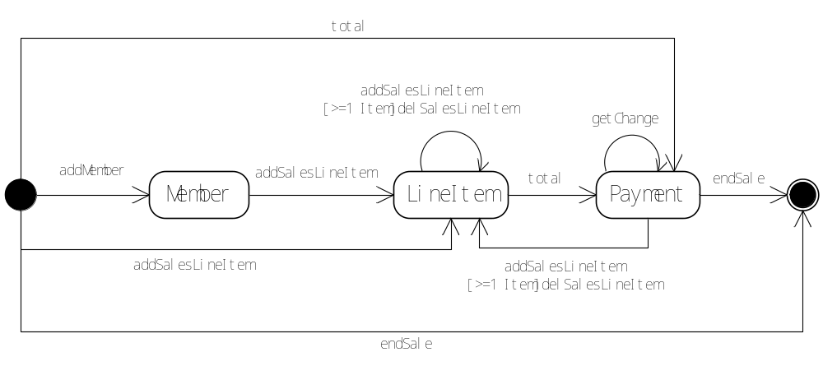
Sales类的状态图

Slide 66
测试用例线索
输入 |  | 预期输出状态
方法 | 当前状态
addMember | Start | Member
 | Member | 非法
 | LineItem | 非法
 | Payment | 非法
 | End | 非法
addSalesLineItem | Start | LineItem
 | Member | LineItem
 | LineItem | LineItem
 | Payment | LineItem
 | End | 非法
[>=1 Item] delSalesLineItem | …… | ……
total | …… | ……
getChange | …… | ……
endSale | …… | ……

Slide 67
测试用例
ID | 输入 |  | 预期输出
 | 前置语句 | 方法
1 | s=new Sales(); | s.addMember(2); | No Exception
2 | s=new Sales(); s.addMember(1); |  | MemberLable Invalid Time
3 | s=new Sales(); s.addSalesLineItem(1);
4 | s=new Sales(); s.addSalesLineItem(1); s.total();
5 | s=new Sales(); s.addSalesLineItem(1); s.total(); s.getChange(100); s.endSale(); |  | Sales dose not Exists
……

Slide 68
主要内容
设计易读的代码
设计易维护的代码
设计可靠的代码
使用模型辅助设计复杂代码
为代码开发单元测试用例
代码复杂度度量

Slide 69
18.6 代码复杂度度量
程序复杂度是造成各种编程困难的主要原因。[Dijkstra1972]很早就指出：“有能力的程序员会充分认识到自己的大脑容量是多么地有限；所以，他会非常谦卑的处理编程任务。”
为了帮助程序员处理程序复杂度，人们提出了很多程序复杂度的度量手段，其中McCabe的圈复杂度[McCabe1976]得到了比较大的关注。

Slide 70
圈复杂度
建立程序的流程图G，假设图的节点数为N，边数为E，那么复杂度V（G）=E-N+2。

Slide 71
圈复杂度
还有一种简单的算法是直接计数程序中决策点的数量： (1) 从1开始，一直往下通过程序。 (2) 一旦遇到下列关键字，或者同类的词，就加1：if, while, repeat, for。 (3) 给case语句中的每一种情况都加1。
[McConnell2004]认为：
  0-5 子程序可能还不错；
  6-10 得想办法简化子程序了；
  10+ 把子程序的某一个部分拆分成另一个子程序并调用它。

Slide 72
类的复杂度
[Chidamber1994]基于所拥有方法的代码复杂度定义了类的复杂度：
  类的加权方法= Sum（Ci） i = from 1 to n
    其中，n为一个类的方法数量，Ci是第i个方法的代码复杂度。

Slide 73
总结
高质量的程序代码需要进行仔细设计
  易读
  易维护
  可靠
可以使用技术模型手段帮助进行代码设计
要使用单元测试验证已完成的代码
代码复杂度在一定程度上可以客观反映代码质量
要避免常见的代码错误

