Slide 1


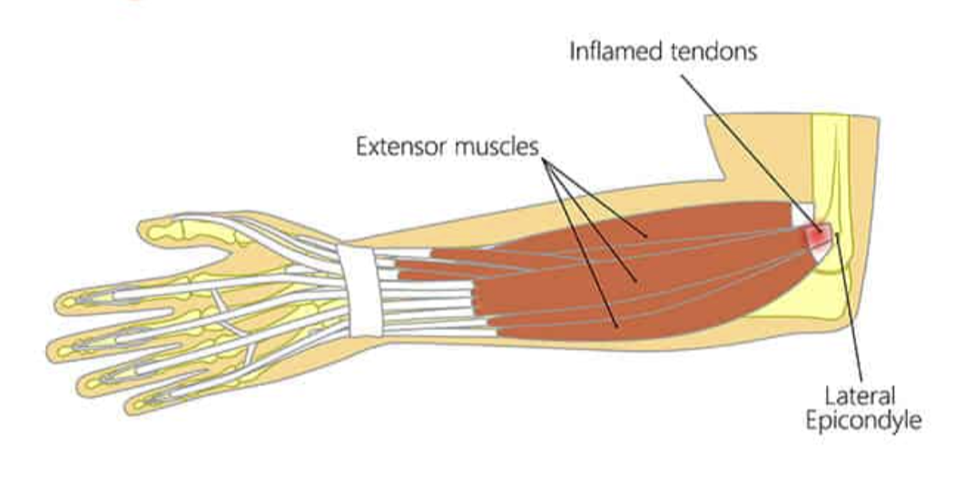
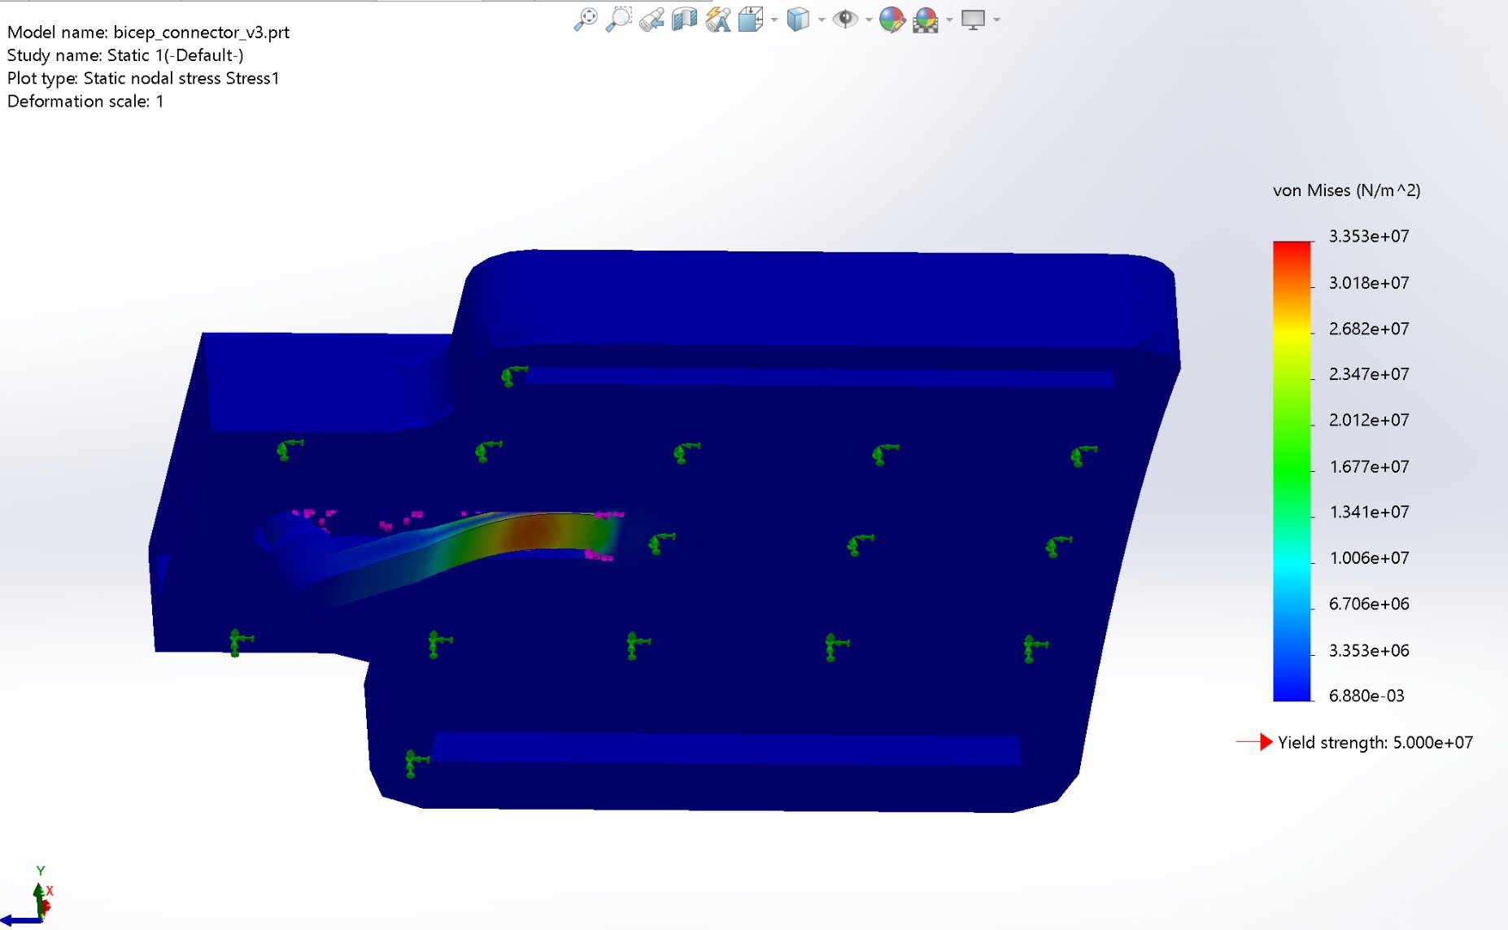
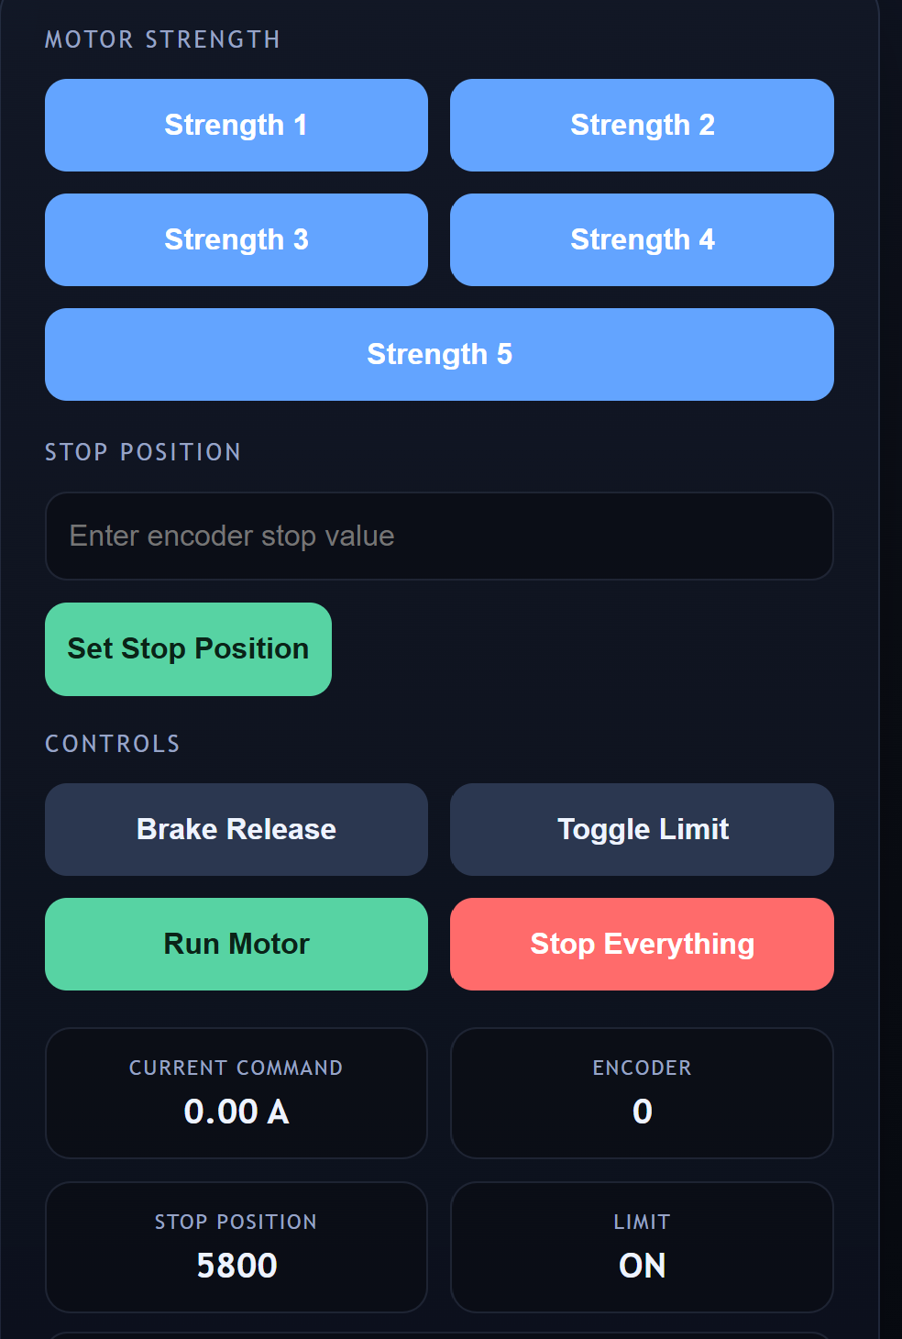
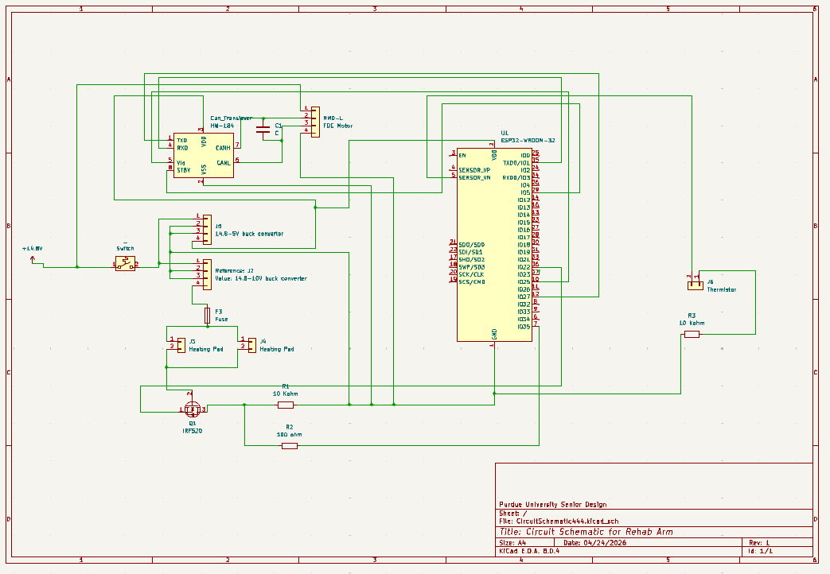
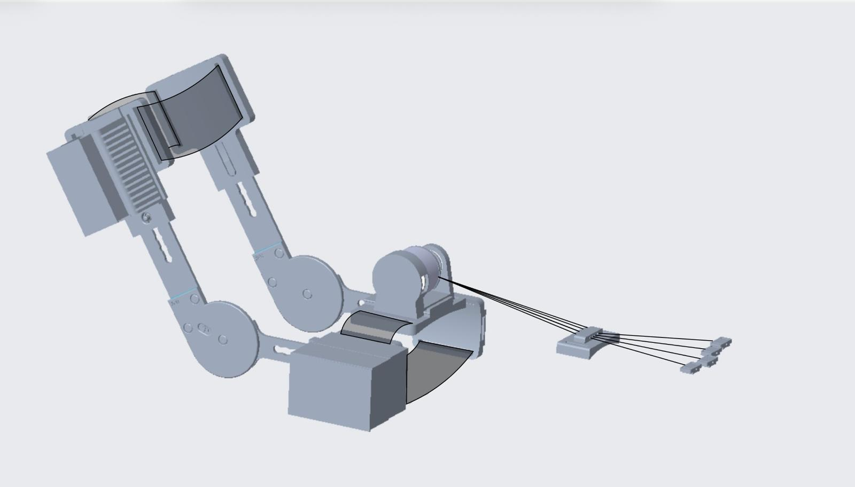
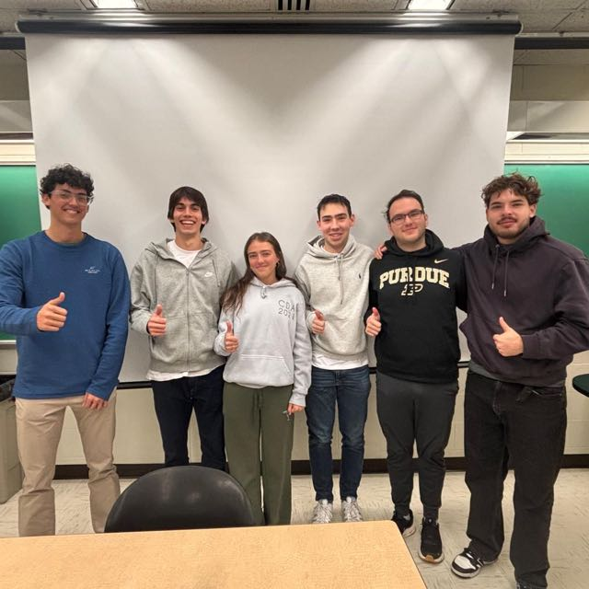
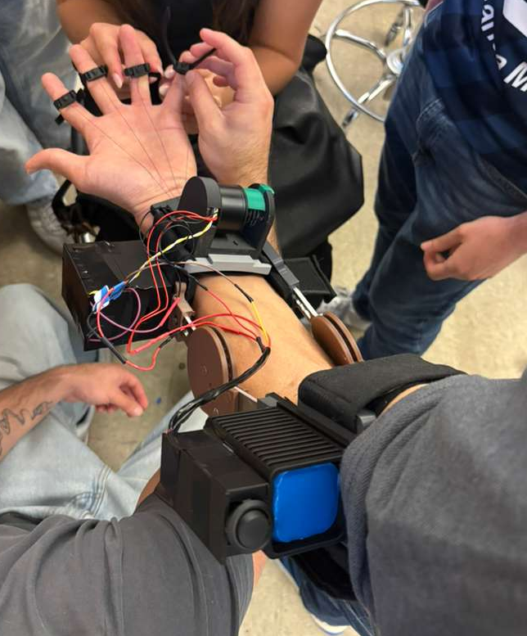
Adaptive Elbow Rehabilitation Device
Student Names: Carlos Caldentey, Catarina Jancso, Enzo Aguirre,
Jose Junco, Javier Echevarria, Victor Weller
Faculty Advisor: Chun-Li Chang
Abstract
Elbow injuries are prevalent among athletes and repetitive-motion users, yet rehab stays inefficient due to limited rehabilitation methods that can cause inconsistent loading, improper execution, increased reinjury risk, delayed recovery, reduced adherence, and higher costs for patients. Therefore, there is a need for a rehabilitation device that objectively measures elbow rehabilitation progress while delivering personalized, adjustable resistance for better outcomes and accessibility. This yielded a wearable device that could adjust to different arm length and sizes that through a motor, reel system, and an interface could provide constant forces for tennis elbow patients resulting in a more effective recovery journey.
Introduction
Prototype & Results
Conclusion
1–3% of the general population develops tennis elbow at some point
Tennis elbow caused by repetitive movements and overextension like typing, painting, golf, lifting, etc.
Muscles and tendons related to injury originate from the fingers.
Connectors
Four attachment points: bicep, forearm, wrist, and reel slider, all following similar geometry.
Material: PETG 3D printed, selected based on FEA results showing resitance under cyclic loading.
Reeling System
RMD-L 4015 DC Brushless Motor 0.49N*m.
Cable guided throgh spool to deliver controlled tensioned to the fingers.
Support with slider
Key connector
Spool
Anti tangling guide ensures correct cable path during cycles.
Structure
Connecting aluminum bars linked attachment points, accomodates variable arm lengths for correct fit.
Electronics and Control
ESP32 microcontoller manages motor commands from app
Mobile app delivers 5 resistance levels, enabling progressive rehabilitation.
Performance and Requirements Met:
The project specifications were completed and surpassed, having the ability to provide a reactive counter force during finger extension and wrist flexions.
The connecting structure of the prototype was tested under large exponentially increasing loads demonstrating stability and durability.
App integrated motor control allows user input to drive exercise collecting data for future recovery.
Engineering Validation:
These results demonstrate that a simple elbow brace can be transformed into a user-friendly device capable of not only providing protection, but therapist approved recovery exercises.
Successful material analysis, optimized structure design, and electronic integration, proves that smart and fast recovery can be affordable, comfortable, and engineered to performance.
Engineering Depth
Requirements
Device capable of doing finger extension and wrist flexions
Progressive Overload based of rehabilitation stage
Range of motion limited to prevent hyperextension
Retail price underneath $1,000
Weight underneath 15lbs
FEA Bicep connector Pin
Industry Impact:
The AER Device dives into a completely untapped market where injury prevention meets rehabilitation through an electromechanical system.
Having an approximate cost of $100 HVM manufacturing price.
Circuit Schematic
Team Picture
Wearable Healing Device, Smart Support and Fast Recovery

