Slide 1
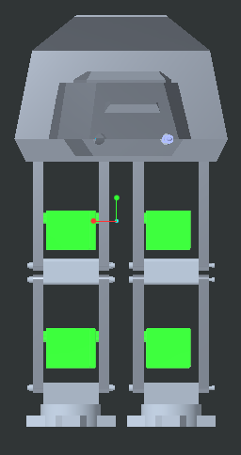
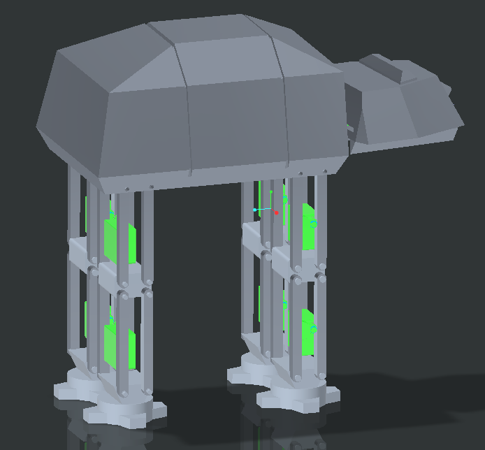
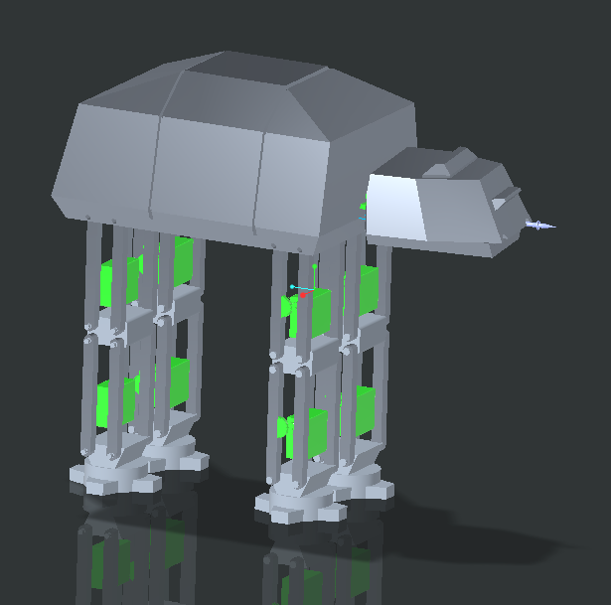
All Terrain Armored Transport
By: Jackson Morley, Hunter Pruett, Carter Lone, Enzo Aguirre

Slide 2
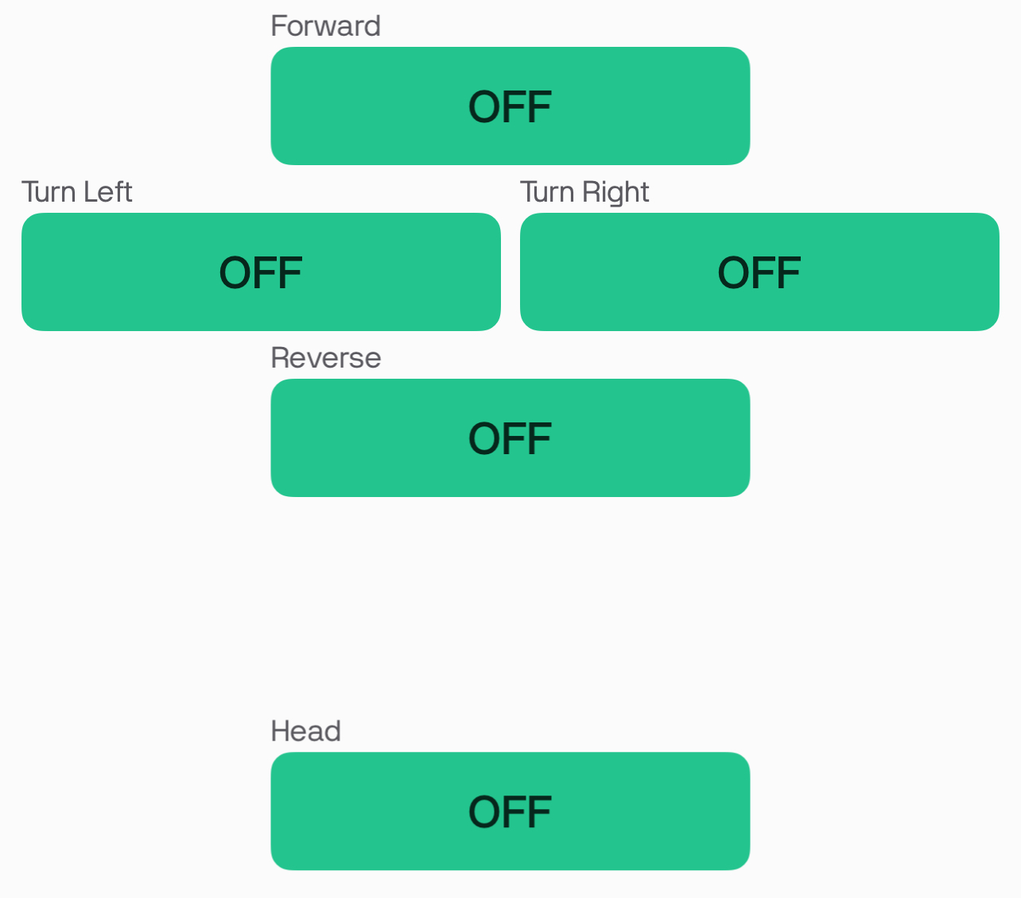
How to Play with the ATAT
ATAT Actions
Walk Forward
Turn
Rotate Head & Fire Blasters
Controls
Connect to the ATAT using the Blynk app
The app allows the individual to easily control the ATAT with simple push button controls.
Where walking and turning occur when the button is held, and the head/blaster movements are an on/off switch

Slide 3
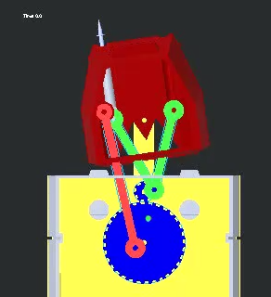
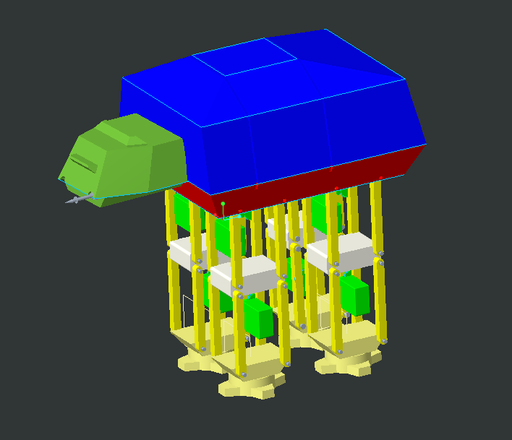
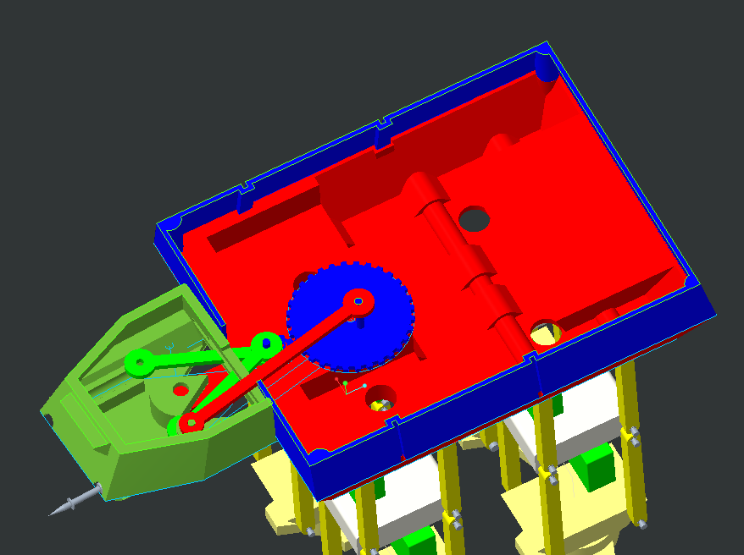
Virtual Assembly & Motion Kinetics

Slide 4
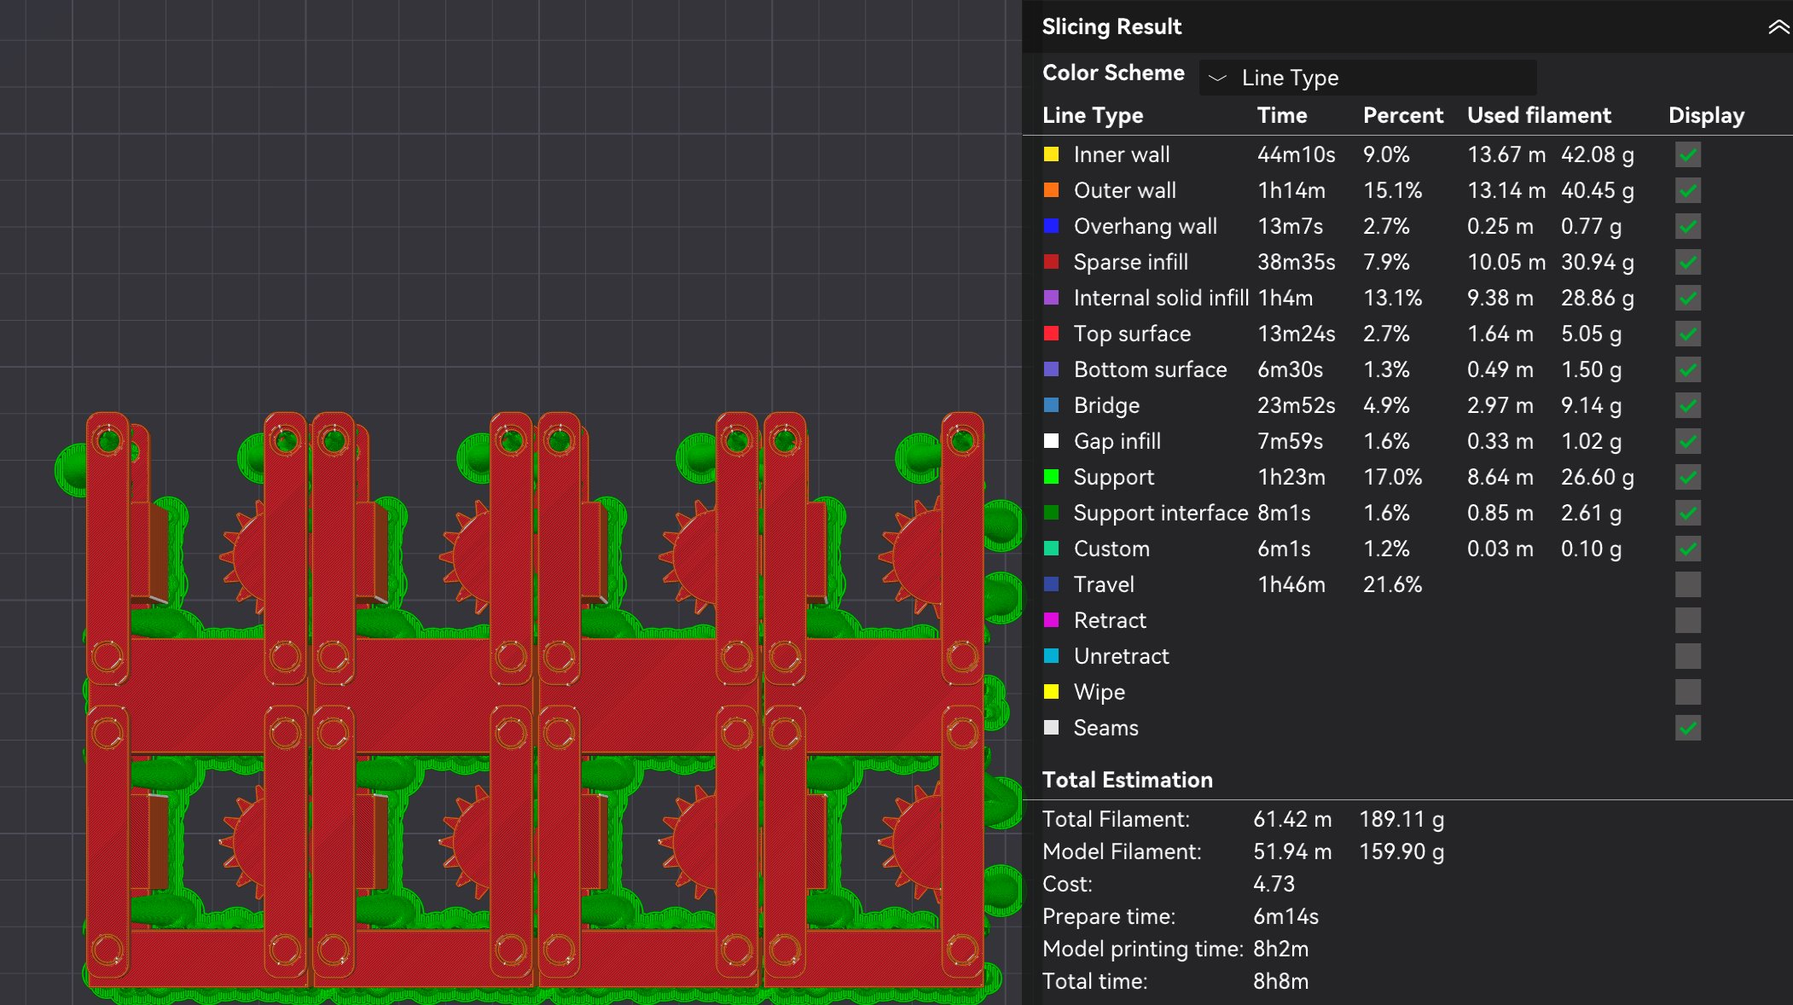
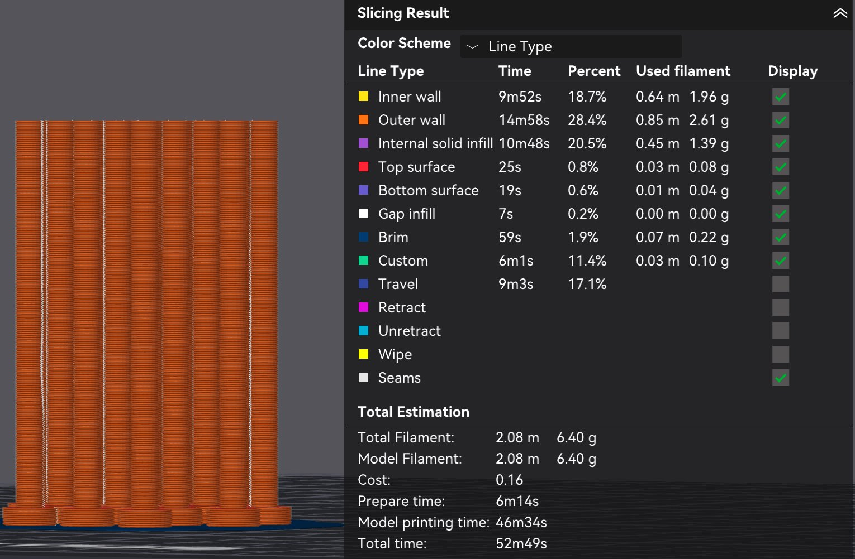
Toy Assembly
The Legs are 3D printed as one entire unit so the only assembly needed is installing them into the chassis using press fit push pins.
The chassis base, body shell, & head base & Head top, are all printed in separate pieces and connected with magnets to make assembly and repair quick and easy.
The Motors for the legs and head are hot-glued into place.
Gears for the head and legs are then installed on to the motors, and wired to the bread board attached to the inside of the body.
Lastly the blasters can be slid into the head, and the linkages controlling the head movement and blasters are slide over the axle connecting them to the gears.

Slide 5
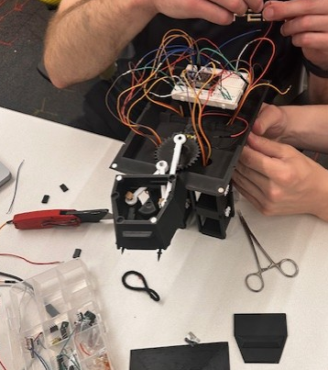
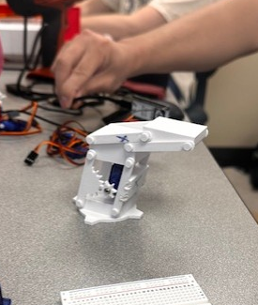
Toy Assembly

Slide 6
Modifications to initial design
Unfortunately, over half of the servo motors the team received came broken.
Missing over half of the drive motors meant the design had to be altered last minute.
The Knee Joints had to be permanently fixed
This resulted in significantly less range of motion.
Now only the hip joints moved; resulting in more of a shuffling motion instead of a full step.
This new motion path led to each not only moving slower, but1/3rd the intended range of travel.
This drastically reduced the overall speed of the ATAT.

